Slide 1
Making Tax Digital for Business
HFMA VAT Sub Committee
Claire Williams
Customer Readiness and External Stakeholder Team
24 May 2018

Slide 2

Purpose of this event
To help you prepare for MTD for VAT
We’ll cover:
        Why make tax digital?
        What is changing and Who’s affected
        Subscribing to the new MTD Service
        and joining the pilot
        Digital Record Keeping
        Submission of VAT returns
        Questions

Slide 3
Background
HFMA VAT Committee

Slide 4
Our Vision
HMRC’s ambition is to become one of the most digitally advanced tax administrations in the world, modernising the tax system to make it
more effective,
more efficient and
easier for taxpayers to get it right.

Slide 5

Get Ready!
“what I’m very keen to signal to everybody out there… is that we are serious about it and it will happen, so there will be no question of any further delay on this, so we all need to make sure that we’re ready for it.”
Mel Stride MP - Financial Secretary to the Treasury
Minister of State with responsibility for Value Added Tax

Slide 6


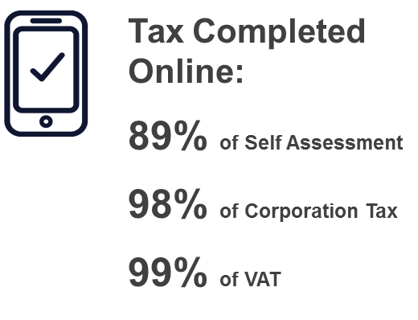
Why Make Tax Digital?
A digital future is what (most) customers expect
Helping businesses ‘get it right first time’
will reduce tax lost through error
Accounting Software can help to integrate tax
into business processes and financial planning
2 million small businesses use accounting or filing software
HMRC provided 1.1 million small business customers in 2014/15 with digital assistance
6

Slide 7
What is Making Tax Digital?
Capturing transactions digitally in record-keeping software
  as near to real time as possible
Summary updates submitted to HMRC via MTD compatible software

Slide 8




How we’re delivering
HMRC providing Application Programming Interfaces (APIs) – not our own software solution.

Slide 9
Timing
April 2016
April 2017
April 2018
April 2019
April 2020
ITSA
May 2016 ITSA Private Beta launched
April 2017 ITSA CGL launched
March 2018
ITSA Public Beta / ongoing pilot
April 2020
Potential mandation for some/all of ITSA
Legislation
VAT
October 2017 Design, Policy, Legislation
Winter 2017/18
VAT Technical Private Beta
Spring 2018
VAT Public Beta
April 2019
Vat Service Go Live
(for those >VAT threshold)
April 2020
Potential mandation (for <VAT threshold)
CT
April 2020
Potential mandation for CT
Timings for CT to be confirmed

Slide 10
VAT
HFMA VAT Sub Committee

Slide 11



What is changing for VAT?
Things that will change
VAT returns compiled by pulling data from digital records
VAT returns sent to HMRC via API-enabled products and not through VAT portal
Things that won’t change
VAT return frequency and payment deadlines
Eligibility for VAT Special Schemes

Slide 12
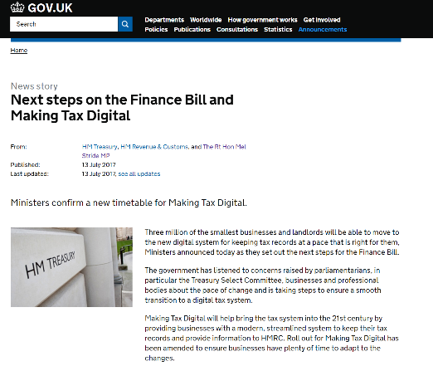
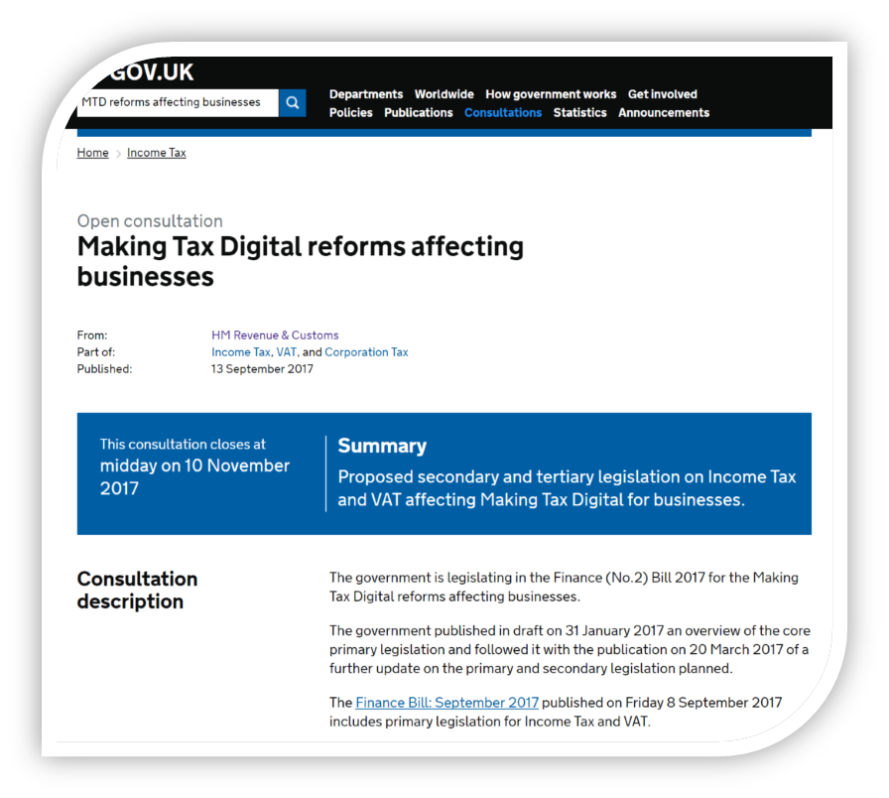
Who is affected?
From April 2019, VAT registered businesses with a taxable turnover above the VAT threshold (currently £85,000) must keep their VAT business records digitally and submit their VAT return through compatible software
Business that are voluntarily VAT Registered can join MTD if they wish
Existing exemptions continue for VAT

Slide 13
Timeline for VAT
February 2018 - technical consultation on the regulations closed
https://www.gov.uk/government/consultations/draft-legislation-the-value-added-tax-amendment-regulations-2018
End March 2018 Regulations made
April 2018 VAT Pilot
- Live testing of MTD begins
Mandation: First VAT period commencing on or after 1 April 2019.

Slide 14
VAT Pilot
Started in April 2018
Agents can act on behalf of their client
Simplest businesses first
More complex businesses join as the pilot grows
Must have compatible software to take part
Ideally already keeping digital records for VAT
Speak to your software supplier

Slide 15
Data that must be recorded digitally
Designatory data
business name
address
VAT registration number
A record VAT accounting schemes
There must be record of outputs split between
standard rate
reduced rate
zero rate
exempt and outside the scope.
For each supply made
The time of supply
The value of the supply
The rate of VAT charged
For each supply received record
The time of supply
The value of the supply including any VAT that is not claimable
The amount of input tax that will be claimed.
If more than one supply is on an invoice record the totals from the invoice.
Adjustments
Total for each type - but not calculations

Slide 16

‘Functional Compatible Software’
Program, or set of compatible software programs, that must
Keep digital records
provide HMRC information and returns using APIs
receive information from HMRC using APIs
If a multiple software is used, there must be a digital link between the products.
Software includes spreadsheets!

Slide 17

Example 1
Software
  to record sales and purchases
spreadsheet
  to calculate the return
bridging software
  to submit the return
All links must be digital

Slide 18

Example 2
Software to
  record sales and purchases
  calculate the return
  submit the return
spreadsheet to
  track of fleet of cars and
  work out adjustments for fuel scale charges
OK to type adjustment into accounting software.
But a digital link may reduce errors

Slide 19
Example 3 – VAT Group
Software – three different packages to
  record sales and purchases
  calculate amounts needed for the return
spreadsheet
  to compile the totals and create the return for the whole of the group
bridging software
  to submit the return
  Five pieces of software maintain the records, calculate return and submit to HMRC. The links between them must be digital.

Slide 20
Summary
HFMA VAT Sub Committee

Slide 21

Get ready
  Talk to your agent
  Talk to your software provider
  Digital record keeping
  Taking part in the pilots

Slide 22
Thank you for listening
makingtaxdigital.mailbox@hmrc.gsi.gov.uk

