Slide 1
Pensions Network Forum

Slide 2
The Pensions Network Forum
The Pensions Network Forum is a closed forum for members of the CIPFA Pensions Network.
It is hoped that the forum will enable members to discuss key issues, ask questions to colleagues and the Pensions Network Advisor and offer suggestions for Pensions Network events.
The forum is not moderated but any offensive posting will be deleted by the forum administrator.
Access to the forum is via the same login details that you use for www.cipfa.org

Slide 3
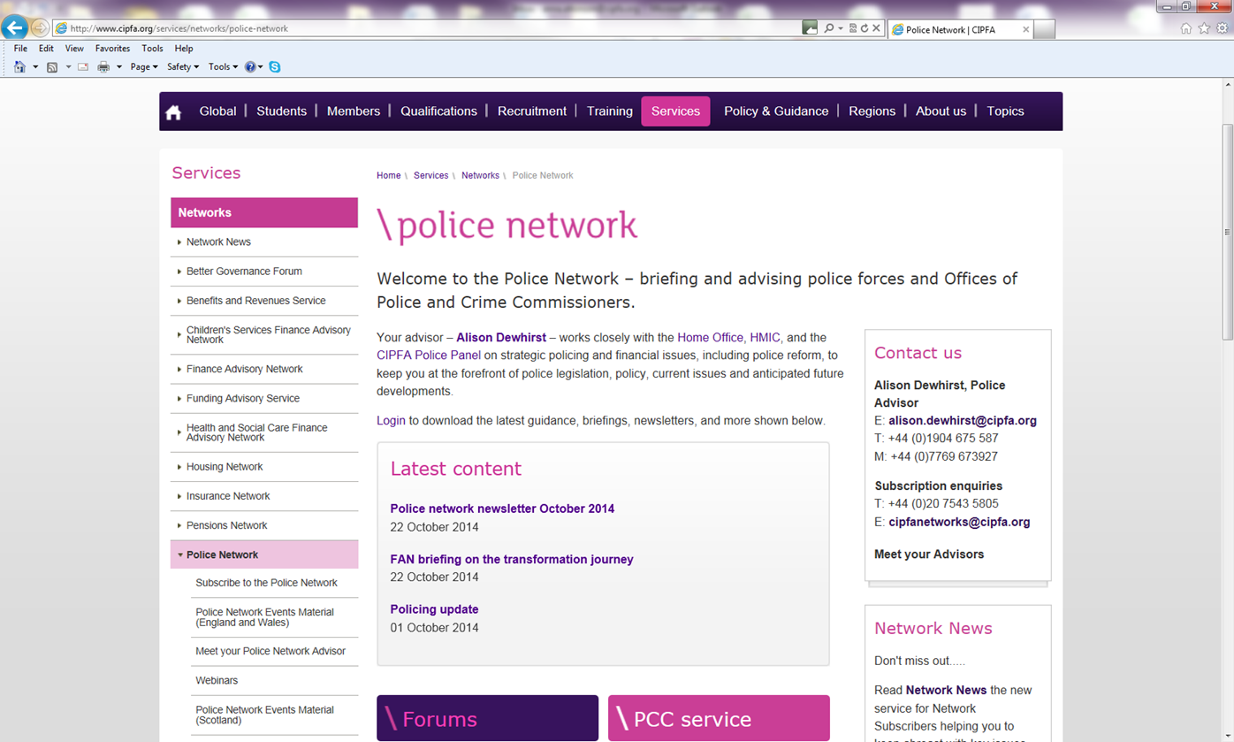
Accessing the Pensions Network Forum
When you are logged into www.cipfa.org go to the Pensions Network page and click on Forums and you should be automatically logged into the Pensions Network Forum

Slide 4
Your forum settings
My profile. This is where you can update your forum display name if you wish to use an alias
My Inbox. This is where emails sent to you by forum members are stored
My Topics. This is where you can view activity relating to topics you have contributed to.
Search. Search forum content
Logged in as: Shows that you are logged in
Members. List of members
Help. More detailed forum help
Watch Forum. Click here to be alerted when new posts added to this forum

Slide 5
Viewing forums, topics and post
Shows the Forum you are looking at
I you wish to add a new Topic for discussion click here
Topics: list the discussion forums within the forum
Click on a Topic link to see the posts within the topic

Slide 6
Add, reply or retweet a post
New topic: Add a new topic to the forum
Share: if you want to email the post or retweet
Post reply: reply to the message

Slide 7
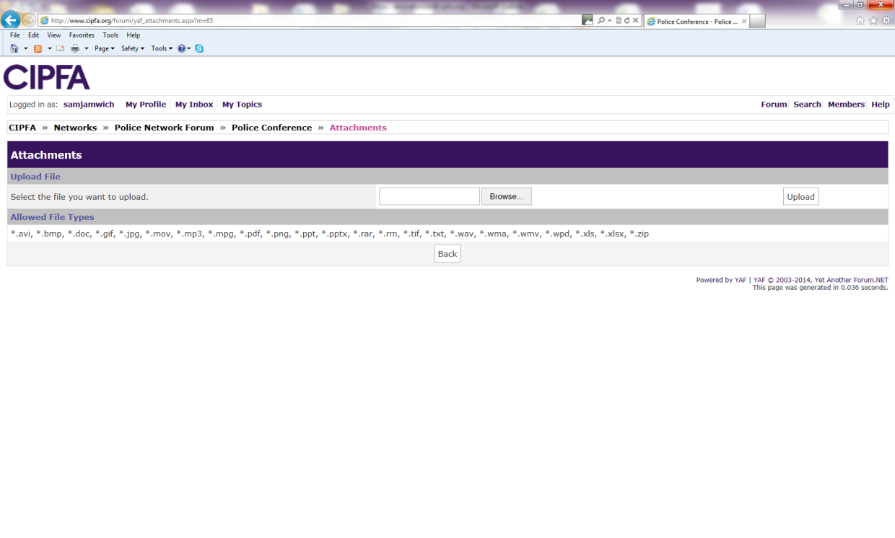
Post reply
Type in your reply to the post
Edit, add weblinks and bullets using these icons
Attach files to your post. They can be word docs , ppt, xls etc. Click the tick box and then the post button and the attachments screen will upload.

Slide 8
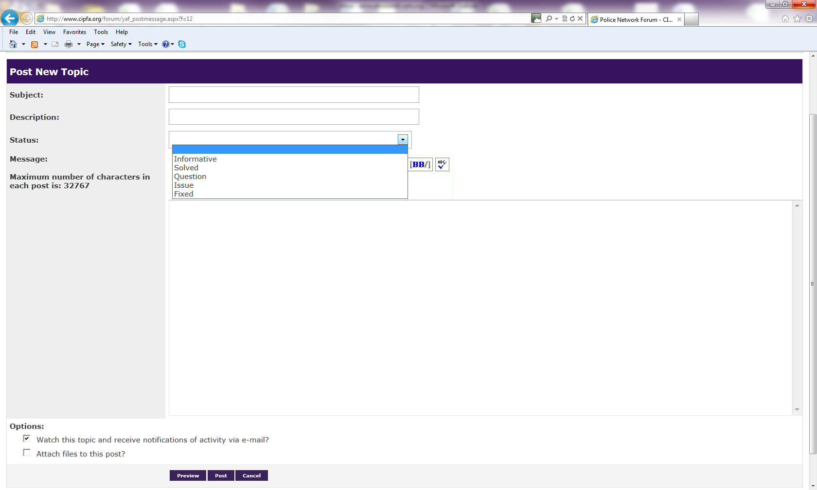
Add a new Topic
Topic give the topic a meaningful title/subject
Description :what the topic is to cover
Status: enter a status if you wish
Enter the text of the topic post
Attach files

