Slide 1

Regional Forum
User Guide Version 2.2

Slide 2
The Regional Forum
The forum is a discussion board for members of the Regional Branches. It is intended to make communications between Branches consistent.
The forum will enable members to discuss key issues, liaise with peers, share and access resources and information, and post regarding branch-specific activities.
The forum is not moderated but any offensive posting will be deleted by the forum administrator.
Access to the forum is via the same login details that you use for www.cipfa.org

Slide 3
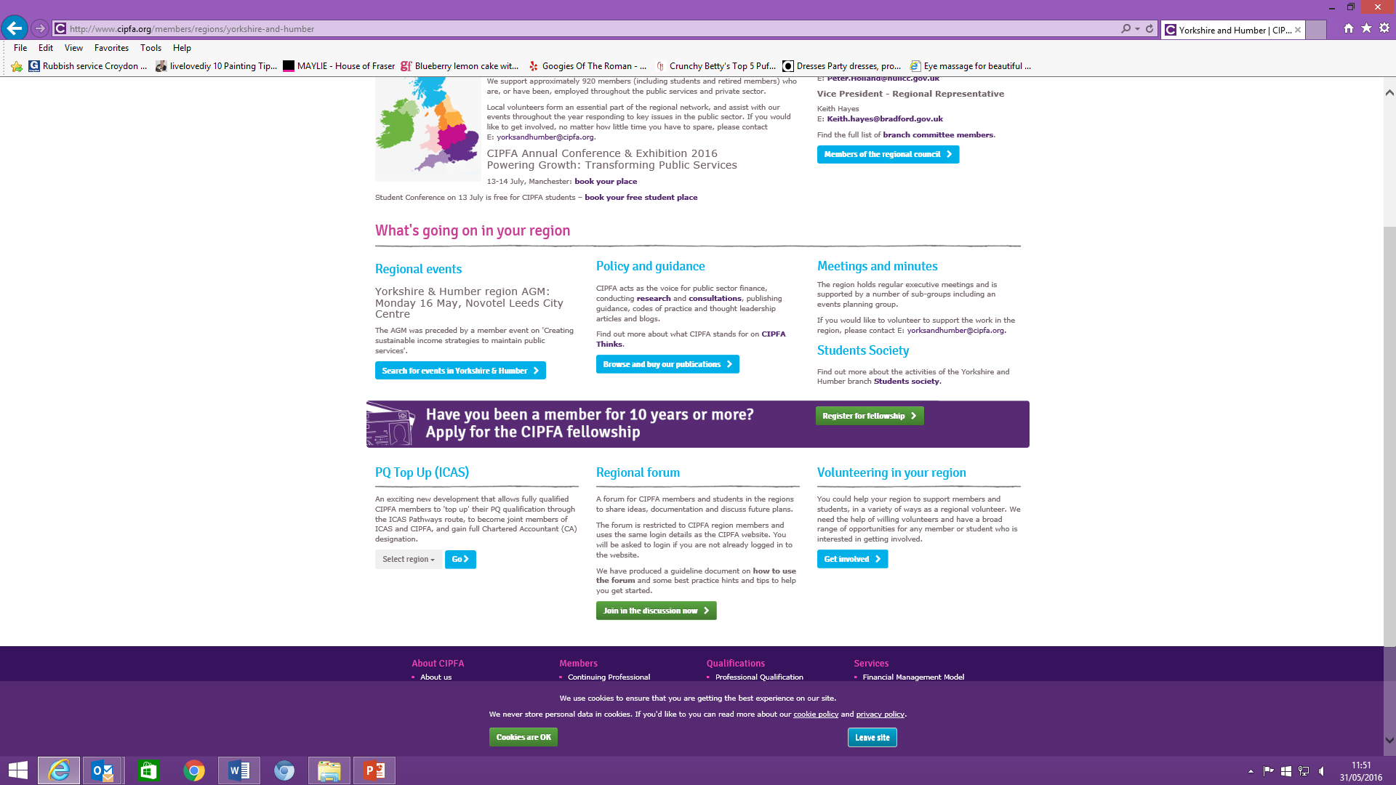
Accessing the Regional Forum
When you are logged into www.cipfa.org go to the Members tab, and click on Regions. Select region from the left-hand side. In the region page, go to bottom of the screen to select Regional Forum:
Click here

Slide 4
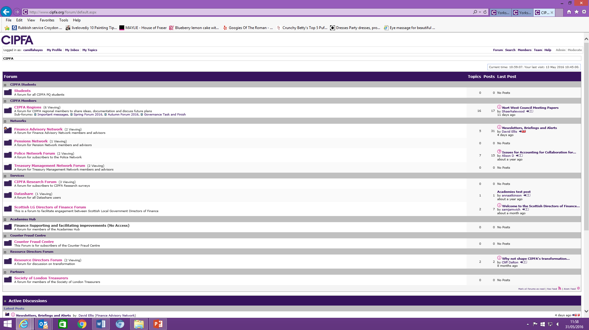
Select the forum from the list displayed by clicking here:

Slide 5
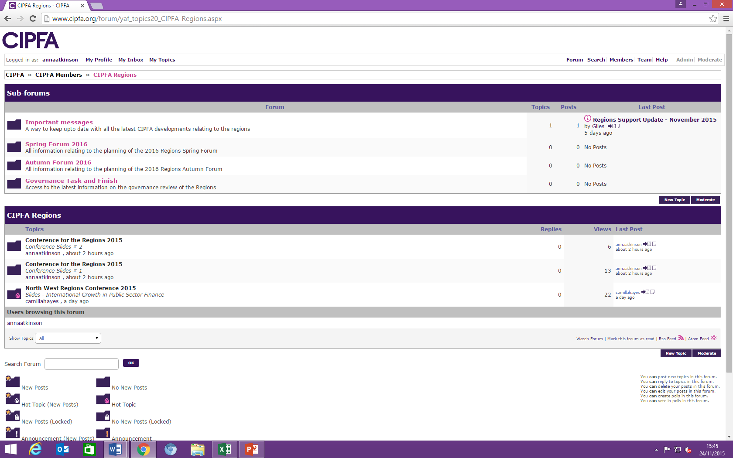
Your forum settings:
My profile. This is where you can update your forum display name if you wish to use an alias
My Inbox. This is where emails sent to you by forum members are stored
My Topics. This is where you can view activity relating to topics you have contributed to.
Search. Search forum content
Logged in as: Shows that you are logged in
Members. List of members
Help. More detailed forum help
Watch Forum. Click here to be alerted when new posts added to this forum

Slide 6

Viewing forums, topics and post
Shows the Forum you are looking at
Topics: lists the discussion forums within the forum
If you wish to add a new Topic for discussion click here
Click on a Topic link to see the posts within the topic

Slide 7
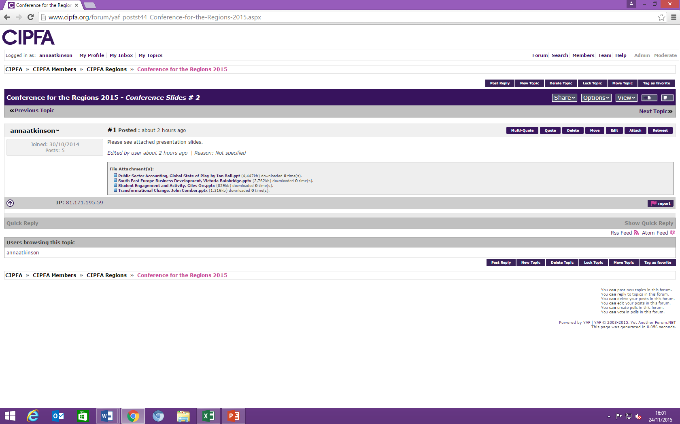
Add, reply or retweet a post
New topic: Add a new topic to the forum
Share: if you want to email the post or retweet
Post reply: reply to the message

Slide 8
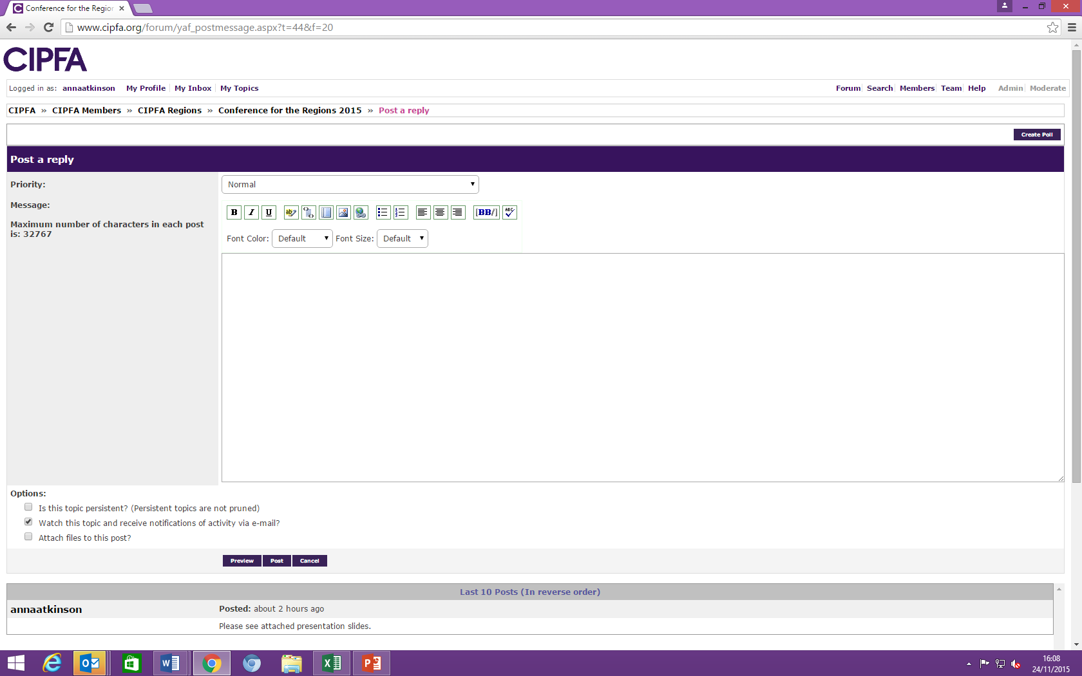
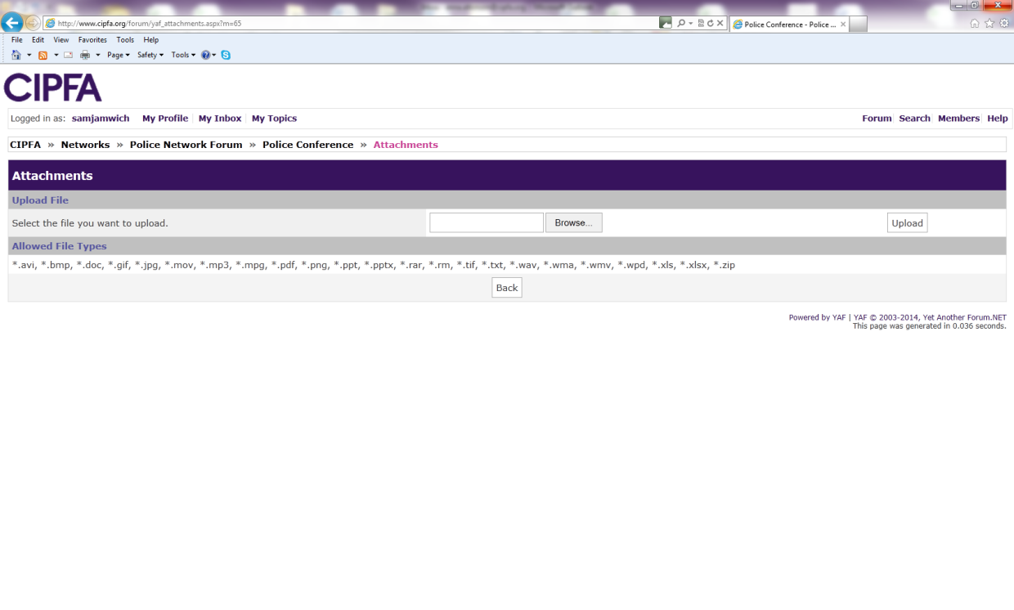
Post reply
Edit, add web links and bullets using these icons
Type in your reply to the post
Attach files to your post. They can be word docs , ppt, xls etc.
Click the tick box and then the post button
The attachments screen will upload.

Slide 9
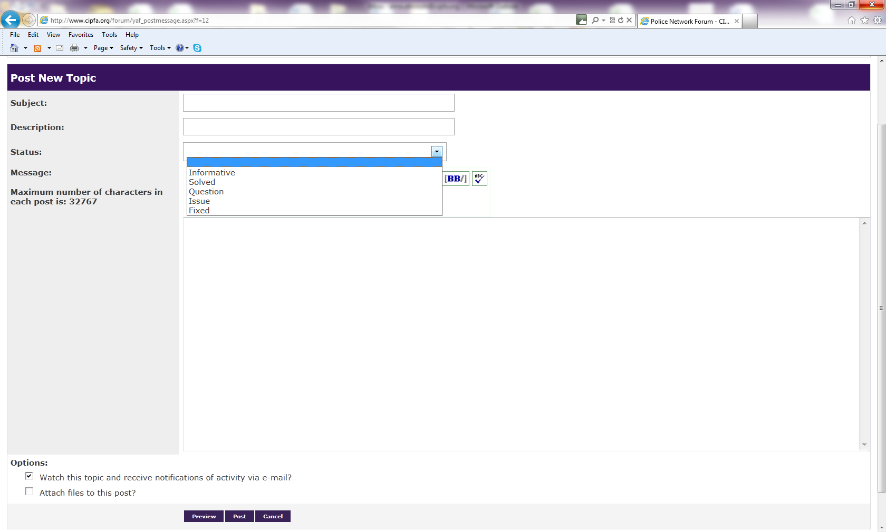
Add a new Topic
Topic give the topic a meaningful title/subject
Description :what the topic is to cover
Status: enter a status if you wish
Enter the text of the topic post

Slide 10
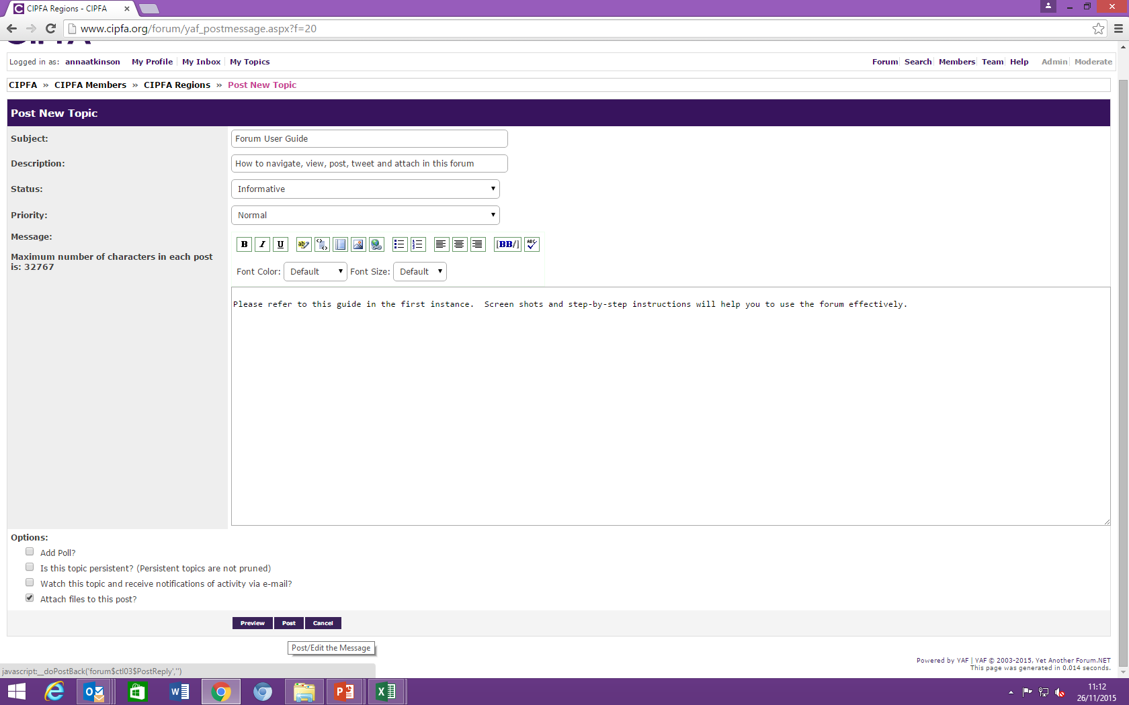
Attach Files
To attach files:
Click the tick box
Click Post

Slide 11
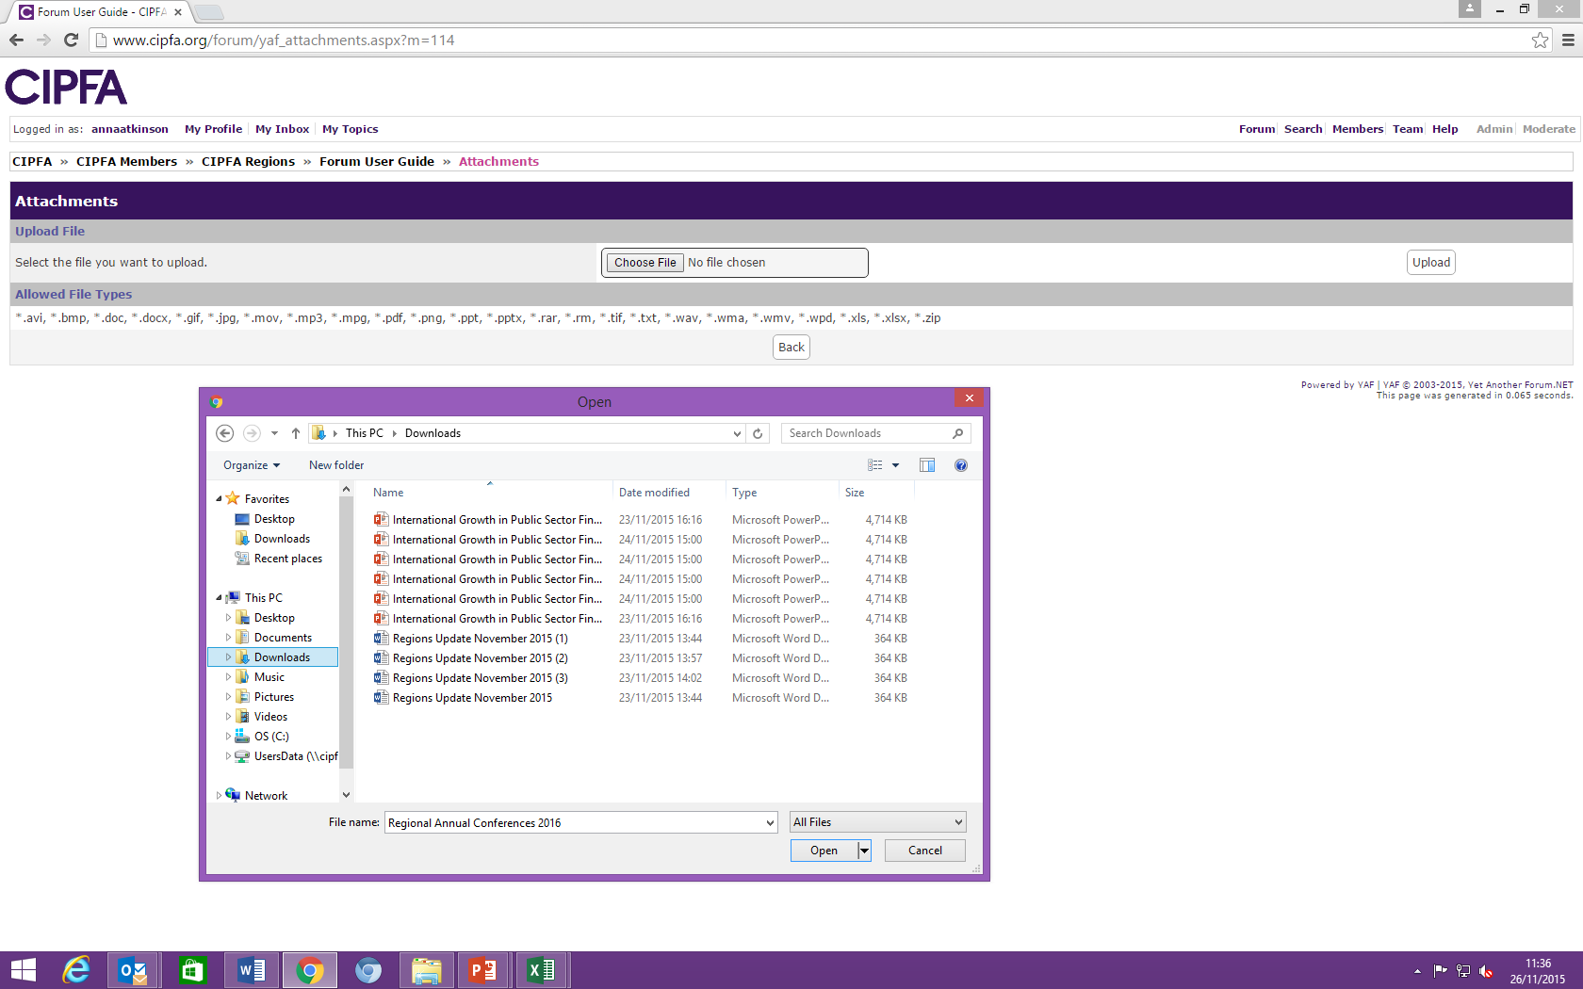
Attach Files
Click Choose File
Double click the file you want to upload
Upload the file

Slide 12
In case of web issues please contact Camilla Hayes:
camilla.hayes@cipfa.org 0207 543 5891
Please contact your BD representative for any other queries:
Region | Senior Lead | BD Lead
South East | Jane Payling | Victoria Davitt | jane.payling@cipfa.org victoria.davitt@cipfa.org
South West | Drew Cullen | Chris O’Neill | drew.cullen@cipfa.org chris.o'neill@cipfa.org
Midlands | Alan Edwards | Dan Cutts | alan.edwards@cipfa.org daniel.cutts@cipfa.org
North East | Drew Cullen | Tana Forrest | drew.cullen@cipfa.org tana.forrest@cipfa.org
North West | Giles Orr | Blane Sweeney | giles.orr@cipfa.org blane.sweeney@cipfa.org
Scotland | Andy Perrin | Graham Drivers | andy.perrin@cipfa.org graham.divers@cipfa.org
Yorkshire & Humber | Cliff Dalton | Joseph Solich | cliff.dalton@cipfa.org joseph.solich@cipfa.org
Wales | Giles Orr | Chris Tidswell | giles.orr@cipfa.org chris.tidswell@cipfa.org
Europe & Channel Islands | Gillian Fawcett | Brian Donnellan | gillian.fawcett@cipfa.org brian.donnellan@cipfa.org
Northern Ireland | Giles Orr | Steve Mungavin | giles.orr@cipfa.org steve.mungavin@cipfa.org
Rep of Ireland | Giles Orr | Steve Mungavin | giles.orr@cipfa.org steve.mungavin@cipfa.org

