Slide 1
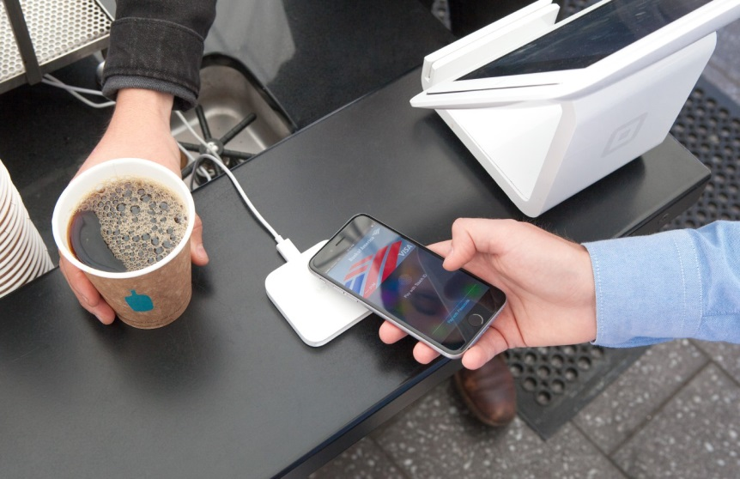
Fraud Trends & Protection
and
Anti-Money Laundering
12 March 2017
Karen Lowe

Slide 2
Introductions
What will we be covering?
Fraud trends & protection
Anti-money laundering changes
(Easy) questions welcomed ☺

Slide 3

Fraud
What’s new and what’s unchanged ?

Slide 4
First, some exercise !

Slide 5
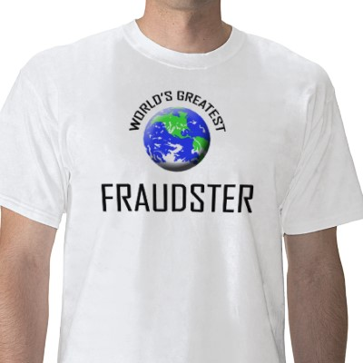
Typical Fraudster
Knows the controls
Knows how to operate below detection rates
Knows when the fraud prevention controls start
Knows the weaknesses in those controls
Has worked for your organisation for at least 4 years
Reasonably intelligent (at first !)
Has his / her own rationale and motivation for committing fraud

Slide 6
What else Hasn’t Changed ?
Supplier bank account changes
Chief Exec emails for money transfers
Expenses frauds
Procurement fraud / bribery & corruption

Slide 7

Same old red flags
Lifestyle changes
Bullies or well-thought of
No holidays or sickness
Overly helpful / extremely unhelpful in audits
High vacancies / stretched staff
Manual controls

Slide 8

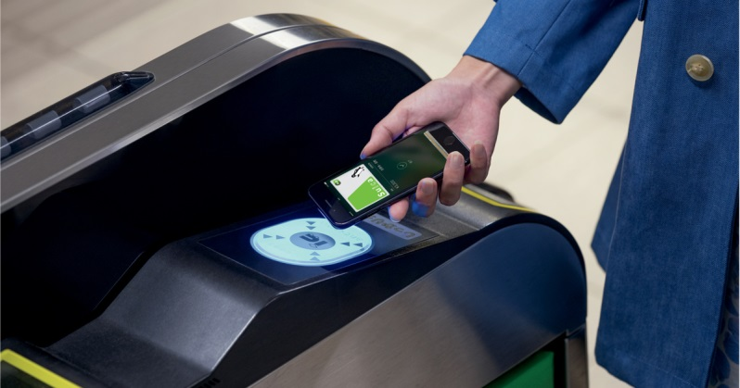
So What is ChangINg ?

Slide 9
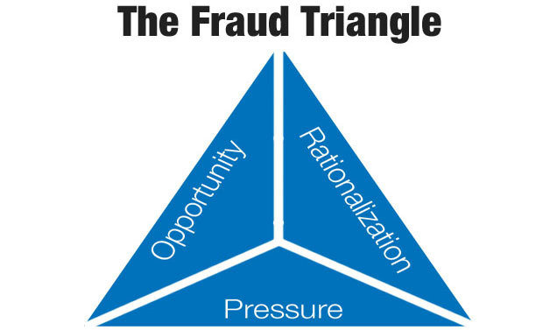
Our trusted Friend…..

Slide 10

….Is Now Firmly a square
4th angle is capability –
not everyone is a born fraudster, thankfully !

Slide 11


What are we seeing more of ?
Theft of information (via hackers or internally)
Theft of assets
Partnerships over-invoicing
Corruption in procurement processes

Slide 12
What ELSE IS happening?
Gaps in assurance frameworks
No investment in automated controls
Controls stripped out at the point of the risk first entering the process
More with less = difficult = fraud opportunities

Slide 13
Typical Fraud Risks and Controls Scenario
Fraud Risks
Supplier Payments process
Controls
Missing controls
Weak controls
Bureaucracy

Slide 14
Help !
COSO Fraud Risk Management Guide
5 key principles
  Communicate fraud risk management programme
  Fraud risk assessments
  Prevention and detection
  Communication and corrective actions
  Continuous review & evaluation

Slide 15
Help ! – cheaper / easier options
Work to within the fraud risk appetite
Who else is an assurance provider
IT to check automated controls
Top slice inherent fraud risk areas
Shared learnings – eg MAG
Health checks when others suffer
Don’t forget cheap deterrent controls

Slide 16
Help ! –
Other options
Get in first, input to design of fraud controls
Push heavily for segregation of duties, automated controls and user profiles
Data analytics / predictive analysis to run matches and report exceptions automatically
Forensic specialist – and suck them dry !

Slide 17
Questions to ask when back at work
Is fraud on your corporate risk register ?
Is there a defined risk appetite ?
When was it last reviewed ?
Has fraud tolerance levels changed ?
Do we need to treat fraud risks, or can we transfer or tolerate ?
Given next year’s EU data protection laws, are we well prepared ?

Slide 18

Still Awake ?

Slide 19
EU Anti-Money Laundering
Applicable if any joint ventures <50% public ownership
New EU 4th Directive AML – June 2017
  Document risk based approach
  Can’t automatically do SDD
  Include domestic PEPS
  On-going monitoring

Slide 20
Any questions ?
Thankyou
and
safe journey home

