Slide 1
How to take the
‘Geek Factor’ out of IT Auditing
Gary Marland

Slide 2
Contents
Me
Normal v Geek
Language Barriers
Grey Jobs

Slide 3
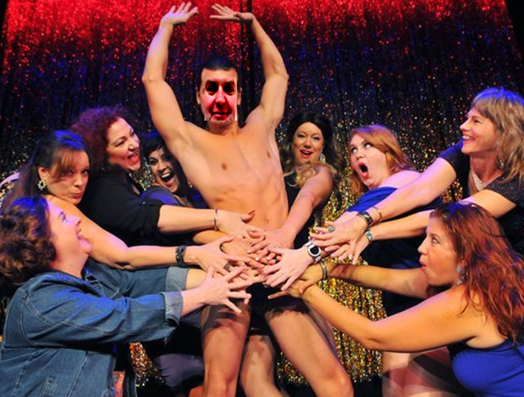
‘Why Always Me’

Slide 4
Normal v Geek
Traditional Audit v IT Audit
Mainstream Audit v Technical Audit
Business Audit v Information Systems Audit

Slide 5
Geek - Definition
An unfashionable or socially inept person.
A carnival performer who performs wild or disgusting acts.
A knowledgeable and obsessive enthusiast. "a computer geek"

Slide 6
The Language barrier

Slide 7
Choosing the right Language
Ohayōgozaimasu, watashinonamaeha geirī, watashi wa kyō koko de anata o 1-jikan tanoshima sete imasu

Slide 8
Choosing the right Language
Bon dia, el meu nom és Gary i jo sóc aquí avui per entretenir durant una hora

Slide 9
Choosing the right Language
Buenos días, mi nombre es Gary y estoy aquí hoy para entretenerte durante una hora

Slide 10
Choosing the right Language
Good morning, my name is Gary and I am here today to entertain you for one hour.

Slide 11

White – Grey – Black Jobs

Slide 12
Software Licensing

Slide 13
Software Licensing
Key risks;
Financial penalties
License breaches
Reputational damage
Efficiencies

Slide 14
Software License audit FAG
Find the right person
Ask basic questions
Get the answers

Slide 15
Software License audit
Find the Spanish techie rather than the Japanese techie
Ask basic questions
  What IT systems do you have that need a license?
  How many licenses did you purchase for each system?
  What Type of licenses do you purchase?
  Who uses them?
  How much do they cost?
  When were they last used per user?
Send me a spreadsheet with all that information…..PLEASE

Slide 16
Software License audit
Using IDEA or Excel tidy up the data
Target data sets
  Based on cost
  Volume
  Known issues
Check actual license purchase records
Compare Actual used to purchased.

Slide 17
Software License audit
Sample - SAP
10 x Developer
  Purchase £2500
  Annual £500
400 x Professional
  Purchase £1500
  Annual £300
200 x Limited Professional
  Purchase £600
  Annual £150
2500 Occasional
  Purchase £300
  Annual £75
1000 Self Service
  Purchase £40
  Annual £20

Slide 18
Data Centres
What are they?
What do they do?
What is stored there?
Why are data centres so important?

Slide 19
Data Centres – What are they all about?
Store all the most sensitive and personal data for the Organisation
The engine of the IT department
Costs a fortune to run

Slide 20
Data Centres – What are the key risks?
Data loss
Service loss
Financial inefficiencies

Slide 21
Data Centres
Physical and Environmental Security Controls
Make sure it’s secure from data loss
Make sure it’s protected from service loss

Slide 22
Data Centres
Physical Security
Lock it
Restrict it
Monitor it
Structurally secure it

Slide 23
Data Centres
Environmental Security
Power
UPS – Back up generator
Cooling
Flood
Air Quality, temperature, Sound, Humidity, etc
Fire
Electro magnetic disturbances
Structure, equipment positioning, flooring, etc

Slide 24
Remote Access
Policies and Procedures
3rd party access
User access management
Security Monitoring
Change control

Slide 25
Penetration testing
Ethical hacking
Blagging (Social Engineering)

Slide 26
Social Engineering
How to determine your Star Wars name
For your new first name: Take the first 3 letters of your 1st name and add
the first 2 letters of your last name
For your new last name: Take the first 2 letters of your mum's maiden name and add
the first 3 letters of the city you were born

Slide 27
Social Engineering
GARMA HAMAN

Slide 28
Social Engineering
How to determine your Bond Girl name
For your new first name: Name of your first pet
For your new last name: The name of your first school

Slide 29
Social Engineering
Your mother’s maiden name
Your full name
Name of your first pet
The City you were born
Name of your first school

Slide 30
Summary
Have a go
Have the usual opening meeting
Google the techy bits
Clarify
If you have a problem, if no one else can help, and if you can find them....maybe you can hire The A Salford Team

Slide 31
Questions
Gary Marland
IT Audit Client Manager
Salford Internal Audit Services
DD 0161 607 6974
E gary.marland@salford.gov.uk
Salford City Council
3rd Floor Civic Centre,
Chorley Road,
Swinton M27 5AW
T 0161 794 4711

