Slide 1
Local government reorganisation EXPERIENCES & LEARNING
Society of District Council Treasurers
21 March 2025
Richard Bates FCPFA
Strategic Director of Finance and Resources
Guildford & Waverley Councils

Slide 2
Happy Interim Submission Day!!

Slide 3
My LGR Experience
1997 – Capital Accountant @ Dorset CC when Bmth & Poole became unitaries
2019 – CFO / s151 Officer @ Dorset County Council
2023 – CFO / s151 Officer @ Mendip District Council
Now – CFO @ GBC & WBC working on Surrey bid

Slide 4
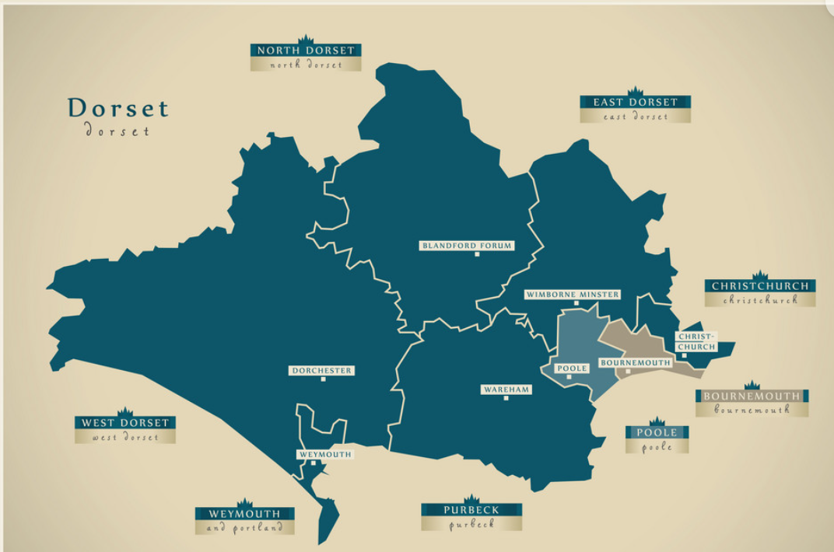
Dorset Pre the 2019 Reorganisation
Bournemouth & Poole already Unitary Councils (since 1997)
Dorset County Council area was 2-tier.
6 Districts / Borough Councils across DCC area.

Slide 5
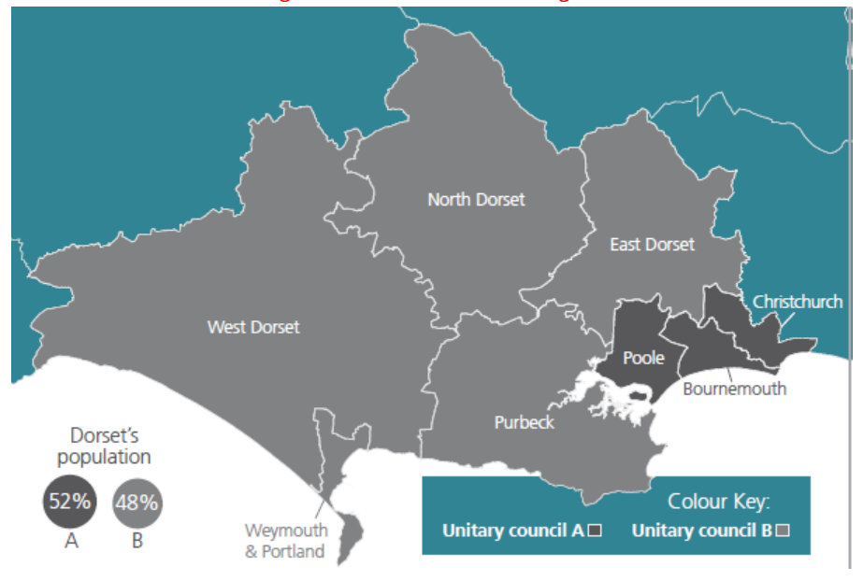
Dorset Reorganisation 01.04.2019
Bournemouth, Christchurch and Poole were combined into one new Unitary Council (BCP Council).
Remainder of Dorset (DCC less Christchurch + 5 Districts) were combined into new Dorset Unitary Council.
Key Issues:-
Disaggregation (Upper-tier services for Christchurch transfer from DCC to BCP)
Aggregation
Council Tax Harmonisation
Transition Costs v Savings

Slide 6
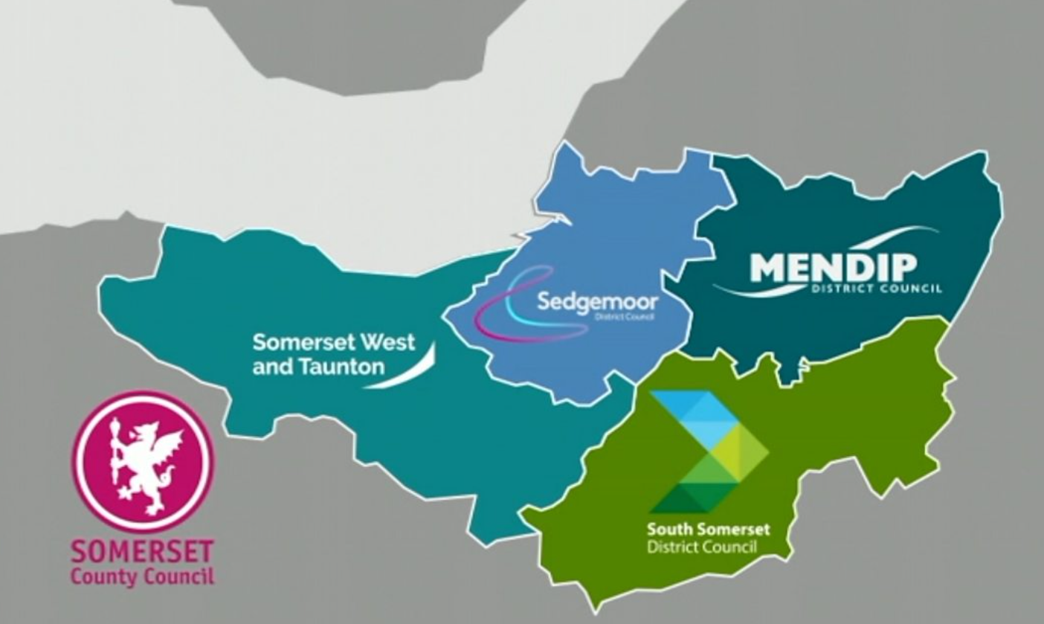
Somerset Pre 2023 Reorganisation
Somerset County Council area was 2-tier.
4 District Councils across SCC area.
North Somerset & BANES already Unitary Councils (since 1997) and excluded

Slide 7
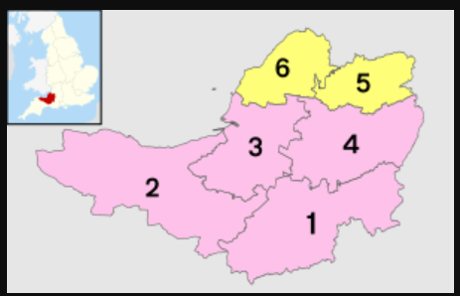
Somerset Reorganisation 01.04.2023
Somerset County Council and the 4 districts (1 to 4) were combined into one new Unitary Council (Somerset Council)
Key Issues:-
Aggregation
Council Tax Harmonisation
Transition Costs v Savings
New Taunton Town Council

Slide 8
So…..
All of the forthcoming LGRs will be different – starting points and end points but most will follow the same process & face the same issues

Slide 9
Disaggregation
Occurs where an upper-tier Council (e.g. County Council) is split into a number of areas
Service disaggregation – all services split unless joint arrangements put in place (e.g. Children’s Trust, Joint Archives Service).
Funding disaggregation – including grants
Balance sheet incl reserves and balances
Assets & Property – incl including investments, ICT, vehicles.
Debt

Slide 10
Aggregation
Occurs where more than one council merges
Staff
Terms & conditions of employment
Policies & procedures
ICT Systems
HQ & operational buildings
Contracts
Fees & Charges

Slide 11
Council Tax Harmonisation
All councils have different rates of Council Tax.
Need to harmonise to a single rate for each new council
Not allowed to harmonise to the highest! Overall amount raised cannot increase (to date ☺)
So - harmonise to an average rate.
If possible, done on Day 1, otherwise you lose income
Government issues an “Alternative Notional Amount” for the new Council as the current year comparator.

Slide 12
Transition Costs
Not normally funded by Government – have to be met from the LGR savings generated. (but ask anyway)
Pay back normally 1-2 years
Transition team (programme management)
ICT
Redundancy (mainly after vesting day)
HR, legal, finance support
Property changes
Communications / branding
Shadow council?

Slide 13
Savings from LGR
Day 1
Elected members reduced
Number of elections
Senior management including statutory officers
Audit / Subscriptions
Year 1+
Remove duplication e.g. back office, contact centre, governance
Property rationalisation
Contracts / buying-power

Slide 14
Finance Workstreams
Disaggregation, aggregation, c/tax harmonisation etc and…..
Monitor costs / savings
New council budgets
New systems
New policies & procedures
Revs & Bens, AP / AR
HRA
Companies / Charities
Assets / database
Contracts / procurement
Capital programme
Schools / DSG
Insurance
Banking / Treasury
Closedown of old councils
NDR
Tax / VAT

Slide 15
Competing outline business cases will be partly driven by political desire for particular outcomes
Puts s151s in difficult position but need to assure yourselves you have reasonable assumptions and caveat work in progress / deficiencies in the data
History shows that the figures in previous reports have not been delivered in full
New Councils will make different decisions on service levels etc which negate potential savings

Slide 16
Business cases & politics create tension between tiers & councils.
After the government decision – shake hands and work together for the good of the new councils
Prevent silly decisions being made now – agree a protocol or use s24 powers (Duty of care). Spending / asset transfers
Review existing commitments (best value may have changed)
Use a mix of staff on the workstreams from County & Districts – good learning experience, networking & gets D&B staff visible

Slide 17
Lessons Learnt #2
Identify assets which will be used by more than one council and get joint use agreed, otherwise may transfer by location
Key issue = how debt is split. (Historic capex? In line with funding split? Population? etc).
Engage early with actuary re pension fund liabilities.
Don’t implement new finance system on vesting day!
Get records up to date in advance – contracts, assets, staff, budgets etc

Slide 18
For you & your teams…..
Remember there are lots of upper tier officers who will want to retire – this presents opportunities across all levels
Disaggregation creates more opportunities
Protect your workforce –
use own staff to do the interesting new work & backfill for BAU
use fixed-term contracts / interims to avoid redundancy
share staff across councils who will merge
Review staff qualifications – may have lapsed, opportunities prior to LGR
Don’t forget to keep people beyond vesting day to close xx sets of accounts etc

Slide 19
Resilience
Make sure you have enough support – this is not a time to stop spend
Ensure comms team messaging to reassure staff
Get HR on board to offer support
Work closely with your other statutory officers on handling difficult issues
Remember you have the power!
Support each other – we’re all in this together!

Slide 20
Questions

