Slide 1
Leadership Workforce and Capacity Issues
Joanne Pitt
SDCT Conference Warwick March 2025

Slide 2


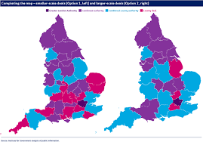

Just a little bit going on

Slide 3

Pressure on an already struggling workforce
Retention Crisis: Many local governments are struggling to retain employees, with increased rates of quitting and retirement
Labour Shortages: There is a significant shortage of workers, particularly in critical areas
Recruitment Difficulties: Attracting new employees is challenging due to competition and lack of attractiveness of the sector
Ageing Workforce: Many local governments have an ageing workforce, especially in key technical professions
Compensation Issues: Competitive compensation remains a challenge, with many local governments struggling to offer salaries that match those in the private sector

Slide 4
Nationally recognized challenge
Local Government Workforce Development Group
Led by MHCLG - Jim McMahon Minister of State for Local Government and English Devolution in the United Kingdom
Attractiveness of the sector
Career pathway
Data
Work streams

Slide 5
Action Plan themes
Leadership Capability and Capacity
Attracting and recruiting the right staff
Developing our people
Creating the right environment to deliver

Slide 6
EFS Assurance Reviews – examples of capacity and skills challenge
Stoke on Trent – finance team does not have the capability and capacity
Cumberland Council – significant capacity issues within the finance function
Bradford City Council – Culture challenges regarding attitude towards financial sustainability
Cheshire East Council – Finance service skills are not sufficient for the agenda
Middlesborough Council – Finance team does not have the capability and skills
Somerset Council – Difficult to see enough skills retained to drive through transformation
Southhampton City Council – Lack of financial capacity in the organisation

Slide 7

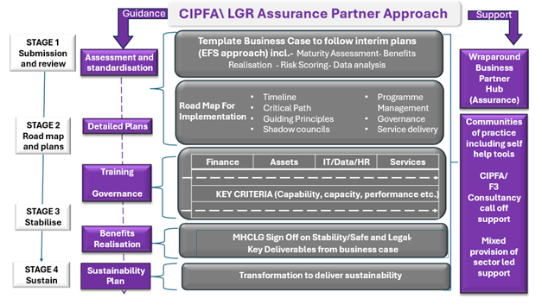
Skills and capacity needs
Possible approach to Local Government Reorganisation

Slide 8

Examples of capacity and capability needed during reorganisation – looking ahead to new authorities
MTFS assumptions re inflation, growth etc
Council Tax harmonisation
Business rates
Fees and charges harmonisation
Capital programme and associated financing
Risk profile and risk appetite

Slide 9
Building the right culture – what does it take
A More Collaborative Working Culture
Approach:
Diagnostic to establish constraints to effective working
Implementation of agreed actions
Dissemination and staff training
Key tasks
Workshops with selected staff
Prepare training materials
Work with Finance and Directorates to develop revised approach
Raise awareness of changes made
Consultation with project board to prioritise the changes required
Consult with Finance and project board on proposed changes
Training
Testing and implementation of proposed changes
Deliverables:
Agreed action plan
confirmation of changes made
Training and dissemination of guidance
:

Slide 10
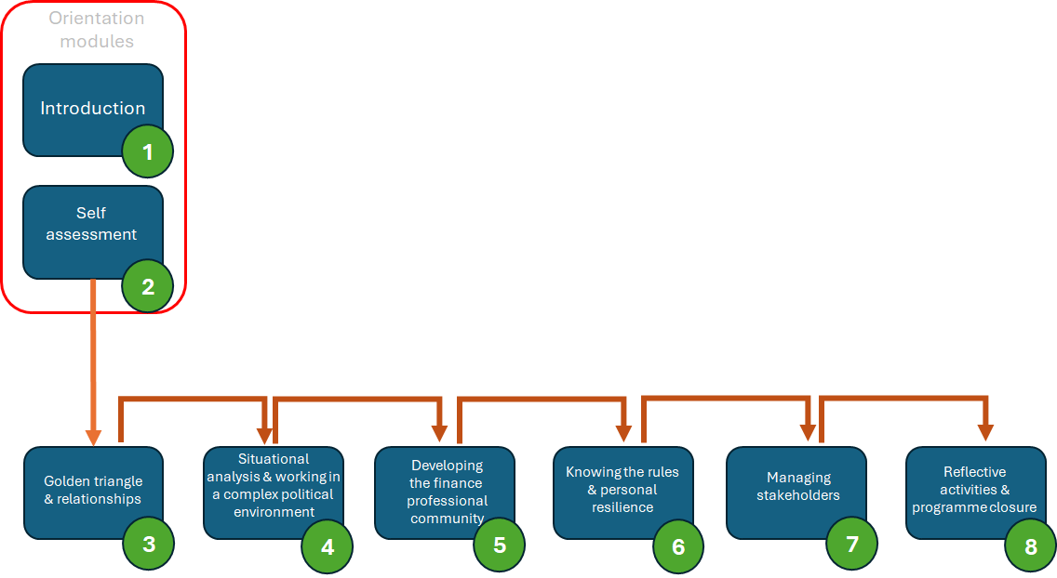
Progress being made
Building the pipeline for new CFO’s

Slide 11
Progress being made
Improving recruitment from outside the LA sector
briefing note to highlight the benefits of recruiting from outside the sector
a guide to attracting finance professionals from outside the local government sector,
a series of case studies
Tool kit and templates to support discussions

Slide 12

