Slide 1
SDCT Conference Workforce Strategy for Local Government Finance Joanne.Pitt@cipfa.org

Slide 2
War for Talent has changed… Local Government finance needs a plan to state its case
The Ask
To collect data and views, and propose a workforce plan
The Reason
Significant challenges exist to attract and retain suitably skilled and experienced finance professionals to deal with the ever increasing acute and complex pressures facing local government finance.
Capability and capacity questions have been asked in the wake of the current focus of Local Government delivery
How we make local government finance an attractive proposition in a crowded and competitive recruitment market?
Collaboration with LGA for DLUHC

Slide 3
Supporting the CFO role in public services

Slide 4
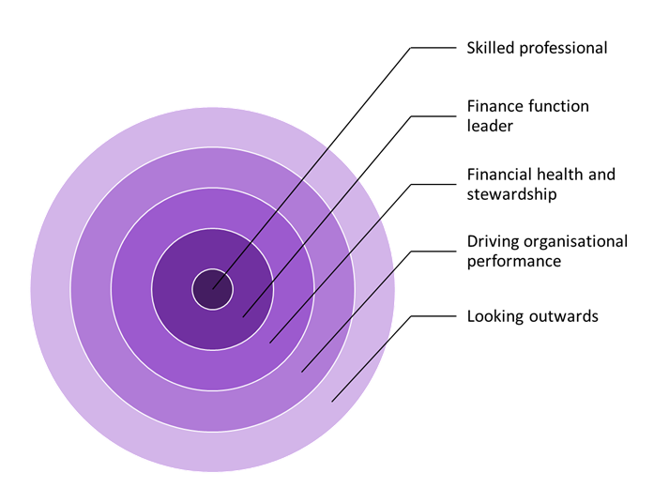
The role of the CFO

Slide 5
Absence of workforce and training plans What you told us….

Slide 6
Retention & Recruitment Statistics

Slide 7
Potential risks and implications
Loss of confidence in the sector
Some increased technical and financial management issues
Continuity and succession challenges
Stretched roles and responsibilities
Reactive rather than proactive

Slide 8
Proposed four themes with supporting actions
Leadership capacity and capability
Attracting and recruiting the right staff.
Developing our people
Creating the right environment to deliver

Slide 9
Draft Example
The renumeration package needs re-thinking, particularly for apprentices and young applicants, in light of the changing values and needs, at different times in their career and personal life. This includes consideration of pension options and alternative forms of benefits.
There is merit in authorities revisiting their benefits packages and considering the diverse range of options that different councils are using and including those in the workforce plan.
Further specific national marketing campaigns are required to help attract more candidates explicitly into the Accountant, Internal Audit and Business Partner roles including promotion events and marketing material

