Slide 1
Preventing failure in local government Society of District Council Treasurers
7 March 2024
Guy Clifton and Richard Thomas

Slide 2
Introduction

Slide 3
The financial trajectory of the sector
Year at risk
Assumptions
Year at risk (Historic Position)
-tve
Inflation continues to add pressure throughout 24/25
-tve
Employee cost pressures continue as a result of the COLC
+tve
Demand across key cohorts slowing
Level of reserves

Slide 4
Preventing failure in local government
Report published on 7 December 2023:
https://www.grantthornton.co.uk/insights/how-can-further-local-authority-failures-be-prevented/
ALATS, CIPFA, LLG, and SOLACE involved in research phase.
A follow up report is due to be published in March 2024.

Slide 5
Organisational failure
Local authority failures remain rare, but they are not as rare as they used to be.
This report examines the themes that relate to examples of government intervention, auditors use of their statutory powers, and the issuing of S114 or S5 Notices.
It is important to note that the act of issuing a S114 or S5 Notice may not in itself represent failure. The statutory officers responsible for issuing such notices are typically acting with integrity, often with personal bravery, and in some cases are responding to organisational decisions that took place before they were in role.
Nonetheless, the issuing of such Notices are signifiers of past or present organisational failure, and this report considers the internal and external factors that can contribute to such circumstances arising, and actions that can help to prevent organisational failure.

Slide 6
Preventing Failure
Report No. 1

Slide 7
Causal factors - structures
Internal factors | External factors
Use of council owned companies | Multiple government departments
S151 Officer or MO not on senior management team | Churn of ministers and civil servants
Over-reliance on interim statutory officers
Combined authorities

Slide 8
Causal factors - systems
Internal factors | External factors
Weak risk management and financial management | Funding reductions
Members not fulfilling responsibilities | Competition between councils for additional funding
Internal audit weaknesses | Ease of access to PWLB borrowing
Weak treasury management | Resource constraints on regulators
Lack of commercial expertise

Slide 9
Causal factors - behaviours
Internal factors | External factors
Weak leadership | Lack of a consistent voice across sector and professional bodies
Poor relationships
Optimism bias and wilful ignorance
Statutory officers not fulfilling their responsibilities
Lack of transparency on decisions
Lack of commercial skills and failure to take appropriate external advice, including accounting

Slide 10
Preventing failure - individual councils
Functions and roles | Good practice
Full Council | Effective resource management, ensure members are well informed/trained, auditor’s annual reports presented to full Council, allow enough time for in-depth discussion on key decisions.
Executive | Ensure those appointed have appropriate capacity, competence and commitment, and are fully aware of responsibilities.
Overview & Scrutiny | O&SC function respected by Executive and full Council. Forward plan to focus on key strategic issues. Sufficient resources/support to meet functions including for call-ins. Non-partisan approach, independent members. Recommendations should be acted upon.
Audit Committee | Independent chair, members receive specialist training, receive appropriate officer support, internal audit plan focus on key strategic /risk-based areas, be curious, challenge IA/EA.

Slide 11
Preventing failure - individual councils (cont’d)
Functions and roles | Good practice
CEO | Pay attention to development needs, seek mentoring/coaching, have well-developed understanding of legal and financial issues, encourage openness and challenge within the council.
S151 Officer | Undertake CPD, seek independent/external advice where necessary, seek peer support and mentoring when relationships internally are strained.
Monitoring Officer | Ideally be legally qualified, undertake CPD, seek independent external advice where necessary, seek peer support and mentoring.
Internal Audit | Annual plan focus on key risks, complete audits in timely way, clear reporting to AC, follow up recommendations, be adequately resourced.
Golden triangle – active leaders across the organisation

Slide 12
Preventing failure - external bodies
Functions and roles | Good practice/opportunities
NAO | Consider the sector challenges as part of planned review of the Code.
External Audit | Complete audits in timely way, identify poor practice and risks and make appropriate improvement recommendations. Report promptly on issues of concern. Ensure appropriately experienced teams.
LGA | Continue training and development of members, build on recent changes to the corporate peer challenge process, such as expecting all councils to publish the feedback report and an action plan, so that progress on the action plan is reported to Full Council.
CIPFA | Consider oversight activity, consider sanctions regime, management of S151s not CIPFA members.
SOLACE | Offer training to CEOs, specify essential criteria for CEOs, consider mechanism to remove accreditation where appropriate.

Slide 13
Preventing failure - external bodies (cont’d)
Functions and roles | Good practice / opportunities
LLG, CIPFA, SOLACE & ALATS | Develop shared set of standards and expectations for statutory officers, training for aspiring statutory officers, support networks.
DLUHC | Implement Redmond Review recommendations in full, issue guidance on MRP (with CIPFA and HMT), review sector funding regime.
HMT | Consider controls used for PWLB borrowing and early warning system

Slide 14
Summary
Most councils are well run, and have avoided significant failures, but the sector is facing increasing challenges.
Legal framework and funding system need to be reviewed.
Common feature of failures is weak leadership and impact on organisational culture.
Everyone with expertise, powers or duties should consider safeguards in place and what they need to do individually and collectively – strong collective leadership.
Understand and learn from past failures, understand and mitigate risk of failure.
Work collaboratively across professions, hierarchies and organisational boundaries to support good governance and financial management.

Slide 15
Preventing Failure – follow up report
To focus on approaches to preventing failure
Including case studies
To be published in April 2024

Slide 16
Finance team capacity

Slide 17
Finance team capacity – dealing with complexity
Why is finance team capacity under pressure?
Prolonged period of increased demands finance teams, through reduced funding and savings, regulatory change, Covid, economic uncertainty and financial statement delays.
Increased complexity of financial reporting – e.g., Commercial Activity.
New accounting implications – IFRS 16 (impacts of infrastructure accounting).
Financial statement delays.
Impacts of these external and internal factors on capacity
Insufficient capacity in finance teams and corporate services
Reduced efficiency of accounts production process and instability of team
Complex accounting treatments inappropriately scrutinised
Reduced effectiveness of systems and process
Reduction in accounting technical capability within teams
Accounts delays – complex transactions may go untested
Increased complexity and levels of challenge
Commercial transactions – not delivering/ increased risk
Insufficient succession planning
Reduced ability to deliver new accounting standards (IFRS 16) and BAU
Reduced ability to deliver new regulatory change
Lack of commercial and technical support

Slide 18
Finance team capacity – dealing with complexity
How we can help
Through our work with the sector, we recognise the challenges that you face and are keen to support.
We are building a team to provide direct support to finance teams in relation to:
Technical Accounting: Commercial activity, complex transactions, adhoc advice or implementing a new standard (e.g. IFRS 16).
Financial reporting: Accounts production support, audit readiness, improved efficiency of accounts production and capacity provision.
Finance Function: e.g. Financial Governance, process and control effectiveness
Example benefits: 1) Proactive understanding of accounting treatment before entering transactions; 2) Ability to sense check complex accounting or financial reporting in advance of audit; 3) Provide additional support with one off matters; 4) As auditors we understand what auditors will need.
I would welcome the opportunity to meet with you, to understand your challenges.

Slide 19
Panel discussion / questions

Slide 20
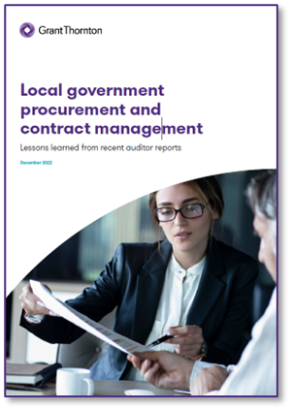
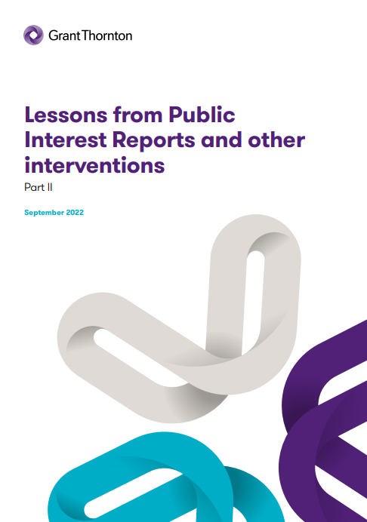
Previous reports
Procurement and contract management lessons learned (Dec 2022):
https://www.grantthornton.co.uk/insights/local-government-procurement-and-contract-management-lessons-learned/
Cheshire East Council PIR (Jan 2023):
https://www.cheshireeast.gov.uk/pdf/council-and-democracy/council-finance-and-governance/public-interest-jan2023/cheshire-east-council-final-17-january-2023.pdf
We published our first lessons learned report on Public Interest Reports (PIRs) in March 2021.
A follow up, covering lessons learned from subsequent PIRs was published in September 2022
Both reports can be accessed here:
https://www.grantthornton.co.uk/insights/lessons-from-recent-public-interest-reports/
20

Slide 21
Presenter contact details
Guy Clifton Director, Grant Thornton UK LLP
T 07771 974285
E guy.clifton@uk.gt.com
Richard Thomas Director, Grant Thornton UK LLP
T 07385 117425
E Richard.DM.Thomas@uk.gt.com

