Slide 1
Society of District Council Treasurers
CIPFA Finance Competency Model
8 March 2024

Slide 2
What is a competency model?
CIPFA COMPETENCY MODEL
CONDUCT
Social and Ethical
Relational
KNOWLEDGE
SKILLS
Business & Commercial
Decision making
Specialist
Finance business partner
Behaviours
Technical
Skills for the Information Age
It’s a framework for behaviours and skills that are essential for effective performance in an organisation
Over 100 competencies
On-line questionnaire
Gathers scores & evidence
Reporting suite

Slide 3
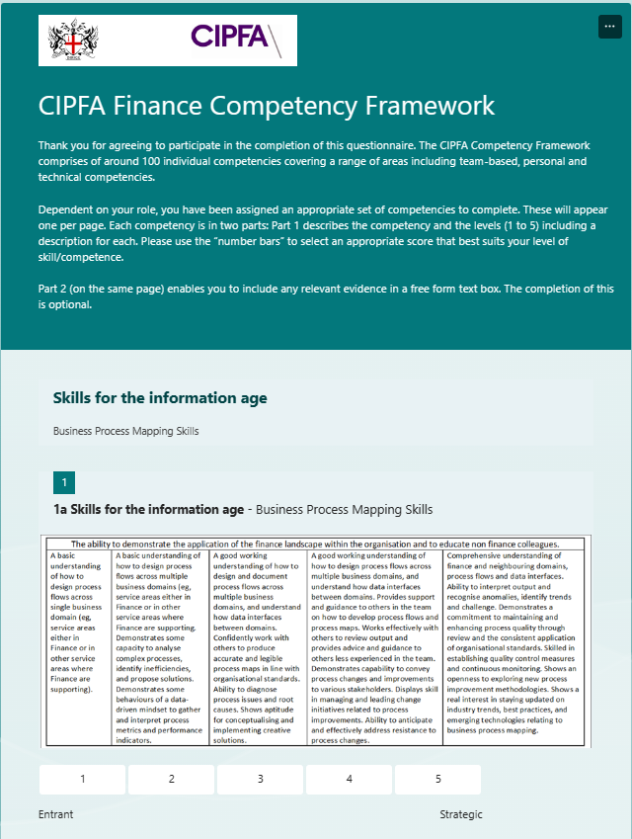

Slide 4
Extract from the Competency Model

Slide 5
How can we use the Competency Model?
The Competency Model can enhance a variety of people management processes:
  Assessing and addressing resilience issues in the workforce
  Job profiling and restructuring of teams
  Recruitment and selection (eg, competency-based interviews)
  Performance management
  Learning and career development
  Diagnostic – understanding how teams work

Slide 6
Key benefits
Targeted training
and development
Setting clear
expectations
for roles
Individual and team development through self awareness
Understanding where skills gaps exist
Informs career and succession planning

Slide 7
Competency model levels
There are five levels that pertain to the proficiency or mastery of a competency.
Strategic/
Expert
Level 5
The key behaviors/descriptions of each level build upon the previous in an ascending numerical order from Level 1 to Level 5. In other words, to achieve a Level 2 rating on a particular competency, one must be proficient in the key behaviors of Level 1. To accomplish a Level 3 rating on a particular competency, one must be adept at the key behaviors of Levels 1 and 2. Completion of the Model is a combination of assessing one’s level against a competency and providing a clear evidence base.
Advanced/
Practitioner Full
Level 4
Level 3
Intermediate/
Practitioner Lite
Foundation/
Aspiring
Level 2
Level 1
Entrant/
Novice

Slide 8
Competency model levels in practice
Senior Management: Executive Director, Assistant Director and Head of Unit, Section 151, Resources Director, Director of Finance etc
Level 5
Strategic/
Expert
Middle to senior managers: senior professional and policy roles. Chief Accountant, Senior Accountant, Head of Finance Business Partnering, Deputy S151 etc.
Advanced/
Practitioner Full
Level 4
Middle managers: senior professional, policy and project roles. Finance Business Partner, Managing Accountant, Finance Team Leader, Senior Finance Team Leader
Level 3
Intermediate/
Practitioner Lite
First line managers/ team leaders: professional, policy and project officer roles. Finance Policy Officer, Business Coordinator, Finance Specialist, Finance Team Leader
Foundation/
Aspiring
Level 2
Junior roles: graduate trainee, Finance trainee, Finance apprentiships, specialist Finance role (eg, Treasury, revenue and capital budget monitoring etc)
Level 1
Entrant/
Novice

Slide 9
Mapping competencies to individuals

