Slide 1

Are we facing a temporary accommodation crisis? What can be done?
Society of District Council Treasures
Temporary Accommodation and Migration Pressures

Slide 2
Welcome
Adrian Rowbotham
President of the Society of District Treasurers
Section 151 Officer at Sevenoaks District Council

Slide 3
Introducing our Speakers
Bob Porter – Thanet District Council
Terry Collier – Spelthorne Borough Council
Emma Foy – West Lindsey District Council
Roy Millard – South Eastern Migration Partnership

Slide 4
Emma Foy – West Lindsey District Council

Slide 5
Is this a National Crisis?
At the end of June 2022 there were 94,870 people in temporary accommodation
Between 9,000 and 10,000 Afghan people in hotels
Councils have enabled hosting of over 163,000 Ukrainian people into the UK
Over 91,000 asylum applications in the year ended 31 March 2023.
Centres for City have reported that we are 4 million houses short in terms of housing delivery requirements

Slide 6
What are our duties for
Temporary Accommodation
The Homelessness Reduction Act 2017 introduce relief duties requiring council to take reasonable steps to help secure accommodation for any eligible person who is homeless for up to 56 days.
Where a main housing duty is accepted then the household must remain in Council provided accommodation until they are permanently rehoused
Local Housing Allowance rates and benefit caps mean that Councils claim the cost of temporary accommodation where B&Bs used through Housing Benefit claims

Slide 7
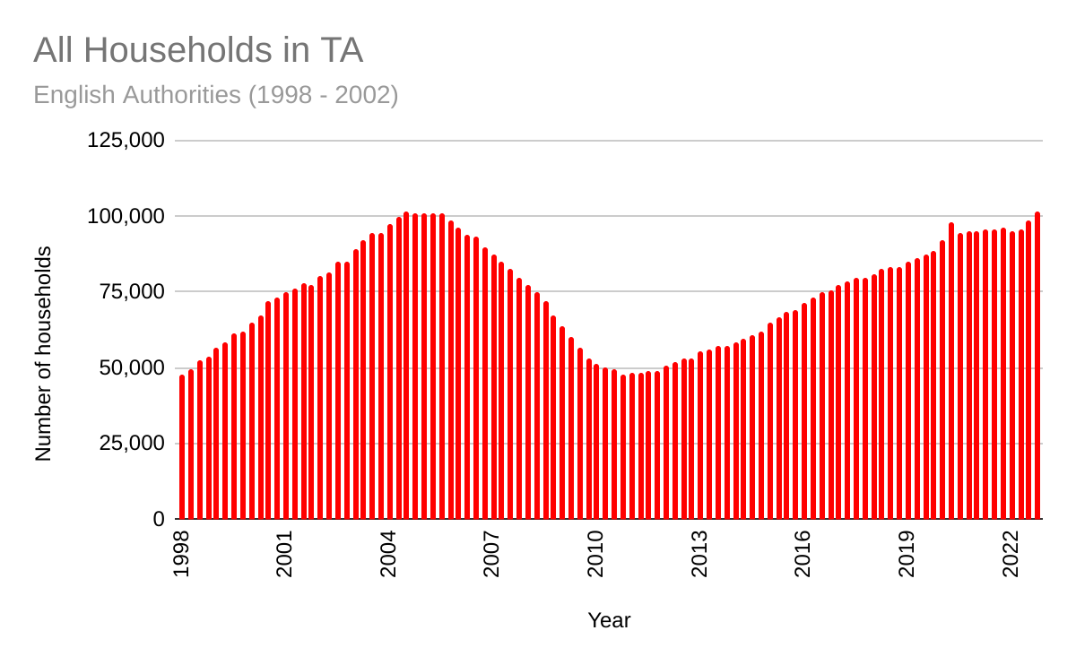
All Households in TA
English Authorities (1998-2002)

Slide 8
Terry Collier – Spelthorne Borough Council

Slide 9
Terry Collier – Spelthorne Borough Council

Slide 10
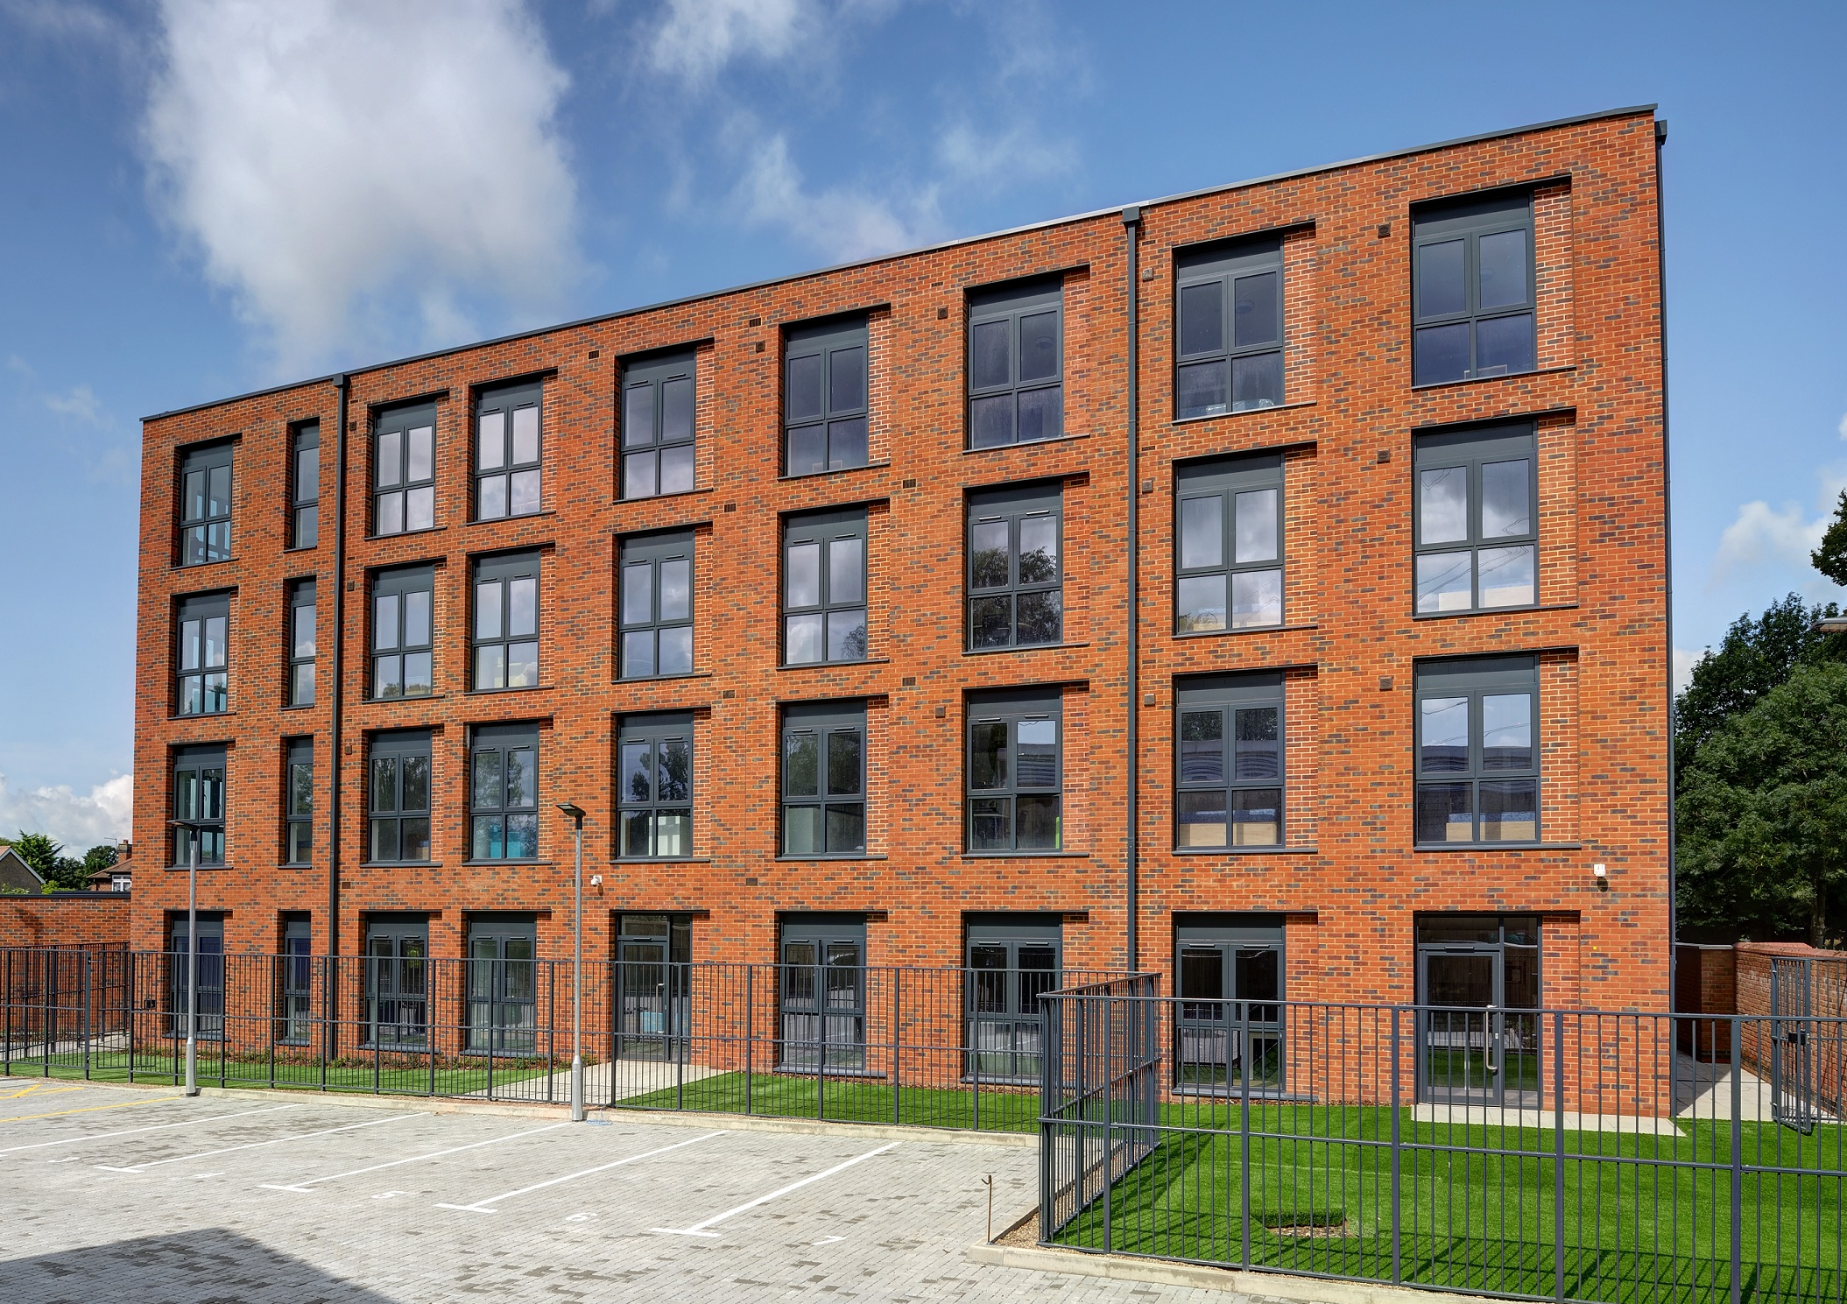
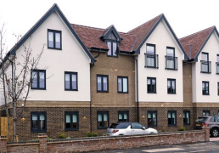
Temporary accommodation demand in Spelthorne
136 households in emergency accommodation (inc. 159 children)
limited family size accommodation available
lack of choice: households are placed outside borough
difficulties with funding emergency B&B space in the borough
wider impact: education, nutrition and associated stigma
White House - homeless facility
Harper House - homeless family facility

Slide 11
Refugee and Asylum Seekers accommodation demand in Spelthorne
Afghan refugees
bridging hotel closure on 16 August 2023
27 families (137 individuals) residing
LAHF - 11 homes delivered through round 1, 4 homes through round 2
PRS - 6 Afghan families
Afghan refugees
Ukraine refugees
355 guests living in 96 sponsor properties in the borough
Asylum seekers
84 individuals in Hotel Contingency Accommodation and 18 in Dispersed Accommodation

Slide 12




Complexity of needs
greater levels of complex needs amongst client group, with increasing instances of anti-social behaviour, mental health issues, substance addiction, and other issues which make housing them more difficult, driven or exacerbated by the Cost of Living crisis
client profile has changed from residents who are facing immediate hardship to people with complex needs, some who cannot be housed independently
shortfall from partner services and agencies who are under severe stress due to the Cost of Living crisis
higher demand for support services
higher proportion of client death, requiring suicide conversation training for frontline staff

Slide 13
Bob Porter
Thanet District Council

Slide 14
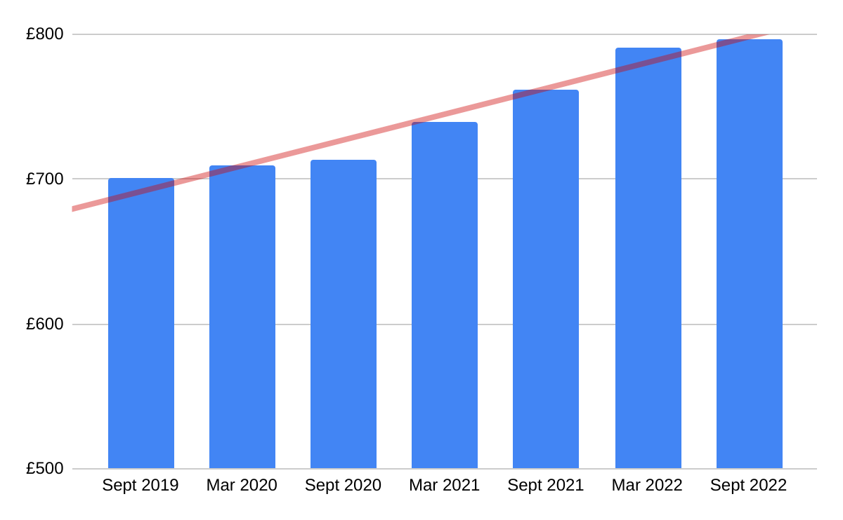
Thanet Market Rents
Highly competitive local market conditions
15% increases in the past 2 years
Use of section 21 procedure
Average 2 bedroom rents

Slide 15
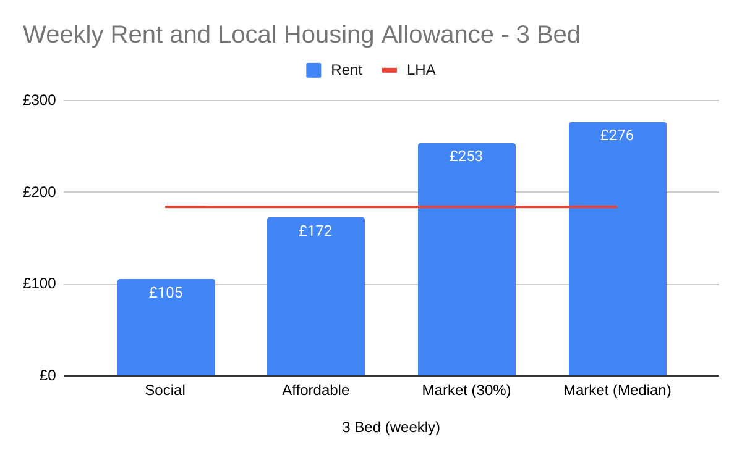
Rents and Local Housing Allowance
LHA previously reflected the 30th percentile
Prolonged freezes in LHA rates
30th percentile is now £69 p.w. higher
And the median rent is £92 p.w. higher.

Slide 16
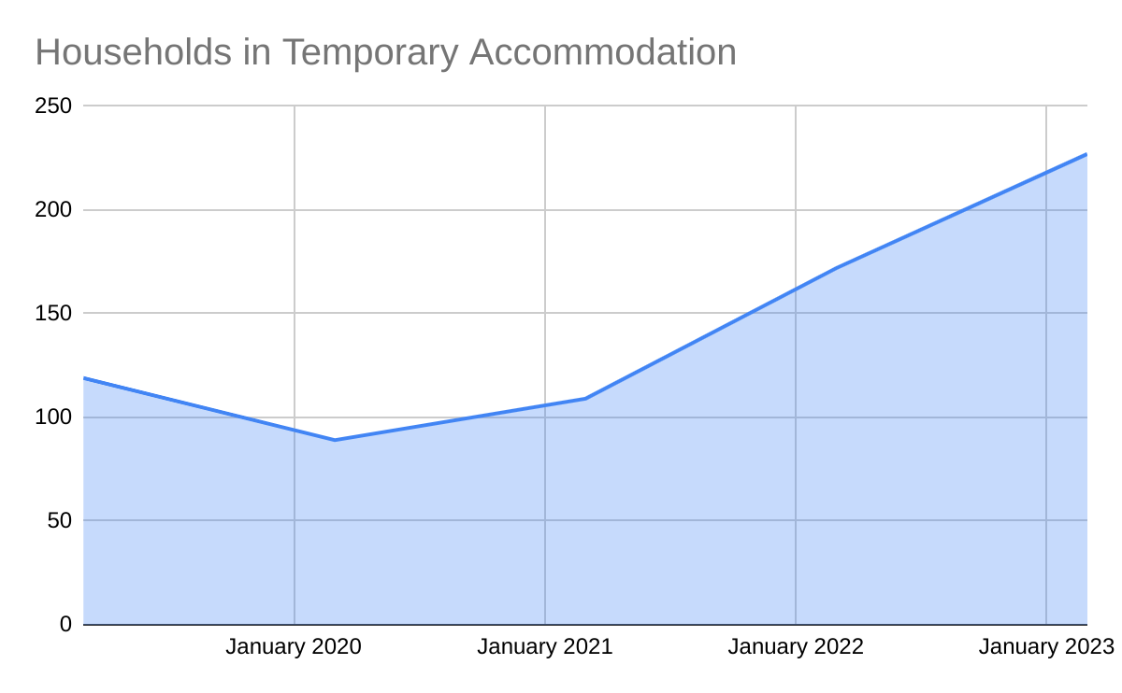
Temporary Accommodation
More than doubled in 2 years
217 households (May 2023)
120 households placed outside of Thanet.
Mostly nightly paid, in the private rented sector
£35 to £70 per night

Slide 17

Key Numbers:
Total gross cost of TA (2022/23): £3.4m
19% of a General Fund base budget of £17.9m
Net TA budget overspend (2022/23): £1.2m
Growth in 2023/4 budget:
  Overall: £3.5m
  22% of which is for TA: £800k
TA is fast becoming the District council equivalent of adult social care

Slide 18
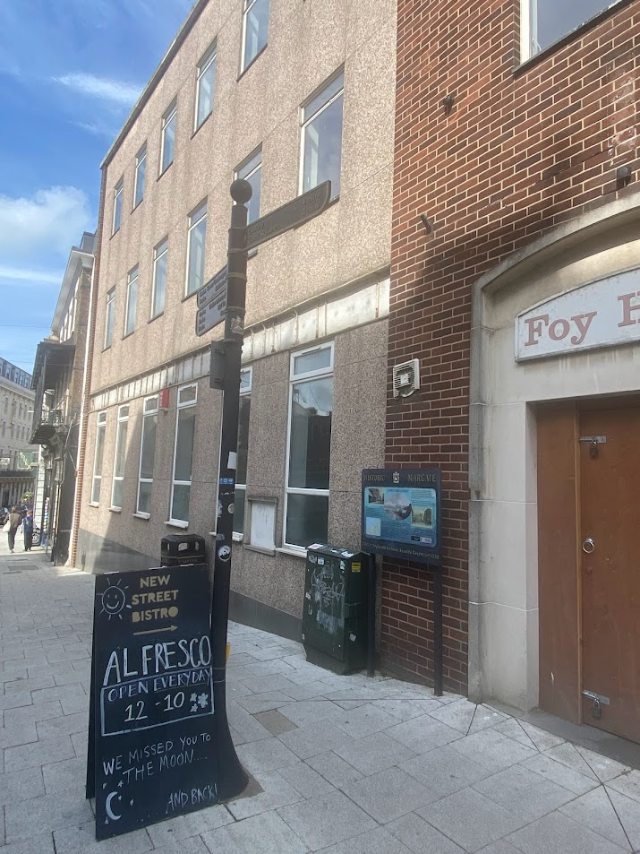

A new approach to Temporary Accommodation
Foy House - A vacant commercial building on Margate High Street
Previously a bank and office
Permitted development rights for residential
Potential for 8 flats and small office

Slide 19
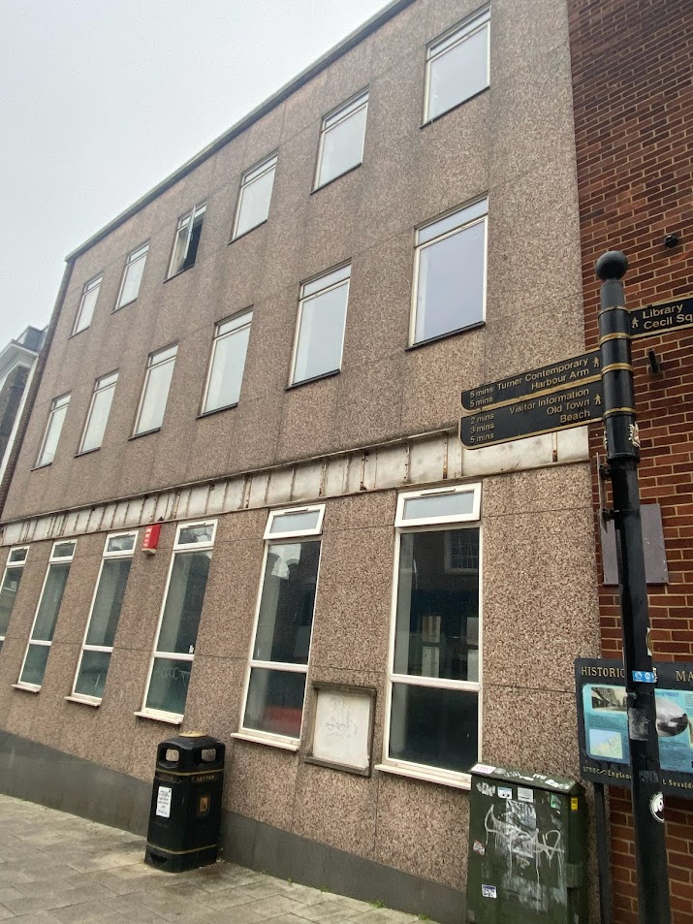
Multiple Outcomes
Tackling a vacant derelict building in the town centre
Adding vitality to the town centre by introducing residential development
Improving the quality of temporary accommodation
Enabling homeless households to return to the district
Reducing the cost of TA

Slide 20
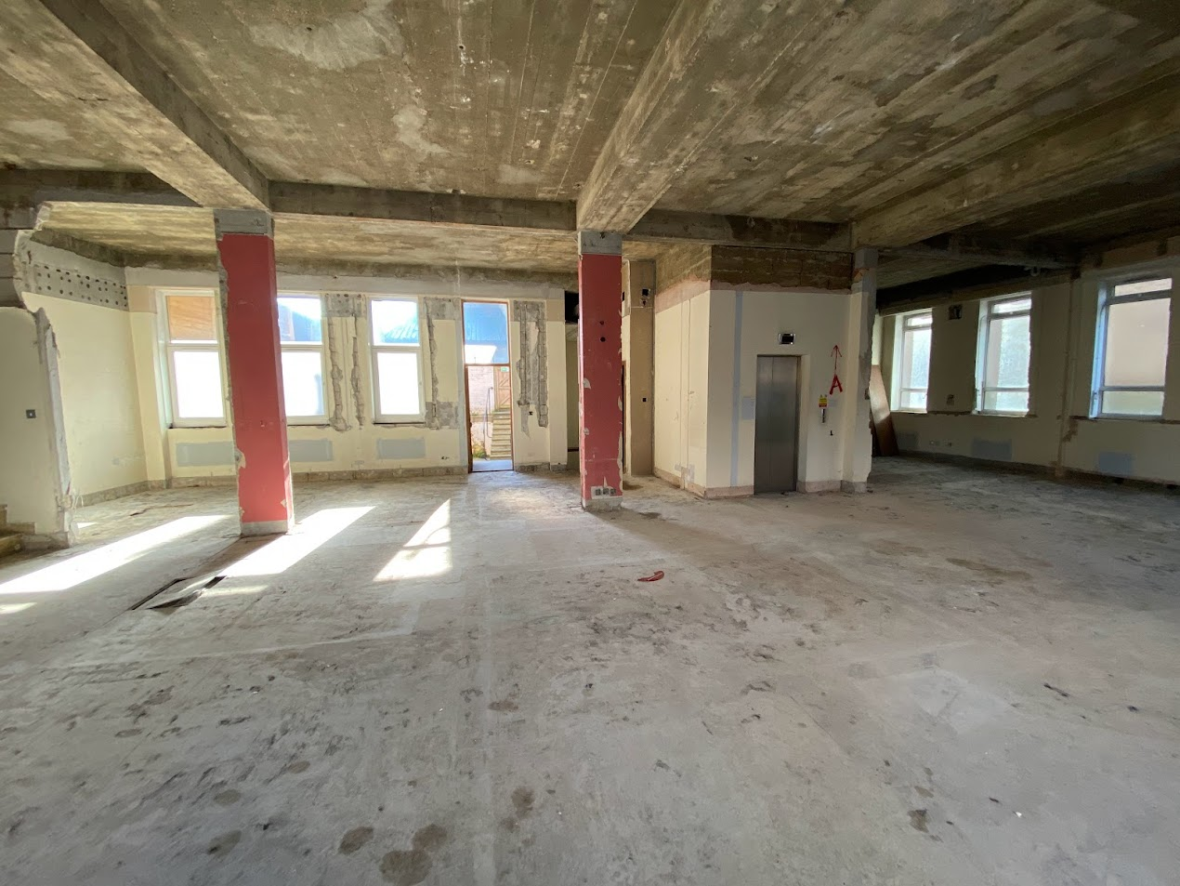
Scheme Costs
Purchase cost: £500k
Refurbishment and Conversion costs: £1.2m
15 month construction period
Funded with general fund borrowing and Retained right-to-buy receipts

Slide 21
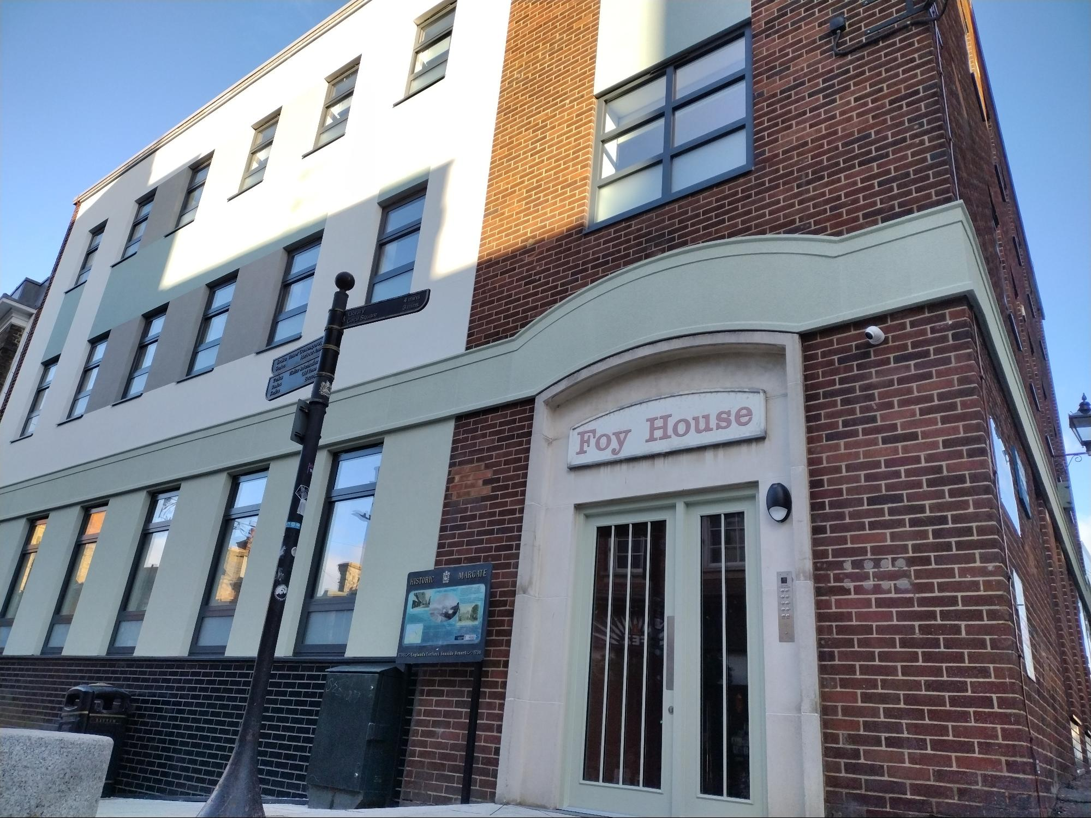
Foy House
4 x 1 bedroom, and
4 x 2 bedroom
Costs funded from rents, set at the LHA rate:
Size | LHA based rent | Private sector nightly rate
1 Bedroom | £11.62 | £27 to £35
2 bedroom | £21.36 | £40 to £59

Slide 22
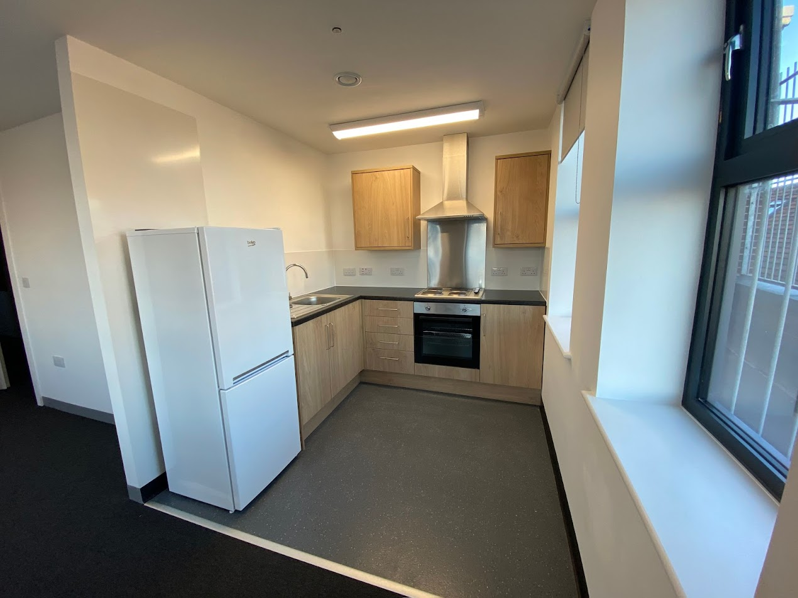
Savings:
Business plan includes:
  Debt costs
  Management and Maintenance costs
  Bad debts and voids
  Depreciation
  Rent income
Overall saving of £35k p.a for the scheme
That’s £4,375 per unit.
Scalable: For 225 cases that’s a saving of £984k p.a.
(44% of total net budget of £2.2m)

Slide 23
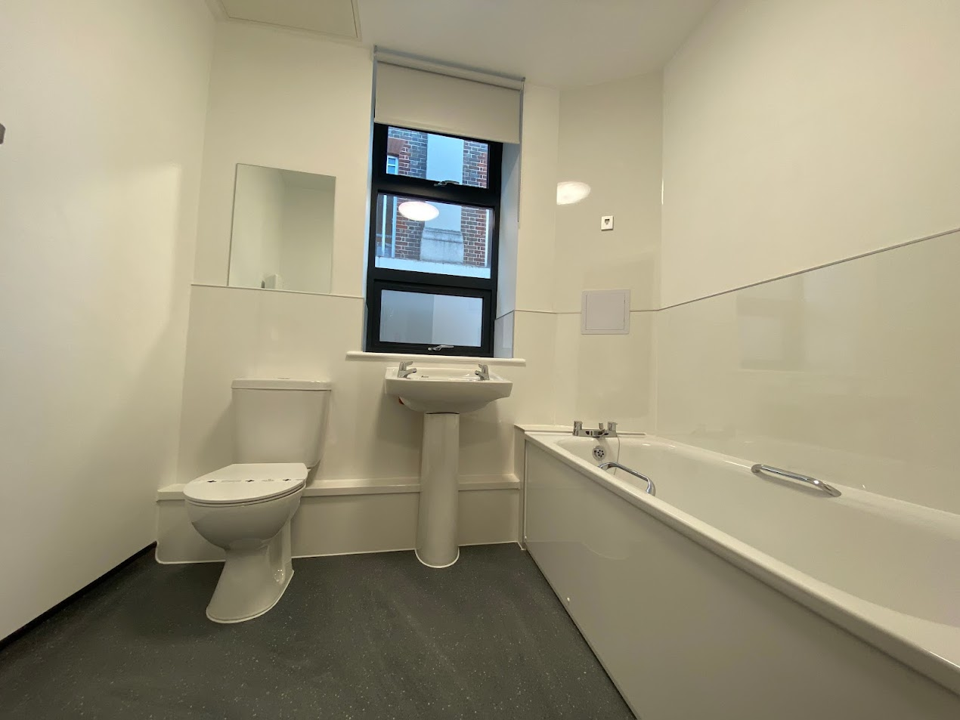
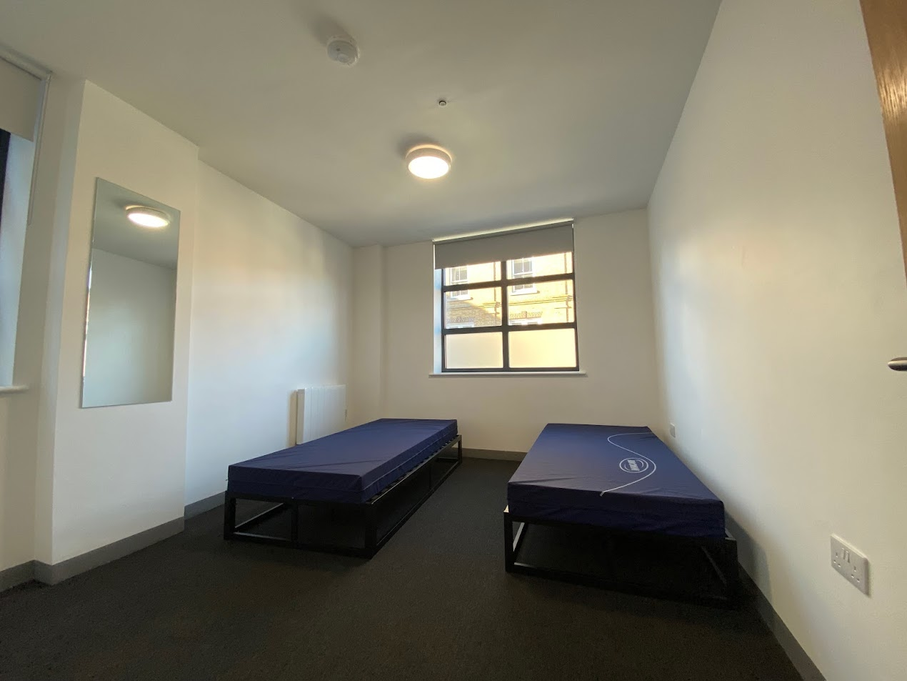
Move On:
Households in Foy House are owed a full housing duty
Dedicated on site support
Average stay is 38 nights
Compared to 195 days for accepted cases in other TA.
Overall: 40% of cost and 20% of duration.

Slide 24

Thank you
Contact:
Bob Porter
Head of Housing and Planning
Thanet District Council
E-mail: bob.porter@thanet.gov.uk
Tel: 01843-577006

Slide 25
Roy Millard
South East Migration Partnership

Slide 26
Information Sharing from the Migration Partnership
Home Office pays funding to different tiers of councils depending on the programme – Borough/District/City and County Councils work together to agree formula to share funding.
SMP-facilitated shared learning and best practice across experienced and newer areas on all programmes – some excellent examples of projects in areas being replicated elsewhere, and projects being delivered across council borders.
Local Authority Housing Fund (district-level) – programme to support Ukrainians and Afghans into longer-term accommodation. Good regional take-up. Round 2 announced and more councils eligible for funding to support Afghan move on from hotels. Learning from Round 1 to be shared.
Asylum cost collation exercise – used several district/county submissions. Increase in one-off asylum funding available to councils as a direct result.
Consideration of “place based” approach to work across all programmes – consider impact on services and utilise flexibility of available funding to meet need.

Slide 27
Future ways of working
Information Sharing from the Migration Partnership
A joined-up single “place based” view of migration programmes and impact in a local area.
Local government desire to utilise available funding in a single-stream to meet need locally, rather than siloed approach to funding programmes and services.
More information sharing via SMPs to improve the experience for people in the various systems.
Review of funding arrangements (especially on asylum) to ensure local services are receiving the support they need to deliver.

Slide 28
Any Questions ?

Slide 29
Thank you for attending!
Reminder:
SDCT General Meeting: 7-8 March 2024 at Warwick University
SDCT Executive Members required. See for further details:
www.cipfa.org/partners/society-of-district-council-treasurers

