Slide 1
Society of District Council Treasurers
Current Issues and Audit Handover
16 March 2023
Sarah Ironmonger
Notes:
16:00-16:30

Slide 2
Current issues

Slide 3
Context
Sep. 2020
Redmond Review reported.
Jul. 2021
PAC reported that without urgent action from government, the audit system for local authorities in England might soon reach breaking point.
Sep. 2021
9% of audited accounts for 2020/21 published by target date of 30 September 2021
Nov. 2022
12% of audited accounts for 2021/22 were published by target date of 30 November 2022
Dec. 2022
By December 2022, PSAA reported that more than 220 opinions from years prior to 2021/22 remained outstanding. Including 2021/22, audit firms still had more than 630 overdue opinions to issue.

Slide 4
Importance of audited accounts
Local authorities, police and fire bodies in England are responsible for approximately £100 billion of net revenue spending each year.
NAO: proper accounting for public funds and high-quality public audit are pivotal for trust in public finance and expenditure in an accountable and democratic system.
PSAA: audited accounts are the main way public bodies demonstrate accountability for managing public money. The publication of timely audited accounts, with an audit opinion, is a key element of financial management arrangements and a fundamental feature of good governance.
CIPFA LASAAC: users of accounts should be able to access the information they want to help them to understand the finances of an authority.
Government: robust local audit system and transparent local authority financial reporting is key to delivering VfM to taxpayers, and for sustaining public confidence in our systems of local democracy.

Slide 5
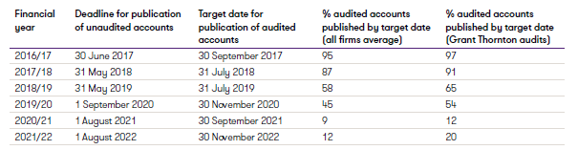
Performance
Performance has been steadily declining:

Slide 6
Key issues
System leadership
Audit quality
Risks in an evolving sector
Complexity of accounts and reporting requirements
Quality of draft accounts
Responding to the audit process
Capacity
Governance
There is no single cause for the delays in completing local authority audits, and unfortunately there is no quick solution in a complicated system involving multiple parties.
We consider a variety of factors contributing to delays, note the measures which have already been taken to support the local audit system and make recommendations for further improvement.

Slide 7
Key issues: system leadership
ARGA to be the system leader for local government, with PSAA continuing with the procurement of local government audit.
The FRC will be the convener for the local authority audit system, when it transforms to become ARGA.
FRC appointed first system leader in Sept 2022.
MoU between FRC and DLUHC in March 2023
ARGA will be responsible for leading response to challenges in the local audit system, the CoAP, for regulating quality and performance, for producing an annual report, chairing a liaison committee and setting audit standards.
System leader to determine role of local audit.

Slide 8
Key issues: audit quality (1)
October 2020 FRC published its first public report setting out the findings from its inspection of major local audits: 60% of audits reviewed required improvements. Their greatest concern was in respect of property valuations, with auditors needing to strengthen their procedures around the challenge of management.
FRC subsequent reports (2021 and 2022) noted improvements in the quality of audit work. However, they continue to stress the need for improvement in the audit of property.
Additional audit focus on property valuations has meant auditors are increasingly reliant on receiving information from expert valuers. This has, in some cases, led to management commissioning additional work from their valuers and in some cases led to the replacement of valuers.
Where an auditor has failed to comply with the auditing framework, the FRC can sanction a firm for such breaches. These powers were first used in January 2022.

Slide 9
Key issues: audit quality (2)
FRC’s focus has been successful in improving both the quality of audit and the quality of financial reporting in the sector.
Audit firms are not willing to compromise on audit quality. Firms will defer audit reports where it is not possible to complete work to the required standards by target dates.
This has posed a number of issues for the sector:
The full application of IFRS and legislation has substantially increased the volume of audit work required.
The pressure on resource and the significant technical knowledge needed to undertake local government audit has reduced the attractiveness of the sector to audit firms.
The complexity of audits, high risk commercial ventures and complex accounting arrangements has increased the amount of work needed.
There remains a limited pool of local audit talent, with many newly qualified local auditors choosing to follow alternative careers.
There is a lack of consensus between the sector and stakeholders over the focus of financial statement audits. This is particularly prevalent in the audit of property.
Accounting for infrastructure assets is an example of this impact, further delaying some 2020/21 and many 2021/22 audits.

Slide 10
Key issues: risks in an evolving sector
The environment in which authorities operate has become increasingly challenging.
Acute financial pressure and risks arising from commercialisation.
Increase in S114s, PIRs and statutory reporting.
Timely auditor reporting is of heightened importance where there are significant governance and financial failings. Inevitably, such complex issues take audit time as well as specialist input and can absorb vast amounts of audit resource.
Challenges faced include:
  weaknesses in councils’ decision making processes
  failure of investments and group companies,
  novel transactions
  non-compliance with laws and regulations
  serious weaknesses in accounts preparation
  bribery and corruption allegations
  falsification of documents
We will continue to us our statutory reporting powers on a timely basis, where it is appropriate.
We believe thought should be given to Government intervention where authorities are not giving sufficient priority to their financial reporting responsibilities.

Slide 11
Key issues: complexity of accounts and reporting requirements
Local authority accounts are inherently complex due to the need to comply with both IFRS and statute. Accounts are regularly over 100 pages and are not easily understandable by members of the public.
Many authorities are increasingly engaging in innovative or unusual projects and transactions.
Since the introduction of IFRS, financial statements contain many estimates and assumptions, generally required to be set out in notes to the accounts, that are dependent on judgements about the future. The impact is particularly notable in accounting for operational and investment property, pension liability balances and financial instruments.
Increased expectations from the FRC following the high profile corporate failures have combined to produce a significant increase in audit work, for example on asset and pension valuations.
Local authorities which administer local government pension funds are required to publish full Pension Fund accounts in the same document as their local authority accounts. Both audits need to be completed for opinions to be signed.
A consensus is needed on the right financial reporting framework for local government.

Slide 12
Key issues: quality of draft accounts (1)
The quality of draft accounts presented for audit can have a significant bearing on the time taken to complete an audit.
Whilst many sets of draft local authority accounts are prepared diligently and are free from material error, this is far from universally the case. Issues include:
  Draft accounts are not reflective of relevant facts and circumstances,
  Group accounts, accounting complexities arising from collaborative working arrangements, complex transactions and failure to meet disclosure requirements
  Unusual and complex arrangements often come with the associated risk that accounting implications are not fully understood ahead of transactions being concluded. Auditors not being sighted on such transactions until receiving draft accounts.
  Local authority accountants not having prior experience of complex, unusual or novel arrangements and the necessary technical accounting expertise may not be available in-house.
  Authorities being reluctant to commission external accounting advice as part of the accounts preparation process.
  Failure to properly complete of the CIPFA disclosure checklist by the finance team and thorough proof-reading and internal challenge of the draft accounts

Slide 13
Key issues: quality of draft accounts (2)
Unfortunately, the quality of too many financial statements and working papers are not adequate.
Some councils have multiple sets of accounts open. Others are having to rely on interim staff for accounts preparation which reduces corporate memory and impacts on succession planning.
Improvement in accounts preparation, and recruitment and investment in finance teams is essential if local government is to prepare consistently high-quality draft accounts and respond to the challenges presented by an enhanced audit regime.

Slide 14
Key issues: responding to the audit process (1)
Officers not being available to answer audit questions.
Lack of capacity and skills to act as a strong enough client in all situations, an issue further compounded by the pandemic.
Significant increase in the complexity of financial systems used in the processing, recording, and reporting of transactions which feed into financial statements, and effective oversight.
Delays are often experienced in obtaining complete and accurate financial data reports from systems that reconcile to account balances and disclosures.
Populations obtained for sampling can often consist of a large volume of transactions, including debits and credits rolled forward for a number of years.
Evidence received during audits varies in quality.
Increased audit focus on property valuations and pension liabilities.
Rising audit quality expectations have increased auditor scrutiny and challenge of audited bodies

Slide 15
Key issues: responding to the audit process (2)
Well-documented accounts closedown process, which captures key data sources, internal and external contacts and their responsibilities and a well-organised approach to working paper preparation, review, version control and filing all help to smooth the audit process and add resilience should there be a change of finance personnel.
Clear and disciplined focus on the part of both preparers and auditors on what can be done early. It is good practice for this to begin with an open and honest debrief at the end of each audit cycle, with a view to continuous improvement.
Early work can and should take place to prepare and review accounting policies. Removing immaterial or redundant disclosures from accounts templates brought forward and entering early dialogue on areas of complexity and significant judgement can pay dividends.
Regular communication and collaborative working between the auditor and audited body.

Slide 16
Key issues: capacity (1)
Local auditors also have a broader remit than their commercial counterparts, with responsibility for assessing local bodies’ arrangements to secure VfM, and quasi-judicial roles on public objections to accounts and public interest reporting.
Significant numbers of experienced audit staff have left the audit profession entirely in recent years, moving into non-audit roles within firms providing audit services and into the public and wider private sector.
Local authorities have faced similar pressures in maintaining staff capacity and capability within their finance functions. We don’t see enough attention being paid to the importance of succession planning.
High staff turnover presents difficulties in terms of the continuity of audit teams and the demand placed on experienced colleagues in recruiting, orienting and training new employees and consequently there has been an impact on the timeliness of some audits.
Impact of reduction in audit fees: in late 2022, in real terms audit fees were just 35% of the level they had been a decade earlier.

Slide 17
Key issues: capacity (2)
DLUHC proposes to work with the new system leader and the audit firms to develop an industry-led workforce strategy to consider the future supply of local auditors.
Latest PSAA procurement will help to support sustainability and competitiveness in the local audit market, although this is a slow burn process as the two new market entrants will serve just 7% of the market through to 2027/28.
PSAA major re-set of total fees for 2023/24, involving an increase in the order of 150% on the total fees for 2022/23. This should give audit firms the confidence to invest for the future.
Scale fee increases will also reduce the prevalence of audit fee variations arising simply from the time lag between increases in audit work due to changes in regulatory requirements and the setting of fee scales.

Slide 18
Key issues: governance
CIPFA clear that audit committees are a key component of governance, noting their purpose is to provide an independent and high-level focus on the adequacy of governance, risk and control arrangements.
Leadership, behaviour, culture and appropriate financial management are all important, so having the right members on an audit committee, with an appropriate remit and appropriate training for those involved is key.
Redmond urged for the forging of closer links between the AC members and S151 Officer, Chief Executive and Monitoring Officer to ensure the membership of the committee feels confident enough to challenge and manage issues presented to them.
We encourage audit committees to thoroughly understand the reasons for delays in publication of audited accounts. Whilst recognising that delays can and do occur, audit committees should hold management and auditors to account for preparing and monitoring delivery plans.

Slide 19
Outstanding issues
The following matters that are yet to be tackled:
Clarity over the purpose of local audit.
The complexity of local government financial statements.
Agreement on the focus of financial statements audit work.
An improvement in the quality of financial statements and working papers.
An agreed approach to dealing with the backlog of local government audits.
Government intervention where there are significant failures in financial reporting processes.

Slide 20
The future
There are some reasons for cautious optimism that the system will begin to recover and there will be a gradual return to better compliance with publication targets.
However, we consider that these are outweighed by a number of risk factors and that the September deadline for audited accounts set by DHLUC is not achievable in the short term and also not achievable until there is further significant change in local audit and local government.
All key stakeholders including local audited bodies, the audit firms, DLUHC, PSAA, NAO, FRC and its successor ARGA, CIPFA and ICAEW will need to continue their efforts to support a coherent and sustainable system of local audit, acknowledging that it will take time to get things back on track.

Slide 21
Auditor rotation

Slide 22
Audit handover
New PSAA framework appointments for 2023/24 – 2027/28
Many councils will retain the same external auditor
For those whose auditors change:
  New audit firm can’t provide non-audit services from 1 April 2023
  Rotating off auditors will be happy to retain trusted advisor role, making introductions as required
  Rotating on auditors will arrange liaison meetings from April 2023 onwards (if not before) and liaise with outgoing auditors (timing will depend on status of audit)…

Slide 23
The position will vary depending on whether opinions have been delayed
Routine audits signed off in 2023
Small delays – audits signed by March 2024
More substantial delays
Multi-annual prior year delays / “problem audits”

Slide 24

Questions?

Slide 25
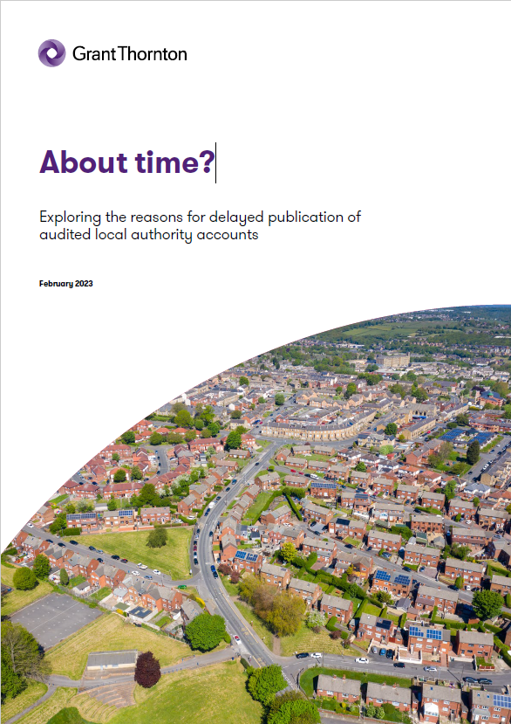
Exploring the reasons for delayed publication of audited local accounts
Report published 6 March 2023: https://www.grantthornton.co.uk/insights/report-key-challenges-in-local-audit-accounting/
Explores the requirements for publication of draft and audited accounts and considers the reasons for the decline in performance against these requirements over time.
We make recommendations for various stakeholders, including Audit Committees and auditors, and include a checklist for consideration by management and Audit Committees.

Slide 26
Presenter contact details
Sarah Ironmonger
Partner, Grant Thornton UK LLP
T 07880 456149
E Sarah.L.Ironmonger@uk.gt.com

