Slide 1
The Role of the CFO in the Public Sector - Enabling and aspiring

Slide 2
Role of the CFO Publications

Slide 3
Right Time
The world of the public finance leader is increasingly complex.
Need fully functioning finance team with the right skills and the right workforce strategy
Strengthen the importance for some of the skills of the CFO that are essential for the public sector
demonstrating value for money,
proper stewardship of taxpayers’ funds
independent and objective analysis
strong financial management

Slide 4
Roles of the CFO
Technical
Stewardship
Innovator
Strategist
Professional
Notes:
.

Slide 5
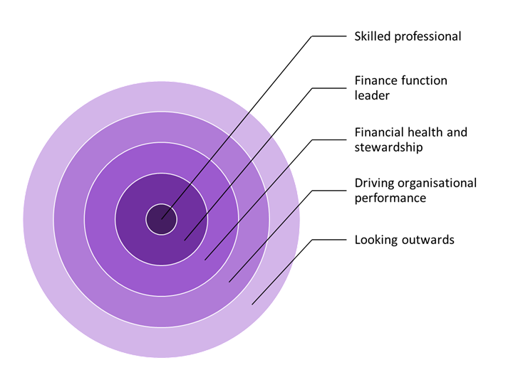
Publication approach

Slide 6
Broader Appeal
allow new and established CFOs to gain insight into their role and to improve their practice;
help aspiring CFOs to better understand the skills, competencies and attributes required;
assist public service organisations in understanding what they should expect from their CFO and how they can create an environment in which the CFO can create maximum value;
provide regulators, funders, auditors, taxpayers and other stakeholders with assurance as to the professional standing and integrity of CFOs in public service organisations;
help to promote the role of CFO in public service organisations as an attractive career choice for high-calibre finance professionals.
Notes:
Broader appeal and be part of the strategy to promote the role and the profession
A Grant Thornton Report September 2022
It is not clear from where the next generation of s151 officers will
be found. Councils are increasingly looking to recruit s151s from
outside their organisation, as they have not invested in developing
the next cohort of senior finance specialists.
This means councils are all looking to the same
external pool which cannot meet the demands for future s.151s.

Slide 7
Pathways to Inspire
Opportunities of the role
Understanding what it involves
Managing the grey
Establishing culture
Leadership behaviours
Influencing colleagues

Slide 8
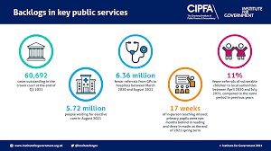
CIPFA strengthening debate in the public sector

