Slide 1

SDCT Warwick Event
Financial Health in District Councils
March 2023
Dan Bates
FINANCIAL RESILIENCE  DELIVERY SUPPORT  INFORMATION MANAGEMENT

Slide 2
Financial Health/Resilience of District Councils
We will look at:
Funding outlook
  Local Government 22/23 settlement
  Council Tax
  Business Rates retention
Reserves Health
Capital Health
  Debt gearing / borrowing
  Internal / external borrowing and interest rates

Slide 3
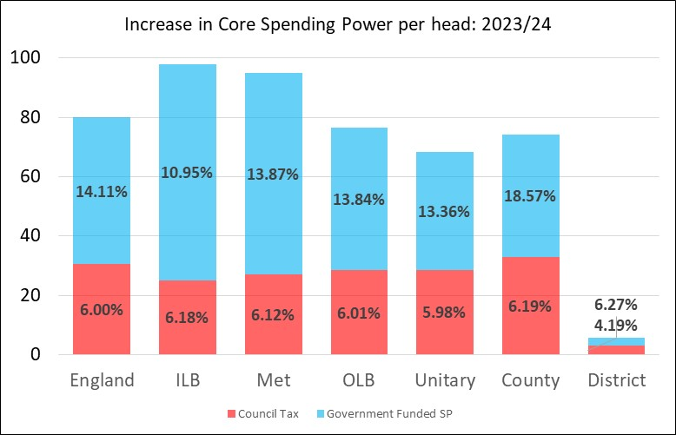
Increase in Core Spending Power (23/24) – better than expected
Graph shows £ increase per head by type of authority with percentage increased in the labels. Overall CSP increases shown below graph
For third year running, Government funding has provided more than Council Tax, significantly more in 23/24.
Better than expected increases in Spending Power …
Govt. Funding
Council Tax
9.32% 9.14% 10.20% 9.32% 8.81% 9.84% 4.99%
Notes:
So it was only this year that SP actually reached the level of ten years previously
And this largely thanks to council tax
So little wonder that authorities have turned to alternative sources of income
We need to manage our financial resilience going forward – sound capital strategies and diversified approach to risk

Slide 4
Increase in Core Spending Power (23/24) – better than expected
Graph shows £ increase per head by type of authority with percentage increased in the labels. Overall CSP increases shown below graph
For third year running, Government funding has provided more than Council Tax, significantly more in 23/24.
Better than expected increases in Spending Power except for DISTRICTS!!
Govt. Funding
Council Tax
9.32% 9.14% 10.20% 9.32% 8.81% 9.84% 4.99%
Notes:
So it was only this year that SP actually reached the level of ten years previously
And this largely thanks to council tax
So little wonder that authorities have turned to alternative sources of income
We need to manage our financial resilience going forward – sound capital strategies and diversified approach to risk

Slide 5
Districts
Not much cheer for districts.
New Homes Bonus reduced again to be almost insignificant.
3% minimum guarantee – transitional relief – easy to discontinue.
And the £5 max CT rise almost meaningless given 3% referendum limit
Stability over fairness and actually quite unfair on authorities that never benefitted from NHB who now don’t benefit from minimum guarantee.
Unlike upper tier, very little to equalise impact of differential taxbases and rates growth.
Government solution: Use your reserves!!

Slide 6
Levelling Up … not for districts!
Spending Power Component | Change 23/24
SFA + Under Index (Inflation) | +£79m
New Homes Bonus | -£82m
Lower Tier Services Grant | -£41m
Services Grant | -£15m
Rolled In Grants Adjustment | -£22m
Funding Guarantee | +£134m
Government Funded Spending Power | +£53m (+6.27%)
Council Tax | +£57m (+4.19%)
SPENDING POWER | +£110m (+4.99%)
SFA increased to reflect inflation
However, one year’s loss of NHB results in £82m reduction
LTSG scrapped and Services Grant reduced
Means that majority of districts (154) needed new funding guarantee to hit the 3% funding floor

Slide 7
Funding Guarantee – a closer look
Figures in axes are in £ms and show 1 year change (22/23 to 23/24)
Y-axis shows Funding Guarantee (ranges from £0 to just over £3.5m)
X-axis shows change in NHB and LTSG
NHB reduced for most (not all) as grant reduced to 1 year and LTSG scrapped

Slide 8
Funding Guarantee – a closer look
Funding Guarantee almost £ for £ replacement for NHB/LTSG loss
If you never had NHB then you’re not going to get any Funding Guarantee!
Funding Guarantee, LTSG and even Services Grant are all transitional – they’ll more likely than not disappear!

Slide 9
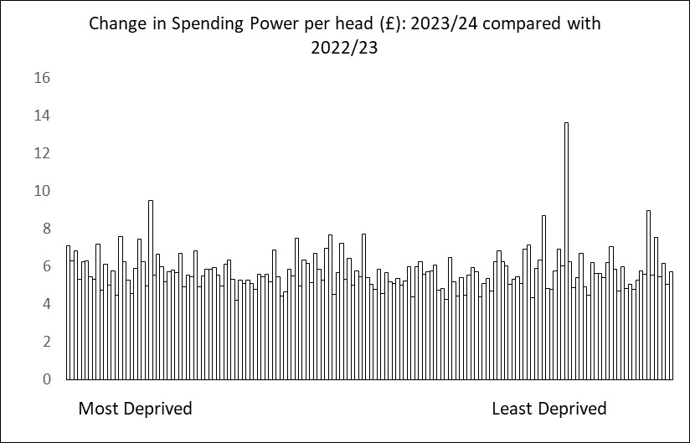
Any sign of Levelling Up for districts?
There is no correlation between deprivation scores and Spending Power changes for district councils.
Those couple of outliers have done very well with NHB this year.
Otherwise, larger SFA increases for more deprived areas balance out taxbase resilience in less deprived areas.
And funding guarantee compensates for loss of NHB and other transitional grants!

Slide 10
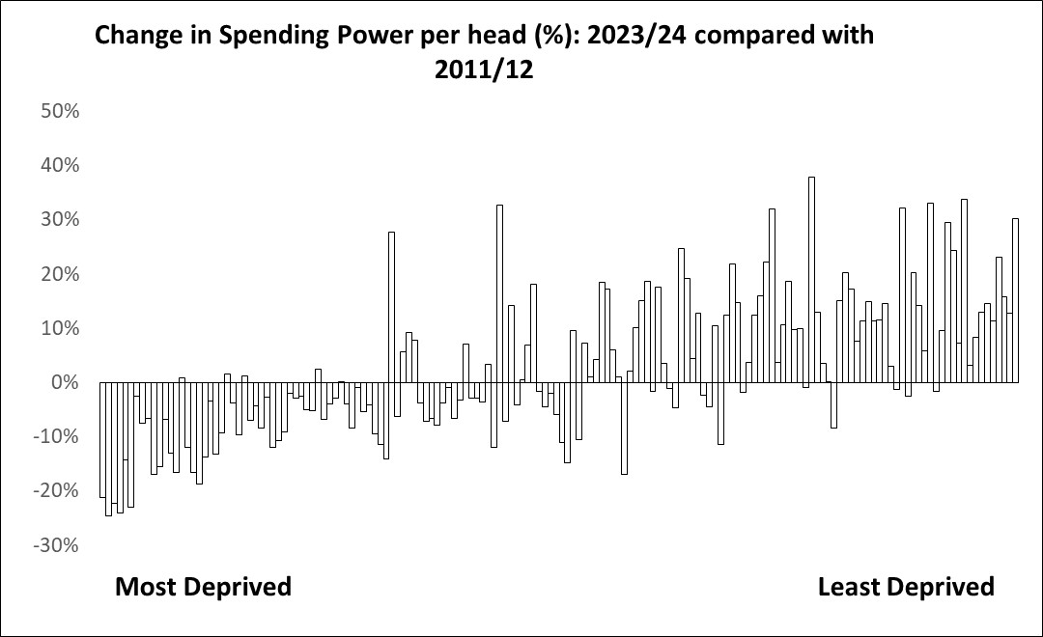
Districts Levelling Down?
Significant redistribution of Spending Power over last three governments to detriment of more deprived areas
Roughly equal percentage cuts in RSG/SFA tougher on grant dependent authorities in deprived areas.
Less deprived areas benefitted from stronger taxbases as council tax has become majority funder of local government.

Slide 11
For districts, its all about taxbase …!
Clear positive correlation between taxbase increase and SP increase over last 12 years
Other determinants include Band D (but only in minor way as controlled by referendum)
But not New Homes Bonus as this has all but disappeared in 23/24!

Slide 12
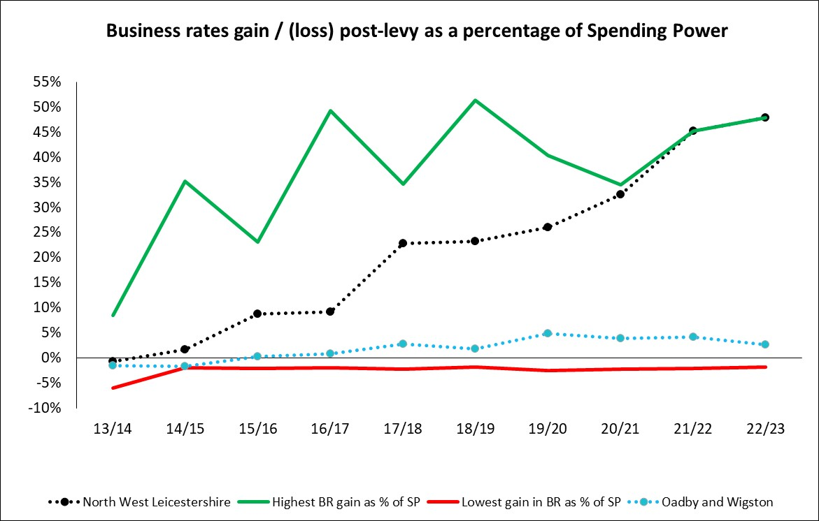
… and business rates gains
Some districts have massively gained from business rates growth
BR growth is outside spending power.
Graph shows highest and lowest district gainers from BR growth.
Highest gainers receiving additional 50% of Spending Power.
Cumulative and set to continue for at least two more years.

Slide 13
Funding impacting on Financial Health
District Spending Power per head in 2023/24 (£120.57) has only just passed the 2011/12 per head total (£119.04).
Large redistributions in Spending Power over the last twelve years with districts in more deprived areas faring a lot worse.
Due in part to New Homes Bonus and business rates gains
But primarily due to taxbase changes which have tended to favour less deprived areas
Taxbase and business rates disparaities set to continue for at least the next two years – still no significant progress of Fair Funding review
Undoubtedly has had an impact on financial health of some district councils

Slide 14
Usable Revenue Reserves
DLUHC find reserves ‘baffling’ but have suggested that councils ‘consider how they can use their reserves to maintain services in the face of immediate inflationary pressures’.
A better understanding of reserves is a good thing all round!
Usable Revenue Reserves have increased over the last decade but:
  This is not surprising given the significant increase in risks and uncertainties.
  Particulalry with respect to continuing uncertainty on future fair funding.
  They are almost certainly going to decline this year (2022/23).
  Business rate gains and New Homes Bonus have contributed to significant reserves boosts.
  There is a huge disparity in reserve levels and in changes in reserves between districts.

Slide 15
Usable Revenue Reserves
35% increase in URR across Local Government in the last two years but exaggerated by COVID and likely to reverse in 2022/23.
Increase in district reserves lower than upper tier – possible sign of greater financial stress amongst districts due to lower levels of funding.

Slide 16
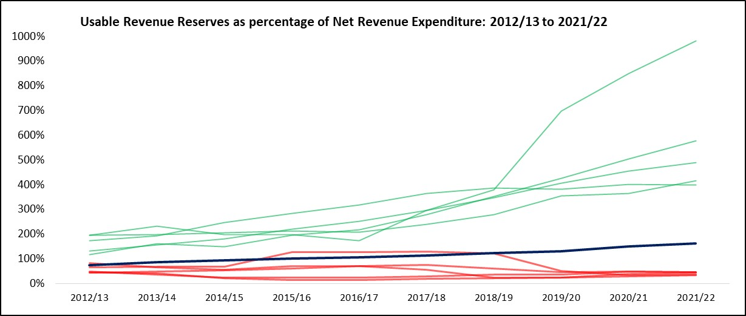
Usable Revenue Reserves
Graph shows huge disparity in change in usable revenue reserves in last ten years.
Green lines are districts with highest URR levels as percentage of Net Rev. Exp.
Red lines show lowest URR levels.
Blue line shows district average.
So although URRs have increased, this is not the case across all districts

Slide 17
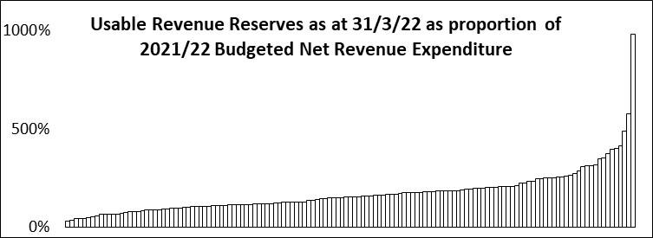
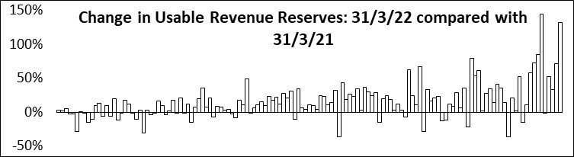
Usable Revenue Reserves
Upper graph shows all districts URRs from 21/22 accounts as percentage of Net Revenue Expenditure.
Lower graph shows changes in reserves over the last year with a reasonable number of authorities seeing falling reserves.
Disparities in levels of reserves and changes in reserves

Slide 18
Usable Revenue Reserves
Significant number of authorities with low levels of reserves, half of which have depleting levels.
This before 22/23 which is expected to be a difficult year given inflationary pressures

Slide 19
Looking forward
Most districts anticipating overspends associated with inflationary pressures
Residual COVID monies set to be used during 2022/23
Taken together, likelihood that URR will reduce in 2022/23: planned and unplanned
Ask the Audience!: Have you set your 2023/24 budget with a planned use of reserves?
In medium term, continuing inflationary pressures, wage inflation, increasing interest rates
Need to make savings in medium term – use of reserves to plug the gap
So we really need to overcome ‘baffling’ reserves and have a better understanding
Watch this Space: LGi will publish first view of reserves on 2 June based on all draft 22/23 accounts published on 31 May

Slide 20
Capital Health
Understood a lot less than is revenue reserves health but just as important
Relationship between capital programme and borrowing
Covered by Prudential Code, Capital Strategy and Treasury Management Strategy
But are these process adequate / robust – not in s114 authorities
Pressure from Government/CIPFA after high profile failures particularly in respect of commercial properties
Interest rate rises have added new complexity in this area
Measures
Debt gearing
Debt profile
Internal / External Borrowing
Debt Management Costs

Slide 21
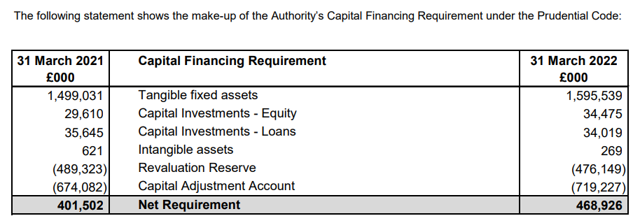
Capital Health Model
Capital
Assets
Equity
Debt
Model takes all the balance sheet components relating to capital and establishes the relationship:
CAA + RR (Equity) + CFR (Debt) = Capital Assets on the Balance Sheet

Slide 22
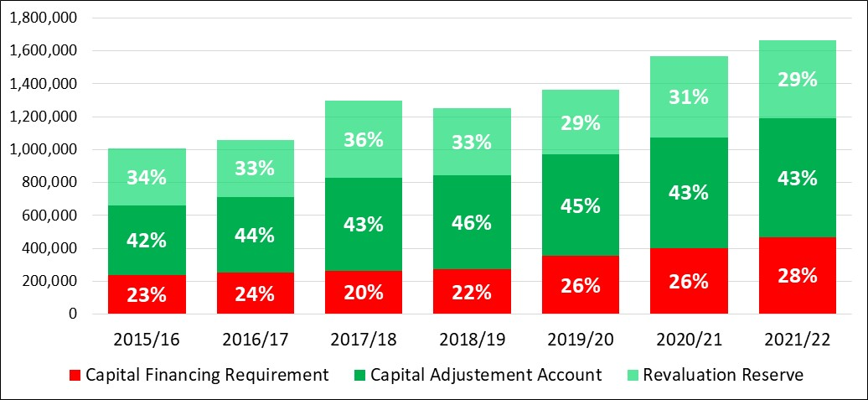
Debt gearing over time
Shows that relationship between CFR/CAA/RR and capital assets over time

Slide 23
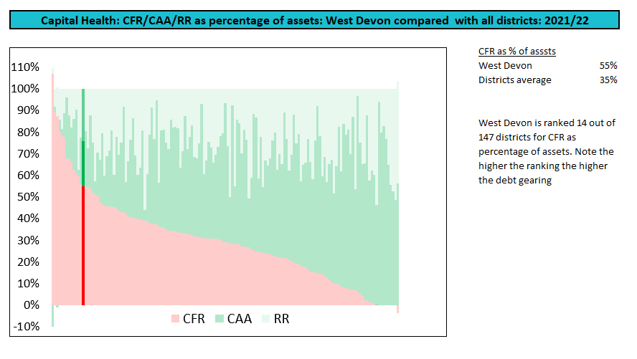
Debt gearing in districts
Big variety in debt gearing across districts.
Debt gearing increasing on average
Authorities on left hand side of analysis now been subjected to Government reviews and potential intervention.

Slide 24
Treasury Management just got more complex!
Years of stable, low interest rates at an end
Successive interest rates rises over the last year and forecast to continue
Internal borrowing set to reduce and transfer to external borrowing
Short term borrowing exposure now subject to higher rates
Debt profiles more important as taking out new debt now much more expensive
Debt management cost set to increase and take higher proportion of reducing budgets
Were our TM / Capital Strategies ready for this?

Slide 25
Treasury Management just got more complex!
Years of stable, low interest rates at an end
Successive interest rates rises over the last year and forecast to continue
Internal borrowing set to reduce and transfer to external borrowing
Short term borrowing exposure now subject to higher rates
Debt profiles more important as taking out new debt now much more expensive
Debt management cost set to increase and take higher proportion of reducing budgets
Are our TM / Capital Strategies ready for this?
Are existing prudential indicators sufficient?
Are processes around CIPFA FM code and AGS sufficient?

Slide 26
Thank you for listening
Dan Bates
dan@lgimprove.com
Twitter: @danbates_Lgi
Dan Bates | LinkedIn
FINANCIAL RESILIENCE  DELIVERY SUPPORT  INFORMATION MANAGEMENT

