Slide 1
CIPFA Commerciality, Codes and Updates Richard Lloyd-Bithell – Senior Policy and Technical Manager, CIPFA Joanne Pitt – Local Government Policy Advisor Kirsty Stanners – Head of CIPFA Policy and Technical
The Chartered Institute of Public Finance & Accountancy

Slide 2
Prudential Code update – what has changed?
 | Material revisions to the Prudential Code (CQ refers to consultation question numbers) | Prudential Code para
1 | A new Objective for proportionate commercial investments (CQ 3&4) | 1(f)
2 | Include the legal status of the Code in Chapter 3 (CQ 9) | 12
3 | Reference to environmental sustainability in contents of Capital Strategy (CQ 5) | 24
4 | Capital Strategy to summarise investments into treasury management, service and commercial purposes | 24
5 | Greater clarity on commercial and service investments in the Capital Strategy, including limits, and compliance with requirement not to borrow to invest for return (CQ 10) | 24
6 | Explicit requirement to set and monitor the treasury management prudential indicators in the TM Code LA Guidance | 43
7 | Quarterly monitoring of prudential indicators as part of normal budget monitoring reports | 44
8 | Replace old para 45 (no borrowing in advance) with new requirement not to borrow to invest primarily for financial return (CQ 1&2) | 48-52
9 | Authorities with commercial financial investments who expect to borrow: annual strategy to review options for exiting commercial investments | 53
11 | New pru indicator for net income from commercial and service investments as % of net revenue stream (CQ 13) | 81-85
12 | Investment Pru Indicators to be reported together with investment indicators under Statutory Investment Guidance | 83
13 | Include Heritage Assets in definition of CFR | 90
14 | New definition of Commercial Property | 92
15 | remove deduction for interest and investment income from definition of Financing Costs | 94
16 | Revised definition of Investments (to include non-financial assets held primarily for financial return) | 95
17 | sub-definitions for treasury management, service and commercial investments (CQ 10) | 95
18 | clarification that Net Revenue Stream excludes capital grants etc | 96
19 | Consequential changes and cross references relating to the above items | throughout
20 | Move some procedural paragraphs into the Governance chapter | throughout
Notes:
This is a full list of the changes to the Prudential code, I suggest you go through this in your own time and please refer to our Guidance Notes for Practitioners Publication. I will pick out the key changes in the next few slides. But first…

Slide 3
Prudence in Borrowing and Investment
Local authorities are reminded that:
Security of Funds is the Prime Objective
Authorities should consider SLY in context of their own risk appetite.
Adopt an appropriate approach to risk management.
Can borrow and invest for the following purposes:
Any function of the authority
Prudent management of their financial affairs
Legitimate examples of prudent borrowing:
Financing capital expenditure
Management of cash flow
Securing affordability
Refinancing current borrowing
Notes:
PRUDENCE IN BORROWING AND INVESTMENT
Local authorities are reminded that the prime policy objective of their treasury management investment activities is the security of funds, and they should avoid exposing public funds to unnecessary or unquantified risk. Authorities should consider a balance between security, liquidity and yield which reflects their own risk appetite but which prioritises security and liquidity over yield. It is therefore important that authorities adopt an appropriate approach to risk management with regard to their investment activities.
Authorities under legislation can borrow and invest for the following purposes:
Any function of the authority under any enactment
For the prudent management of their financial affairs
The Code considers legitimate examples of prudent borrowing to include:
Financing capital expenditure primarily related to the delivery of a local authority’s functions (subject to the considerations set out in this Code);
Temporary management of cash flow within the context of a balanced budget;
Securing affordability by removing exposure to future interest rate rises; or
Refinancing current borrowing, including replacing internal borrowing, to manage risk or reflect changing cash flow circumstances

Slide 4
The Prudential Code determines
An authority must not borrow to invest primarily for financial return
Access to PWLB is dependent on CFO certifying Capital Spending plans do not include investing primarily for yield
Access to the PWLB is important
Leveraged investment always increases downside risks,
Authorities with existing commercial investments not required to sell.
May want to consider options for exiting if future plans to borrow.
Should not take new borrowing if Commercial investments can be reasonably realised.
Can continue to improve and repair existing Commercial property.
Notes:
The Prudential Code determines that certain acts or practices are not prudent activity for a Local Authority and incur risk to the affordability of Local Authority investment:
An authority must not borrow to invest primarily for financial return;
It is not prudent for Local Authorities to make any investment or spending decision that will increase the CFR, and so may lead to new borrowing, unless directly and primarily related to the functions of the authority and where any financial returns are either related to the financial viability of the project in question or otherwise incidental to the primary purpose .
The UK government’s rules for access to PWLB lending at the date of this publication require statutory Chief Finance Officers to certify that their Local Authority’s capital spending plans do not include the acquisition of assets primarily for yield, reflecting a view that Local Authority borrowing powers are granted to finance direct investment in local service delivery (including housing, regeneration and local infrastructure) and for cash flow management, rather than to add debt leverage to return-seeking investment activity. Since:
Access to the PWLB is important to ensure Local Authorities’ liquidity in the long term, and
Leveraged investment always increases downside risks,
local authorities must not borrow to fund acquisitions where obtaining financial returns is the primary aim.
Authorities with existing commercial investments (including property) are not required by this Code to immediately sell these investments. However, Authorities which have an expected need to borrow should review options for exiting their financial investments for commercial purposes in their annual treasury management or investment strategies. The options should include using the sale proceeds to repay debt or reduce new borrowing requirements. They should not take new borrowing if financial investments for commercial purposes can reasonably be realised instead, based on a financial appraisal which takes account of financial implications and risk reduction benefits. Authorities with commercial property may also invest in the repair, renewal and updating of their existing commercial properties

Slide 5
Definitions in Summary
Treasury Investments
Arising from the cash flows or treasury risk management activity.
Balances which need to be invested until the cash is required
On commercial terms and will rarely constitute capital expenditure.
Commercial Investments
Primarily for financial return, neither for treasury management nor delivering services.
Includes non-Financial Assets.
Usually constitute Capital Expenditure
Service Investments
Primarily and directly for the delivery of public services
May or may not involve financial returns
Normally constitute capital expenditure and it may be appropriate to borrow
Notes:
‘Investments for treasury management purposes’ (or treasury management investments)
are those investments that arise from the organisation’s cash flows or treasury risk management activity, and ultimately represent balances which need to be invested until the cash is required for use in the course of business.
Treasury investments may include an allowance for a reasonable level of short term treasury investments to provide access to liquidity.
Treasury investments may also include the investment of borrowing proceeds where it has been prudent for an organisation to borrow in advance of the need for cash, eg in order to reduce financing and interest rate risks.
Treasury management investments should always be on commercial terms and will rarely constitute capital expenditure for local authorities.
For organisations with long term surplus cash, this category may include long term investments such as equities, bonds and property, whether accessed through a fund or directly, but unless an explicit link to cash flow management can be demonstrated, these should normally be classified as commercial investments.
‘Investments for commercial purposes’ (or commercial investments)
are taken or held primarily for financial return and not linked to treasury management activity or directly part of delivering services.
This includes non-financial assets which are held primarily for financial return such as commercial property.
For local authorities, investments of this type will usually constitute capital expenditure.
‘commercial’ in this context refers to the purpose of the investment. Commercial investments are not taken to meet treasury management cashflow or risk management needs, but are additional investments voluntarily taken in order to generate net financial return or profit.
‘Investments for service purposes’ (or service investments)
are taken or held primarily and directly for the delivery of public services (including housing, regeneration and local infrastructure) or in support of joint working with others to deliver such services.
Service investments may or may not involve financial returns; however, obtaining those returns will not be the primary purpose of the investment.
For local authorities, service investments will normally constitute capital expenditure and it may be appropriate to borrow to finance service investments.

Slide 6
Monitoring Prudential Indicators
CFO is responsible for:
monitoring and reporting at least quarterly.
establish a process that highlights significant actual or forecast deviations.
Monitoring reported as part of the integrated revenue, capital and balance sheet monitoring.
In respect of the Authorised Limit:
A report on likely breaches is required.
The decision-making body determines the way forward
Notes:
MONITORING AGAINST PRUDENTIAL INDICATORS
The chief finance officer is required to establish procedures to monitor and report performance against all forward-looking indicators at least quarterly. The chief finance officer will need to establish a measurement and reporting process that highlights significant actual or forecast deviations from the approved indicators. Monitoring of prudential indicators, including forecast debt and investments, should be reported as part of the authority’s integrated revenue, capital and balance sheet monitoring.
The chief finance officer should have particular regard to the following with respect to prudential indicators and external debt:
In respect of the prudential indicators for the authorised limit for external debt, where the chief finance officer forms the view that a limit is likely to be breached a report to the decision-making body is required. It will then be for the decision-making body to determine if it would be prudent to raise the current limit or, alternatively, to instigate remedial actions.

Slide 7
Treasury Code - what has changed?
 | Material revisions to the Treasury Management Code | TM Code section
1 | Investment Management Practices and other recommendations relating to non-treasury investments in Section 8 are required under the Clauses to be formally adopted | 5.
2 | Definition of treasury management amended to explicitly include borrowing | 6.
3 | TMP1 (1) on counterparty credit risk: counterparty policy to set out the organisation’s policy and practices relating to environmental, social and governance (ESG) investment considerations | 7.
4 | Some TMP 1 treasury risks have been renamed to align with general practice | 7.
5 | TMP 10 on training requires a Knowledge and skills schedule (CQ 1) | 7.
6 | Section 8 on non-treasury (ie service and commercial) investments definitions updated in line with Prudential Code | 8.
7 | All reporting under the TM Code to address service and commercial investments in appropriate categories, as well as treasury ones | 8.
8 | The purposes, objectives and management of each category of service and commercial investment should be described. | 8.
9 | The risks of commercial investments should be proportionate to the organisation's financial capacity (as per Pru Code) | 8.
10 | Local authorities must not borrow to invest for commercial return; other public service orgs may decide that this principle applies to them also | 8.
11 | Investment Management Practices for non-treasury investments - updated | 8.
12 | A new Illustrative Competencies schedule (CQ1) | Guidance Appx 1
Notes:
Here are the changes to the Treasury Code, again take time to go through this list in more detail. We are going to pick out the key change.

Slide 8
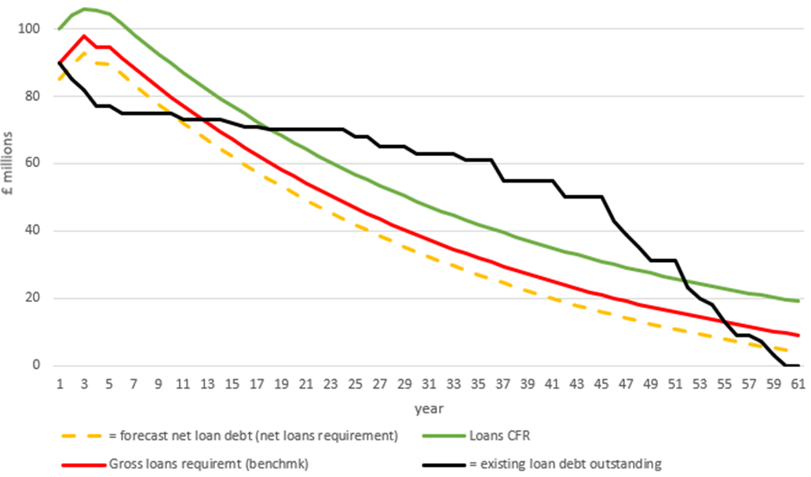
Liability Benchmark
Notes:
The code formally introduces the Liability Benchmark

Slide 9
The FM Code Review
Managing the implementation
Addressing the themes covered .
Ensuring continuing compliance .
Lessons Learnt
Notes:
1 Introduction 1
2 The Financial Management Code 3
3 Understanding the requirements of the Code 7
4 Managing the implementation of the Code 10
1 Introduction 1
2 The Financial Management Code 3
3 Understanding the requirements of the Code 7
4 Managing the implementation of the Code 10
5 Addressing the themes covered by the Code 12
6 Ensuring continuing compliance with the Code 16

Slide 10
FM Code Feedback
Relevant and easy to understand
Assessment baseline approach ( RAG)
Evidence
Reporting variances
Audit
Leadership
None
Challenges
VFM ( A )
Management Style ( E )
Reporting for decision making ( Q )
Collaborative working interpretation

Slide 11
New Guidance on Council Owned companies
Recognition of the increasing risks to local authorities and sector
Complimentary to CIPFA’s Codes and Guidance
Financial Management Code
Financial Resilience Index
Governance Code
Builds on the lessons learnt
Stakeholder conversations
CIPFA’s consultant experiences
Principles-based guidance

Slide 12
Common causes of failure
No common understanding of what “being commercial” actually means.
Weak options appraisal - rationale for creation is poor – optimism bias.
Lack of alignment with local authority’s objectives – divergent thinking.
Not identifying / clarifying what the desired outcomes are.
Lack of formal or inconsistent set-up procedures– can lead to poor decisions re structural model chosen.
Weak scrutiny and challenge - ineffective company boards.
Unclear legal control framework – shareholder/service agreements.
Poor market knowledge – buyer behaviour/ competitors not understood.
Business plans - not up-to-date or simply don’t exist, costs of delivery not transparent.

Slide 13
What good looks like
GOVERNANCE
CLEAR STRATEGY
Appointing the right people to boards
Shareholder Reps
Non-Executive Directors
Role of MO and Scrutiny
Commercial design principles
Commercial Strategy
Alignment to Corporate Strategy/Council Plan
QUALIFICATION
Open and transparent, Project Brief, Business Case
Passes the “challenge” test: internal/external
Solid, referencable market research
Based on sound financial modelling
REALISM
Creating companies is not a quick fix
for solving other problems in a council
Setting realistic outcomes
CULTURE
EXIT PLAN
Communicating key messages
Measuring behavioral change
Checking on who has had the “conversion” experience
Understanding what the end point looks like
What will it cost?
Can we terminate early?

Slide 14
Practice Oversight Panel
Terms of reference
Matters of practice concern
Advisory Note
Initial note on Governance
Intention to raise profile of key themes
Not just local government
Earlier awareness of challenges to sector
Chair Aileen Murphie

Slide 15
Changes to Continued Professional Development
Recognition of the pressures and complexity faced by CFO’s
Additional support through web and guidance
Assurance through annual members statement
Driving sector improvements
Notes:
.

Slide 16
Procurement Update
Concern over the impact of rising costs on procurement budgets
Webinar on 24 March to look at the issues
CIPFA Procurement Expert highlights some challenges
New Procurement Bill – timescale
Aim of simplification – Challenging
Need to review procurement process and rules – next 12 months
Challenges of VAT now added to contracts causing problems
Capacity and resources issues generating risks

Slide 17
Any Questions?
Notes:
Are there any questions on what we have covered today?

