Slide 1
Society of District Council Treasurers Financial Management and Commerciality in Districts – What Next?
Simone Hines, SDCT President – Nuneaton and Bedworth BC
Ian Knowles – West Lindsey DC
Adrian Rowbotham – Sevenoaks DC

Slide 2
What we will cover
Join the Society of District Council Treasurers to explore the challenges and opportunities faced by district councils, including approaches to financial management and commercial investments. This session will reflect on what districts have delivered over the last five years, and look to examine what the future holds for these vital organisations.
We will also cover a brief update on the Spending Review, Fair Funding Review and Business Rates Retention from a District perspective

Slide 3
Scene setting
Districts have seen the highest funding reductions across Local Government
Some areas have benefitted from economic growth – Business Rates and New Homes Bonus – but not all
Choices had to be made for future sustainability
Risk Vs reward
Business-like approaches

Slide 4
Funding Reductions – District Councils
Source: LGA

Slide 5
Future Challenges
Less reliance (or no reliance) on direct government funding
Fair Funding review
Uncertainty on Business Rates Retention
Rising demand for homelessness due to Welfare Reform changes
Commercial property investment – new guidance expected
Government uncertainty – Brexit and Leadership contest

Slide 6
Opportunities
Is time running out?
Sharing the learning to save time/money
Districts have a track record of responding well to challenges
Opportunities to grow and invest rather than always looking for service reductions?

Slide 7
Financial Management Approaches
Sevenoaks DC 10-year budget approach
Reduced reliance on diminishing reserves
Stable footing with flexibility between years
Budget Stabilisation Reserve
Savings in earlier years = greater benefit
Member buy in
Future challenges: New Members
Business Rates Retention (short term and long term)
Pension Fund deficit

Slide 8
Financial Management Approaches
West Lindsey District Council Ten Year MTFP
Five years in detail and projection of projects for a further five years
Commercial Property Valuation Volatility Reserve
Commercial Income Contingency
Use of reserves for economic development and social regeneration
Borrowing used only where a return can be generated
Align officer/member risk appetite
Future Challenges:
Next set of projects harder to find
Increasing Risk
Funding uncertainty

Slide 9
Financial Management Approaches
Question for feedback/interaction – how are districts in the room updating their MTFP’s and preparing for 20/21 budget setting with so little information available?

Slide 10
Commercial Investments – Sevenoaks
Property Investment Strategy
Criteria:
Income yield of 3%+ above treasury management return or borrowing rate, 10 year average
Lot size £1m - £10m - Freehold / long leasehold
Individual properties or portfolios
Single or multi tenanted
Asset categories: industrial, office, retail, trade counter, private residential
Located within 50 miles of Sevenoaks or within Kent
Potential to increase rental income, through pro-active asset management

Slide 11
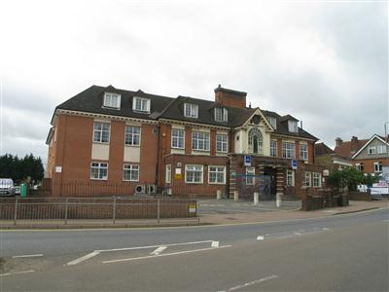
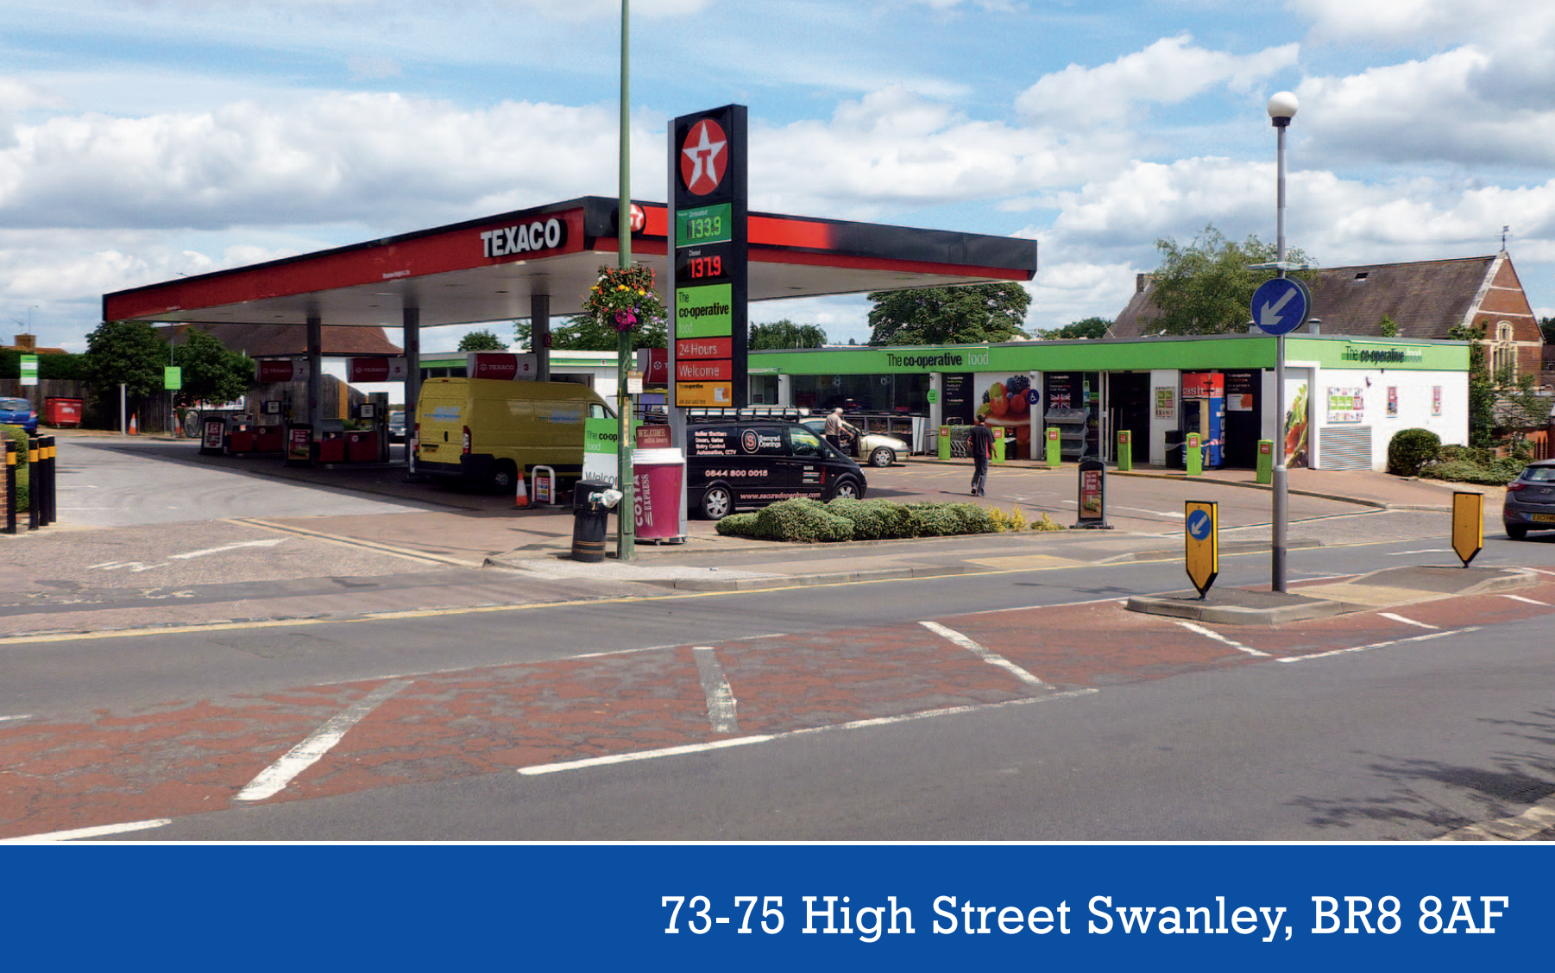
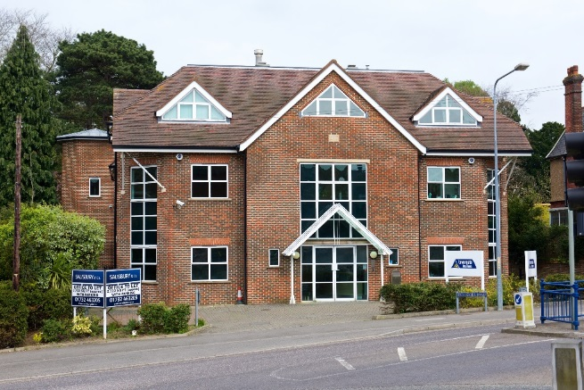
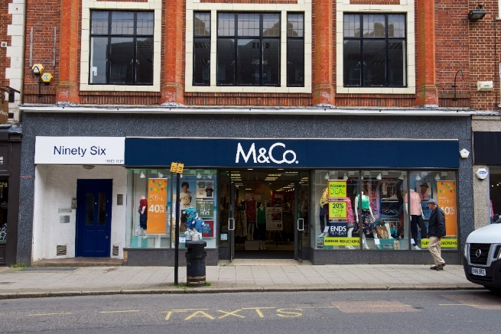
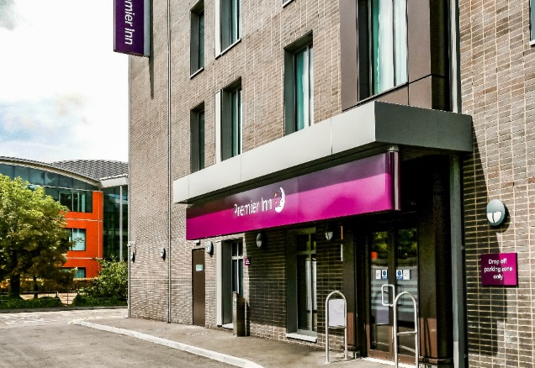
Commercial Investments – Sevenoaks

Slide 12
Commercial Investments – Sevenoaks
6 properties bought or built
2 require further development
£25m spent
£1.4m income
Quercus 7 Ltd
House, flats, industrial unit
£4m spent
£0.2m income (£0.1m interest to Council)

Slide 13
Commercial Activity – Nuneaton and Bedworth
Trading arm established in 2013 – Nuneaton and Bedworth Community Enterprises Ltd
Two business streams so far:
NABCEL Homes – purchase of residential properties on the open market and let at full market rent.
Council has purchased the properties (using New Homes Bonus) and leases them to NABCEL which brings in a revenue income stream.
Portfolio of 47 properties so far, mix of property types and locations
Minimum gross and net yield criteria – 5.5% and 4.5% respectively
Two B&B properties used for temporary accommodation

Slide 14
Commercial Activity – Nuneaton and Bedworth
NABCEL Gas
Gas servicing and maintenance of Council Housing Stock
New boiler installations
TECKAL contract
TUPE transfer from previous contractor
Benchmarked prices against Framework to ensure HRA was getting good VFM
Plans to offer the service to neighbouring local authorities and private customers (within 20% TECKAL limit).

Slide 15
Commercial Activity – Nuneaton and Bedworth
NABCEL Turnover in 2018/19 - £1.2m
Income to Council - £460k (mix of lease income, support services and dividends)
Estimated turnover in 2019/20 - £2.4m
Estimated income to Council in 2019/20 – approx. £600k

Slide 16
Commercial Activity – West Lindsey
Commercial Property (£20m)
Crematorium
Re-commissioned Leisure Services (required £7.4m investment)
Acquired Staffing Agency
Trade Waste
Commercial Loans

Slide 17
Lessons learned from commercial activity so far
Balancing political expectations – should Members be on the boards of trading arms?
Ethical issues and conflict of interests for the S151
Not every project will work!
Manage Member expectations and risk appetite
Balance need for certainty with commercial expediency
Understand your strengths and focus activity around those

Slide 18
LGA Resources
The LGA recognises commercial activity as an important development area
‘Profit with a Purpose: Delivering social value through commercial activity’ https://www.local.gov.uk/profit-purpose-delivering-social-value-through-commercial-activity
Commercial skills training

Slide 19
Future
New income stream ideas/different ways of working
Property acquisition restrictions
Changing funding sources
less reliance on PWLB?
Income strip funding?
Making better use of council covenants
Potential new projects may have greater risks as ‘low hanging fruit’ is delivered
Learning to be reliant on uncertain income

Slide 20
Knowledge sharing
Commercialisation register LGA/SDCT – sharing experience and supporting each other. There is a link to this on the SDCT website (www.cipfa.org/partners/society-of-district-council-treasurers) or search for SDCT.
Please complete the forms: information will be entered on the commercialisation register and an income stream ideas register. These will be circulated to Members and available on the SDCT website.

Slide 21
What SDCT can do for you
Specific advisor areas – details on our website
Responding to Government consultations
Representation on MHCLG/LGA Steering Groups
What would you like SDCT to do?
How best to communicate with our members?
Vacancies on the Executive

Slide 22
Questions?

