Slide 1
Society of District Council Treasurers Council Owned Companies: A District Council Perspective
14 July 2022

Slide 2
Chair
Adrian Rowbotham: SDCT Vice President and Sevenoaks DC
Panel
Louise Branford-White: Link Group and formerly Director of Finance at Hambleton District Council
Sandeep Bhakar: Knight Frank
Joanne Pitt: CIPFA Local Government Policy Manager

Slide 3
Society of District Council Treasurers
SDCT General Meeting, 16-17 March 2023 at Warwick University
SDCT Executive Members required. See for further details: https://www.cipfa.org/partners/society-of-district-council-treasurers

Slide 4
Council Owned Companies: A District Council perspective
Louise Branford-White I Hambleton District Council
Notes:
Introduction

Slide 5
Introduction
How District Councils’ relationships with companies can work
What went well
What was challenging and how was it Managed
Summary
TREASURY MANAGEMENT ORGANISES CASH IN RELATION TO POLICY
5

Slide 6
How District Councils’ relationships with companies can work
Council
Development Partner
Holding Company
Crematorium LLP
Prison Site JV
Property Company
Notes:
This slide shows the relationship between the Council and the Companies that it set up.
It is important to choose the right delivery model to achieve what the Council’s aims and objective actually are.
The Council formed the four companies for different projects:
JV company which was the regeneration of the former prison site - Central Northallerton Development Company Ltd
The JV partner brought expertise from the developer and skills that the council didn’t have – they closely monitored the contractors whilst on site and also did the private sector accounts
The Council ensured that the historic grade II listed buildings were developed- the council kept control of the outcome
2. The holding company and Property Company – Hambleton district Holdings Ltd and Hambleton property Ltd
Were created to invest in property to generate income to support the Councils financial position due to the continued decrease in funding from Government
The holding company was created so that if further Ltd companies were required by the Council then potentially costs and income to be netted against each other to redce the cost of the tax implication.
3. Crematorium
The crematorium company was set up as a Limited Liability Partnership took Tax advice in relation to VAT for this operating model and the partial exemption requirements on exempt supplies. This resulted in the building of the crematorium in the council , leasing the building and operating it through the Limited Liability Partnership. Advice was taken from tax advisers (PWC)

Slide 7
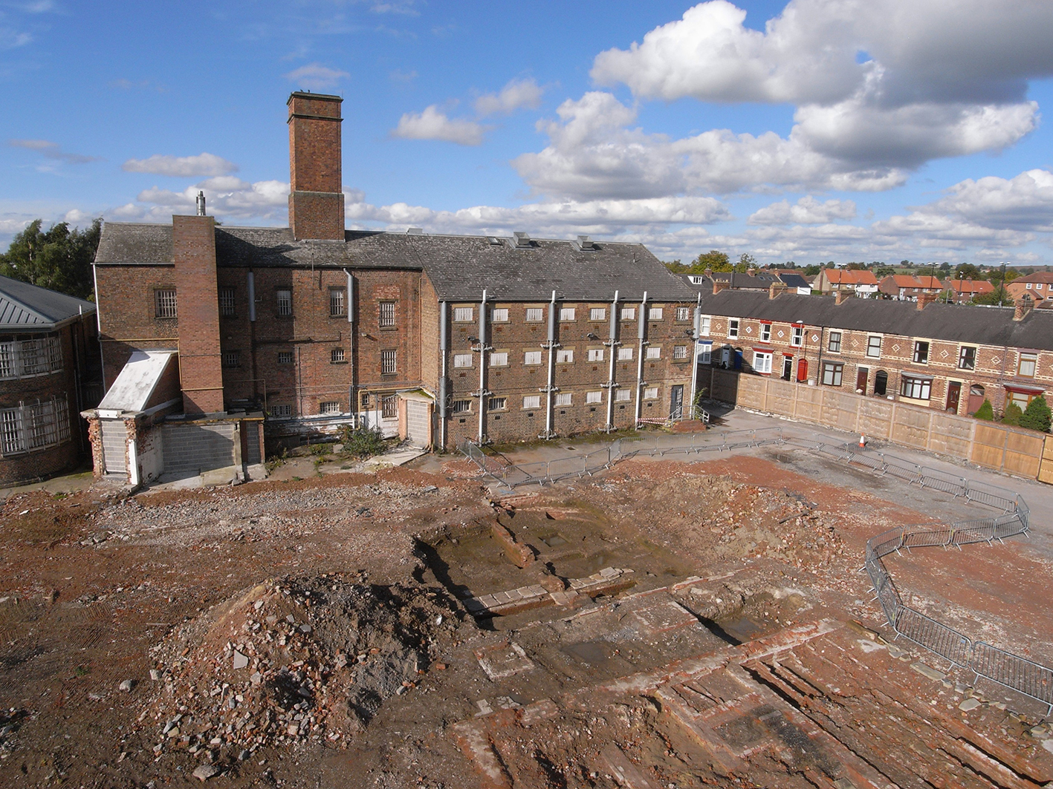
Prison Site - before

Slide 8
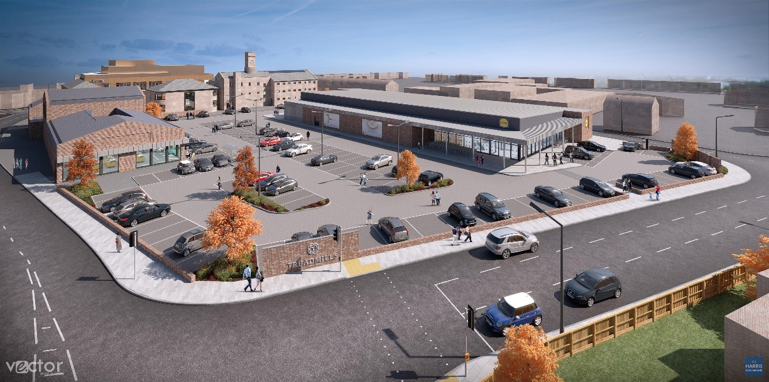
Prison Site - after
Notes:
Prison Site

Slide 9
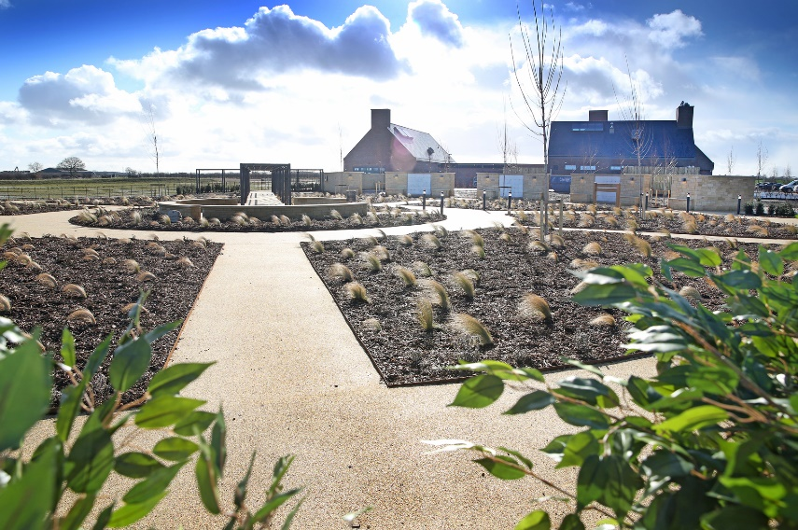
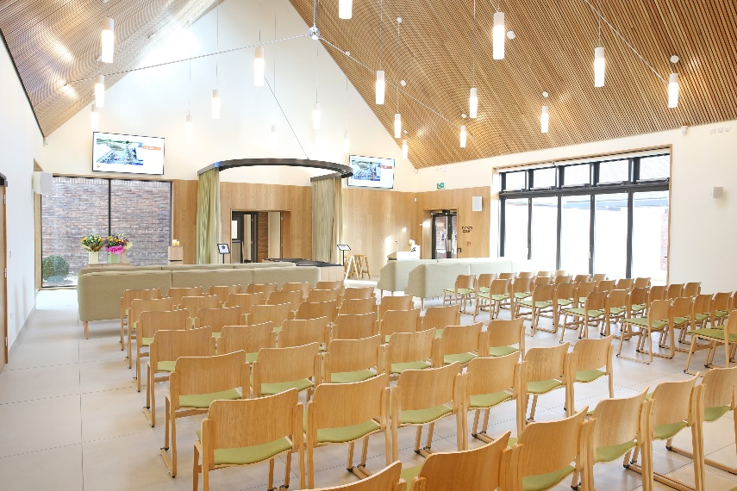
Crematorium Site
Notes:
Crematorium Site

Slide 10
How District Councils’ relationships with companies can work
Reason / Purpose
Costs / Efficiencies
Scrutiny
10
Notes:
How District Councils relationships with companies can work
Make sure you know why you are forming it – can you do it in house – what is the purpose – does it fit within regulations and legislation
- Localism Act 2011 and s1-4 are useful to consider, along with MRP
Make sure you understand the costs (LATER in challenges) and the efficiencies that can be obtained from not being developed in the council – great example is the crematorium as described so didn’t get caught in partial exemption limits
Scrutiny and transparency are really important……………….Made sure the Council’s Auditors understood what the Council's plans were, we passed them sight of financial models so they could understand before year end. Made sure Members were engaged - Quarterly capital and treasury management reports updated Members as to the position of all the four companies so they had information available in the public domain and could ask for scrutiny sessions if required. Reports were written on individual projects e.g. for the Property Investment Company explain why in September 2019 the Council believed that it was in line with the Prudential code, but also gave alternative views which is in the public domain – thais was at a time when there were mixed views as to if commercial investment should occur and outside of the borough. Quarter explained that for example for the property company it was on in line with the prudential code but the reports showed that there was alternative views

Slide 11
What went well
Building of finance models
External advice
Communication
Governance arrangements
Monitoring costs
Transparency / Reporting
Understanding regulations
Risk register
Notes:
Understanding you costs leads on to what went well:
Building of the finance model – Completed this for all three scenarios to understand that projects were affordable / sustainable and prudent.
For the JV prison site –
For all three we created cashflow models for the Prison site JV over 50 years to ensure that the income received would repay the interest and MRP on an annual basis
For the crematorium – created a cashflow model to see borrowing repaid over the shortest time period as a result of income form cremations and also over the life of the asset – out to 40 years.
For the property over a 10 year life for the modelling that capital receipts would be received at the end of the 10 years to repay the borrowing (of which I will revert to this when speaking of challenges)
Also modelled up the final accounts position for the operation of the crematorium and implications around VAT for SLA agreements and modelled the accounting treatment for the property company for the Property company under FRS102, the holding any and for the council – also consider the Group Account position.
Understanding regulations – Localism Act 2011 ss1-4, private companies - commercial interest rates, to charge on loans between the Council and the companies, understand State Aid / Subsidy Control, the MRP regulations and the ability to borrow from the PWLB (which I’ll revert to in Challenges) accounting treatment, transfer of land s123 LG Act 1972
level of MRP to charge in the Councils accounts how is the loan to be returned, form capital receipts?
VERY Topical at the moment with the DLUHC consultation on MRP finished last week - Implication of the new consultation for DLUHC – looks like current relationship are ok, for a specific purpose – housing regeneration. Focusing on commercial need to charge MRP.
Governance Arrangements –control and oversight from the Council – define roles and responsibilities – enables people to be held to account.
The JV company had clear reporting guidelines, e.g. The Leader could not sit on the company hence the Deputy Leader did and the the Deputy Chief Exec made decision with the Leader at Council , rather than the chief exec who was on the board.
The operation of the crem again had segregation of duties with different officers and Members sitting on the LLP and the holding company.
All had and knew what they could authorise at what levels.
Transparency / Reporting – (i) for the prison site -
Transparency – code of ethics – financial reporting / narrative scrutiny / audit – run things by your auditors
Talked about Transparency and reporting on the previous slide in relation to clear information for scutiny
Communication – (i) all tendering process went into the public domain in line with the council’s procurement regulations.
(ii) Excellent communication between Finance / legal and the project manager for the crematorium as well as the prison site development
(iii) Good external relationships developed –with contractors, developers, stakeholders – regular flyers, news letter , consultation session on the crem site and prison site, 4 months tour of the prison site by volunteers and archaeology opportunity
External advice – Taken different types of advice for specific purposes e.g. legal – Localism Act 2011 S1-4 the power to form the companies
for the prison site - Took advice at the outset of the project for legal set up – they supported us in the tendering and competitive dialogue process.
development,
Treasury management advisors – Link – to have discussions around ACCOUNTING TREATMENT. Specifically for the JV company and the transfer of the land where no money exchanged hands, deferred capital receipts
Property Company we took – tax advice and for the crematorium took VAT advice (VAT as already explained and also corporation tax advice for the property company) – also used the relationship wit the councils.
Monitoring costs – Treadmills quantity surveyor close working relationships with the council and
The accounts were prepared by Wykeland, the developer partner, but there was the ned fr close monitoring. External funding and borrowing supported the project from the Council’s capital programme and therefore the refection in the council’s acounts had to agree / match with JV accounts.
Close working relationships between Finance at HDC and Finance at Wykeland over came the difficulties and we worked well as a team

Slide 12
What was Challenging and How was this Managed
Increasing costs of the project
Appointing the right contractor
Due diligence
Meetings and who should attend
Volume of work
Notes:
Increasing costs of the project –
Hidden costs / competitive dialogue process – took a over a year / increase in legal fees. BUT the developer paid half those fees.
Income form the site covers the borrowing and MRP costs and results in a small surplus.
No longer proceed - (Did have a reserve approved by members for development by member for The property company had incurred set up cost when in March 2020 the PWLB brought out eh consultation that suggested that if borrowing occurred for a commercial purpose then further borrowing form the PWLB for council services would not be possible.
The property company did not continue – communication was key with those contracts that were held, and also with members. The report describes in September 2020 that it was no longer viable due to market conditions due to covid along with Consultation from PWLB.
Good communication with members and the working relationship between Members, Officers and the developer
(ii) appointing the right contractor / Investment Manager / developer - -
unforeseen costs – CREMATORIUM - waterlogged site - who picks up the cost Council or the contractor – negotiation – council legal contracts in a strong position
Good relationship with the contractor – regular weekly meetings on iste – employed external support on the unforeseen costs – waterlogged site (DD done sufficiently) who picks up the cost Council or the contractor – negotiation – council legal contracts in a strong positional crem build – this relationship was invaluable
, good support network – and with Wilmot Dixon
(iii) due diligence – Prison site – appointing the contractor - Press cutting – HH – appointed Moody’s a local developer for phase 1, Phase 2 and an alternative for phase 3 but due to Covid liquidations, so retendered and only a few weeks that held up the development – went with Moodys – Press article
(iv) Meetings and who should attend – Although the governance structure were set up, for te JV company in the first few months the board 2 form the developer and chief exec / deputy leader form the Council – decisions were being made that were nit passed down and across ot the developer form officer. The solution was increased communication and the dveleopr was invited to the council operational meetigs – this improved the position
(v) – Volume of Work –(A) General increased in work load an covid, it was difficult to ensure on top of everything all teh time – report in quaryrely bases helped to ensure we were
(B)Difficulty employing the crematorium mamager and assitsnace – put pressure on time takes to recruit – spread reesponsibilities wider round the Council and employed facilities manger and trained them up – Crematorium open in March 2022 – recent quote from the Project manger an commercial Head fo Drvice ‘super proud’
(c)

Slide 13
Summary
Purpose / Structure
Communication
Governance – due diligence / monitoring
13
Notes:
Learning (i) Purpose / structure – know why you want a company – it achieves the objectives- use the right delivery models which provide the right outcomes
(ii) Communication is key ––– internal at all levels– individually, project management teams, management team services, Members, Council,
External – developers / contractors / external advice AS WELL AS external stakeholder s- users of the site /locals that it impacts / partners- ensure there is engagement
Governance arrangements – good GA make all the difference with efficient control and operation, oversight from the Council – define roles and responsibilities – enables people to be held to account, this along with Due diligence (do your research up front of partners / contractors / developers be aware of what the company you are creating is engaging with) and Monitoring – continually be aware of the financial position and other indicators to know your business is going in the right direction to be successful , transparent and in the public domain and FINALLY

Slide 14
CIPFA Conference
Comparison of delivery structures in regional development

Slide 15
Introduction
Sandeep is a Partner at Knight Frank’s Public Sector Advisory. He is a chartered accountant and financial advisor. His experience covers working with client to establish project protocols (governance, reporting, risk reporting & management), advising on commercial delivery, funding solutions and taxation advice, building financial models, has run the procurement process for partner selection on several large scale residential and commercial developments.
Sandeep is contributor to the trade press, including a recent report published by London First that comments on the appropriateness of various forms of development partnerships.

Slide 16
Delivery Structures
Delivery Structures:
In-House
Wholly Owned Company (WOC)
Joint Venture (JV)
Development Corporation (Dev Corp)
High
Development Corporation
Joint Venture
Scale of investment
Wholly Owned Company
In-house/Council led structure
Low
High
Complexity

Slide 17
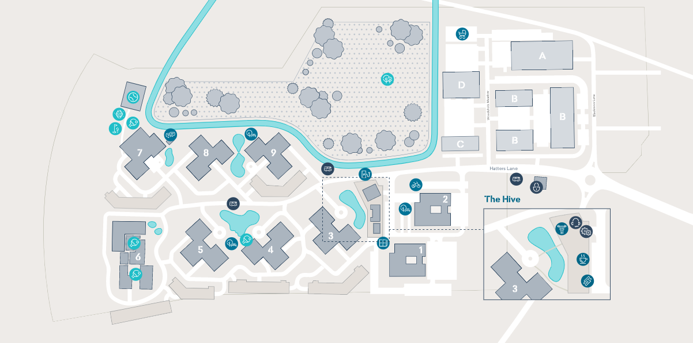
Lease Finance – Watford BC, Croxley Park
Key features
Set in green parkland of 75 acres, Croxley Park is primarily a business community for over 2,400 employees.
As well as providing a wide offering of office space, Croxley Park hosts a number of amenities which can be used by its occupiers, primarily located within the 10,000 sq. ft Hive building, which holds a gym, café and events space.

Slide 18
Head Lease
Council
Institutional Funding
Lease from Fund to Council at PC
Sub-lease
Funding
Tenants
Developer
Asset Manager
Key considerations
Council transaction to support economic development
Negotiate Top-Up fund to share investment value created.
Council can achieve a profit rent.
Council can obtain asset at the end of the lease term for a small nominal sum.
Due diligence on tenants

Slide 19
Summary of Delivery Structures
Factor | In-House | WOC | JV | Development Corporation
Structure | n/a. | Typically a company limited by shares (CLS)c. | CLS or limited liability partnership (LLP). | Statutory Vehicle.
Funding | Typically, Council on-lends PWLB. Options for 3rd party funding. | Typically, Council on-lends PWLB and provides equity as share capital. Options for 3rd party funding. | Typically the Council invests its equity through land contributions. Private sector partner provides cash equity. Once suitable equity contributions are invested, the JV raises senior debt against the capital and reserves held by the JV. | Central government grant and loans. Options for 3rd party funding. Council borrowing.
Control | High. | High given the Council owns all of the share capital. | Medium assuming a 50:50 agreement is in place where neither partner has the ability enforce its own preferred decisions. | High level of control as locally-led. Enhanced CPO powers
Risk | High given the Council cannot offset risk. | High given the Council owns all of the share capital and act as a developer. | Medium – shared with partner. | Medium risk as a statutory vehicle governed by the UK government.
Return | Takes 100% of returns generated. | Takes 100% of profits generated. | Typically shares profit 50:50 with partner. | Local authority generates long-term return through investment into a region.
Resourcing | Reliant on Council resourcing and experience. | Reliant on Council resourcing and experience or will need to buy in services. | Levers development experience of partner. | Expert resource required e.g. Oversight Board to govern the vehicle.

Slide 20
Local Authority Owned Companies – A good practice guide
SDCT Presentation PF Live
July 2022
Joanne Pitt Local Government Policy Manager

Slide 21
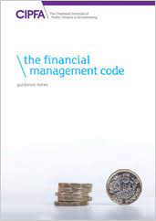
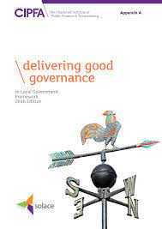
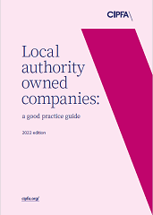
Drivers for guidance
Recognition of the increasing risks to local authorities and sector
Complimentary to CIPFA’s Codes and Guidance
Financial Management Code
CIPFA / SOLACE Framework
Builds on the lessons learnt
Stakeholder conversations
CIPFA’s consultant experiences
Written research

Slide 22
Starting point
Many local authority trading companies are successful:
Contributing to the local authority
Creating opportunities for local employment.
Creating and delivering real social value.
Aligned to local authority corporate objectives.
But, the sector has seen failures
Guidance and lessons learnt brought together in one place

Slide 23
Common causes of failure
No common understanding of what “being commercial” means.
Weak options appraisal - rationale for creation is poor – optimism bias.
Lack of alignment with local authority’s objectives – divergent thinking.
Not identifying / clarifying what the desired outcomes are.
Lack of formal or inconsistent set-up procedures– can lead to poor decisions re structural model chosen.
Weak scrutiny and challenge - ineffective company boards.
Unclear legal control framework – shareholder/service agreements.
Poor market knowledge – buyer behaviour/ competitors not understood.
Business plans - not up-to-date or simply don’t exist, costs of delivery not transparent.

Slide 24
Key messages from our interviews
Balance
Freedom to deliver vs sufficient oversight
Relationships
Channels of communication and conversation
Right delivery model
Look at everything else first before you decide
Consultation
Bring people with you - get them involved
Expertise and advice
You can’t know everything - you will need support
Roles and responsibilities
Be clear on your legal obligations

Slide 25
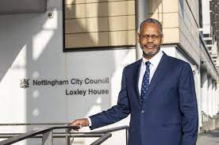
Example from Nottingham City Council - the challenge
A high profile corporate failure revealed shortfalls against “What good looks like”.
Companies had accumulated over time, rationale ranged from supplier of last resort to pursuit of innovation/ strategic outcomes.
Some established with clear rationale and business cases, others in need of confirmation - purpose and value still relevant?
Absence of a consistent approach
Embedding good governance

Slide 26
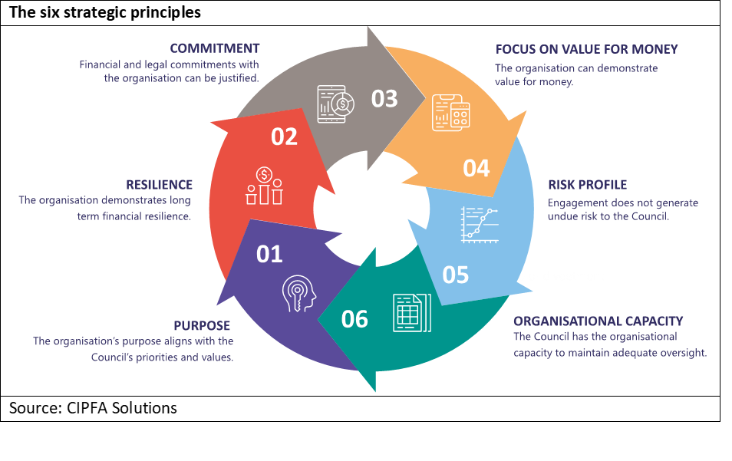
Consistency of approach

Slide 27
Embedding good governance
Doing the boring stuff, and doing it well!
Not valued until it goes wrong
Addressing the PIR & non statutory review learn lessons
CIPFA guidance also LLG and LP
Initial decision making and business case
Formal roles and responsibilities
Monthly financial and performance monitoring
Directors and board effectiveness
Use of reviews

Slide 28
Wiltshire County Council example - Internal Review
Methodology
The Director of Legal & Governance, conducted an initial review using :
the information provided to the Cabinet about the performance of the Stone Circle companies
the information available in the Stone Circle SharePoint site
Consulted with the Leader and Deputy Leader, the Chief Executive, Director for Housing & Commercial, colleagues from Legal Services who provide the company secretary role and legal advice to the companies.
Considered some academic literature and other best practice information
The Corporate Director of Resources and Deputy Chief Executive and the Director of Legal & Governance then collaborated in the completion of the review to provide observations and recommendations to Cabinet

Slide 29
What good looks like
GOVERNANCE
CLEAR STRATEGY
Appointing the right people to boards
Shareholder Reps
Non-Executive Directors
Role of MO and Scrutiny
Commercial design principles
Commercial Strategy
Alignment to Corporate Strategy/Council Plan
QUALIFICATION
Open and transparent, Project Brief, Business Case
Passes the “challenge” test: internal/external
Solid, referencable market research
Based on sound financial modelling
REALISM
Creating companies is not a quick fix
for solving other problems in a council
Setting realistic outcomes
CULTURE
EXIT PLAN
Communicating key messages
Measuring behavioral change
Checking on who has had the “conversion” experience
Understanding what the end point looks like
What will it cost?
Can we terminate early?

Slide 30
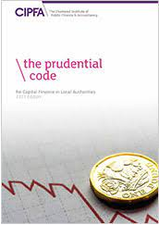
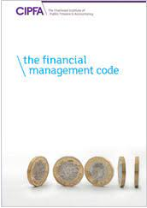
Further help/Questions

Slide 31
Questions and answers

Slide 32
Thank you for attending reminder:
SDCT General Meeting, 16-17 March 2023 at Warwick University
SDCT Executive Members required. See for further details: https://www.cipfa.org/partners/society-of-district-council-treasurers

