Slide 1

CIPFA Professional Update
Society of District Council Treasurers AGM January 2019
Don Peebles
Head of CIPFA Policy & Technical UK

Slide 2

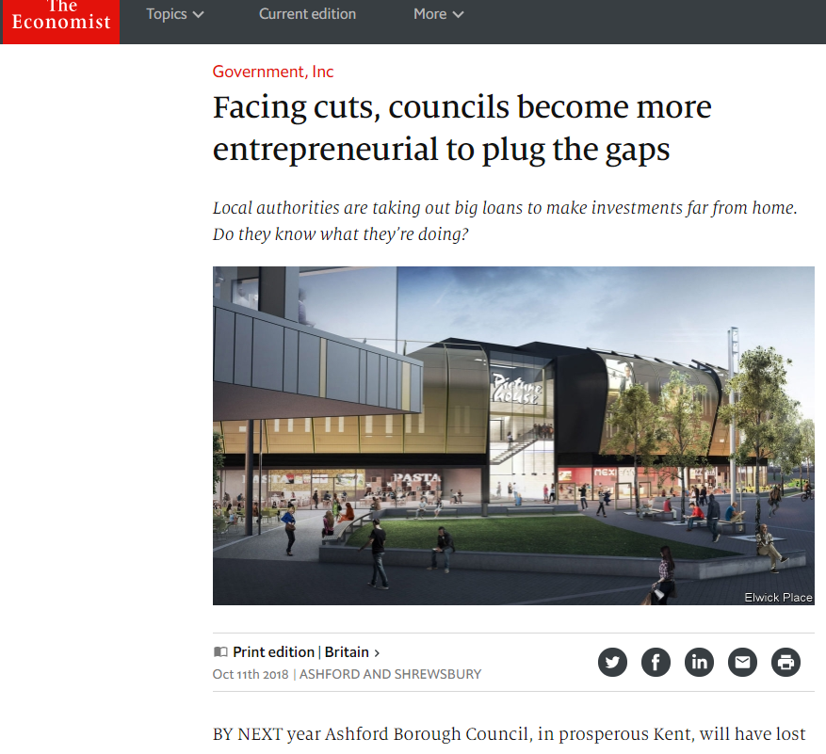
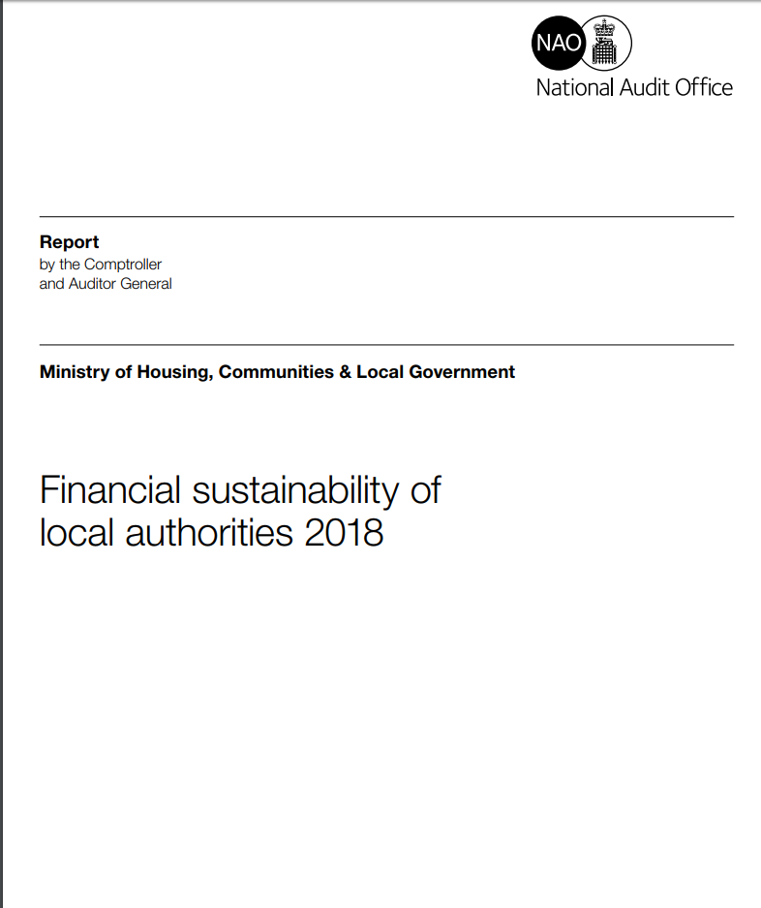



2018 in Financial Headlines

Slide 3
CIPFA Professional Update
Ethics and You (in 2019)
Financial Resilience
Borrowing for Commercial Investment
&
The New Financial Management Code

Slide 10
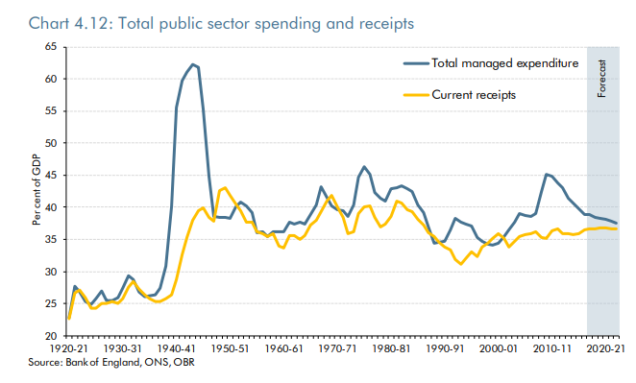
Successive governments have not been able to raise the taxation necessary to balance the budget
Public expenditure
increased from the
mid-1950s to the late
1970s from c36 per
cent of
GDP to 43-45
per cent
Current receipts
have not been
above 37% of GDP
since 1989-90
Source: OBR

Slide 11
CIPFA’s Resilience Index
Our intention was to provide a tool that supports councils in making decisions
Proposal for a resilience index
  Single composite index with components
  Excel tool with colour coding
Range of consultation questions
  Nature of indicators?
  What is missing?
  Presentation?

Slide 12
The response to Consultation
189 responses in total
Type of Authority | Frequency | Base
District Council | 59 | 203
Metropolitan District | 26 | 36
County Council | 21 | 27
English Unitary | 21 | 66
Special Interest Group | 10 | ..
Commercial | 9 | ..
Outer London | 9 | 23
Private Individual | 9 | ..
Inner London | 8 | 14
Police | 7 | 44
Auditing Body | 2 | 11
Welsh Unitary | 2 | 22
Combined Authority | 1 | ..
University | 1 | ..
Total | 155* | 446
Table shows only those who completed the web form

Slide 13
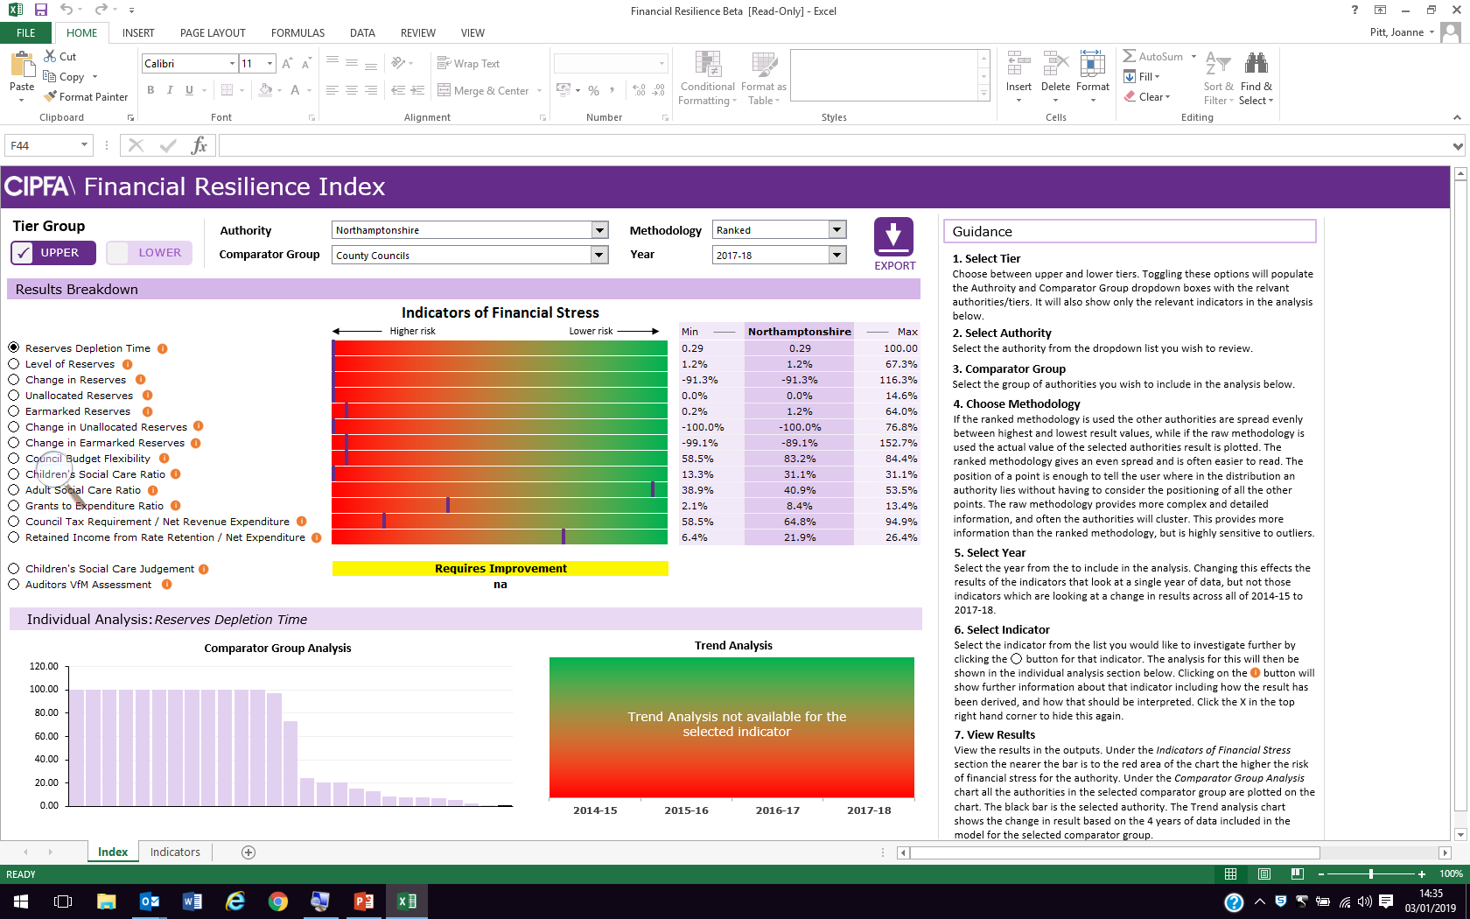

Slide 14
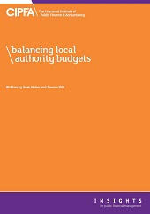
Looking Ahead
  CIPFA remains committed to the provision of transparent publicly available information
  Engagement and consultation with the sector
  Workshop(s) in the spring
  Model now distributed to D of F’s
  Feedback

Slide 15
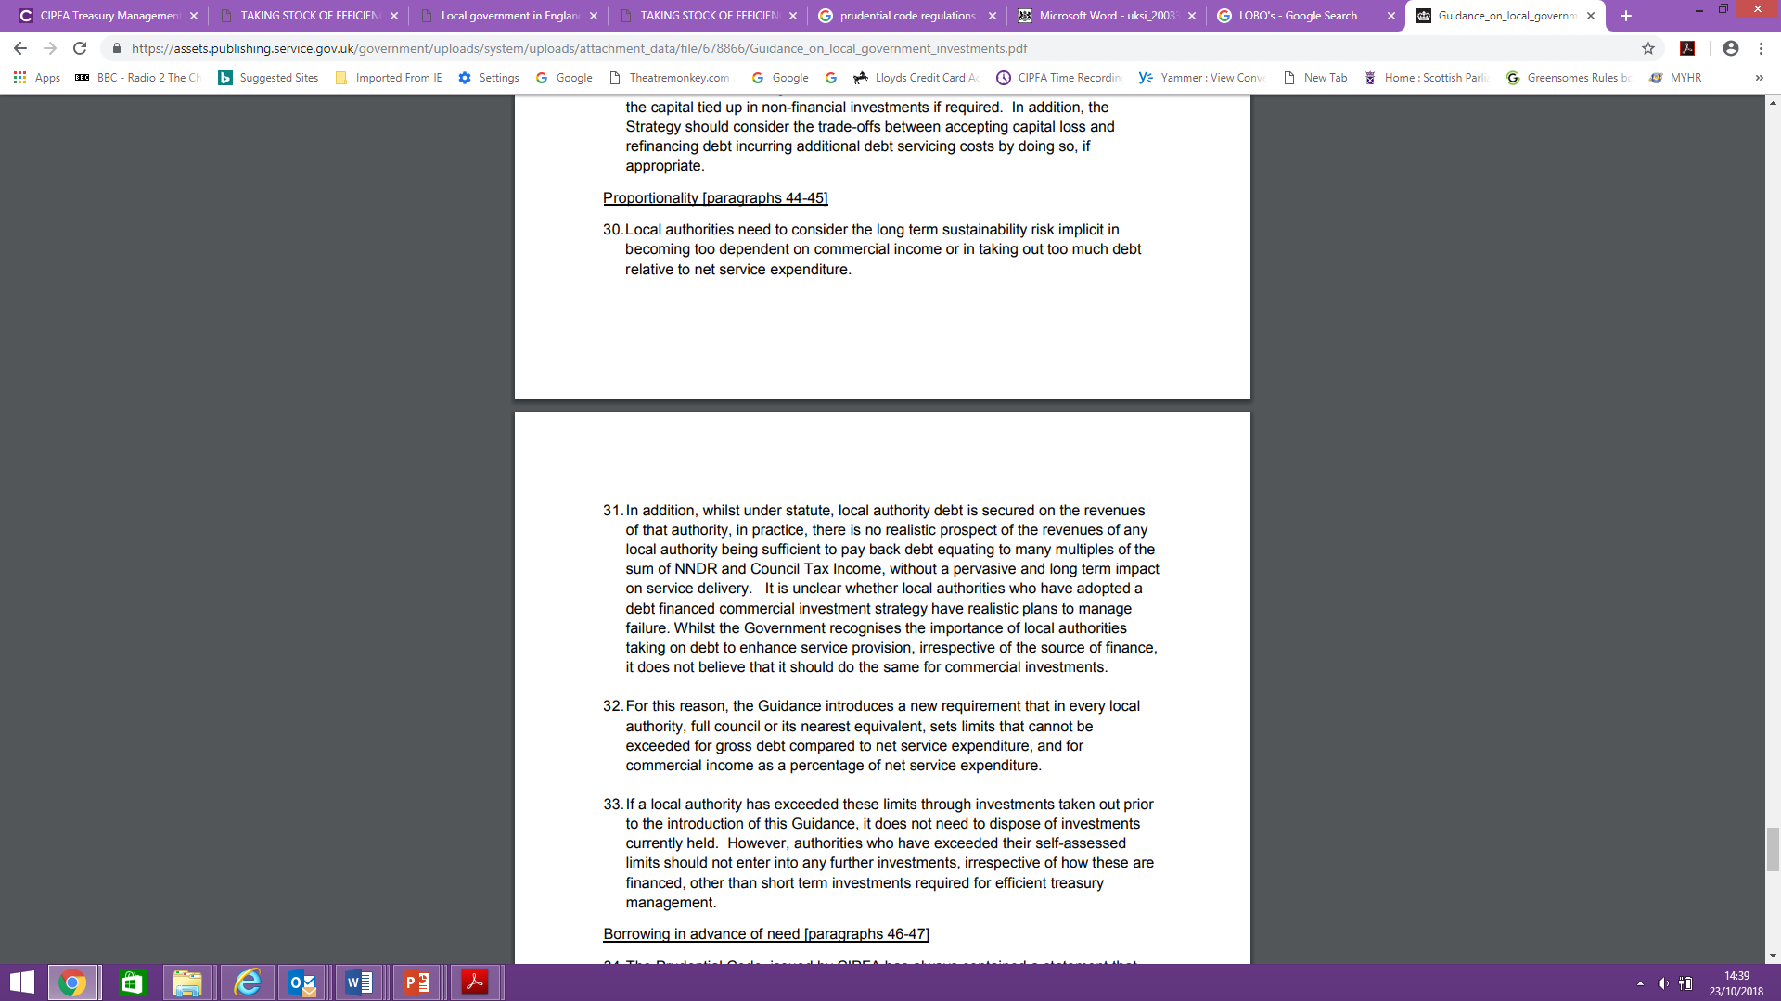
Statutory Guidance on Local Government Investments - Extracts

Slide 16
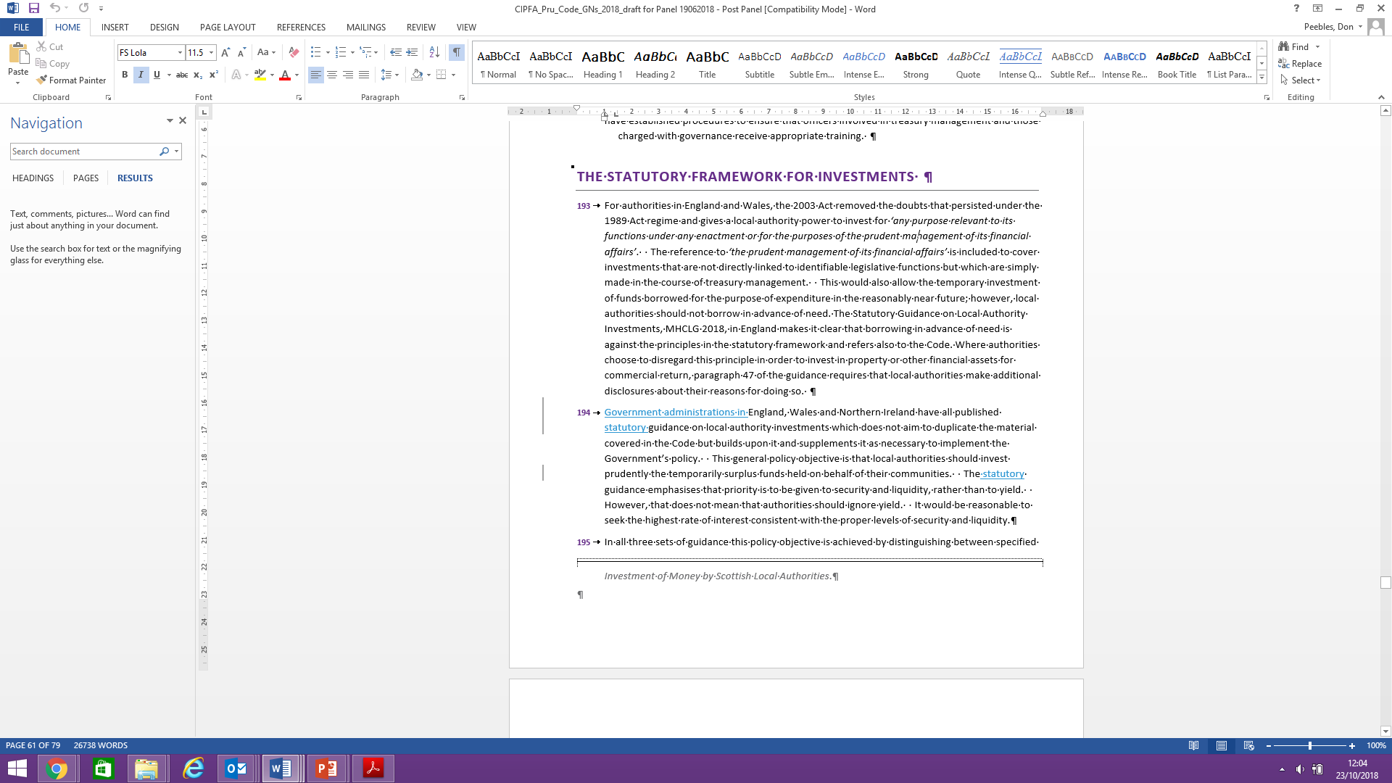
Borrowing for Commercial Investments

Slide 17
… Linking to The Capital Strategy
Extract from The Prudential Code:
‘high level overview’
‘how ..risk managed’
‘Implications for future sustainability’

Slide 18
The Capital Strategy – Building Blocks
Capital Expenditure
Governance
Long term plans
Asset management planning
Restrictions around funds
Investments and liabilities (risks)
Approach, due diligence, risk appetite
Governance process for approval and monitoring
Summary of material investments, guarantees and liabilities
Treasury Management
Governance
Long term planning inc. MRP
Risk appetite, key risks and sensitivities
Skills and knowledge
Copyright © CIPFA 2018 protected under UK and international law.

Slide 19

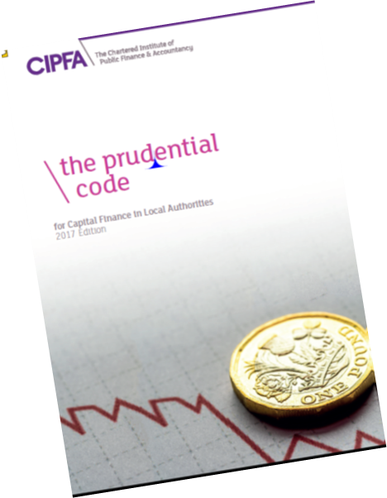
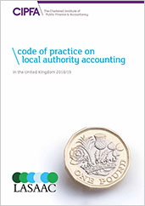
CIPFA’s Professional Code Hierarchy & Index
Professional Proper Practice
Primary/Secondary Legislation
Good Practice
CODE OF FINANCIAL
MANAGEMENT
---------

Slide 20
The Code: The Timeline
Stake holder group to agree content and terms of reference | July 2018
Research, recommendations on chapters content initial draft | October 2018
Stake holder ‘road’ test | December 2018 – January 2019
Consultation on Draft Code | ‘Early’ 2019
Code ‘Franked’ by CIPFA | July 2019
Code Publication | September 2019

Slide 21
The Code Hierarchy
Principles
Financial Management
Standards
Statements of Standard Practice

Slide 22
The CIPFA Principles of Good Financial Management - Expanded

Slide 24
The CIPFA FM Code Structure

Slide 25
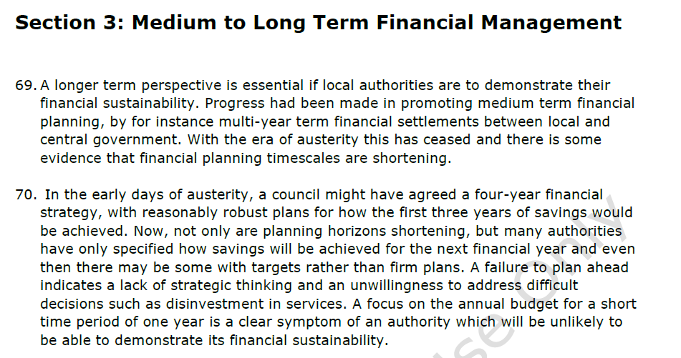
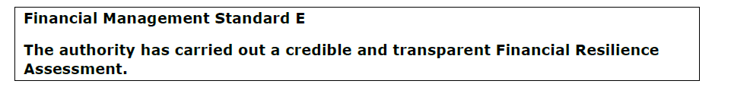
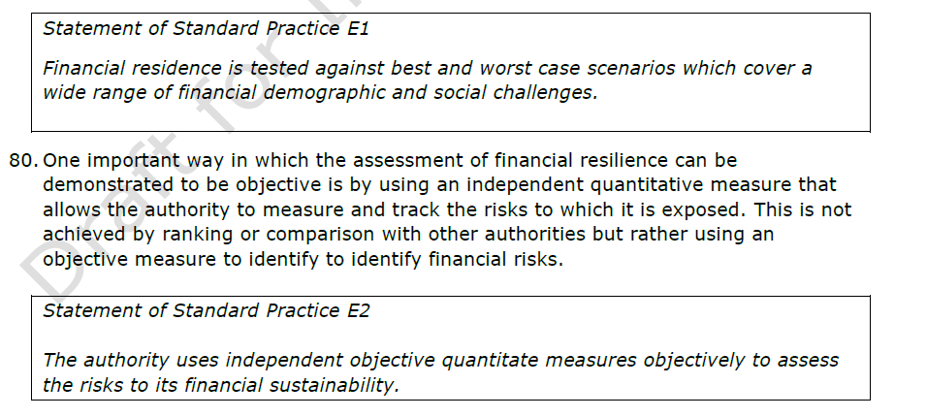
Principles
FM
Standards
Statements of Standard Practice

Slide 26
Coming in 2019
(Additional) Guidance on Borrowing
CIPFA will set financial management standards – The FM Code
Publication of the Resilience Index
And ………………………………….

Slide 27
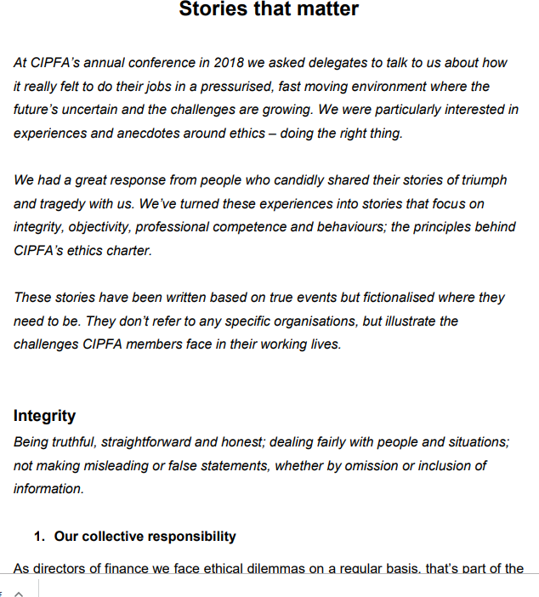
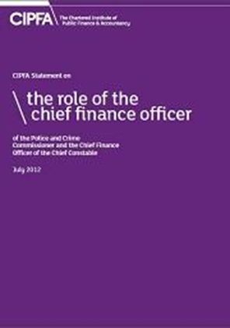
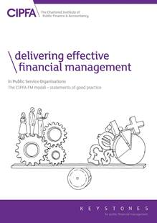
ongoing support
(2018)
Ethics and you (2018)
CIPFA’s ethical helpline: ethics@cipfa.org

