Slide 1

NAO update
December 2021

Slide 2
Recently published work

Slide 3
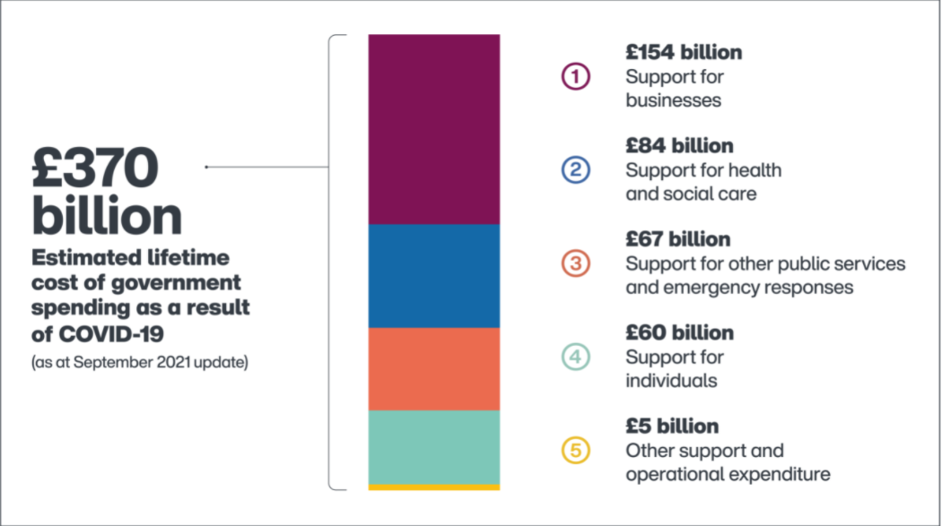
Covid-19 cost tracker
Interactive tool that brings together data from across the UK government.
Based on measures announced since February 2020 and on or before 31 July 2021
Provides estimates of the cost of measures announced in response to the COVID-19 pandemic and how much the government has spent on these measures so far

Slide 4
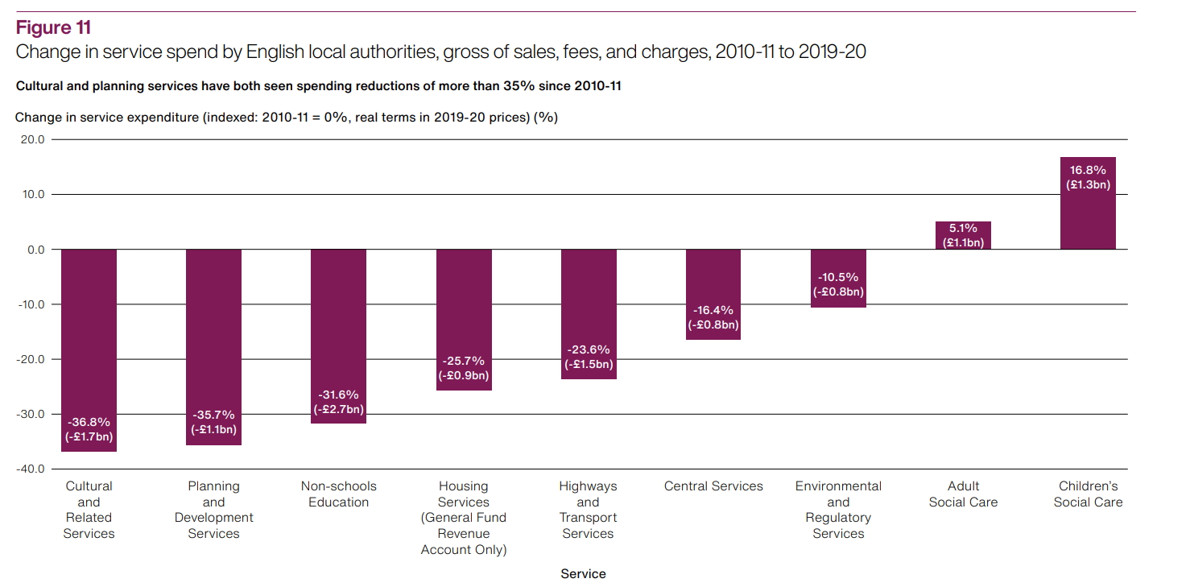
The local government finance system in England: overview and challenges
Based on our back catalogue of local government finance work, including data visualisation
Graphics and data rich rather than VFM-style output
Three parts:
  Local government spending and income 2019-20
  Developments in local government finance policy since 2010
  Impact on local government finance
PAC session with DLUHC and HMT focused on ongoing risks to local authorities financial sustainability, sufficiency of SR announcements, service pressures, uncertainty of major reforms and DLUHC oversight

Slide 5
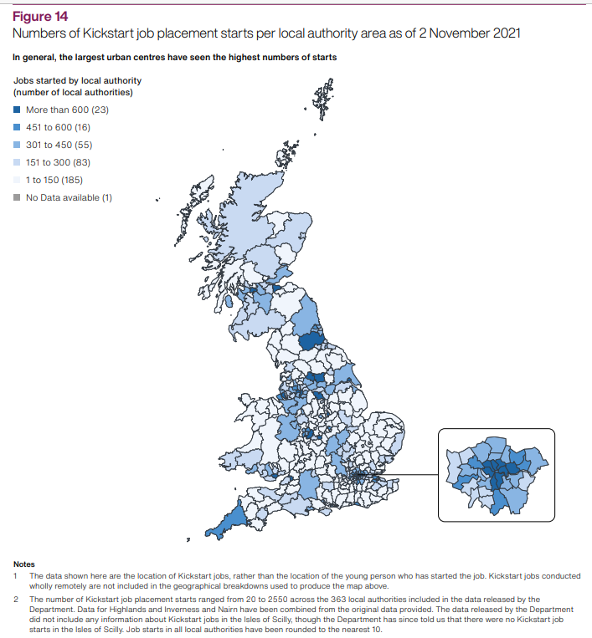
Employment support: The Kickstart Scheme
.. At the start of the pandemic, DWP acted quickly to set up Kickstart…However, DWP has limited assurance that Kickstart is having the positive impact intended. It does not know whether the jobs created are of high quality or whether they would have existed without the scheme. It could also do more to ensure the scheme is targeted at those who need it the most
National Audit Office, November 2021
Note difference in administration with DWP taking this on whereas Future Jobs Fund administered by local authorities – note concerns about LA capacity, so DWP needed to build systems from scratch
Developed at pace so could not trial changes to the FJF blueprint before implementation
Delay to DWP providing local data on numbers and locations of Kickstart employers and participations

Slide 6
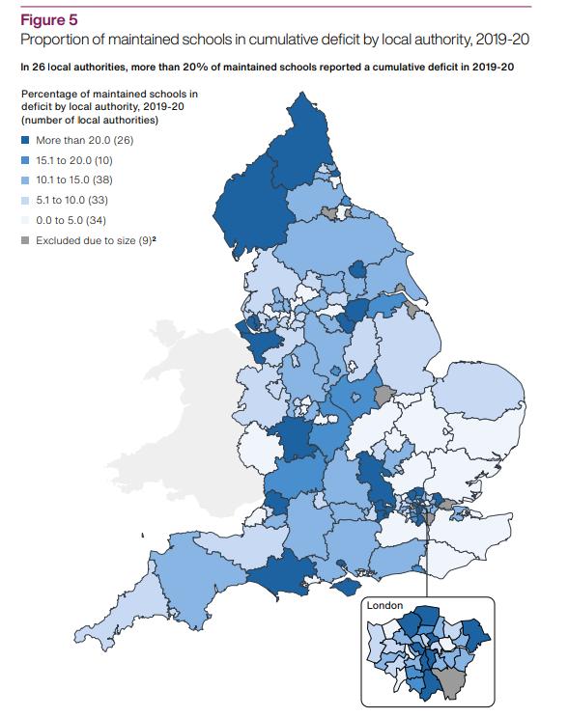
Financial sustainability of schools in England
.. The Department for Education implemented a range of sensible programmes in recent years that have helped schools to achieve savings. However, until it improves the reliability of its data, it will not be able to make fully informed decisions about the support it offers to schools.”
National Audit Office, November 2021
Proportion of maintained schools in cumulative deficit ranged from 0% (in 14 authorities) to 46% in 2019-20.
26 local authorities with more than 20% of their schools in deficit- note no link found between deprivation levels and schools in deficit
Net balance for dedicated schools grant in 2019-20 was a deficit of £484 million (95 authorities in deficit)
125 of 149 authorities overspent high-needs budgets (net overspend of £385m) compared with 80 of 150 in 2014-15

Slide 7
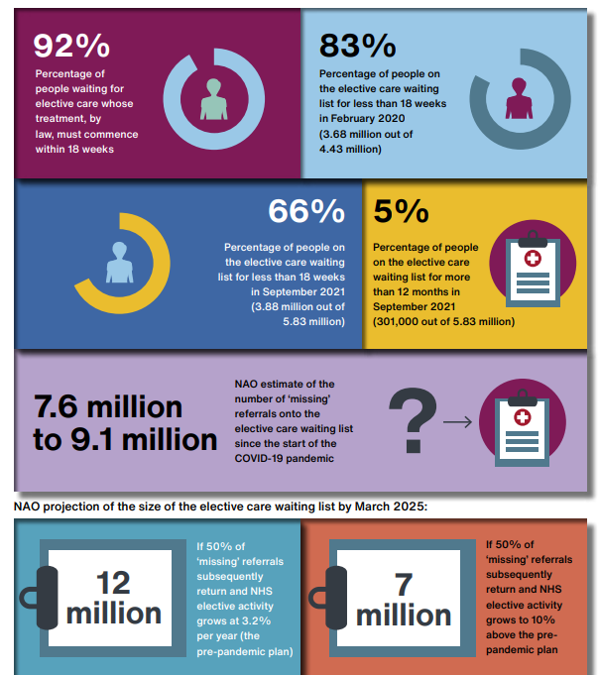
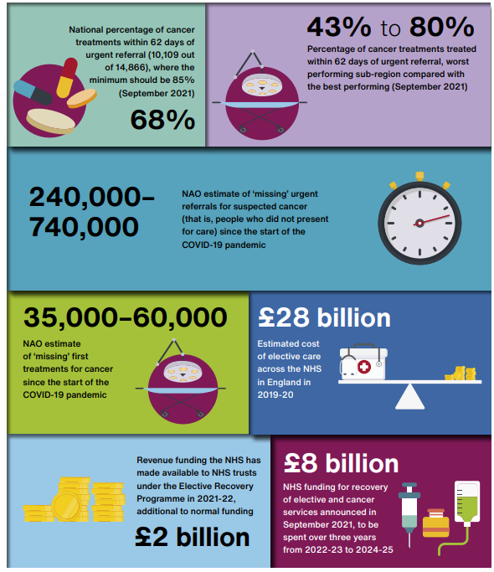
NHS backlogs and hospital waiting times

Slide 8
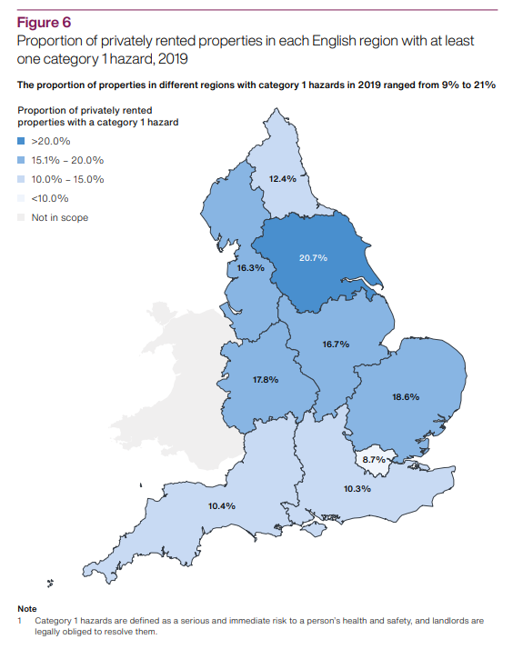
Regulation of private renting
.. The Department is not proactive in supporting local authorities to regulate effectively. Furthermore, it does not yet have a plan to improve the significant gaps in data that prevent it from identifying where problems are occurring, which regulatory approaches work well at a local level, or the impact of regulation on the vulnerable.
National Audit Office, December 2021
Considerable variation in approaches and regulatory activity – some inspect almost no properties while others inspect a large proportion of the market
65 of 308 authorities license more properties than the minimum requirement
Data limitations – no robust data on regulatory approaches, limited data on property conditions held by DLUHC, landlord population analysis not given to LAs
LAs called for more support and best practice sharing

Slide 9
BEIS Annual Report and Accounts
Qualified audit opinion because of material levels of fraud and error in the COVID-19 business loan scheme guarantees and COVID-19 business support grants
At 31 March 2021, the Department estimates £18.9 billion of the £21.8 billion noted above had been paid out to support businesses by local authorities
The Department has estimated that material levels of fraud and error are present in the payments made to businesses by local authorities on behalf of the Department
The Department wanted local authorities to make payments quickly to provide rapid support to businesses but recognised the risks in working at pace to value for money and that grants might be paid in error. In March 2020, the Department’s Accounting Officer sought and obtained Ministerial Directions to proceed with the introduction of the SBGF and RHLGF schemes as a result of these risks
The Department intends to conclude its assurance testing for all business support grant schemes by Spring 2022 to support local authorities in undertaking their own work to identify irregular payments
The work will also support the Department’s efforts to work with local authorities on the recovery of grant payments made as a result of fraud or error

Slide 10
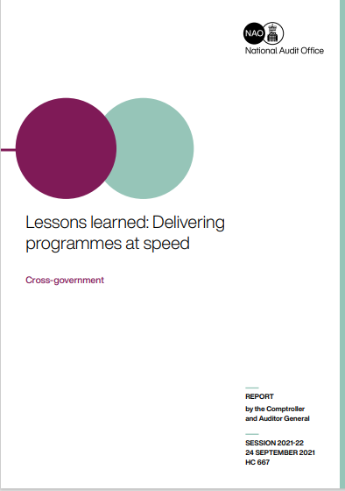

Good practice guides
Lessons learned: Delivering programmes at speed (nao.org.uk)
Cyber and information security (nao.org.uk)

Slide 11
Work in progress

Slide 12
Supporting local economic growth
VFM study publishing January 2022
Examines measures for supporting local growth in SR20 and 2021 Budget
Considers how well government has learned and applied lessons from previous local growth programmes. It will examine:
    whether government understands what has been effective in supporting local economic growth;
    whether current plans for supporting local economic recovery apply lessons learned from previous programmes; and
    whether government is putting in place effective plans for monitoring, overseeing and evaluating its new local growth interventions

Slide 13
The roll out of the COVID-19 vaccine in England
VFM study publishing in January 2022
Follows on from vaccines investigation published in December 2020
It examines progress made since our last report and the end-to-end process from procurement to supply, including whether:
  the drivers of success are understood
  there is clarity as to what the vaccines programme needs to achieve and by when
  risks to sustainability and delivering VFM in future are understood and being managed

Slide 14
Investigation: Lessons from implementing IR35 reforms
Investigation publishing in January 2022
The 2017 reforms put new responsibilities on all public bodies to assess whether workers they contract through intermediaries such as personal service companies should be treated as employed or self-employed for tax purposes.
Investigation will examine what lessons HMRC has learned from the public sector implementation of IR35 reforms
We have sought perspectives from local government as well as central government and education and health sectors – including from LGA and CIPFA as well as individual local authorities via focus groups and a survey

Slide 15
Financial sustainability of higher education in England
VFM study due for publication in February 2022
It builds on the NAO’s track record of reports on financial and service sustainability.
It will examine how well DfE and Office for Schools (OfS) are protecting students’ and taxpayers’ interests from risks to higher education providers’ financial sustainability, including:
  whether the Department has set a clear purpose and scope for the oversight regime;
  whether the Department and OfS are effectively managing known, systemic, risks;
  and whether the Department and OfS have responded appropriately to new financial risks, for example arising from COVID and EU exit.

Slide 16
Tackling local air quality breaches
We expect the study to examine:
At a high level, government’s approach to air quality, to examine whether government has plans for clean air that it expects will meet its objectives
In more detail, government’s programme for tackling local breaches of air quality limits, to examine how well this has been set-up, its progress and management of key risks for delivery. We expect this to include:
  An overview of the progress that has been made by local authorities in responding to national government directions to reduce NO2 to within legal limits
  The progress made by National Highways in tackling breaches on the Strategic Road Network
  How much funding and other support has been made available to, and used by, local authorities and other organisations.
Fieldwork will include focus groups with selected local authorities and interviews with local government representative organisations such as ADEPT and LGA.
Publishing in Spring 2022

Slide 17
Affordable housing
VFM study planned to publish in June 2022
Focus on the affordable homes programme
Considers whether the affordable homes programme has effectively increased the supply of new affordable homes that people need
It will examine:
  How well the affordable homes programme has been managed, between 2015 and 2021
  If lessons have been learnt from previous iterations ahead of the 2021-26 programme
  Whether the affordable homes programme aligns with other housing initiatives

Slide 18
Integrated care systems: Funding and accountability
VFM study publishing in July 2022
Will measure the extent to which DHSC and NHSE&I have taken a strategic approach for the support, frameworks and regulation needed in establishing ICSs. It will:
  Clarify the definition of success for an ICS
  Set out the criteria necessary for ICSs to succeed (likely to include resource, structural and cultural factors)
  Assess whether these criteria are in place, both within ICSs and in the system around them (including system incentives and monitoring, failure regimes)

Slide 19
Sport participation
VFM study publishing in July 2022
Will evaluate VFM by evaluating DCMS’s spending against criteria including: understanding of impact; tackling inequality and diversity; access and opportunity; oversight and cross government collaboration. It will examine:
  The landscape of DCMS’s management and measurement of sports participation
  DCMS’s achievement of objectives for sports participation, examining trends and impact, including Olympic legacy
  Future plans for achieving ambitions for sports participation and management of emerging risks

Slide 20







Thank you and questions
Follow the NAO on Twitter @NAOorguk
Follow the NAO
on LinkedIn www.linkedin.com/company/naoorguk
View our blog www.nao.org.uk/naoblog
All reports are available at www.nao.org.uk
Subscribe to
notifications with
NAO preference centre
Contact:
Vicky Davis
Director
020 7798 7794
Vicky.davis@nao.org.uk
If you are interested in the NAO’s work and support for Parliament please contact:
parliament@nao.org.uk

