Slide 1
Introducing CIPFA’s 5-star
Financial Management (FM) Model
February 2024

Slide 2
The global professional accountancy body for people in public finance
Promoting excellence in public finance management and governance around the world
Only professional accountancy body focused on public services
Serving the public interest by improving public service outcomes
Setting standards and sharing best practice
An authoritative voice for the accounting and finance profession
Building trust by strengthening financial management

Slide 3

Financial Management has never been so important with current economic climate
No room for poor decision making
The FM Model identifies Strengths / Development areas
Prioritise and create a clear Action Plan for improvement
Progress can be tracked
Why is good financial management so important currently?

Slide 4
CIPFA’s 5 Model
400+ UK customers
improvement
austerity
leadership
central government
diagnostic tool
decision making
revenue
process
economic climate
local government
information
evidence
stakeholders
strengths
assess
weaknesses
people

Slide 5
What is CIPFA’s FM Model ?
Framework of 30 Statements capturing characteristics of best good practice across full spectrum of Financial Management
Each statement has supporting questions
Supported by a Self-improvement Online Diagnostic tool to measure the strength of Financial Management against the framework

Slide 6
Elements of the FM Model
A matrix of Management Dimensions and Financial Management Styles
Management Dimensions:
Leadership
People
Processes
Stakeholders
Financial Management Styles:
Delivering Accountability
Supporting Performance
Enabling Transformation

Slide 7
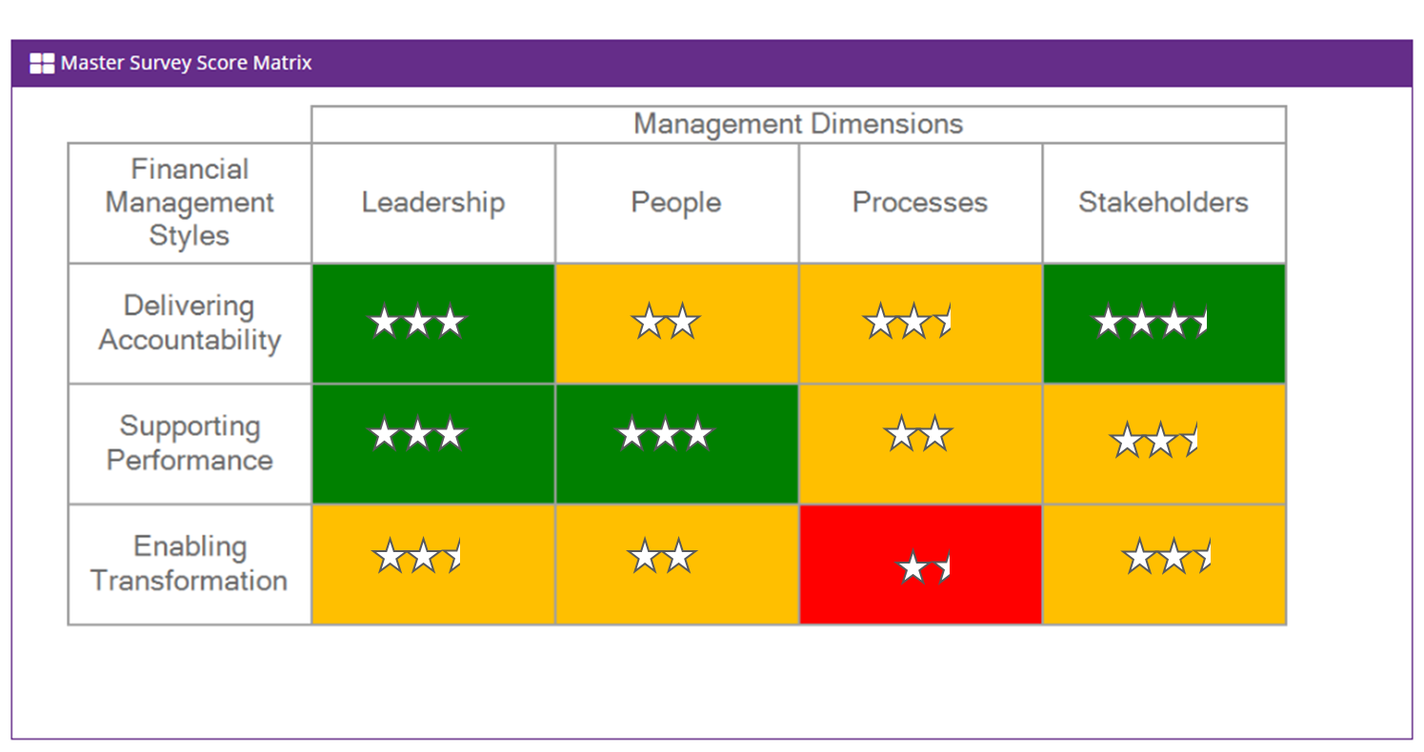
FM Model Survey matrix

Slide 8
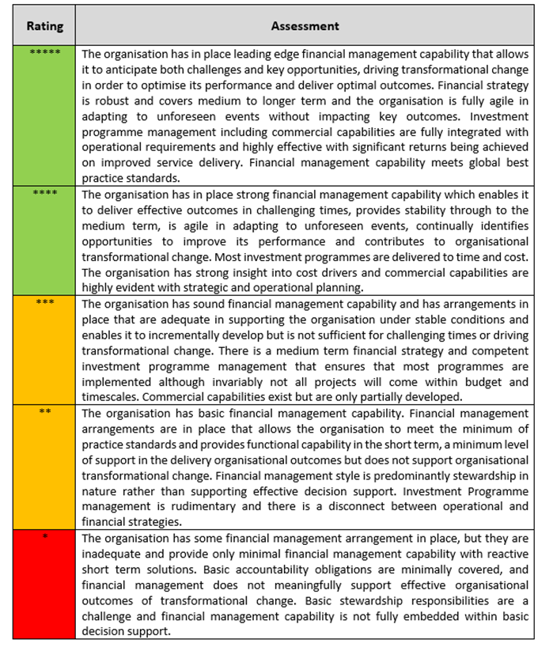
5 Star Scoring System

Slide 9
Progression to World Class
World Class
The business positively seeks finance input into strategic and operational decisions because of the value added to the delivery of their objectives
Enabling
Transformation
Supporting
Performance
Finance teams display relentless commitment to continuous improvement
Degree of challenge
Driving
Accountability
Financial information is accurate (right first time), timely and complete

Slide 10
Positions financial management capability against global best practice
Identifies Strengths / Development areas
Helps to prioritise and create a clear Action Plan for improvement
Progress can be tracked
Outputs of the FM Model?

Slide 11
Spans entire spectrum of FM
FM strategy/audit/financial reporting/stakeholder confidence
Wider than finance function
Focus on FM capability across the organisation
Scope of FM Model

Slide 12
A score is determined for each statement
Each statement has supporting questions
Questions assist in the scoring process
Supported by an Online Diagnostic tool to undertake the assessment based on gathering evidence
How does it work ?
Evidence – ‘The Three Strands’
1. Document review
2. Interviews – specialist and sampling
  Interviews tailored to organisation
  Finance staff and stakeholders interviewed
3. Electronic Online Survey
  Number of participants dependent on size and structure. Can accommodate large numbers and far reaching

Slide 13
Example interview list
Chief Executive | Head of Revenue Team (Strategic Finance) | Portfolio Holder for Resources/Finance
Chief Officers / Service Directors | Head of Capital/Commercial Team (Strategic Finance) | Chair of Overview and Scrutiny
Selected Assistant Directors (or equivalent) | Head of Services Team (business partners) | Head of Internal Audit
Selected Heads of Service | Treasury Management lead | Head of Procurement
Selected Budget Holders | Selected Finance Business Partners | External Audit
Section 151 Officer | Lead for Centralised (Transactional Services) team | Risk Manager
Deputy Section 151 Officer | Leader of the Council | Performance Manager

Slide 14
Example document list
Annual Report and Accounts | Business Case Protocols | Financial performance indicators
Organisational structure charts | Financial Standards and Regulations | Procurement strategy and performance report
Governance documents (anti-fraud / whistleblowing) | Internal Control Procedures | External Audit reports
Corporate Plan | Scheme of Delegation | Internal Audit plans
Medium Term Financial Plan | Asset Register | Financial management training strategy
Information Strategy | Management reporting and KPIs | Customer/stakeholder engagement

Slide 15
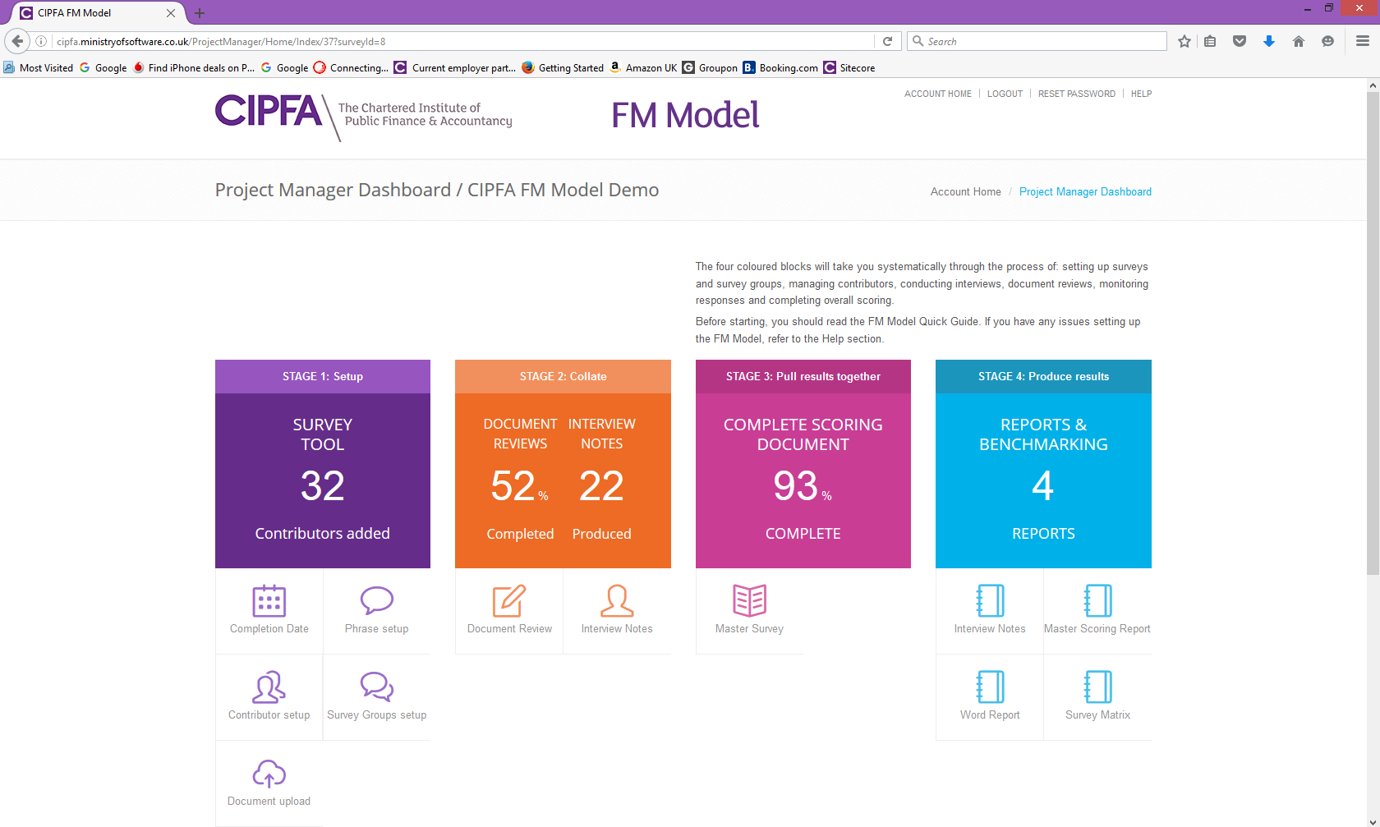

Slide 16
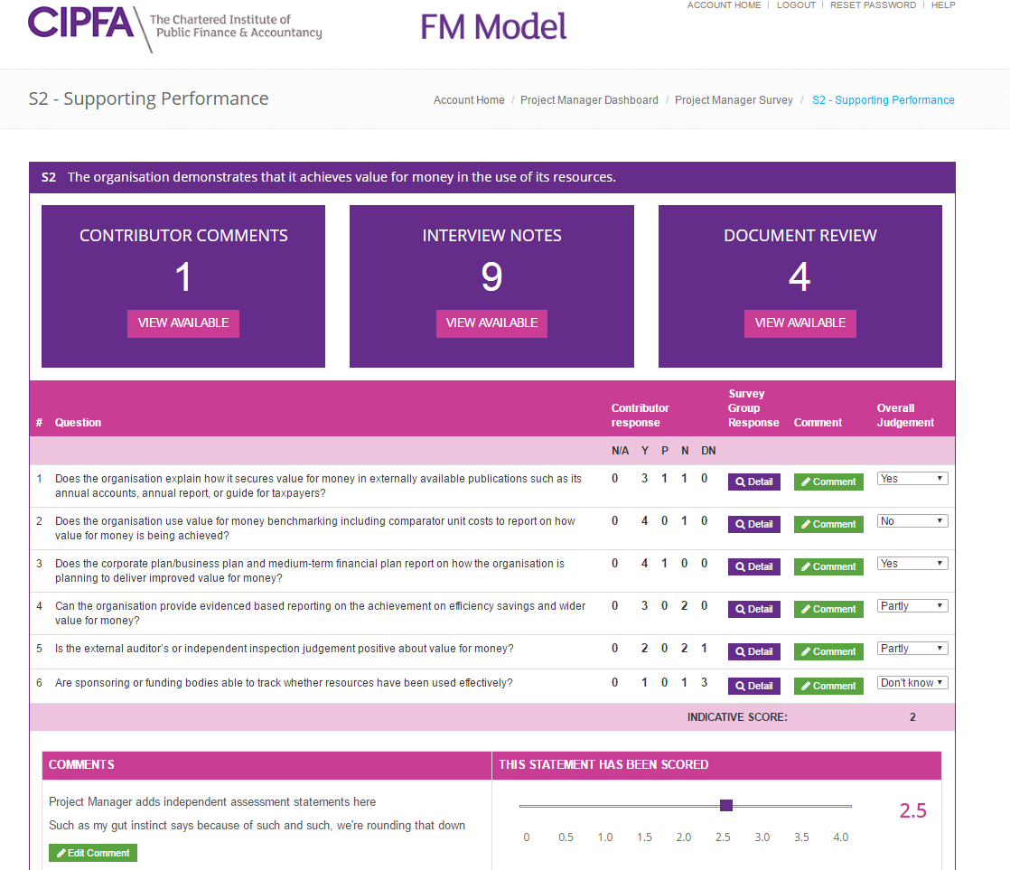

Slide 17
Unrivalled experience on FM Model Assessment throughout many large Government organisations and other public sector bodies
Leadership on FM standard setting
Independence – weight placed on CIPFA’s independent assessment of FM capability
Tailored approach for specific needs
Confidential support
Moving forward – support to address the improvement opportunities identified
CIPFA Offering

