Slide 1
A Battleground in the War on Fraud
CIPFA – Annual Training & Development Event
Suzanne Milne
Partner
0161 233 7348
Suzanne.milne@weightmans.com

Slide 2
Topics
The headlines
Just opportunists? PL fraud
The enemy within, EL fraud
The information game
Sanctions.
Notes:
Not intended to be an in depth analysis of reported FD cases / law but a brief overview of where insurance claims fraud and other funds lie and how it can evolve within the public sector.
The headlines is hopefully also a helpful introduction.

Slide 3
Headlines
What do I mean by an insurance claim?
A claim for compensation under the terms of an insurance policy or fund for coverage or compensation for a loss or policy event;
Can be based on allegations that the person and/or organisation covered has somehow breached an obligation or duty. i.e. alleged breaches of common law and/or of a statutory duty
There could be a situation when government and local funds are set aside following a catastrophic event.
Notes:
Not a legal definition but to put in context the reference to an insurance claim and the type of claims which a public authority may face,
Just because something is presented as an insurance claim does not automatically mean it will transpose into an actionable claim
Government / local – still potentially privy to fraudsters - eg Grenfell.

Slide 4
Headlines
Types of insurance claim could include:
Public Liability
Employers Liability
Motor Liability
Officials Indemnity
Property
Travel.
Notes:
All can be prone to fraud

Slide 5
Public Liability – in a nutshell
Duties of care exist for individuals / organisations to behave in a reasonable manner towards others and/ or to uphold certain responsibilities
If not, they may become legally obliged to pay compensation to anyone who is injured or whose property is damaged as a result.
Common examples include
Highway claims – e.g. slips and trips
Owner / Occupier claims – visitors to parks, buildings, housing.
Notes:
Not intending to deliver a law lecture
Liabilities may arise through the careless or negligent acts of individuals or organisations or under certain Statutes (Acts of Parliament)

Slide 6
Employers Liability – in a nutshell
All employers have a legal duty to protect the safety of their employees at work
Those who fail to do so may become legally obliged to pay compensation if an employee is injured, or becomes ill, as a result of their negligence
Common examples include:
Manual handling claims
Vicarious liability for negligent actions of other employees
Slips & trips in the workplace

Slide 7
Headlines - coverage
The majority of insurance claims involve a claim for personal injury and loss
Insurance may exist to cover the cost of some or a proportion of your claims
But… common place in the public sector to have large deductibles and/or to self insure/fund
This could equate to £100,000s annually - in addition to payment of any insurance premium.

Slide 8
Headlines - ABI – 22 August 2018
ABI’s comprehensive analysis into UK insurance fraud
Every minute an insurance fraud is now detected;
562,000 insurance frauds were detected by insurers;
This included 113,000 claims valued at £1.3 billion;
Fraud generally is said to cost the public sector 2.1 billion …. Insurance claims fraud plays a part of that!
Notes:
Lets talk about Insurance and Fraud.
Association British Insurers = ABI

Slide 9
Headlines
The number was down 8% on 2016, while their value rose slightly by 1%;
This reflects the industry’s collaborative work in detecting and deterring fraud;
The belief is that a similar amount/value of claims which go undetected each year;
Insurers invest at least 200 million each year to identify fraud – how much does the public sector invest?

Slide 10
Headlines - Insurance Fraud Bureau
Ben Fletcher, Director of the IFB, said:
“…The IFB has seen a rise in the number of live investigations, as well as a more diverse range of fraudulent behaviours, as these criminals move to target new areas.
Fraudsters are tenacious and regularly change their methods, moving between products, sectors and approaches. They will exploit any area they are able, and the industry faces a constant battle to stay one step ahead.

Slide 11
Headlines - The public purse
Insurance fraud is recognised as a high risk area
Public Sector - counter fraud strategies – key themes
Acknowledge
Deter
Prevent & Detect
Pursue
Impact of fraud extends wider than simply looking at ££’s.
Notes:
The public sector / councils have a duty to protect the public purse and a major part of this is limiting fraud and corruption.
Insurance fraud is recognised as a high risk area for local government whether that mean PL, EL or motor fraud.
acknowledge, deter, prevent detect, Pursue
Fraud impact
There’s not only the lost/stolen money to
consider but also the:
• loss of working time, with officers putting things
right and liaising with police and lawyers
• cost of the investigation and any subsequent
court costs
• increased insurance premiums.
The impact of fraud should never be
underestimated. Fraud leaves the council with
less to spend on services for residents and costs
taxpayer’s money. Fraud against a local council
is not a victimless crime.
There’s not only the lost/stolen money to
consider but also the:
• loss of working time, with officers putting things
right and liaising with police and lawyers
• cost of the investigation and any subsequent
court costs
• increased insurance premiums.
There are also non-financial implications that are
often forgotten. These will also, indirectly, have a
financial impact, which is often difficult to qualify,
such as:
• reduced or poor service for residents
• political impacts, eg government interventions,
by-elections
• reputational damage for individuals or the
council as a whole
• poor staff morale leading to poor performance
and/or more fraud.

Slide 12
Headlines - Challenges
Public sector budget reductions means:
less resources to maintain administrative procedures that prevent fraud;
potentially reduced resources for investigating fraud;
the risk of greater fraud activity by professional criminals or opportunists who identify the public sector as vulnerable.
Notes:
These challenges recognised by the Local Gov Association
When fraud is concerned money is the drivers both individually and also collectively if looking at income for an organised fraud ring.

Slide 13
Headlines - Fundamental Dishonesty
Insurance claims are civil, not criminal cases.
Differing burden of proof and
largely governed by The Civil Procedure Rules
Criminal prosecution referral remains a viable consideration BUT establishing ‘FD’ can be a silver bullet. It can:
“Kill” a claim, even where C may have a genuine claim (s57 CJCA 2015) and;
Create an enforceable costs order against C and;
Can lead to committal proceedings including prison.
Notes:
Insurance claims governed by CPR
BoP rather than beyond reasonable doubt
Fundamental Dishonesty = FD
Options that can lead to the same if not similar outcome.

Slide 14
Headlines - Fundamental Dishonesty
Primary types of fraudulent claims:
Fabrication
Exaggeration
You will need to find:
Evidential Inconsistencies (untruths);
Which are dishonest (Ivey v Genting CA 2017) ; and
Fundamental to the claim.
Notes:
Gosling V Screwfix
Dishonesty must go to the root of the whole, or a substantial part, of the claim.
Dishonesty incidental or collateral to the claim would not be considered fundamental.
LOGOC v Sinfield 2018
Dishonesty that has substantially affected the presentation of his case… in a way which potentially adversely affected the defendant in a significant way.
The fact that the greater part of the claim may have been genuine was neither here nor there.
CPR; in which
The claim must be fundamentally dishonest (April 2013 onwards) and
S57 CJCS; in which
The claimant must be fundamentally dishonest (13 April 2015 onwards & entitlement to damages)
Differences in costs - CPR 44.16 v S.57 (5)
Investigations are identical as will be the decision to repudiate/ allow the claim to litigate

Slide 15
Just Opportunists? – PL Fraud
Slips & Trips - Highways / Occupiers Liability
Why are such claims potentially attractive to fraudsters?
Subjective accounts;
Often no independent verification;
Evidence can be constructed;
Not always opportunists;
Ideal for unscrupulous claim famers
Can there be organised claim presentation?
Notes:
When we talk about public liability fraud it is not simply restricted to slips & trips but for the purpose of this short slot I am focusing on these types of claim given the recognised scope for wider organised fraud.
Thought useful to give you some working examples to show you how wide spread this can be.
Highways claims no doubt feature as one of your highest claim notifications, albeit you my have high repudiation rates to help you successfully defend these. But have you got your house in order or is this set to change given the pending CoP review?
Opponents never like the S.58 but if they establish the breach element they can sit back to see if you will discharge your own burden of proof under S.58.
Why are PL claims attractive ??
Subjective accounts – I fell there as a result of that defect… did he/she really fall there?
No witnesses
Can construct evidence – complaints/ medical treatment / routes/images etc
Can see fraud rings / targeted – involvement of unscrupulous claims farmers

Slide 16
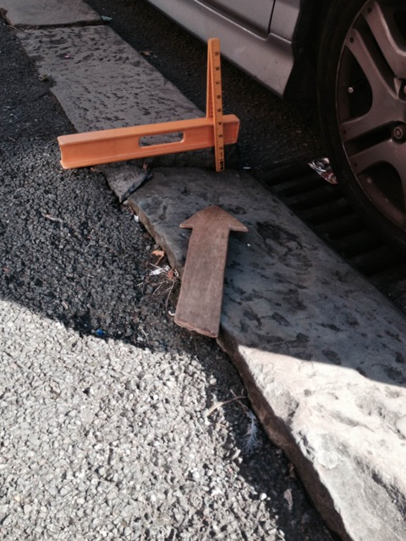
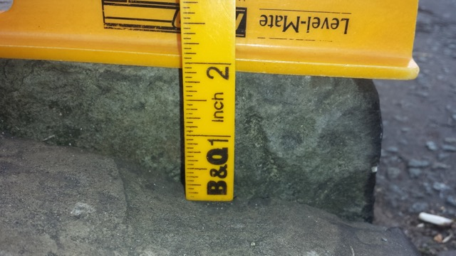
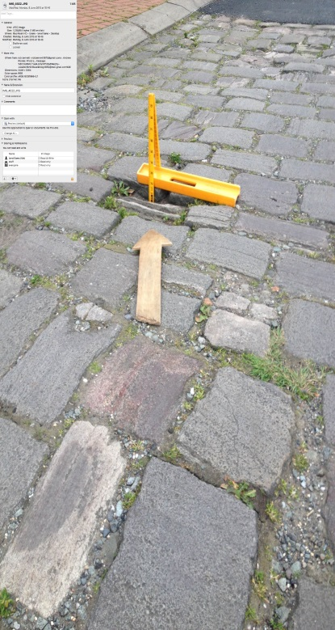
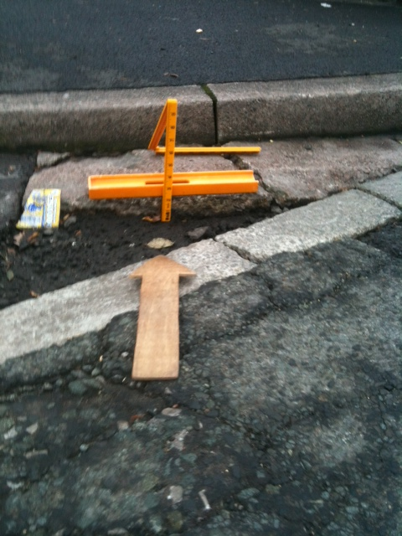
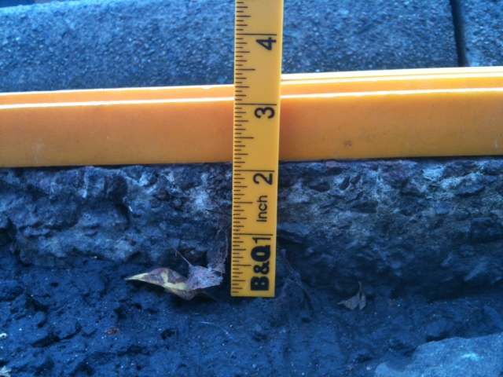
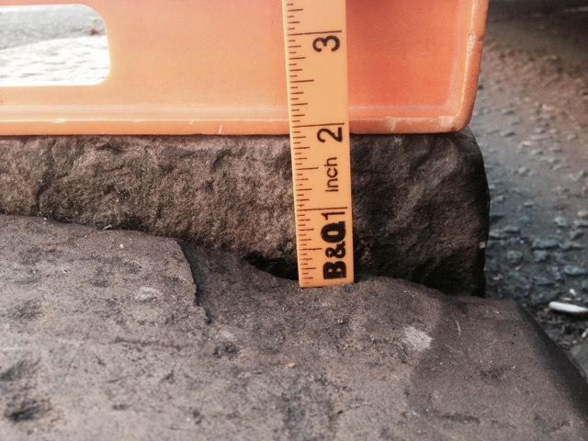
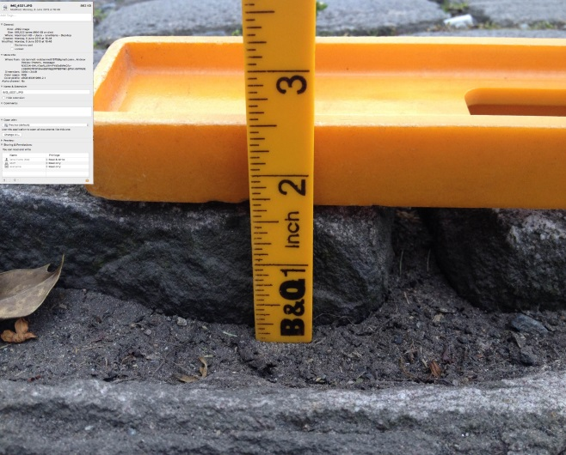
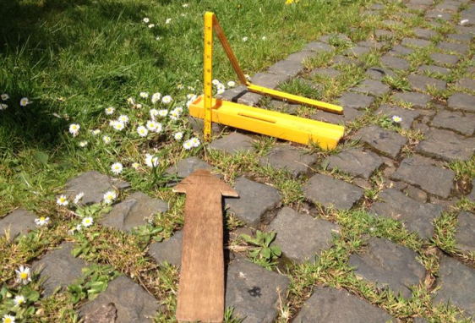
Notes:
Any similarities?
This is just a handful of pictures from hundreds of pictures in a live fraud operation
This is not to say that all Claims management companies / claim investigators are fraudulent but the number of claims featuring them / solicitors caught the attention of the local authority / housing association department.
9 pictures with consistent imagery – would you be concerned if you saw 100 / 200 or even 500?

Slide 17
Background - Operation X
Highways Concerns
Fraud Indicator Checks
Potential Commonalities Identified
Operation Established
Further Analytics and Investigations
Case Strategy Management
Notes:
SM

Slide 18
Operation X
A large public liability (Slip/Trip) Operation effecting a local authority and Housing Trust – identified as organised fraud
Intelligence gathering across all historic data identified with the modus operandi which identified extensive links and connections between the individual cases (over 500 claims)
20 litigated lead claims identified & case managed together. Wider connected claims strategically managed for evidence and intel gathering
Extensive collaboration between several clients insurers, investigators & ourselves. An agreed strategy was put in place.
Notes:
I will call it Operation X

Slide 19
Modus Operandi
Slip/Trip PI Claims
Multiple Household Claims
Connected Claimants
Solicitors
Claim Features and Timing
Incident Locations
CMC
Photographs
Home Addresses
Notes:
What do I mean when I say Modus Operandi?- a common way in which a claim works or is presented.
Within each of those indicators is extensive information which needs to be analysed.

Slide 20
Fraud Network diagram
Notes:
This tab demonstrates how we can plot links between parties where fraud rings are suspected, looking at claimants, claimant solicitors, social media connections and experts – bear this in mind when thinking about the extent of data which you have to consider.

Slide 21
Operation X - the sequel
All original case managed litigated claims have been defended successfully;
Wider claims have also all been discontinued or been repudiated to trial. Many have not proceeded into litigation. PL claim notifications significantly dropped;
The agreed strategy is applied / adopted as new unsuspecting claimant solicitors appear. Positive pleadings of fraud have been presented with orders secured for further claims to be case managed together and the operation continues.
Notes:
Findings of FD / strike out etc
£100.000’s of pounds saved which is continuing by knocking back claims from new sets of solicitors / continued pleadings and focus on pursuing the facilitator – ie the photographer.
In the current climate every one of the claims being presented would fall within the clients own funds for payment. Even if being liberal and suggesting a claims exposure of £10,000 per case that soon mounts up.

Slide 22
How to work together
Analytical Tools
Local Knowledge
Partnership Working
Understanding Trends
The Power of Data
Detailed Investigations
Case Management Strategy
Maximising Resources
Protocol for Future Cases
Notes:
Key is to work together in identifying and investigating and pursuing the fraud

Slide 23
The enemy within – EL Fraud
What is the perception – lower claims presentation?
Quality of Health & Safety
Impact of the Enterprise & Regulatory Reform Act 2013
‘LASPO’ and fixed costs.
Scope for fraud?
Accident may not be reported / witnessed
Exaggeration is a major feature.

Slide 24
The enemy within – EL Fraud
Nightingale v Castings PLC - 2017
Fast track EL claim
Fall in workplace – no witnesses
Defended on legal causation alone
Previous claims history
Active in supporting other claimants
Trial Judge did not believe him
Fundamental Dishonesty finding
Subsequently dismissed from his employment.
Notes:
Fabrication – this is an old school FD
Not s.57 but a fraud finding
Talk about dismissal and benefit to employer

Slide 25
The enemy within - EL Fraud
Advance Housing Ltd v Sandra Thomson April 2017
Defendant care worker – EL tripping claim
Genuine accident – breach admitted
Multi track claim for damages
Claimed permanent loss of function in arm
Surveillance revealed no ongoing injury
Gross exaggeration & claim struck out
Secured contempt of court – 28 days in prison.
Notes:
This was a pre CJCA claim - This case now be dismissed under s.57.

Slide 26
The enemy within – EL Fraud
Why?
Disgruntled employees
Financial difficulties
Job risk
Union representation / claims culture
Ignorance of the definition of fraud.
Potential Indicators
Disgruntled employees
Previous claims
Sickness absence.
Notes:
Although a lower claims experience for EL – fraud does exist and the claimants involved often are disruptive to business in any event. Even if there is a genuine accident there remains scope to establish FD such that a claim could be dismissed in it’s entirety.

Slide 27
The basics – fraud indicators we look out for
Previous claims history
Inconsistencies between different accounts
Lack of corroborating evidence (GP records/accident reports/photographs)
Motives for bringing claim (Financial difficulties/criminality/ dependencies
If in doubt do not admit breach!
Notes:
FIC can be as long as you like
The basics may then lead to consideration of wider information searches and intel gathering

Slide 28
The information game
Information gathering is key when considering fraud
Not solely evidential based but may include intel searches
However - when investigating ensure it is done in a DPA compliant way. Have due consideration to:
Fair Processing Notices / Privacy Notices
Relevant exemptions which may be applicable
Legitimate Interests Assessment.
Notes:
Schedule 2, Part1, Paragraph 2 DPA 2018 - the processing of personal information for the purposes of fraud and/or legal purposes – old s.29 requests made via this
Schedule 2, Part1, Paragraph 5 DPA 2018 - Information required to be disclosed by law etc. or in connection with legal proceedings

Slide 29
The information game
Useful Investigations
Financial background:
Experian
Land Registry.
Vehicle checks - DVLA keeper enquiries / MOT history/status
Credibility:
Social media – Facebook, Instagram, Twitter, Youtube etc
Newspaper articles
Google Maps/Streetview
CUE PI / Sherlock / DPA requests
IFB / IFIG
Companies House/Duedil
GMC/ HCPC register
Full-time.theFA.com / Strava
Surveillance.
Notes:
We also work with our clients who have access to wider searches within their own data sharing arrangments

Slide 30
And finally …
How to deter Fraud?
Sanctions…
Notes:
Costs recovery
Publicity
Personal sanction – employee? Tenant?
Penal sanction / deterrent
Insurance register fraud

Slide 31
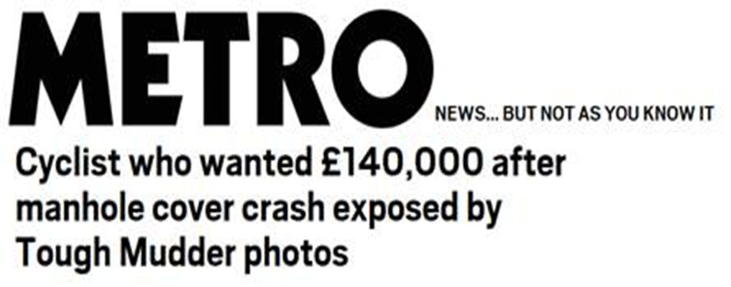
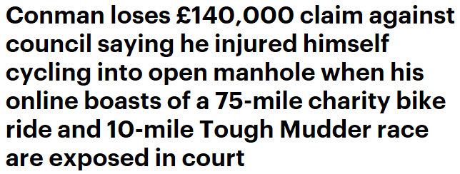
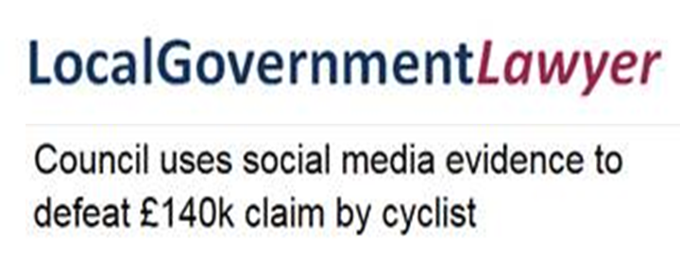
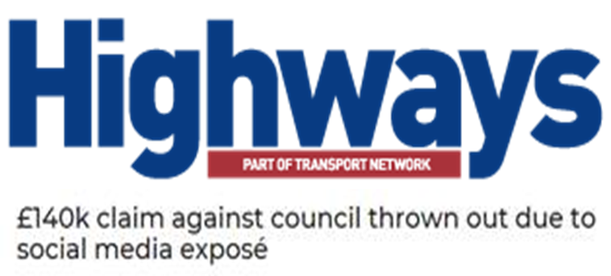
Notes:
Gary Lucking v Cheshire East Council – October 2018

Slide 32
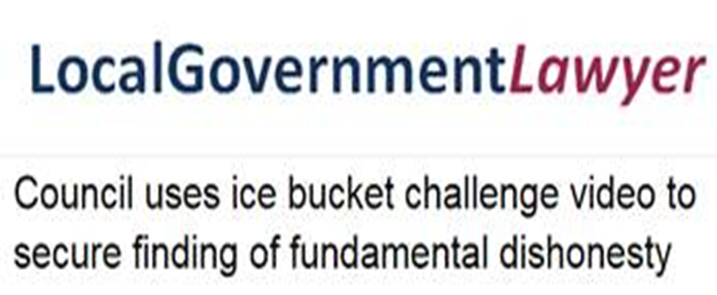
Notes:
Brown v North East Lincs Council Nov 2018

Slide 33
Notes:
Grix v Doncaster Council 2017

Slide 34
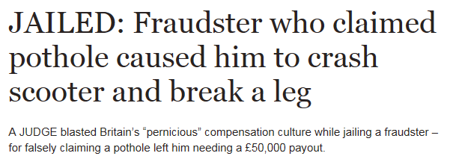
Notes:
Daniel Condron v Halton Council 2015

Slide 35
Thankyou
Any questions?

