Slide 1
Providing Assurance across ‘Integrated Systems’…
CIPFA NW Audit, Risk and Governance Professional Development Group
Annual Development and Training Event, March 2019

Slide 2
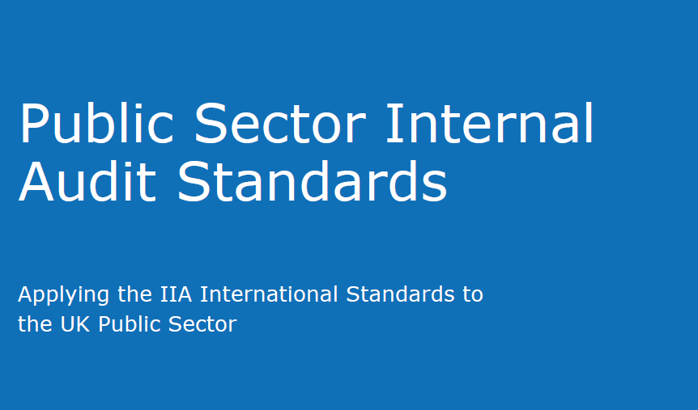
Context
Traditional focus of Internal Audit assurance
As the public sector landscape has changed we have seen an increase in organisations working in partnership
The professional standards, approach and expectations placed on internal auditors are fundamentally the same across sectors

Slide 3
Health and Social Care Collaboration…..
The need for collaboration on Assurance?...
Organisations can no longer deliver objectives on their own
Various forms of organisations coming together for health and social care provision
Statutory body requirements alongside the need to work together in a ‘system’/ ‘place’
Blurred boundaries to organisations, systems and processes, and ‘accountability’
Organisations starting to focus on the wider risks and external factors
Needing to think differently about what is needed to deliver the HOIA opinion
Traditionally difficult to audit across boundaries, relying on third party assurance, limited scopes etc.
Creating Conversations and Relationships……
Notes:
Events Brochure
ADASS
Local discussions re ‘PLACE’

Slide 4
Group Exercise 1
What are the benefits of working together?
What are the barriers?

Slide 5
Agreeing a set of core principles to work in partnership is key…..
Shared understanding of the organisation working arrangements and where these cross boundaries
Regular and timely communication to discuss areas of mutual interest
Flexibility needed in terms of approach, timing, reporting styles etc..
Where systems are operated within an organisation then the local internal audit team should be directly involved.

Slide 6
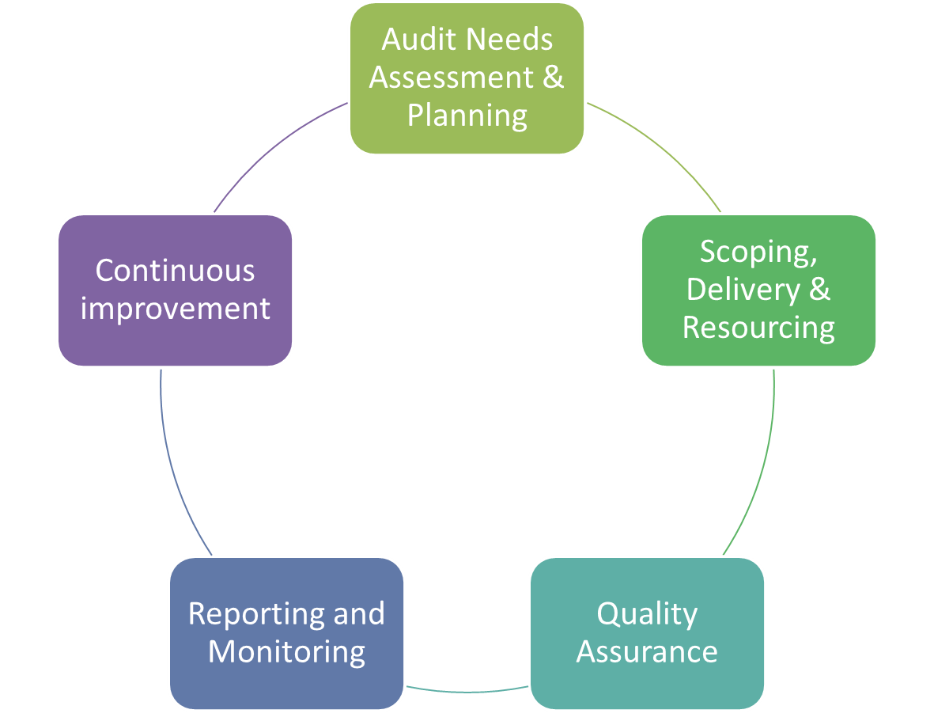
Strategic and Operational Planning needs…
Statutory body – strategic risk assessment
Identifying areas of ‘mutual’ interest
Agreeing the best approach to the provision of assurance:
Third party assurance
Integrated Team
Joint Working
Sharing
Delivery - logistics

Slide 7
Strategic and Operational Planning
Group Exercise 2
What are the key risk / assurance areas to your organisation from an integration perspective?
For each area what would be the best approach to the provision of assurance?

Slide 8
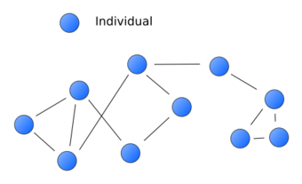
Relationships and Networks
Developing key relationship can support your team in the achievement of its goals and also support you individually in your personal development.
Having solid relationships with the right people is critical for professional success.

Slide 9
Relationship Mapping: Stage 1
Group Exercise 3
Add circles in the quadrants with the names of people, organisations, allies, associations, groups etc. that that are important to your success. Think about your organisation’s context, existing and emerging partnerships and collaboration. In some instances, these can be people or entities that you do not know yet – but you need to know.
Draw a line between you and the person/entity to represent your relationship with them. A solid line means strong relationship, dotted line means relationship in place but needs strengthening and no line means relationship needs to be cultivated.
Ask yourself the following questions:
What are the strategic relationships needed to achieve my goals?
What do I need to do to strengthen existing relationships?
What do I need to do to start relationships that are important but not yet in place?
How can I create win-win relationships that will benefit me/ my team as well as them?

Slide 10
Relationship Map
Known
Within your organisation
External to your organisation
You
Unknown

Slide 11
Relationship Mapping Exercise: Stage 2
Group Exercise - Take Away
Repeat the stage 1 exercise with your teams.
Join together and compare your maps.
What do they look like?
Are there areas where we have a number of people with the same relationship?
Are there areas where we do not have any relationship however they are important?
Are we spending the right amount of time on the important relationships?
What do we need to do to ensure we have solid relationships in key areas to support the achievement of our goals (collectively and individually)?

Slide 12
Conclusion
Requirements of professional standards – risk based planning, annual internal audit opinion etc…
Agreeing a set of core principles for joint working is key
Importance of relationships and networks

Slide 13
Sarah Dowbekin
Senior Audit Manager
07788 308 155
sarah.dowbekin@miaa.nhs.uk

