Slide 1

#Auditiscool
Sally Clark, Chief Internal Auditor
March 2019

Slide 2
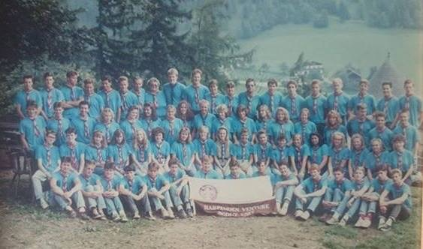
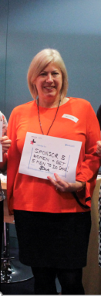
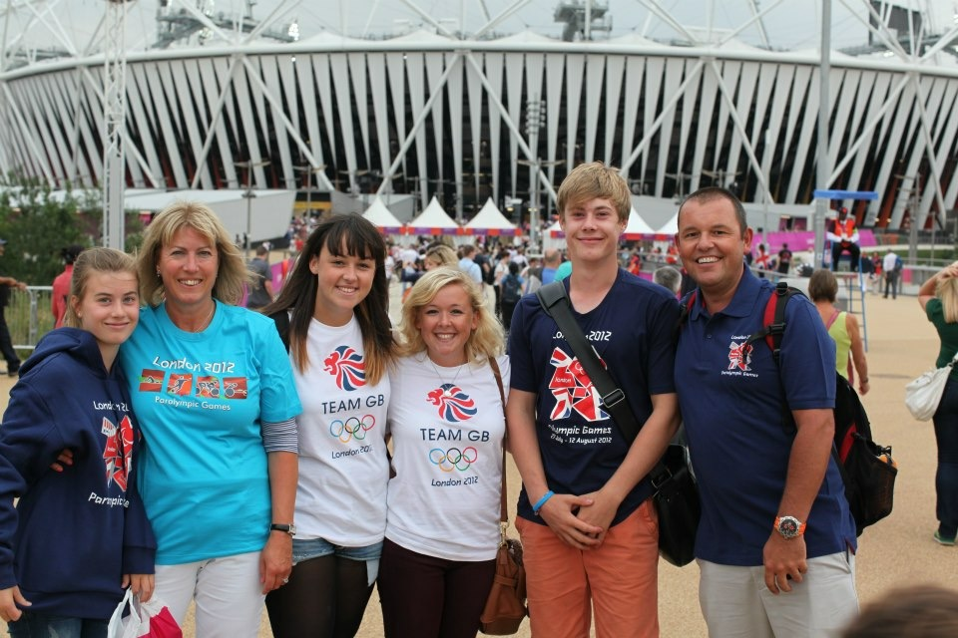
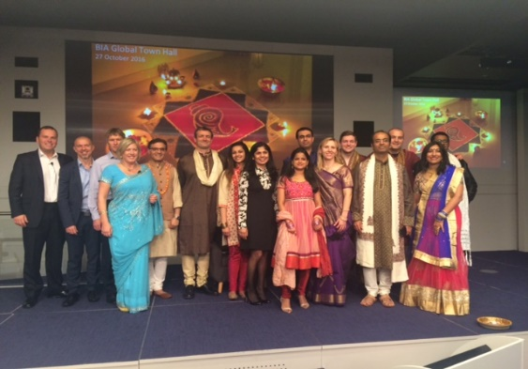
About me
My passions
My family

Slide 3


How I chose my career…
Graduates wanted… involves international travel

Slide 4


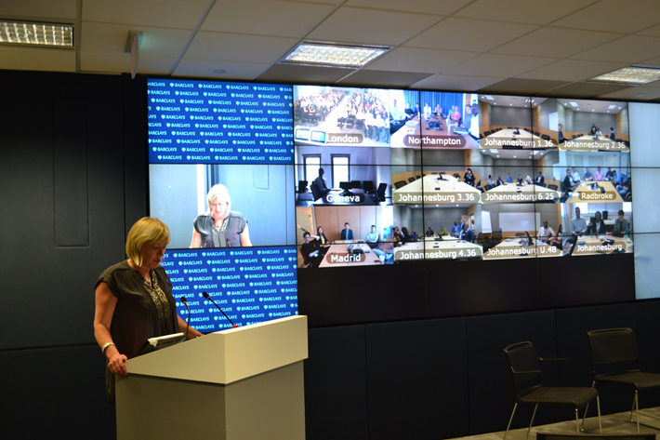

My Career
Notes:
-

Slide 5
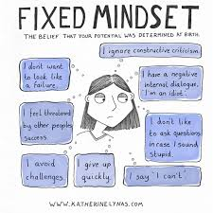

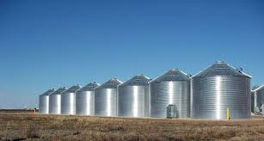
Some of the challenges

Slide 6
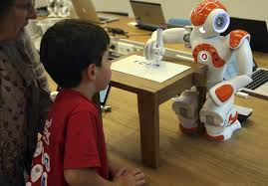
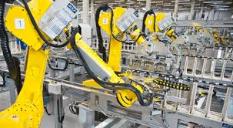

Internal Audit’s response
Data mining/analytics
Artificial intelligence
Machine learning
Agile

Slide 7
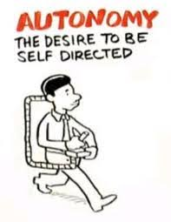
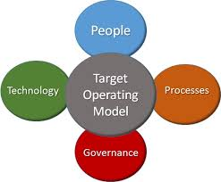
Internal Audit’s response
Working out the right operating model
Create autonomy by empowering more junior staff

Slide 8
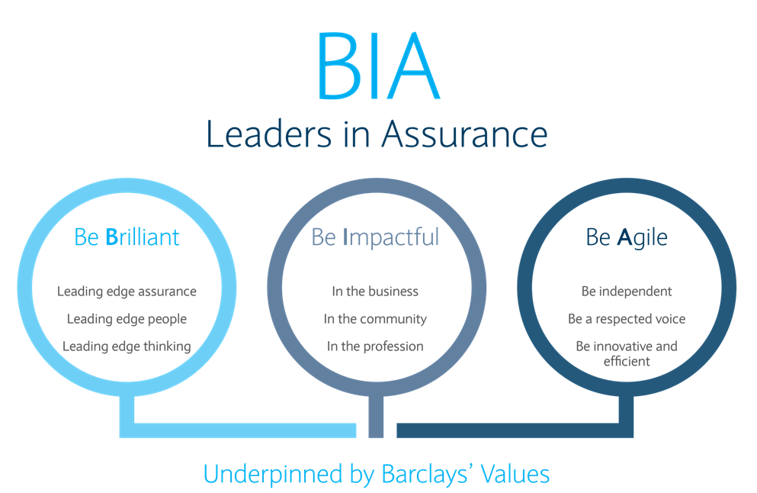


Knowledge and Skills
      Working out how to keep the team motivated, developed and engaged
      Support training – technical and personal
      Support qualifications – specific to role
      Communicate regularly and repeat messages for clarity so that everyone knows what is going on and can get involved.

Slide 9
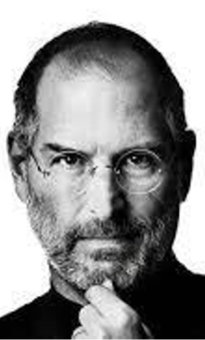
“ The only way to do great work is
to love what you do. If you haven’t
found it, keep looking. Don’t settle.”
Steve Jobs

Slide 10
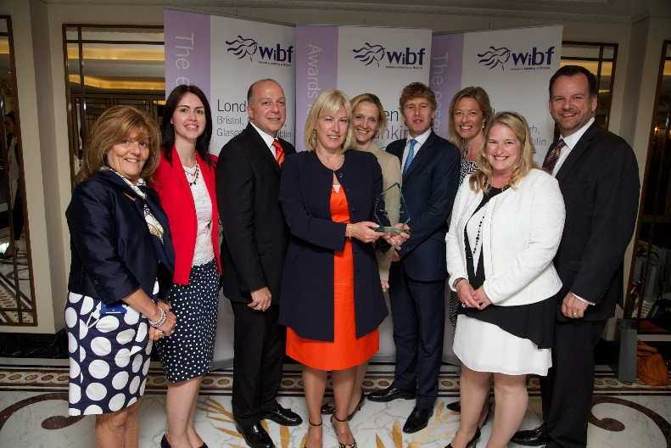
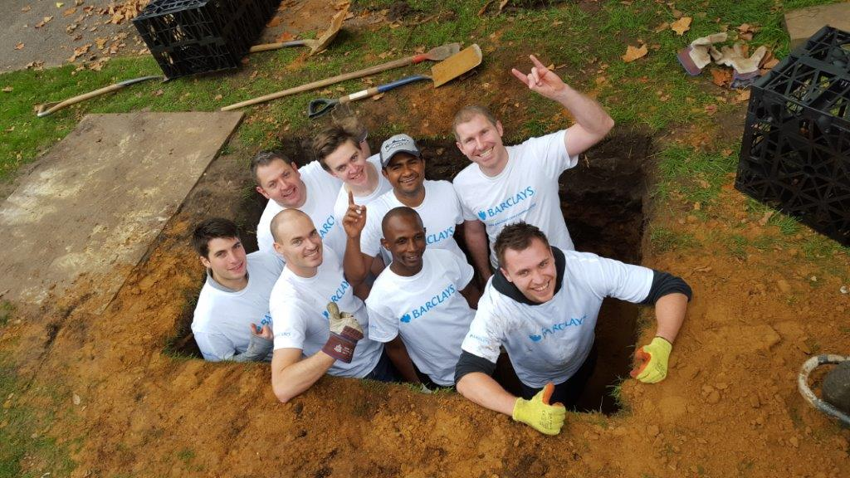
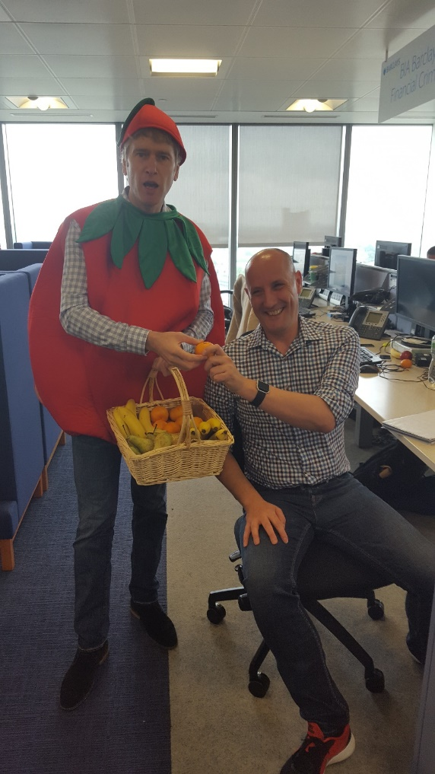
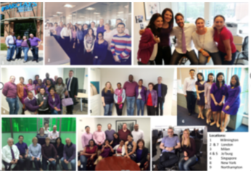
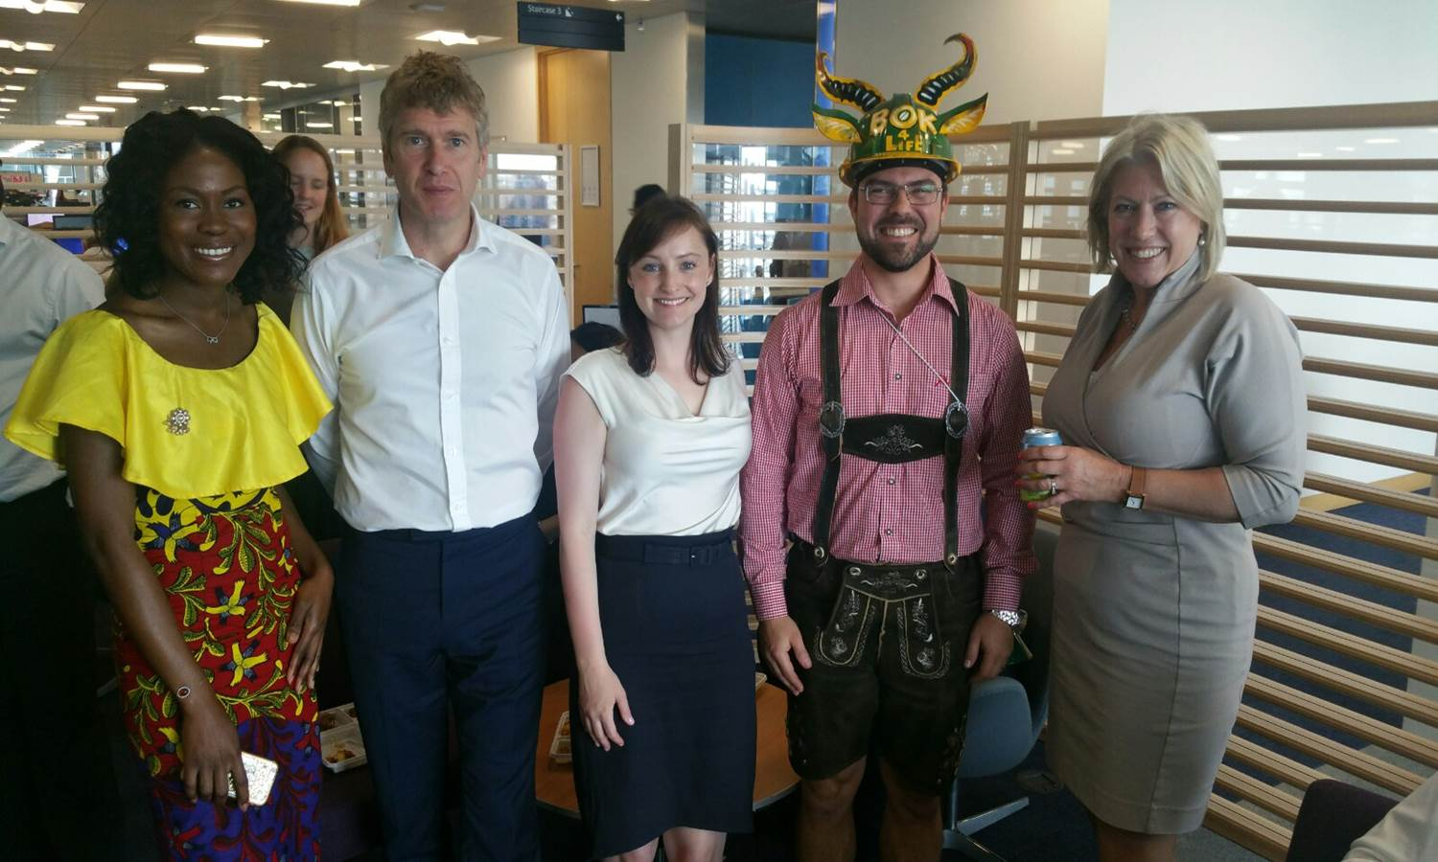
My Team is…..
Committed to Citizenship
Award
winning
IDAHOBIT
Diverse
& Inclusive
Focused on Well Being

Slide 11


