Slide 1
System Change and Integration in Health and Care – A View from Wirral
Simon Banks, Chief Officer, NHS Wirral Clinical Commissioning Group and Wirral Health and Care Commissioning, 2nd March 2019

Slide 2
System Change and Integration in Health and Care – A View from Wirral
System Change and the NHS Long Term Plan.
Cheshire and Merseyside Health and Care Partnership.
Healthy Wirral.
Healthy Wirral – Integrating Commissioning.
Healthy Wirral – Integrating Provision.

Slide 3
System Change and the NHS Long Term Plan

Slide 4
The NHS Long Term Plan
Recommended changes in primary legislation to: create publicly-accountable integrated care locally; to streamline the national administrative structures of the NHS; and remove the overly rigid competition and procurement regime applied to the NHS.
Within the current legal framework, the NHS and our partners will be moving to create Integrated Care Systems everywhere by April 2021.
ICSs bring together local organisations in a pragmatic and practical way to deliver the ‘triple integration’ of primary and specialist care, physical and mental health services, and health with social care.
Key role in working with Local Authorities at ‘place’ level, and through ICSs, commissioners will make shared decisions with providers on population health, service redesign and Long Term Plan implementation.
Shift left in service delivery models toward expanded community multidisciplinary teams aligned with new primary care networks based on neighbouring GP practices that work together typically covering 30-50,000 people on a geographically aligned basis.

Slide 5
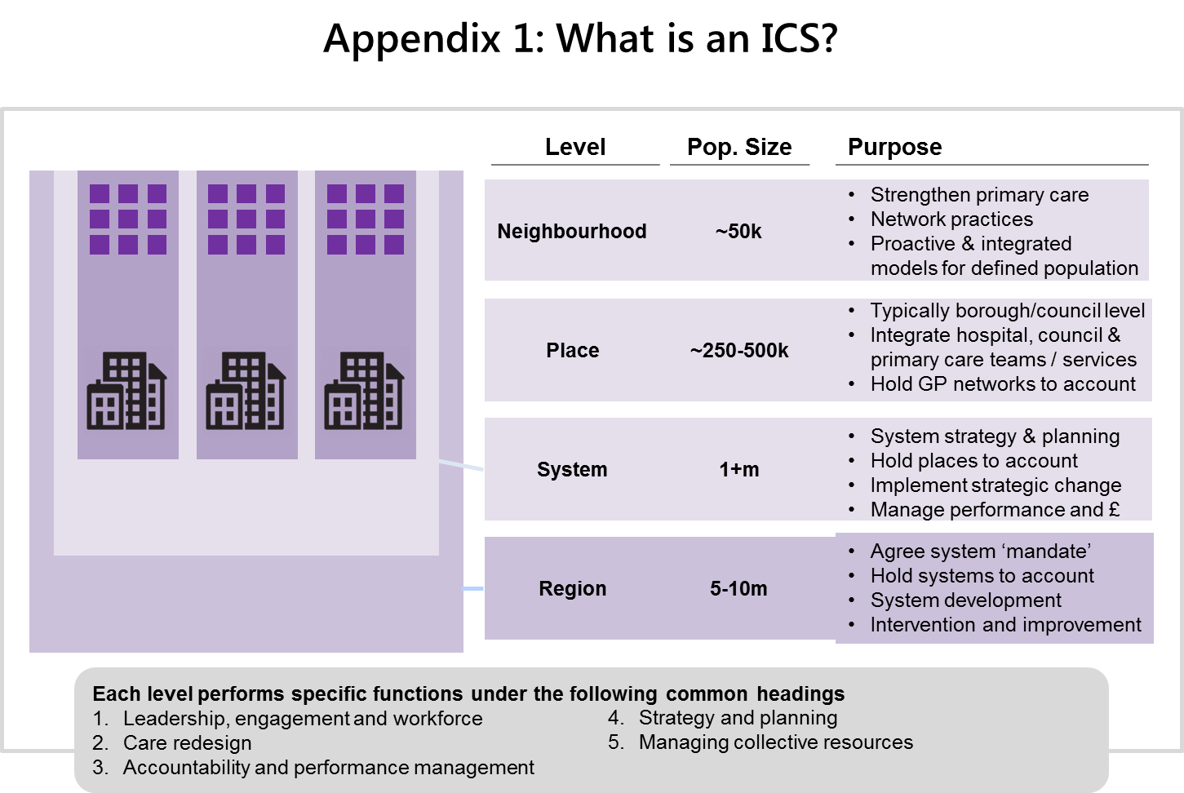
A new system architecture?

Slide 8
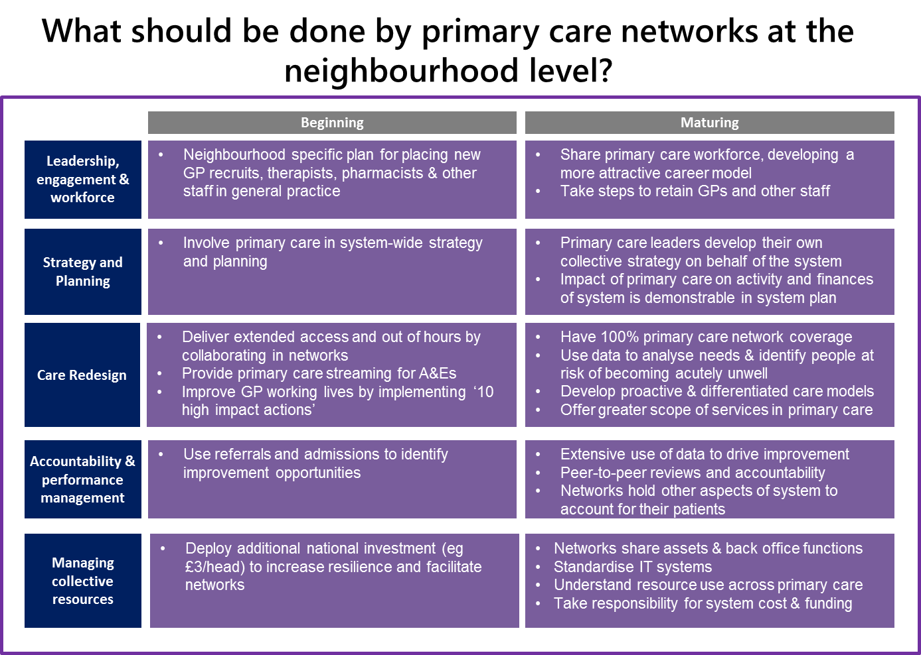

Slide 9
Cheshire and Merseyside Health and Care Partnership

Slide 10
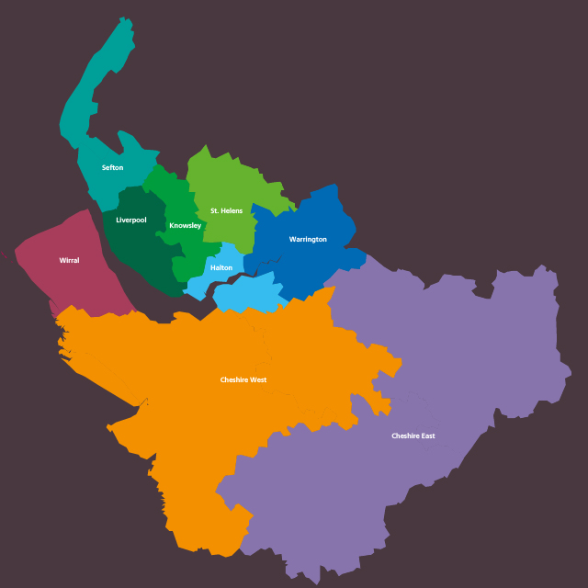
Cheshire and Merseyside Health and Care Partnership – Nine Places

Slide 11
C&M HCP Delivery Framework - draft
Places
Cheshire East
Cheshire West
Wirral
Knowsley
Halton
Liverpool
Sefton
Warrington
St Helens
Trust Boards
Health & Wellbeing Boards
Overview & Scrutiny Committees
CCG Governing Bodies
Collaborative Forums
(Selection)
Core C&M HCP
C&M Programme Portfolio
(Managed by HCP PMO)
Strategic
Enabling
System Management Board
Academy Forum
Acute Sustainability
Population Health
Digital Revolution
Provider CEOs Group
Joint Committee of CCGs (CCF)
Urgent & Emergency Care
Primary Care Forward View
Workforce
Local Authority Consultative Forum
Elective Care
Mental Health
Communications & Engagement
Steering Group
Transformation & Delivery Group
Local Workforce Action Board (LWAB)
Women & Children’s
Transforming Care (LD)
Financial Sustainability
MDs Forum / DoNs Forum
Carter at Scale (clinical)
CVD
Capital & Estates
NHSE/I
PHE, HEE
Directors of Finance Group
Carter at Scale (non-clinical)
Neuroscience
?Voluntary Sector?
?Citizens Group?
Diabetes Network
Palliative/EOLC
Cancer

Slide 12
Healthy Wirral

Slide 13
Healthy Wirral
Our Mission:
Better health and wellbeing in Wirral by working together in collaboration.
Our Vision:
Our aim is to enable all people in Wirral to live longer and healthier lives by taking simple steps of their own to improve their health and wellbeing. By achieving this together we can provide the very best health and social care services when people really need them, as close to home as possible.

Slide 14
We will do this by…..
Acting As One – exemplified in actions and behaviours.
Improving Population Health – delivering the Healthy Wirral outcomes around better care and better health using a place based approach.
Clinical Sustainability –sustainable, high quality, appropriately staffed, organisationally agnostic services.
Financial Sustainability – managing with our allocation, taking cost out, avoiding costs, delivering efficiency and better value.

Slide 15
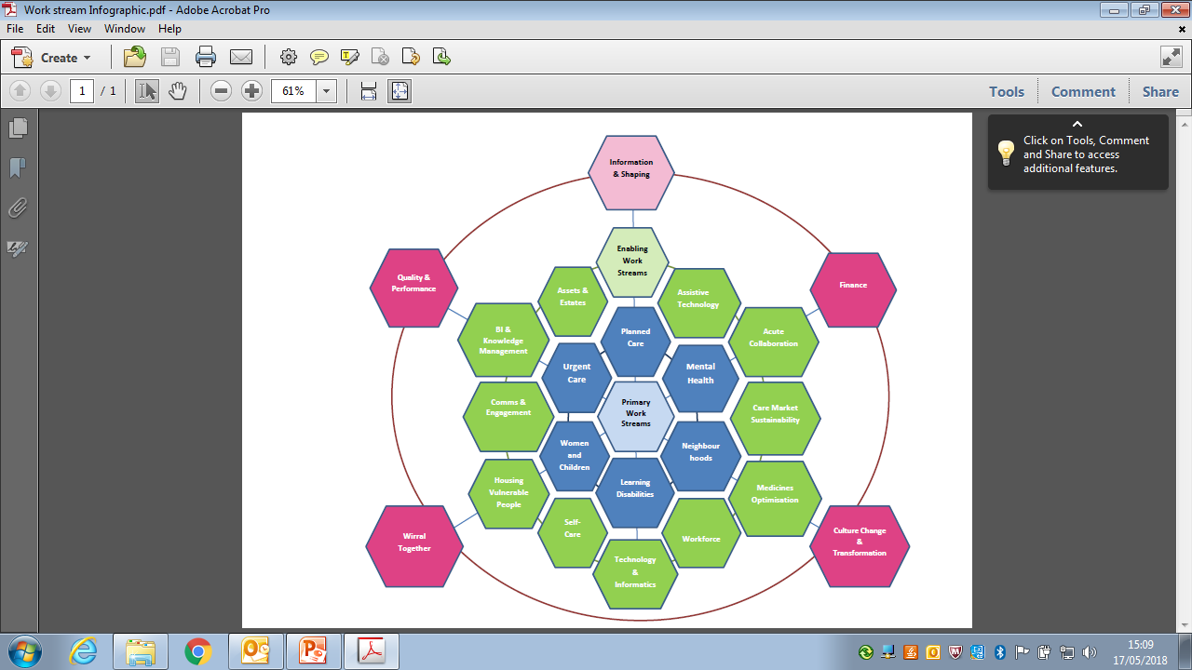

Slide 16

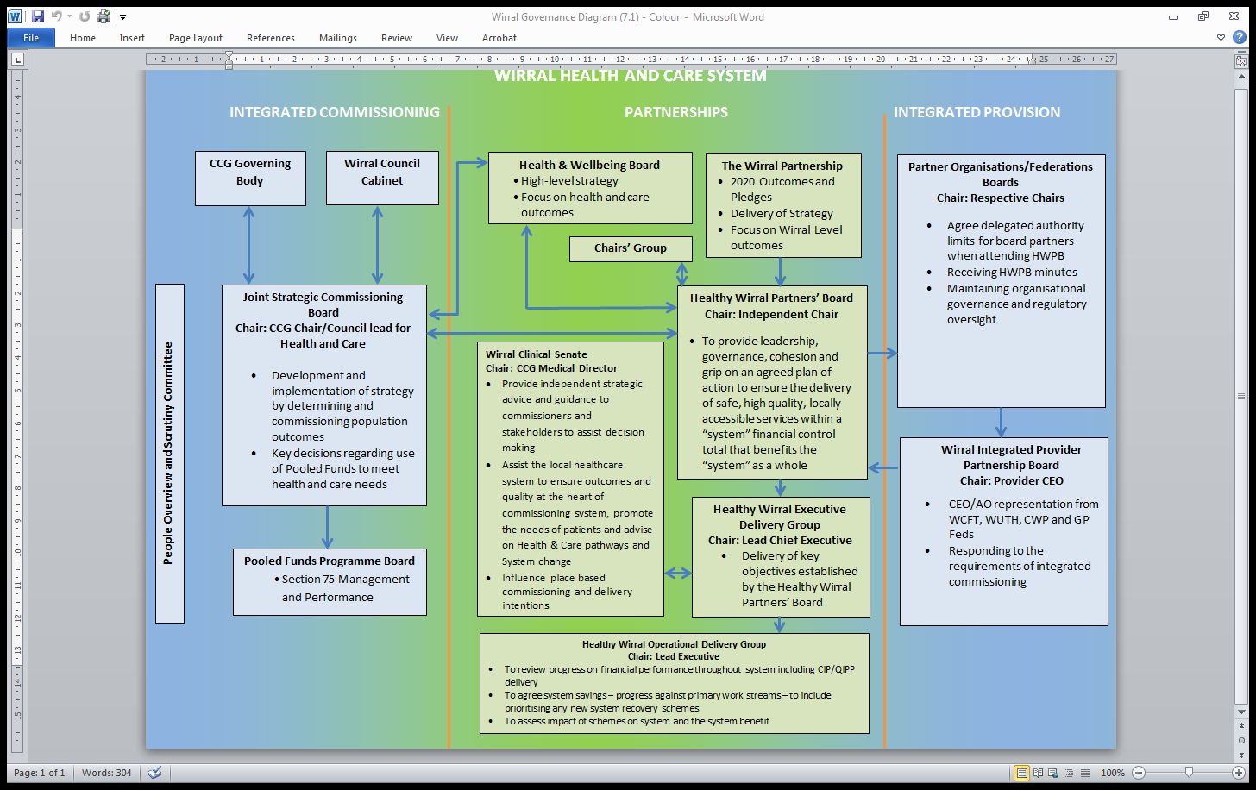
Wirral Health and Care System

Slide 17
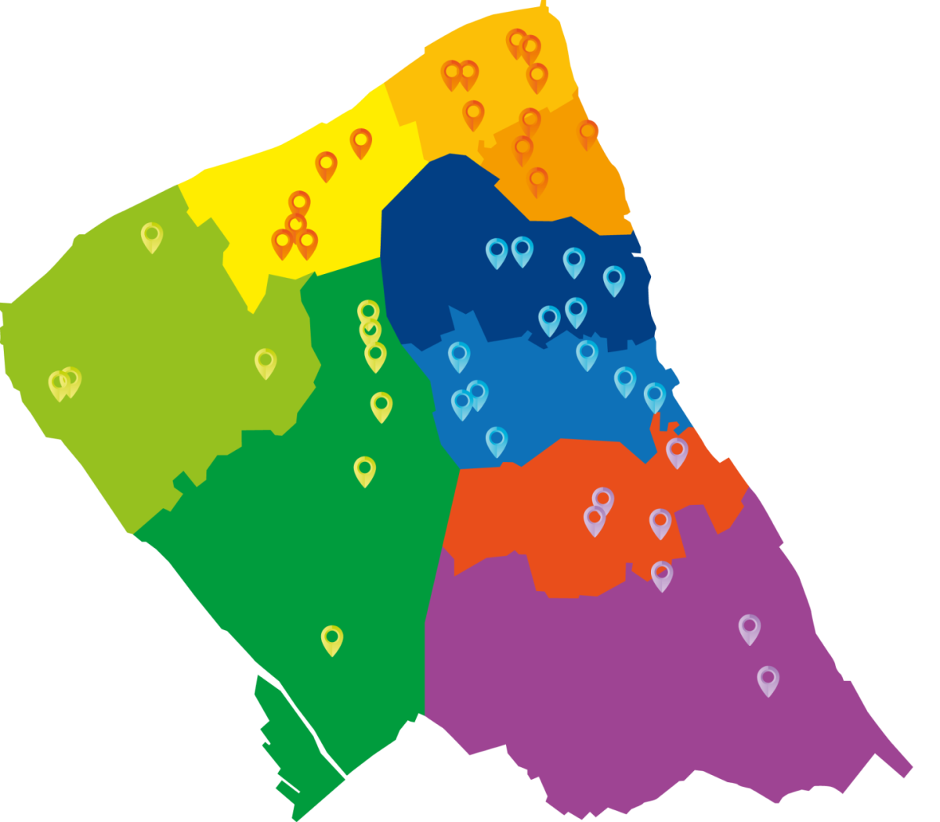
Healthy Wirral Place and Neighbourhoods
Wallasey B
Wallasey A
Wallasey C
Birkenhead A
Birkenhead B
West Wirral A
South Wirral A
South Wirral B
West Wirral B

Slide 18
Healthy Wirral – Integrating Commissioning

Slide 19
Why Integrate Commissioning?
Fragmentation and poor quality social care
The public want one approach to health and care.
Unique location and structures to achieve a meaningful integration.
Strong track record of NHS and Local Authority colleagues working together.
Provides an opportunity to provide leadership to the local health and care system.
Enabled us to set one strategy that meets the needs of our communities and delivers the Wirral 2020 Plan.

Slide 20
What is Wirral Health and Care Commissioning?
A formalised strategic partnership brought together to undertake all care and health commissioning in Wirral.
Provides system leadership for the design and delivery of care and health outcomes.
Brings local democracy more firmly into health related commissioning decisions.

Slide 21
Features of WHCC
Single structure.
Formal MOU.
Section 75 NHS Act 2006 Pooled Budget arrangements.
Joint Strategic Commissioning Board.
Single Programme Office.
Driving Healthy Wirral programme.
Shaping “place” and neighbourhoods.

Slide 22
Progress so far…
Working much more closely as a single system.
Social care staff transferred to two NHS providers.
Wirral Integrated Provider Partnership growing influence
Buy-in to develop 3 year System Sustainability Plan.
Programme Governance in place.
Work streams, sponsors, system leads and teams for each work stream.
Confirmation of place based approaches – neighbourhood model.
Contemporary Challenges Requiring Strategic Focus
Rapidly changing political environment
Challenging finances / Win-Win
Relationships

Slide 23
Healthy Wirral – Integrating provision

Slide 24
What is Place Based Care?
Place Based Care is about using a defined set of resources to provide the best possible quality of care and health outcomes for a defined population (as opposed to providing – and being paid for – solely episodic or reactive care).
Place based care involves strong system leadership:
  Established leadership teams and relationships.
  Effective collective decision-making and governance structures and a capability to support delivery.
  Track-record of getting stuff done.
Place based care is about collaborating to improve services:
  Building capacity in the voluntary sector and local communities to support people to be as healthy and well as they can be.
  Encourages organisations to work collaboratively around the person and their community.
  Taking collective responsibility when things go off track.

Slide 25
“Place-based working is a person-centred, bottom-up approach used to meet the unique needs of people in one given location by working together to use the best available resources and collaborate to gain local knowledge and insight. By working collaboratively with the people who live and work locally, it aims to build a picture of the system from a local perspective, taking an asset-based approach that seeks to highlight the strengths, capacity and knowledge of all those involved.”
[Munroe 2015]

Slide 26
Place Based Working Principles
Partnership Approach: Engage stakeholders across all sectors in collaborative decision-making.
Central Control: Be led by the people who live and work locally.
Community Engagement: Encourage collaborative working, critical thinking and problem solving.
Local Flexibility: Provide a robust foundation for decision-making.
Long-Term Commitment: Ensure there are adequate time and resources to commit to this work.
[Munroe 2015]

Slide 27
Place-Based Care in Practice
Integrated Care Teams, including general practice, serving
Neighbourhoods of 30,000-50,000 people each
More focused on Neighbourhood team than organisations, better sharing of information, planning and care coordination
Greater understanding of people’s needs through risk stratification
More proactive care in primary and community settings, strong links to secondary expertise
Helping people improve their lives with less reliance on statutory services
A renewed focus on how we engage and listen
Notes:
Place-based care is a way of providing health and care more suited to the needs of current and future generations. It will require a new approach to working with people and communities to support health and wellbeing in its widest sense as well as providing high quality services.
Place-based care reflects the principles of Integrated Care Systems, which we are seeing a move towards nationally.
Realising the potential of place-based care requires effective integration of many services.
All partner organisations have a critical role to play in deploying their expertise and experience to act as a system integrators, working across organisations and groups in primary care, mental health, secondary care and the independent and voluntary, community and faith sectors.

Slide 28
Healthy Wirral Place and Neighbourhoods
Wallasey B
Wallasey A
Wallasey C
Birkenhead A
Birkenhead B
West Wirral A
South Wirral A
South Wirral B
West Wirral B

Slide 29
Our Neighbourhood Approach
51 Practices
9 Neighbourhoods
1 Place System
Multi-agency and multi-disciplinary teams
  G.Ps
  Community Nurses and Matrons
  Social Workers
  Care Coordinators
  Therapists
  Voluntary/ Community support
Care wrapped around the “place and people”.
Communities of 30-50,000 people
Proactive joined up care delivered as 'One Team'
Initial focus on supporting Frail citizens
Aim to reduce inappropriate admissions to hospital.
Notes:
Progress so far
GP Leads for each team
Population profiles for each neighbourhood
Neighbourhood Plans to identify local action to support citizens
Working closely with our community and voluntary services through Community Action Wirral and Age Concern Wirral

Slide 30
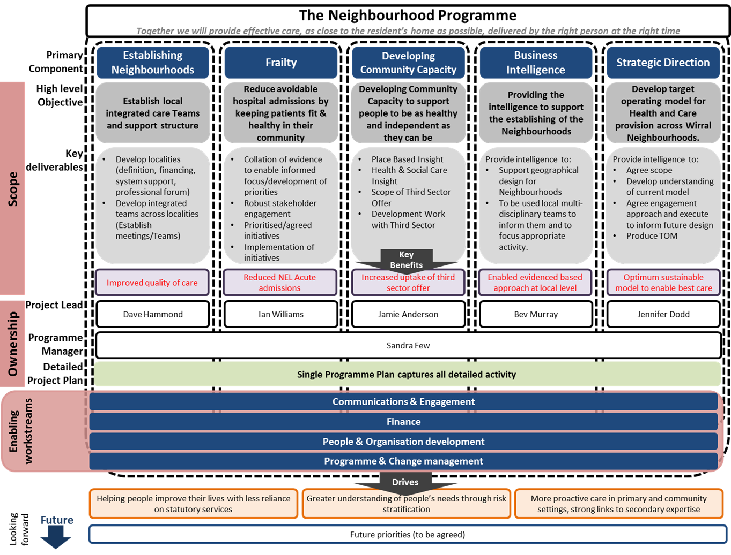
Neighbourhood Programme Structure

Slide 31

Questions?

