Slide 1
Mutual benefit?
The audit committee and internal audit
Diana Melville FCPFA
Governance Advisor
CIPFA Better Governance Forum

Slide 2

How do you feel about your audit committee?
?
Copyright © CIPFA 2016 protected under UK and international law

Slide 3
Mutual benefit
Mission of internal audit:
To enhance and protect organisational value by providing risk-based and objective assurance, advice and insight.
Core Principles for the Professional Practice of Internal Auditing include:
aligns with the strategies, objectives and risks of the organisation
promotes organisational improvement
PSIAS 2016
Copyright © CIPFA 2016 protected under UK and international law

Slide 4
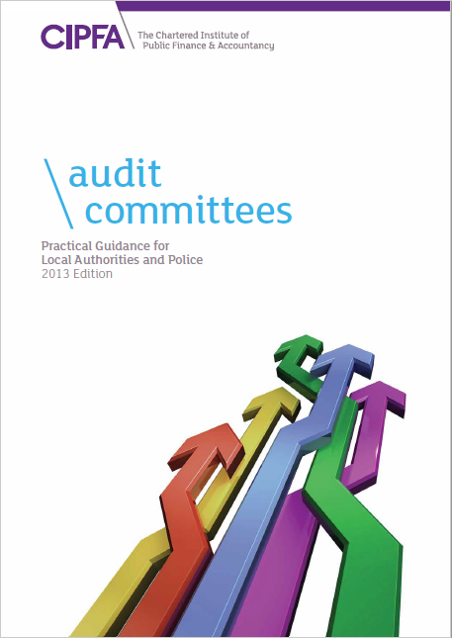
Purpose of audit committees:
Audit committees are a key component of an authority’s governance framework. Their function is to provide an independent and high level resource to support good governance and strong public financial management.
CIPFA’s Position Statement: Audit Committees in
Local Authorities and Police 2013
Copyright © CIPFA 2016 protected under UK and international law

Slide 5
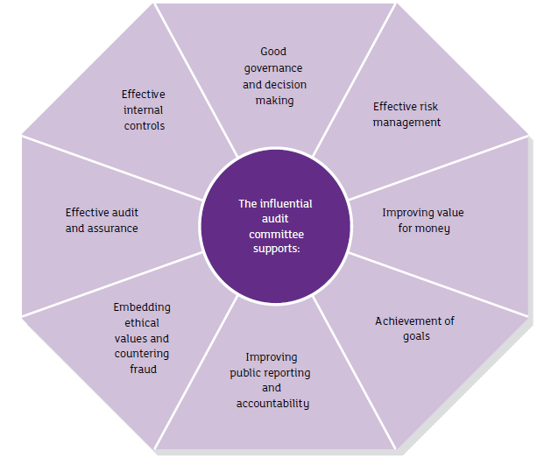
Assuring, supporting, advising, guiding
Audit committees add value by supporting improvement across a range of objectives:
Copyright © CIPFA 2016 protected under UK and international law

Slide 6
The committee’s oversight of internal audit
Internal audit needs the audit committee to fulfil many of ‘the board’ roles in the PSIAS, including:
approving the internal audit charter
approving the risk-based internal audit plan
approving the internal audit budget and resource plan
audit reporting
reviewing inappropriate scope or resource limitations.
Copyright © CIPFA 2016 protected under UK and international law

Slide 7
Does a poor audit committee matter??
To the organisation:
governance is weaker
audit is less effective
weaknesses, risks and control failings not addressed
accountability is reduced.
To internal audit:
less support for audit
lower profile
audit issues not escalated
more difficult to meet professional standards.
Copyright © CIPFA 2016 protected under UK and international law

Slide 8
So how good are audit committees?
Working well – effectiveness of the audit committee in supporting internal audit:
Source: CIPFA Survey of Audit Committees 2016
 | Very effective | Quite effective
Local authority head of internal audit | 59% | 37%
PCC CFO | 79% | 21%
Local authority chair | 66% | 31%
Police chair | 53% | 47%
Copyright © CIPFA 2016 protected under UK and international law

Slide 9
Positive views:
The support from the audit committee is first class and it is difficult to identify how it could better support the work of internal audit. The committee is focused on addressing control issues and making a difference in terms of how the council ensures that it provides value for money.
Head of audit, English unitary council
I have always found them to be very supportive. They are willing to call responsible officers to account via attendance at committee to explain improvement plans if and when audit assurance ratings show weaknesses, or for more understanding on the management of key risks. They have always shown concern for internal audit resources being adequate and appear to appreciate the work and role of internal audit.
Head of audit, English district council
Copyright © CIPFA 2016 protected under UK and international law

Slide 10
Do audit committees challenge enough?
Effectiveness of the audit committee in following up outstanding actions or improvement plans:
Source: CIPFA survey of audit committees 2016
 | Very effective | Quite effective
Local authority head of internal audit | 41% | 49%
PCC CFO | 61% | 28%
Local authority chair | 51% | 43%
Police chair | 53% | 29%
Copyright © CIPFA 2016 protected under UK and international law

Slide 11
So what would heads of audit like to see?
Support and understanding is pretty good. However, there is always scope to challenge management more about the issues internal audit might have reported and certainly over the timely implementation of recommendations.
Head of audit, English metropolitan district council
Copyright © CIPFA 2016 protected under UK and international law

Slide 12
Knowledge and understanding
Copyright © CIPFA 2016 protected under UK and international law

Slide 13
Effectiveness of internal audit
Copyright © CIPFA 2016 protected under UK and international law

Slide 14
What do the results tell us?
Committees are providing good support to internal audit
Scope for improvement:
developing the knowledge and understanding of the audit committee members
more questioning and constructive challenge
improving dialogue between some internal auditors and the audit committee
Copyright © CIPFA 2016 protected under UK and international law

Slide 15
Other results: effectiveness
Copyright © CIPFA 2016 protected under UK and international law

Slide 16
Barriers to improvement
Copyright © CIPFA 2016 protected under UK and international law

Slide 17
Barriers – views of chairs
Copyright © CIPFA 2016 protected under UK and international law

Slide 18
What do the results tell us?
It is possible to attract capable people – but you need to get the best out of them
Councillors have more engagement with organisation than appointed independents, but may lack knowledge and skills
Is the blended approach the best?
Copyright © CIPFA 2016 protected under UK and international law

Slide 19
Looking to the future
Combined authorities
New external audit arrangements
Emergency services collaboration
New PSIAS
2016 governance framework and impact on annual governance statement
Copyright © CIPFA 2016 protected under UK and international law

Slide 20
Summing up
Most audit committees are supportive of internal audit
……… But improvements can be made to their knowledge and skills
Audit committees could have more impact by challenging more and following through on risks and recommendations
Most internal auditors are meeting the needs of their audit committees
……….But some could engage better
Audit committees could be more effective, particularly in relation to assurance on partnerships and explaining their role
Copyright © CIPFA 2016 protected under UK and international law

Slide 21
Access the survey reports
Six briefings available to download:
http://www.cipfa.org/services/networks/better-governance-forum/corporate-governance-documentation/cipfa-survey-of-audit-committees-in-local-authorities-and-police
Other audit committee materials:
Audit Committee Update Issue 21
Support for Audit Committees
Copyright © CIPFA 2016 protected under UK and international law

Slide 22

Questions?
Diana Melville
CIPFA Better Governance Forum
E: diana.melville@cipfa.org
www.cipfa.org/Services/Networks/Better-Governance-Forum

