Slide 1

Addressing gender inequalities in accounting & finance: an overview
Prof. Kathryn Haynes
Northumbria University, UK
Women in Finance event
18th January 2023

Slide 2

Key Facts and Trends in the Accountancy Profession - Financial Reporting Council
https://www.frc.org.uk/auditors/professional-oversight/key-facts-and-trends-in-the-accountancy-profession
Notes:
Six major accounting bodies plus AIA and AAT.
20 year set of data.
Overall, the accountancy bodies collect data on their members and students concerning six of the nine protected characteristics under the Equality Act 2010; seven bodies collect data on age and sex, six on race, and five on disability, for example. Three of the bodies also collect data on socio-economic background (Figure 9). Figure 20 shows the number of bodies that collect diversity data on their own workforce in respect of the protected characteristics; all nine of the protected characteristics were used by at least one of the bodies to record diversity information on their workforce. All the bodies have diversity policies/statements in place.

Slide 3
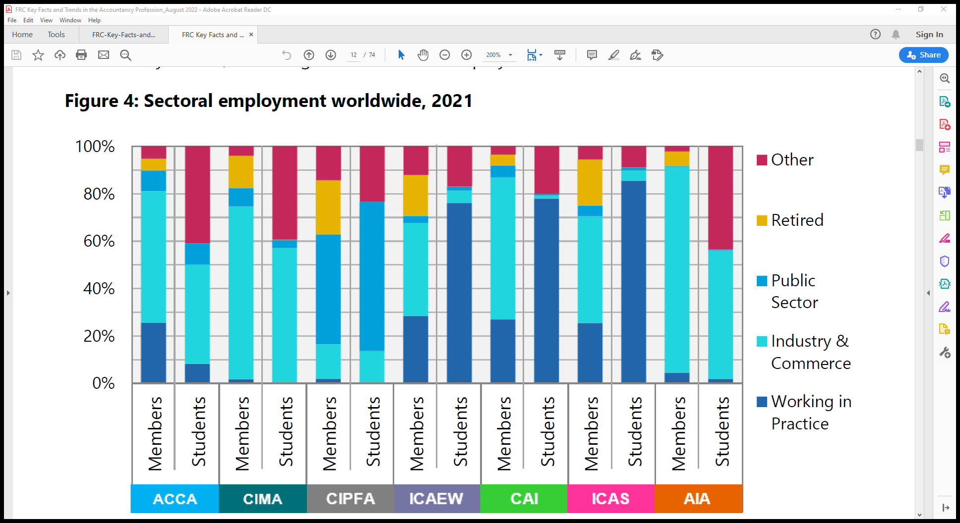

Slide 4
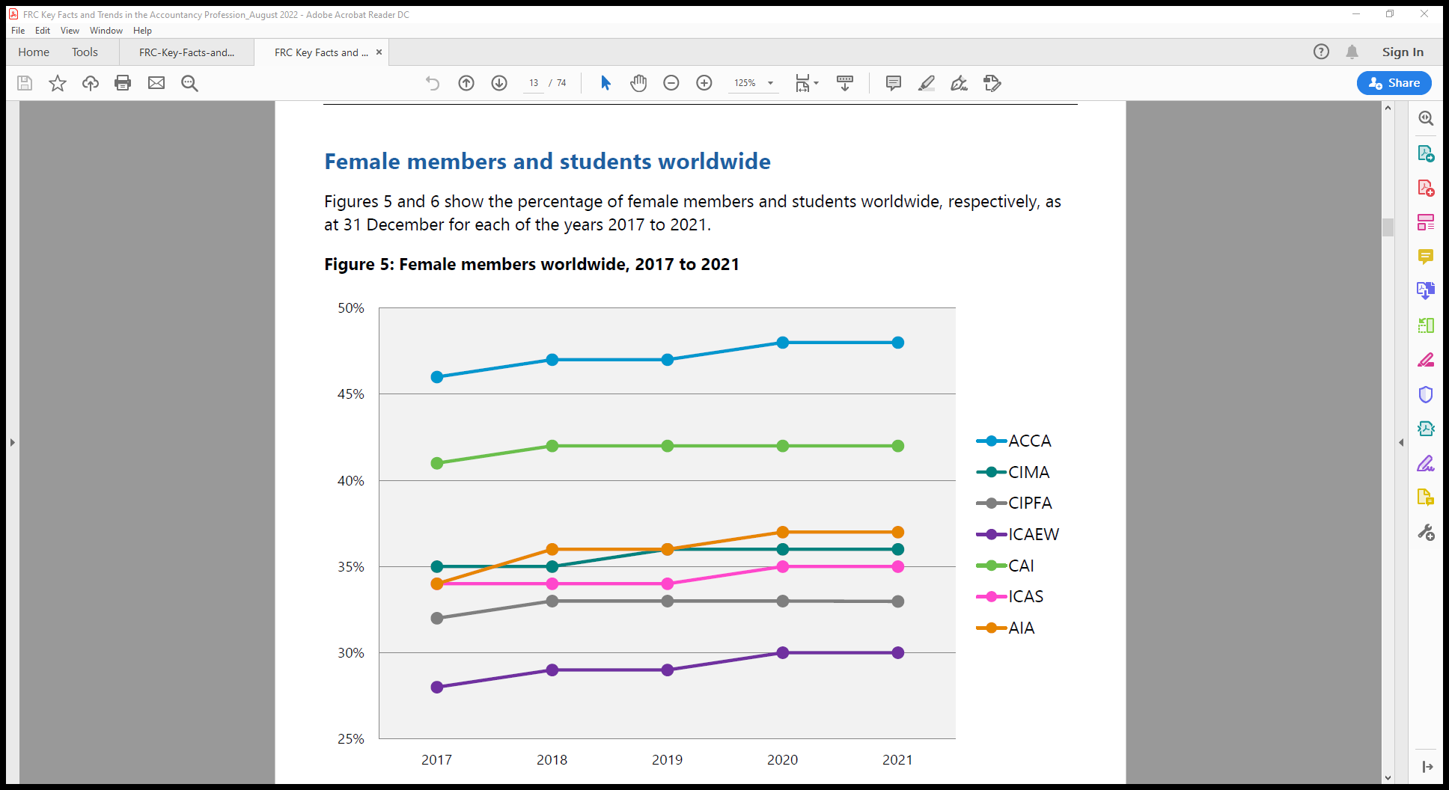

Slide 5
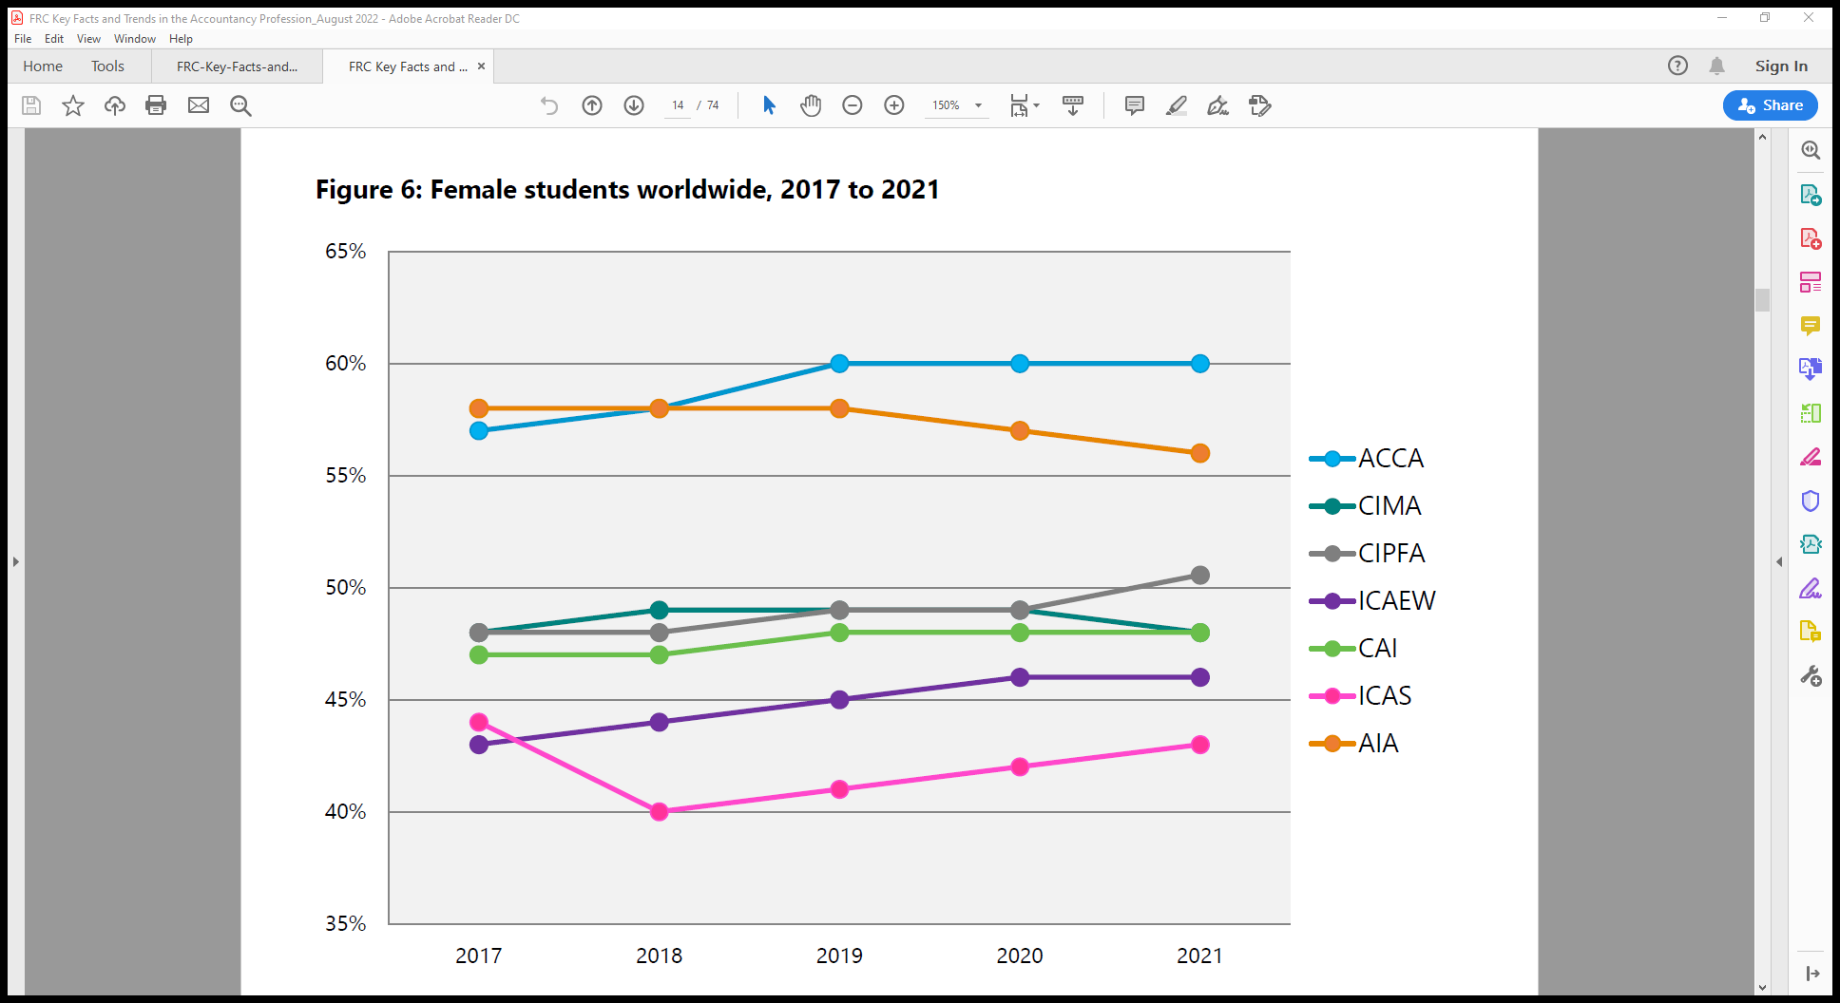

Slide 6
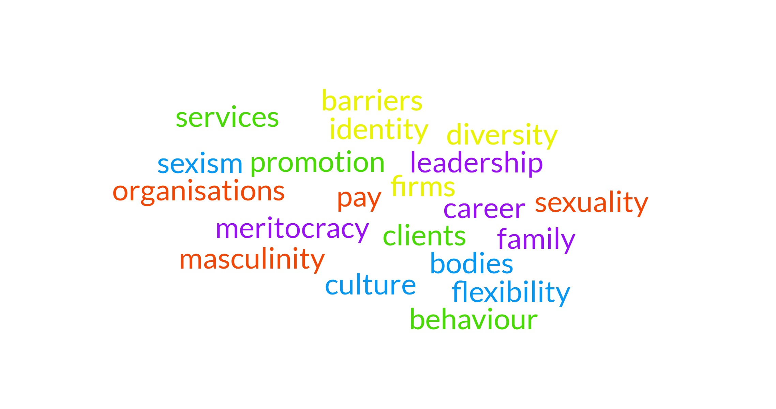
Gender issues in Accounting & Finance

Slide 7
Gendered histories of accounting and finance
Barriers to entry
Individual struggles for admission to professional work
Experiences within their contexts
  Large professional services firms are relatively homogenous, but the geographical, political and cultural context also needs to be addressed to provide insights into areas of difference
Role of accounting & finance profession – the degree to which the profession reflects the shifting demographics of society or actively shapes that society

Slide 8
Accounting & finance as a gendered and gendering institution
Accounting & finance profession both reflects and shapes reality
A historically masculine profession has opened its doors to women in large numbers but many challenges remain:
  Gendered career hierarchies
  Interaction with motherhood/caring
  Work-life issues and choices
  Meritocracy
  Feminisation and segmentation in the profession
Accounting as gendering and gendered: A review of 25 years of critical accounting research on gender

Slide 9
Identities and bodies intersecting with gender
Identity and embodiment
ESRC funded project
  Body Beautiful? Gender, Identity and the Body in Professional Services Firms
  (Re)figuring accounting and maternal bodies: The gendered embodiment of accounting professionals
Physical body is an important facet of professionalism because it is symbolic of aspects of identity and the self, an embodied representation of a perceived identity
Gendered embodiment in accounting & finance
Notes:
Embodiment - refers to the perception that one’s body represents, or embodies, a particular form of identity

Slide 10
What is ‘professional’? - appearance
Nature of professionalism goes beyond technical attributes to incorporate aspects of behaviour, embodied in the form of required attire, dress and presentation.
“The whole group of first level people will go up to our Headquarters and there will be two or three days training, now 90% of it will be technical, you know, how to audit, how to do that, but they often throw in something light, like business etiquette or how to present yourself, and appropriate dress and appropriate behaviour and how to eat properly.” (Partner A - Accounting firm)
Notes:
Not always explicit.
WHAT IS PROFESSIONAL?’ – PROFESSIONAL APPEARANCE

Slide 11
Women’s ‘professional appearance’
Women have to present themselves in a way that exudes their status and ability as professionals, and adds credibility to their competence:
“I certainly find that with women they have got to understand the consequences of the way that they are dressing but if they dress in a way that is not traditionally professional, or too casual, or too sort of trendy that veers away from the business look, I think it effects their credibility and I think it is hard, you know, the Juniors are already struggling with looking young, with not having a lot of experience, maybe not having a lot of confidence yet, and then on top of it your appearance is not emanating this...” (Partner B – Law Firm)
Notes:
The exact nature of required professional self – presentation, through dress and appearance, however, is difficult to define and is not always explicit. For women, in particular, this form of professional embodied identity may be difficult to negotiate because the informal rules governing women’s attire and appearance are not as explicit or traditional as the archetypal professional male suit

Slide 12
Negative characterisations of women
Differential sets of embodied for men and women
“If a man had made the same arguments, in the same manner, in the same way as a woman, you know they were just protecting their clients’ interests or whatever, but if a women does it, she is a bitch, So that is one of the things for women, it is more of a problem for women to be taking strong positions and arguing forcefully and striking that balance. If you do it too much you are a bitch, that is how you would be characterised and you know with some people if you do it at all you are a bitch”. (Partner A – Law Firm)
Notes:
Women who are deemed as acting contrary to femininity and embody more masculine attributes required by the law profession are subject to negative characterisations:
So that elusive and ephemeral professional demeanour which encapsulates body language, manner and speech may have differential sets of criteria for men and women, so that what is regarded as professional for a man may be regarded as too masculine for a woman

Slide 13
It is not a question of ‘fix the women’
We have to shift cultures and structures
Embrace diversity and difference
We cannot achieve gender equality without men
  Men can take parental leave, share ‘double shift’, challenge peers, call out sexism, address unconscious bias, be an ally, work to change cultures
Men benefit from gender equality
  Restrictive gender roles and stereotypes also harm men and boys e.g. male suicide, violence, toxic masculinity, homophobia, lack of opportunity for family life

Slide 14
Business case for diversity
External benefits:
  selecting from the widest talent pool, thus attracting more women or a diverse workforce;
  marketing gains from increased cultural insights;
  avoiding costs of integrating workers poorly or employment tribunals.
Internal benefits:
  increased creativity and problem-solving from exposure to a wider range of perspectives.
  performance benefits through improved governance
  a more flexible approach to external environmental changes.

Slide 15
Ethical case for diversity
If we want to live in a world where social justice matters, where human rights are respected, where we can live in a just and fair society, with freedom from violence, from sexual discrimination and sexual violence, then we have to do more to ensure that respect for gender equality is integrated into our own lives, and those of the organisations we work in, and the institutions, civil society in which we operate at citizens.
It is a matter of global citizenship.

Slide 16
The emancipatory potential of accounting & finance – as a tool
Ambitious and binding national goals
Robust data and accounting metrics in public accounting to address inequalities
Gender responsive budgeting
Holding businesses and organisations to account
  e.g. living wage, supporting inclusivity, flexible working hours, avoiding precarity
Notes:
Accounting underpins institutions under neo-liberal and globalised capitalism

Slide 17
The emancipatory potential of accounting & finance – as a profession
Professions shape society as well as reflect it
  Powerful institutions
  Move towards alternative reporting
  Enhancing diversity and inclusivity

Slide 18

Contemporary feminisms and their emancipatory potential for accounting
Leverhulme Trust Major Fellowship Contemporary Feminisms and their Emancipatory Implications for Accounting - 2 year funded project
The role of a feminist perspective is to disrupt, subvert and emancipate from constraining gender norms, cultures and structures
An overview of contemporary feminist approaches and their relevance to accounting (as a tool and as a profession) and organisations
What is the role of accounting in forming and overturning inequalities?
Notes:
Contemporary feminist approaches which address the interaction of gender, race, sexuality and class with economic exploitation under global capitalism hold high relevance for research and feminist activism
Feminist research on the interrelationship of gender and accounting could investigate the role, purpose and effect of accounting in interacting with globalised and localised contexts in which different forms of oppression and inequality are constituted, while also recognising the variety of alternative organisational and individual responses and forms of resistance aiming to create more justice and equality in the world, and providing insights into the further transformation of accounting’s gendered and gendering role in our global society

Slide 19
Thank You

