Slide 1


Hello and welcome!
FIRST Face to Face t/a FIRST is the proprietor of the copyright and all intellectual property rights within this Presentation. No use of any concept or format may be made without the consent of FIRST and these materials must not be used, copied, edited or reproduced in any material form in whole or in part without the written permission of FIRST.

Slide 2
“When determination meets opportunity”
Karan Bilimoria – Founder of Cobra Beer

Slide 3
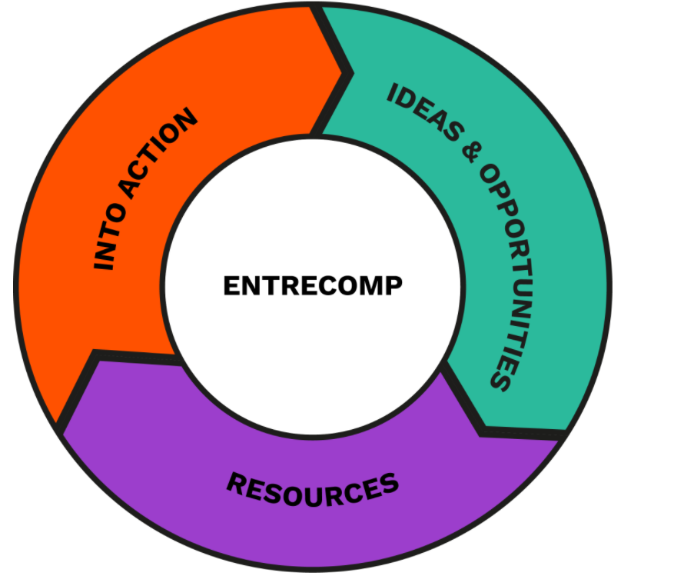
www.youarefirst.co.uk

Slide 4

Talk outline:
The why
Opportunity examples
Case studies

Slide 5
“Fear of rejection”
“Selling myself”
“Imposter syndrome”
“Finding the right people”
“Forcing conversation”
“Looking like I don’t know what I am doing”
“Talking about myself”

Slide 6
Why

Slide 7
YOUR VALUES
Rokeach Values Survey

Slide 8
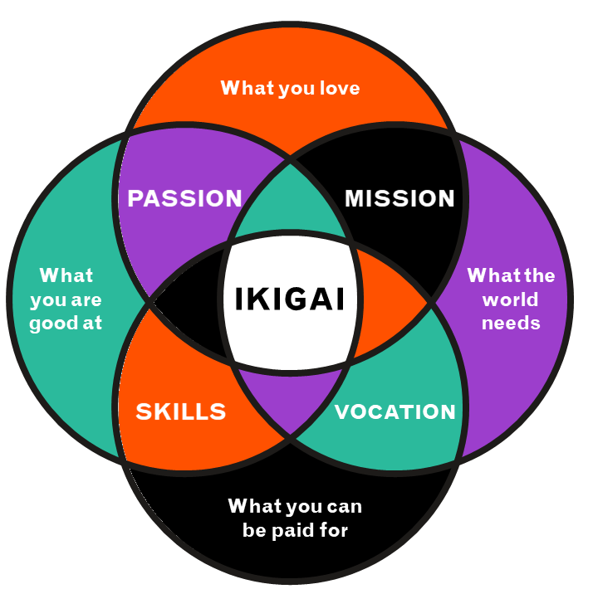
IKIGAI
Passion + Mission = what you love
Passion + Skills = what you’re good at
Skills + Vocation = what you can be paid for
Mission + Vocation = what the world needs

Slide 9
PROFESSIONAL PALS!
NEW JOB
TRUSTEESHIP/NED ROLE
EDUCATION
VOLUNTEERING
CPD
LEADERSHIP OPPORTUNITIES
HOBBY
ENTREPRENEURSHIP
SECTOR SPECIFIC INFORMATION

Slide 10
External networking

Slide 11
WORKSHOPS
CONFERENCES
MEETUPS
LAUNCHES
SESSIONS
CLINICS

Slide 12
Where to find them

Slide 13




Slide 14
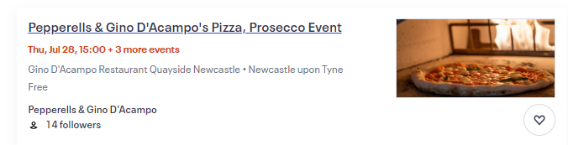
PROFESSIONAL PALS!

Slide 15
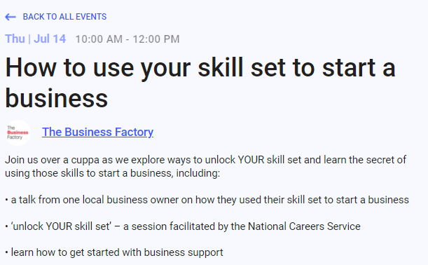
ENTREPRENEURSHIP

Slide 16
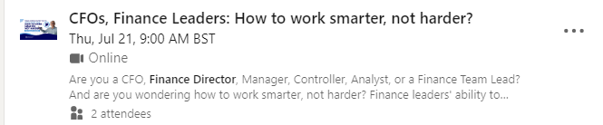
CPD

Slide 17
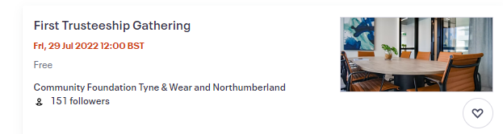
TRUSTEESHIP/NED ROLE

Slide 18
Internal networking

Slide 19
Celebrating success
Connecting with people I want to get to know or already know
Recruitment
Reconnecting
Finding events and news relevant to my sector
Mentoring/asking for help

Slide 20
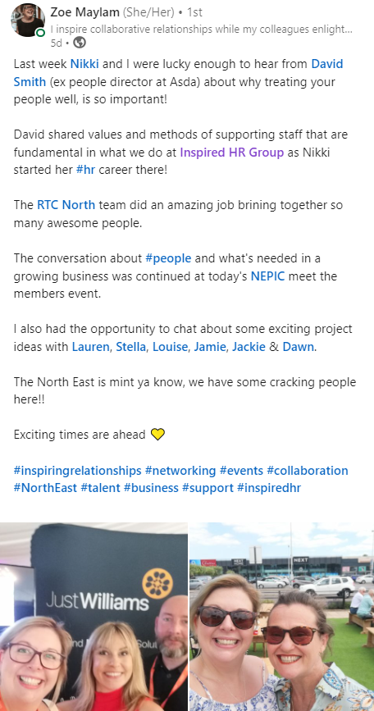
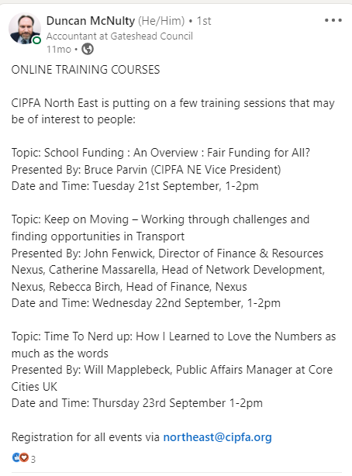


Slide 21

www.youarefirst.co.uk @firstlifeskills

Slide 22
“When determination meets opportunity”
Karan Bilimoria – Founder of Cobra Beer

