Slide 1
How to be an anti-fraud ninja Katie Sargeant (Audit Manager – Fraud & Error)
Mike Newbury (Director)
July 2022

Slide 2
What do we mean by fraud?

Slide 3
Fraud definition
The Act provides for a general offence of fraud with three ways of committing it, which are by false representation, by failing to disclose information and by abuse of position.
Proving intention to deceive is key.
Fraud Act 2006
Government’s definition recommends using the civil burden of proof i.e. whether the action or inaction was more likely than not to have been made to defraud the department rather than being erroneous.
Cabinet Office
Notes:
Reminder of what we mean by fraud – three offences per the Fraud Act 2006. Intention key – loss without intention is an error, intention without loss is fraud.
Govt has its own definition based on FA06 for purposes of fraud reporting, lower burden of proof.

Slide 4
Career of a lifetime!
What can this role offer you?
Use of cutting edge technology to secure lasting global impacts
Highly competitive reward scheme
Access to professional networks for career advancement
Regular opportunities for training and development
Successful candidates are likely to be:
Highly motivated and able to deliver at pace
Comfortable working independently and as part of a team
Creative and innovative in their approach to problem solving
Goal orientated and committed to the cause
Notes:
Before we get into the fraud update – start with a job advert. Never been easier to begin your career

Slide 5
Types of fraudster
Types of fraudster
Opportunistic
Professional
Notes:
Many types of fraudster, two most common you might come across are the opportunistic & professional fraudsters
Opportunistic - does not usually make a living or a steady income from fraud, but is willing to take advantage of a loophole or weakness for a quick reward. They have a low level of operational security, but due to the sporadic nature of their fraud, they consider themselves to be at a low risk of being caught and are willing to take chances. The rise in popularity of fraud-themed discussion platforms online (forums, messenger groups, online guides) has made it simple for this type of fraudster to get a basic education on how to commit fraud, with plenty of 30 minute tutorials available.
Professional - organized criminals making a professional grade living out of committing fraud. As per job advert– hard working, intelligent, well resourced and ruthless. Only interested in taking as much as they can and not getting caught. Will target charities and public funds as much (if not more than) private sector companies.

Slide 6
External fraud
False claims
Customer or beneficiary fraud
Public sector service provision
when a public service to which a person would not otherwise be entitled is used fraudulently e.g. when a resident permit is sold on to a non-resident
Phishing
using fake messages as bait to lure you into clicking on the links within the email or text message, or to give away sensitive information
Account takeover
when a fraudster or computer criminal poses as a genuine customer, gains control of an account and then makes unauthorized transactions.
Social engineering
a variety of techniques used by fraudsters to deceive and manipulate victims into voluntarily performing actions which result in them giving out confidential information or transferring funds.
Notes:
Fraud can be broadly split into two categories – external (someone from outside targeting the organisation) and internal (usually someone who works for the org)
According to PwC’s latest global economic crime and fraud survey, the damage caused by external fraudsters is on the rise, as is collusion between internal and external actors.
Many ways to commit fraud resulting in hundreds of fraud types, some of which have vague or technical names. Picked out some of the external frauds most likely to encounter working in public sector.
Social engineering: Techniques vary and can include: emails which purport to be sent from employees, vendors, clients, customers, or other organisations; phone calls, text messages, or even leaving a malware-infected USB stick lying around an office. Fraudsters aim to piece together information from various sources such as social media and intercepted correspondence in order to appear convincing and trustworthy while perpetrating the fraud. The often complex nature of these schemes makes it extremely difficult to identify the fraud before it is too late. Victims range from small businesses to large organisations, across many industries and geographies. The fraudsters are not selective, and will often adopt a scattergun approach to see what response they can get from a fraudulent communication.

Slide 7
Internal fraud
Corruption
Conflicts of interest
Bribes and kickbacks
Bid rigging
Asset misappropriation
Theft of cash or inventory
Skimming
Personal purchases
Ghost employees
False expenses
Forged endorsement
Financial statement fraud
Under / over stated revenue or expenditure
Concealed liabilities
Timing differences
Notes:
Association of Certified Fraud Examiners – three branches of internal fraud. Summarised types most likely to encounter in public sector

Slide 8
What does fraud look like in practice?

Slide 9
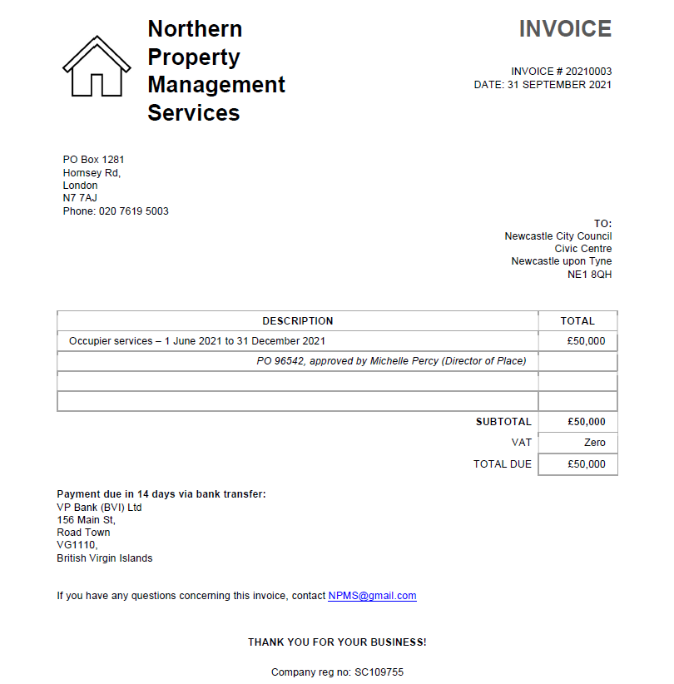
Spot the red flags

Slide 10
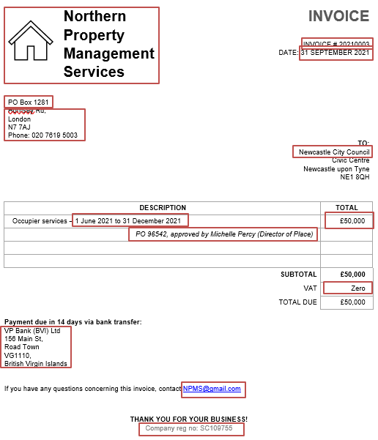
Spot the red flags

Slide 11
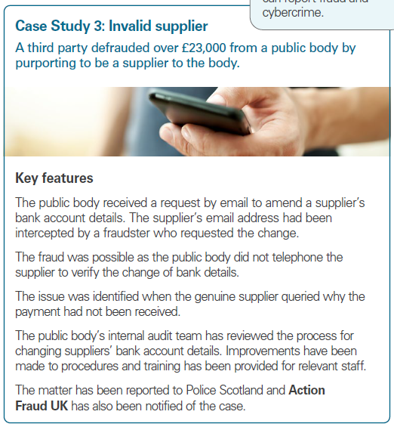
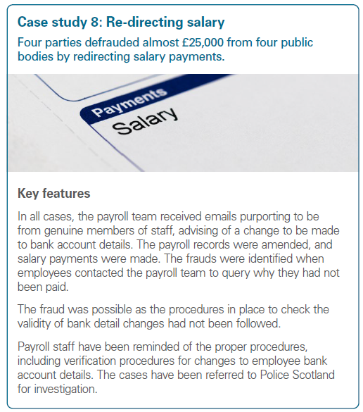
Case studies: external fraud
Fraud and irregularity 2021/22, Audit Scotland
Fraud and irregularity 2020/21, Audit Scotland
Notes:
Case studies from public sector (Audit Scotland’s annual report of fraud and irregularity)

Slide 12
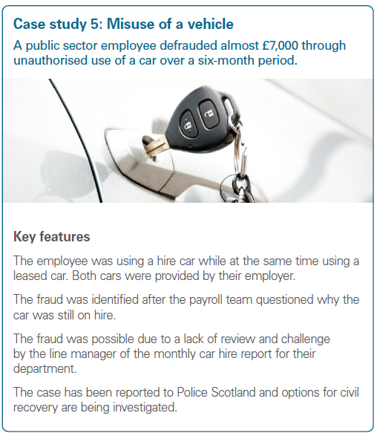
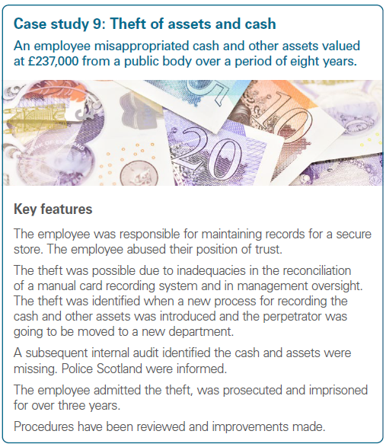
Case studies: internal fraud
Fraud and irregularity 2020/21, Audit Scotland

Slide 13
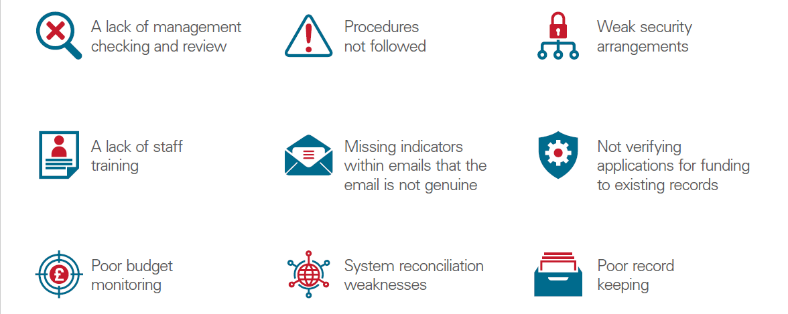
Common control weaknesses
Notes:
Controls. Graphic is a summary of common control weaknesses per the Audit Scotland report. ACFE annual study found that nearly half of internal fraud cases occurred due to a lack of ICs or override of existing ICs – we can see that in these public sector fraud cases and earlier case studies. Prevention is so much cheaper and more effective than recovering after the fact for fraud.
Controls are supposed to be meaningful, not tick box exercises.

Slide 14
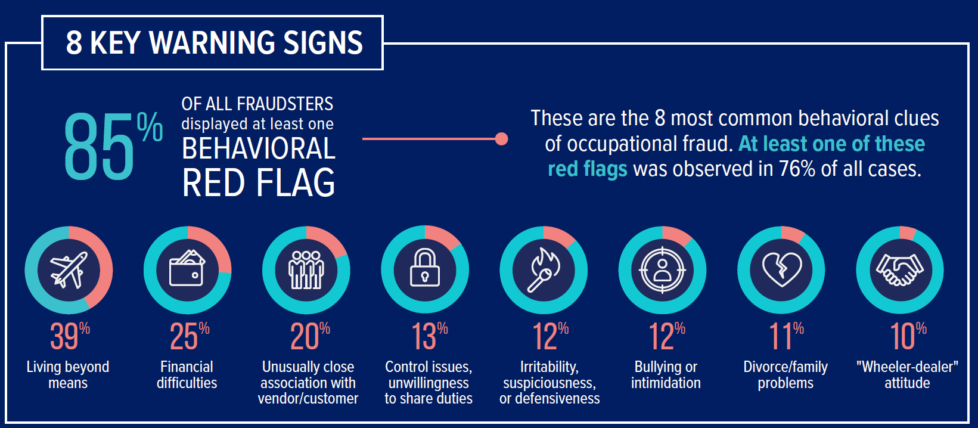
Common ‘red flags’

Slide 15
What impact does fraud have?

Slide 16
Cost of fraud to public sector (pre COVID-19)
Between £29.3 billion and £51.8 billion every year
200,000
200,000
200,000
83
166
Notes:
The Government Counter Fraud Function (GCFF) estimates that before the COVID-19 pandemic the public sector was losing between £29.3 billion and £51.8 billion a year from fraud and error, before any recoveries.
Around £26.8 billion is based on measurement of fraud and error in specific areas of income or expenditure. The rest is based on GCFF’s assessment that fraud and error is likely to be in the range of 0.5% and 5% for the £503 billion where fraud and error has not been measured.
To put into perspective CIPFA worked out that the money lost to fraud in 2019 could fund roughly:
200,000 police officers AND
200,000 doctors, AND
200,000 teachers, AND
83 new hospitals, AND
166 new libraries.
Another way to look at it - General government deficit (or net borrowing) was £46.1 billion in 2019 (UK government debt and deficit - Office for National Statistics (ons.gov.uk))

Slide 17
Cost of fraud to public sector (COVID-19 only)
At least £15.7 billion in 2020-21 alone
Notes:
Through our work auditing the 2020-21 accounts we have helped Departments to identify at least £15.7 billion was lost to fraud and error in COVID-19 support schemes. This central estimate is highly uncertain and government continues to refine its estimates based on sampling exercises and loan repayment data.
We know the £15.7 billion excludes potential fraud and error in:
COVID-19 spending where the identified risk of fraud and error was not material to the department’s accounts, such as the Coronavirus Business Interruption Loan Scheme or Coronavirus Large Business Interruption Loan Scheme where government considers the risk of fraud to be “normal”,
COVID-19 PPE procurement, as the Department for Health & Social Care wasn’t able to quantify potential fraud and error due to issues with inventory management,
types of fraud that are hard to identify. For example, claims for support from HM Revenue & Customs (HMRC) where businesses were not “adversely affected” by COVID-19 or where bounce back loans were taken out for personal use, and
fraud outside the 2021-22 financial year. We don’t yet have estimates for 2022-23 although we’re expecting that it will amount to some very large numbers.
We don’t know the long term impact of COVID-19 on fraudulent behaviour – anecdotally organised criminal gangs and opportunistic fraudsters now see public funds as an easy target – and DWP seeing higher levels of UC fraud than ever before which they attribute in part to CV19. We also know that fraud increases during times of recession.

Slide 18
Wider costs of fraud
Wider costs of fraud
Human impact
Policy impact
Reputational impact
Opportunity costs
Industry impact
Notes:
More than a financial cost
Human - not a victimless crime, traumatic experience that often causes real and irreversible impacts for victims, their families, carers and communities. Those who rely on government services, such as the elderly, the vulnerable, the sick and the disadvantaged, are often the ones most harmed directly or indirectly
by fraud. Fraud can have a devastating and compounding effect on these victims; amplifying the disadvantage, vulnerability and inequality they suffer. Fraud can also cause lasting mental and physical trauma for victims, and in some cases, take people’s lives.
Policy - compromises the government’s ability to deliver services and achieve intended outcomes. Money and services are diverted away from the intended targets and the services delivered can be substandard or unsafe.
Reputation - when it is handled poorly, fraud against government programs can result in an erosion of trust in government and industries, and lead to a loss of
international and economic reputation
Opportunity cost - drains government resources across multiple areas including investigations and compliance, prosecution, prison, welfare, identification and computer systems
Industry - can result in distorted markets where fraudsters obtain a competitive advantage and drive legitimate business out. It can affect services delivered by business and expose other sectors to further instances of fraud. It can also result in greater burdens on charities and community services who assist those affected by fraud against public bodies.

Slide 19
What can you do every day to be an anti-fraud ninja?
Notes:
10 things you can do

Slide 20
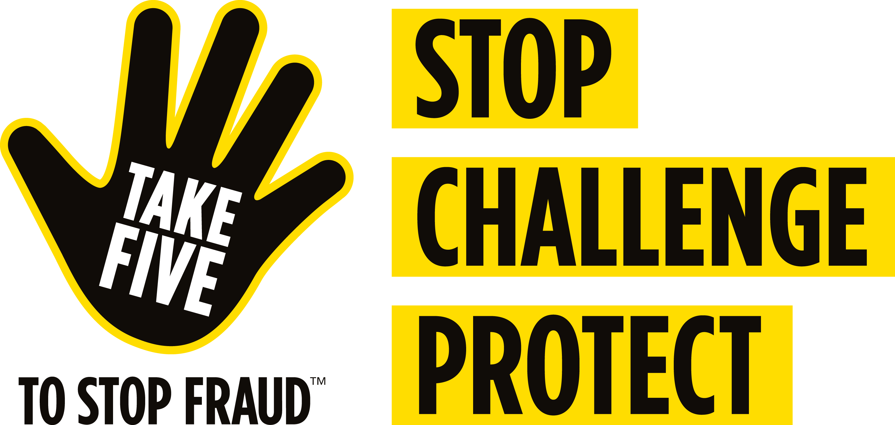
Six everyday ways to tackle fraud
Trust but verify!
Adopt a questioning mindset and provide a space where it’s safe to challenge decisions.
Clearly document processes – especially those with a high fraud risk.
Make sure everyone understands and follows them.
Don’t be pressured into overriding or ignoring controls by anyone.
When in doubt, Take Five.
Use the contact details you already have (or that are publicly available) not any new details provided.
Notes:
Encourage a questioning mindset in your teams – professional scepticism, or trust but verify.
Foster a culture that encourages constructive challenge of decisions made by both peers and managers. If possible provide support to those who do not feel confident participating in constructive challenge in the form of training, or an independent mediator if required. A space where everyone feels safe to challenge makes for better decision making all round and is a huge asset in preventing fraud
Document clear policies and procedures for activities that pose a high risk of fraud, and ensure these are easily accessible for relevant employees. Helps to avoid uncertainty under pressure, and ambiguity that could be exploited by internal or external actors
Fraudsters are taking advantage of home working and hybrid working model – pressure to act quickly via email, not as easy to turn to colleague and ask “does this seem right to you?”
If you’re unexpectedly contacted by a supplier or colleague asking to change payment details – confirm via an alternative channel you know is credible. Phone on a number you’ve used before and know is genuine.
Take 5 - Excellent initiative from UK Finance, useful for preventing fraud in your professional and personal life
Many people may already know the dos and don’ts of financial fraud and scams – that no-one should ever contact them out of the blue to ask for their full PIN or full password, or ever make them feel pressured into moving money to another account. The trouble is, in the heat of the moment, it’s easy to forget this.
After all, trusting people on their word is something everyone tends to do instinctively. If someone says they’re from your bank or a trusted organisation, why wouldn’t you believe them? Take Five urges you to stop and consider whether the situation is genuine – to stop and think if what you’re being told really makes sense.

Slide 21
Six everyday ways to tackle fraud
Make oversight more meaningful - tick box exercises don’t help anyone.
A fresh pair of eyes can make all the difference.
Don’t assume someone else has checked – especially if request hasn’t followed the usual process.
Talk more openly about fraud.
Raise fraud awareness internally, especially around common red flags.
Highlight the impact of fraud in external communications – it’s not a victimless crime!
Be collaborative and share intelligence within the sector wherever possible.
Fraudsters thrive on lack of communication between public sector bodies.
Notes:
Case studies and control failings show the importance of sufficient meaningful oversight
frauds often uncovered due to sick days - a fresh pair of eyes has questioned a transaction that’s happened hundreds of times already.
Internal fraudsters prey on familiarity – “We’ve worked together for years, they’re a really nice person…”
Be collaborative and share intelligence within the sector wherever possible. Fraudsters thrive on lack of communication between public sector bodies, often cycling between orgs to commit same fraud as they’ve spotted a common weakness

Slide 22
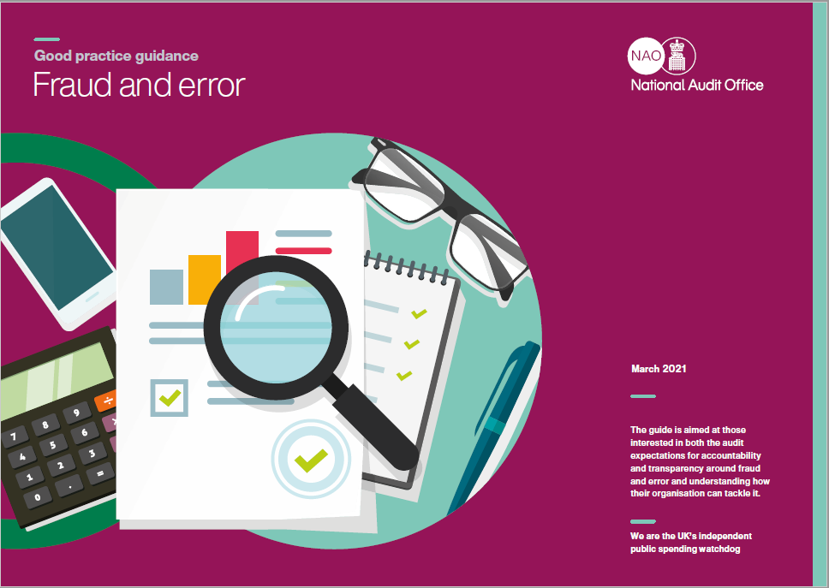
Notes:
If you want more info on what good practice looks like for tackling fraud and error – see our good practice guide.
https://www.nao.org.uk/report/good-practice-guidance-fraud-and-error/

Slide 23
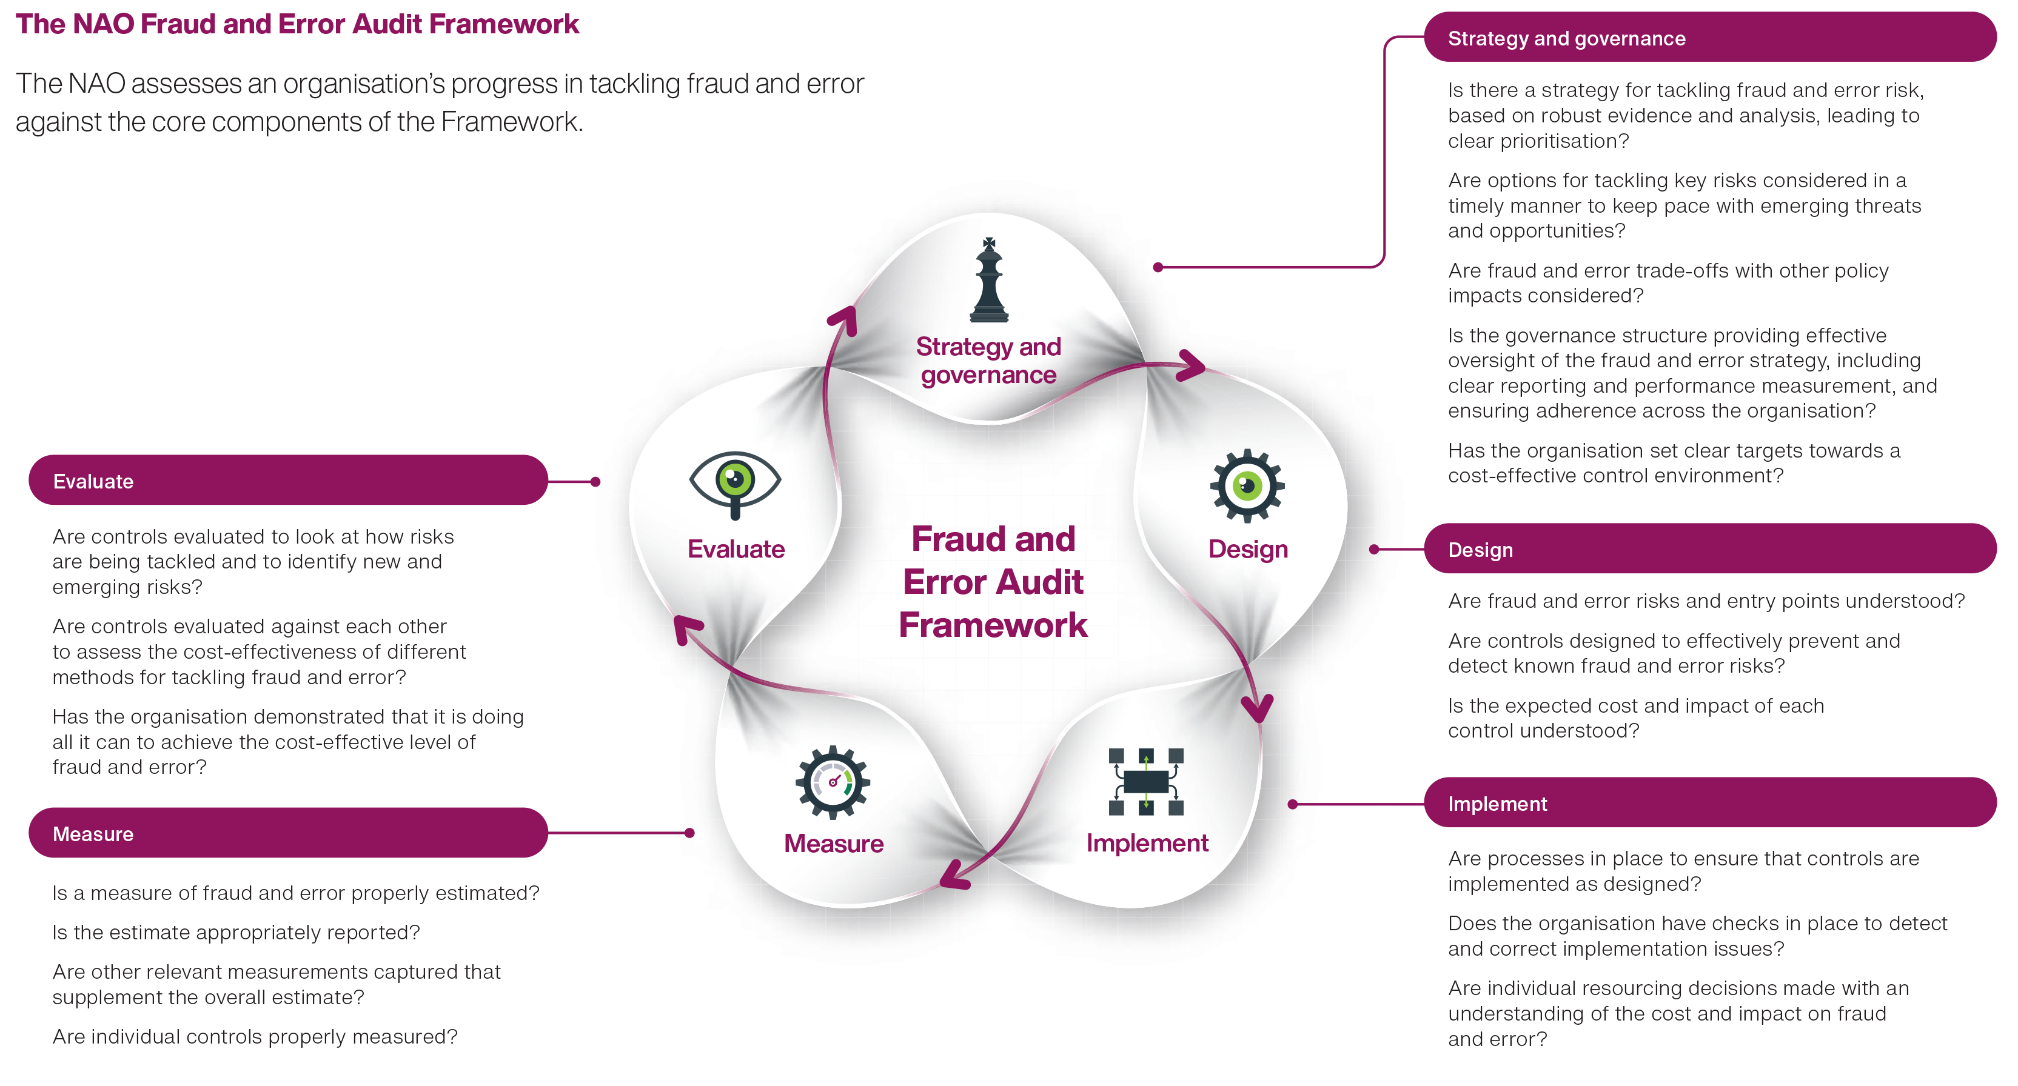
Notes:
In particular, Fraud and Error Audit Framework. What we as govt’s external auditors look for when we’re assessing the effectiveness of fraud and error controls

Slide 24
Thank you
For more information about the work of the NAO
Visit our website
www.nao.org.uk
or follow us on twitter
@NAOorguk

