Slide 1
CIPFA Conference North East 2021 Recover Together in Northumberland National Park Sustaining Nature, Climate , People and Place Tony Gates Chief Executive Northumberland National Park Authority

Slide 2
Introduction

Slide 3
Location
Facts
1,050km² or 400sq miles
< 2,000 inhabitants
~1,096km of Rights of Way
750km² Open Access Land
40% of North East's scheduled monuments
38.6% in public ownership
MOD
Public Forest Estate
Notes:
Qualities
Landscape
Geology (Great Whin Sill & Cheviot Hills)
Heritage
1 world heritage site
426 Scheduled Monuments
Nature
66% of NNP is upland moorland
32 SSSIs (12,450 ha)
400 ha of Waxcap grassland
10,000 ha of bog
Low Human Impact
International Dark Sky Park
Most tranquil NP in England*
Cleanest Rivers of NPs in England**
Greatest carbon sink of NPs in England**

Slide 4
Reason for being
Notes:
Created as part of post war recovery
1949 national park and Access to the Countryside Act
Kinder Scout trespass
Purposes
Section 61 of The Environment Act (1995) updated the two purposes of National Park designation:
Conserving and enhancing the natural beauty, wildlife and cultural heritage of the Park;
Promoting opportunities for the understanding and enjoyment of the special qualities of (the) areas by the public.
And; to ‘seek to foster the social and economic wellbeing of the local communities’.

Slide 5
Economic Value
Notes:
Industry
Farming (and forestry) is the dominant industry employing residents (22%) and accounts for two thirds of businesses and 55% of jobs located within the National Park.
The National Park’s business base is dominated by micro firms and small businesses. Many of these are tourism or visitor economy related
ONS data indicates that there are no businesses operating that employ more than 50 members of staff (with 97% employing fewer than 10). Than makes the NPA by some measure the largest employer.
It also highlights connectivity as a key challenge for the local economy at present. Road connectivity and public transport access is relatively poor.
Visitors
STEAM economic analysis suggests we receive 1.7 million visitors p.a.
Around 1.9 to 2.0 million visitors visit both the National Park and our gateway settlements.
The economic value of tourism in the Park is
Our paid for use car parks record 100,000 tickets p.a
The Sill:National Landscape Discovery Centre receives 150,000 visitors in an average year.

Slide 6
Potential

Slide 7
Potential
Notes:
Between 2010 and 2016 there was a decline in funding and visitors to our sites
The Sill project, supported by NLHF looks to provide a year round attraction offering
Retail and Café areas
A centre for Activities, Events and Learning
Exhibitions focussed on our landscape
Business hire and corporate away days
80% of our suppliers are from the local area

Slide 8
Since 2020
Notes:
Since 2020
Government restrictions were eased in July 2021.
We have seen even greater numbers of people travelling to our sites than 2018, and those numbers were the highest for a decade.
This brough some significant challenges – especially during a pandemic which high levels of anxiety around public health
There is an increasing desire to visit the outdoors and increasing desire to do it in a sustainable way.
Highlighting the ensuring or re-freshed purposes behind national parks – beauty and well-being.

Slide 9
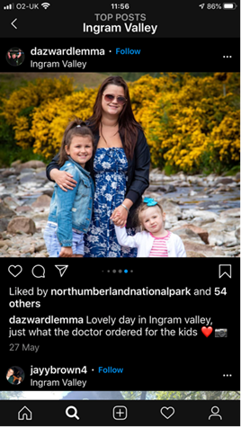
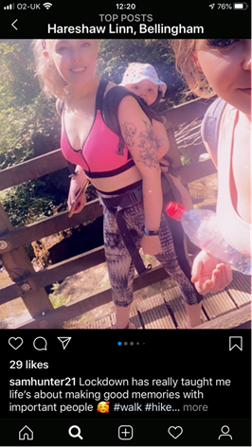
Beyond the finances –
Recover Together
Notes:
Impact of Covid and lockdown
Our response – welcoming park
Easing of lockdown – new audiences
Economic impact and recovery
Health and well-being impact and recovery

Slide 10
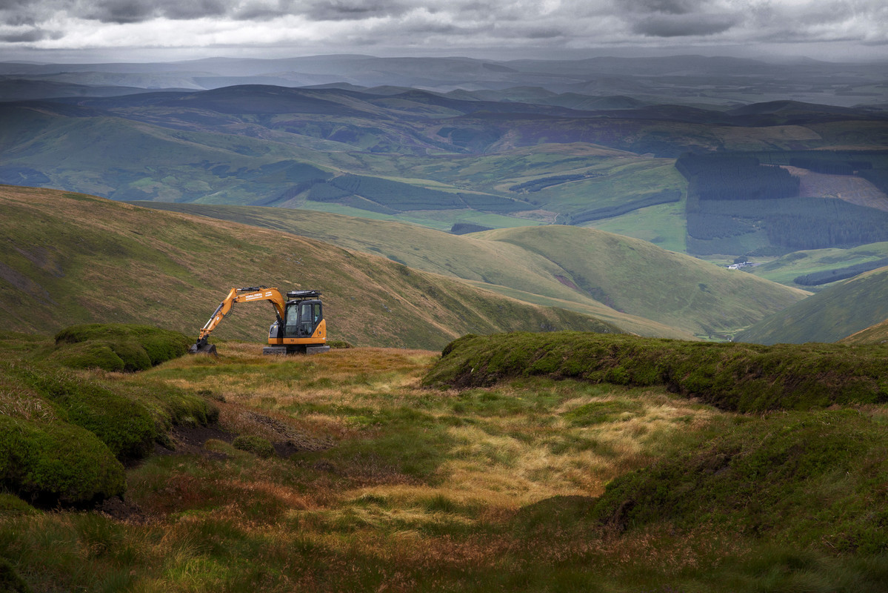
Recover Together
Notes:
Outline the elements:
Economy
People
Nature
Climate
Place

Slide 11
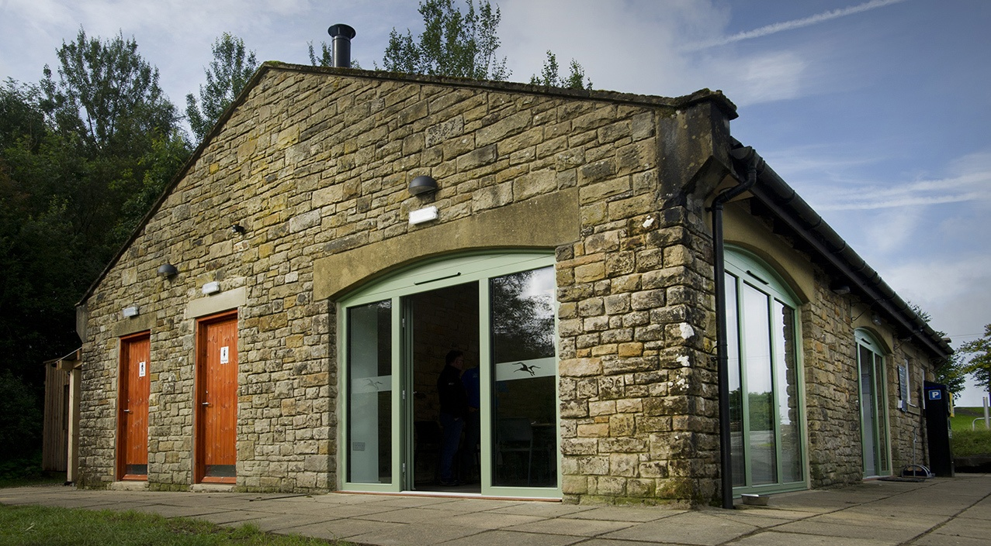
Economy
Notes:
New visitors
Stay-cations
Visitor spend
Capital investments
Land management changes
Others….

Slide 12
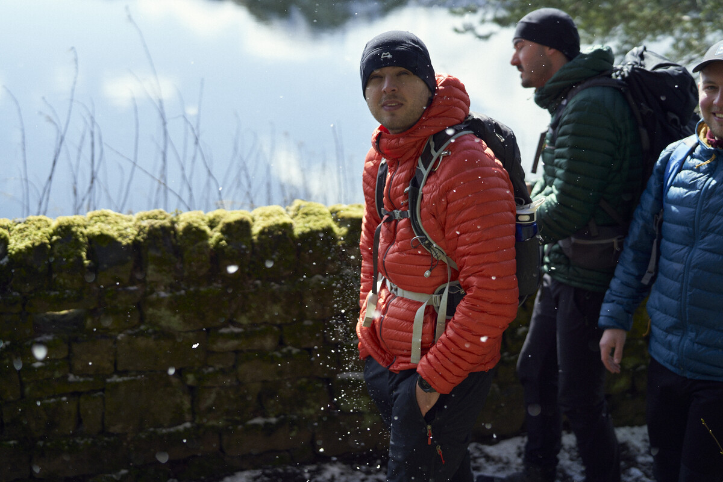
People
Notes:
Supporting local communities – initially with deliveries , food supplies, PPE -
New audiences
Challenges
Retaining audiences
Health and well-being, physical and mental, recovering people
Examples of new audiences and activities
National parks for everyone
National Parks on your doorstep etc…

Slide 13
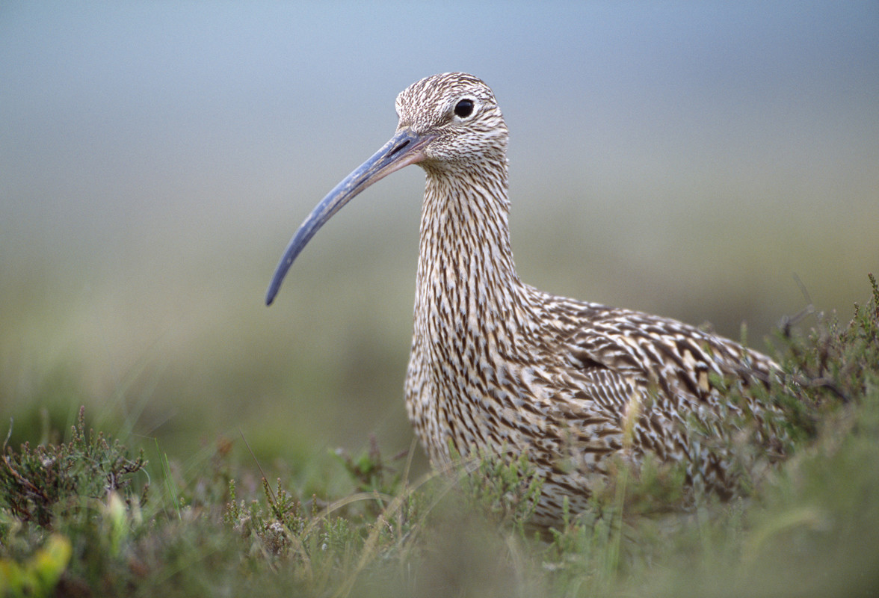
Nature
Notes:
Figures on global and national nature loss
Evidence of impact on nature on people
Examples of projects – Cheviots Peatland

Slide 14
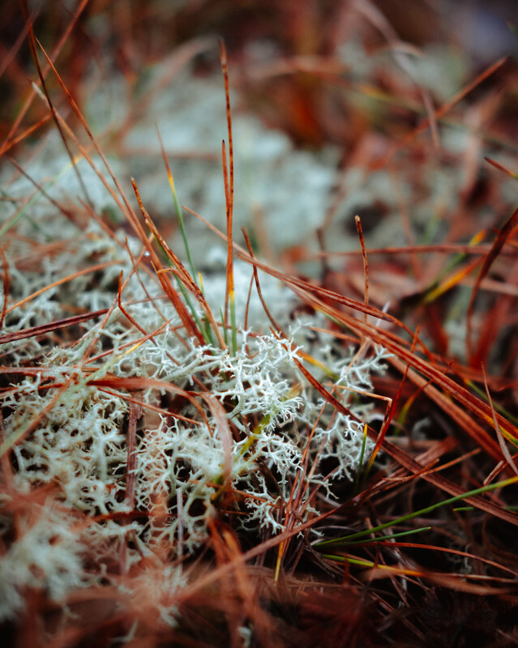
Climate
Notes:
Our targets – 2030 Authority and 2040 Park Our actions The Park as a net carbon sink and the natural capital it provides for the region

Slide 15
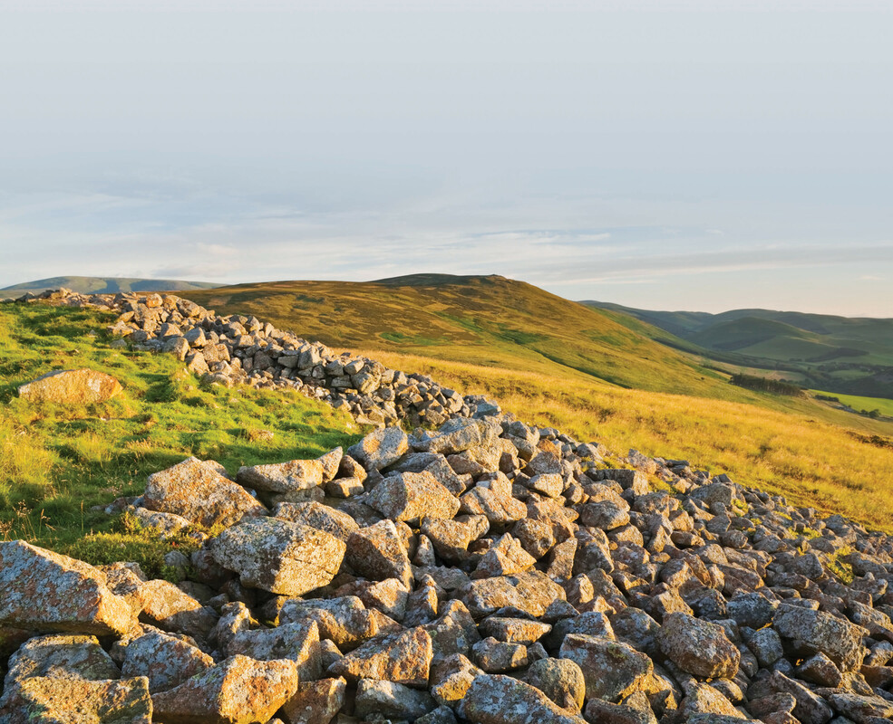
The Place
Discussion
Notes:
One of England finest landscapes
Our special qualities
To pilot and demonstrate new approaches
Multiple ways to engage in rich variety of heritage
Returning to our initial mission

Slide 16
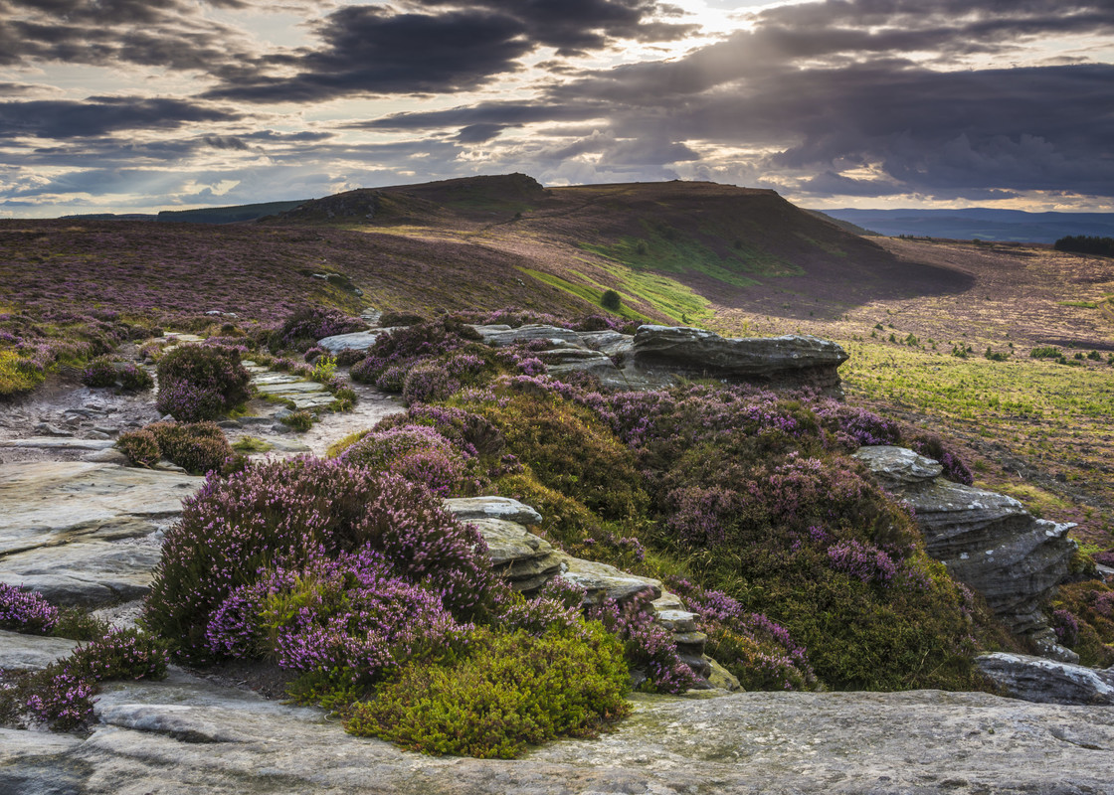
Thanks for listening
Notes:
Point in time for parks to play a key role
Call to action – need to balance the books – but to what end?
Keen to work with partners
Innovative and enterprising
Thank You
Questions

