Slide 1
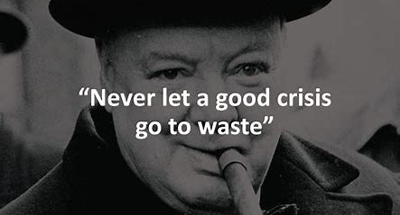
Notes:
Never let a good crisis go to waste. It’s a famous quote attributed to many people over the decades – but most cite Churchill as its author. And what he meant of course was that in challenging time and when things go wrong, you can’t just accept conventional wisdom and approaches because the resolution may well be found outside the usual compass.

Slide 2
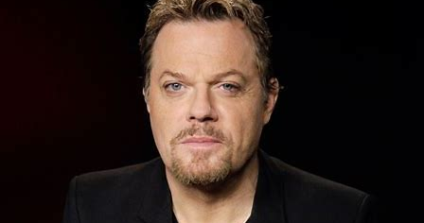
Notes:
So the plan for today’s session – and for a multitude of very good and not so good reasons it was a plan conceived as I was writing this last night – is to meander Eddie Izzard like through my reflections on the pandemic both personal and professional. Highlight a few of the things we’ve learned along the way and how we can not waste the crisis to create a sustainable recovery in every sense. In many ways the reflections aren’t rocket science … there are no new ideas … and I think for me they are things that I or we simply need to remember. And then like Poundland Eddie – with nowhere near as much skill. I’ll seamlessly try to draw this all together at the end.

Slide 3
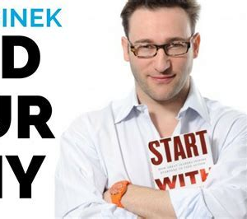
Reflection 1 :
Find your Why and if necessary refresh it!
Notes:
I don’t normally like leadership gurus, but Simon Sinek I can stomach. In particular I absolutely agree with him on the importance of Why and we are going to find that more an more with millineals where the evidence is they will be much more mission/purpose driven than earlier generations.

Slide 4
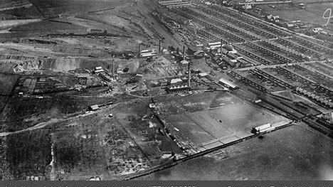
Notes:
So if you’ll indulge me I’m going tell you my story. My why and why it matters to me and I Hope why it should matter to you.
It may shock you to know that I didn’t always want to be an accountant. Yes I wanted to be an auditor. Seriously if I rewind a bit both my parents were teachers and I grew up in a town that was ravaged by the loss of heavy industry in the 1980s and growing up in those days as community crumbled I watched out public services rebuild. And with minimal post hoc rationalisation I knew then I I wanted to be a public servant. But what. Too scared of blood to be a doctor or nurse, not brave enough for the services I stumbled into an accounting degree but focused on the accountant in the public sector as an option and only applied for public service jobs.
Fast forward and my profound belief in the value of public service has only grown stronger. My dad, who remained my hero in later life, sadly passed away last year. But I got to share an extra 5 years with him because of the wonderful skill and dedication of firstly the paramedics who literally zapped him back to life and then the doctors and nurses who cared for him after his cardiac arrest. I got longer after they helped him through an earlier heart attack and before that an additional 10!years when he survived cancer having had his voice box removed in 2002. All of this precious extra time I owe to the NHS and of course my Dad’s Lazarus like abilities.
And it was in my first job post qualification that I realised the profound impact I could have as finance professional. Cutting a long story short through some deep analysis and a bit of insight I generated about £5m additional income for Northumbria Police which led to us employing 50 extra police officers each year for 3 years. Over those 3 years from being wore performing Force across a whole range of measures we made top 5 in everything that mattered and were heralded as good practice by HMIC. In that moment I realised that as one cop I could impact a finite number of crimes and improve a small number of lives. As that finance professional my impact was 150 times over.
So I tell you that with all humility, not to show how clver I am, but to ask you all to Take pride in what you do, and what you do, what we each do, all of us, together. It matters.
So just remember, whenever you hear talk of investing in the front line, just know that front line is bolder and wider and more visible because of you, because of each of us.

Slide 5
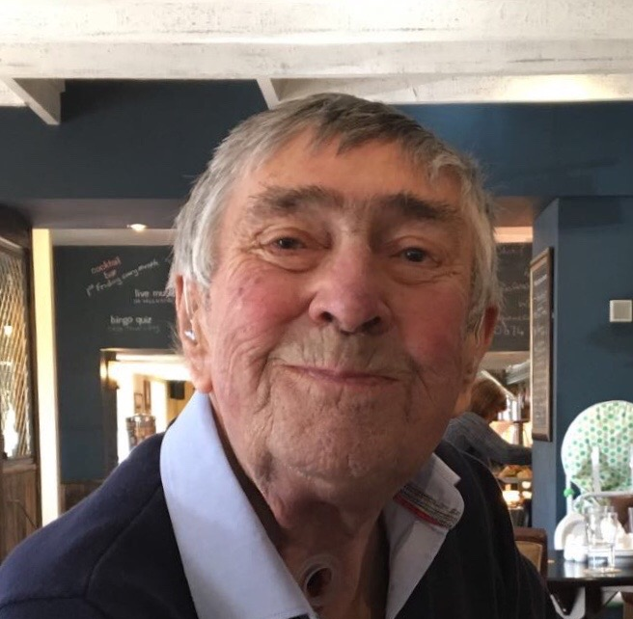

Slide 6
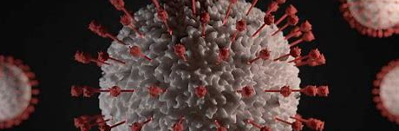
The Covid-19 Pandemic
Notes:
So in the spirit of never wasting a good crisis and in looking backwards to look forward I thought I’d just share a few reflections on the last 18 months or so. Can anyone remember where they were when they first heard about Covid and interestingly when that was.
I cant remember the first instance … but do remember a conversation over dinner with friends in January where I was arguining without necessarily whole heartedly believing it, that we should all be sitting up and taking notice. I then remember in the fringes of a LT meeting where I had invited Professor Peter Kelly from PHE to speak to the NHSBSA LT about population health – being a bit spooked by how spooked he was. A month later we were in lockdown.

Slide 7


Reflection 2 :
Happenchance/Happenstance.
Things just happen.
Good and bad.
Notes:
So if I can just say a few words about my unusual pandemic. So the second logo there is the NHSBSA logo. It’s a wonderful, eclectic, special organisation that provides a range of at scale high volume transactional services to the DHSC and NHS. We pick up, transform, digitise and operationalise a whole range of services in the Workforce, Primary Care space and direct to customers. During the pandemic we stood up at pace 50 new services to support colleagues on the front line and wider government response. We did this because of our digital expertise, contact centre capabilities, access to great commercial supplier and a stable, dedicated workforce.
At the start of the pandemic I agreed to help out DHSC and former PHE colleagues by using those capabilities to help stand up and scale a new Contact Tracing service, which quickly became part of NHS Test and Trace. I’ll come back to that. And then a few months later in August 2020 I was asked to step in/step up and lead PHE through to the transition to the new public health landscape. It would be 4 – 6 months they said. As it transpired it was 13 months all the while doing both roles. In the current climate I feel the need to be clear I didn’t take a penny extra remuneration. It wasn’t something I wanted to do, but it mattered to me that someone who cared about public health, the public’s health and the people in public health led that final phase of the organisation and I did so with the former CEO’s blessing – in fact insistence.

Slide 8
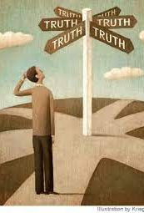
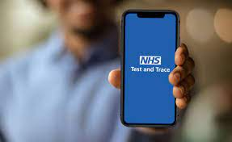
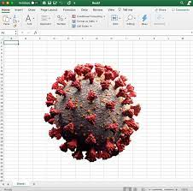
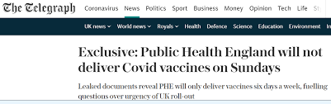
Reflection 3 :
In an always on, digital and contemporaneous world, is history still written by the victors?

Slide 9

Reflection 4 :
Focus also on your how.
Behaviour matters.
Be good to be around even on a bad day.

Slide 10
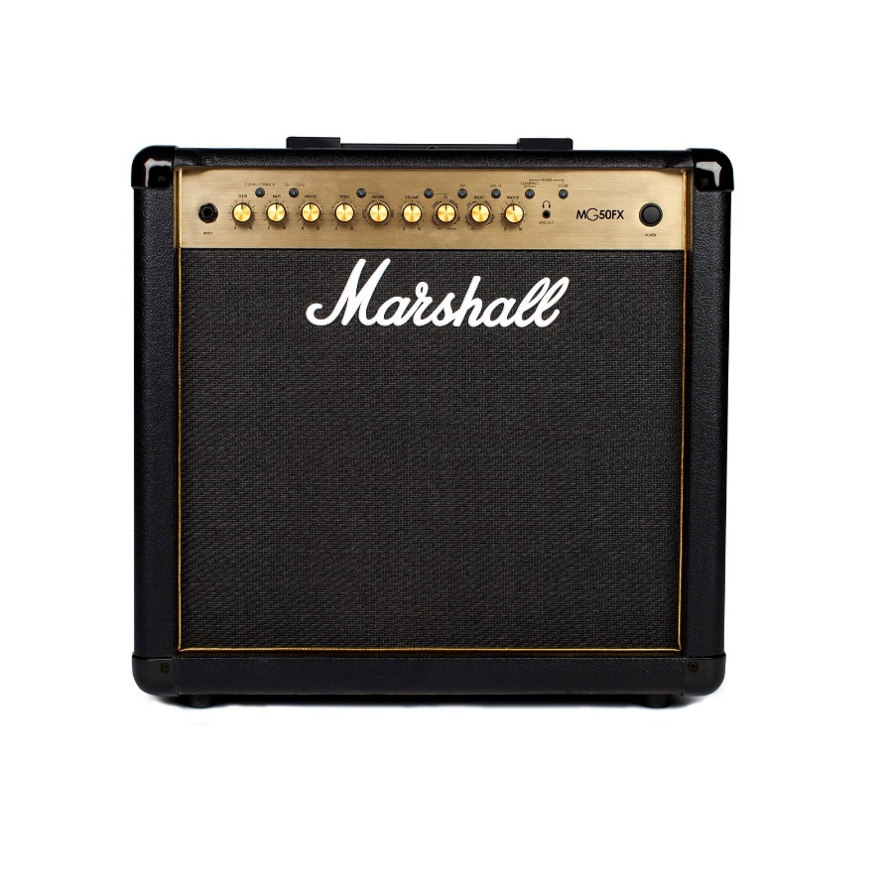
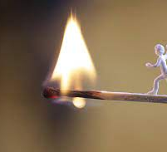
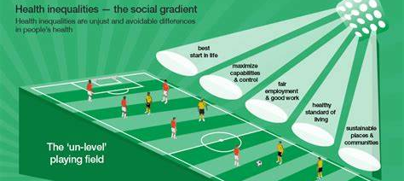
Reflection 5 :
Covid amplified many things.
Covid shone a light.

Slide 11
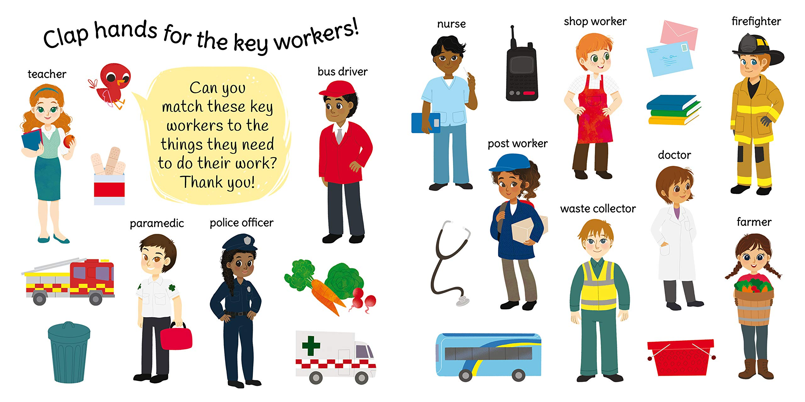
Reflection 6 :
It reminded us who and what matters and the importance of gratitude.

Slide 12
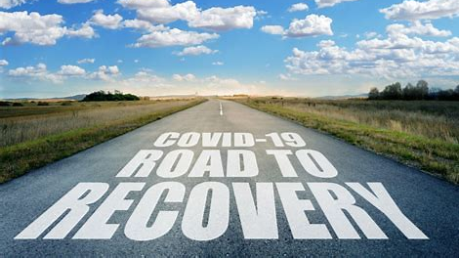
Reflection 7 : From chaos can come coherence

Slide 13

Reflection 8 :
People don’t mind change it’s loss they fear

Slide 14
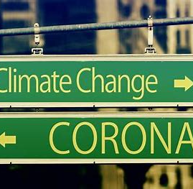
Reflection 9 :
The next crises is already with us.
As public servants and as accountants we can have genuine agency in responding.

Slide 15
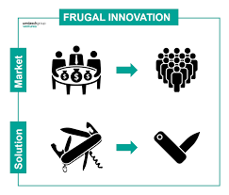
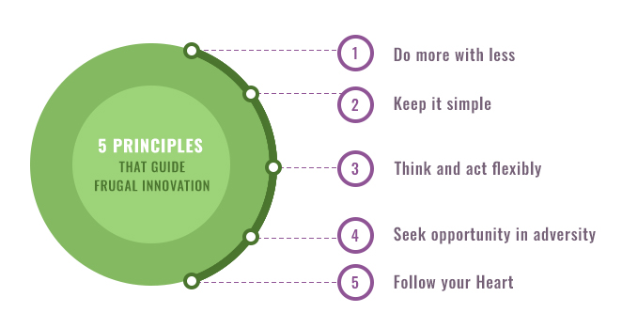
Reflection 10 :
We need to be brave, bold and disruptive - with frugal innovation.

Slide 16
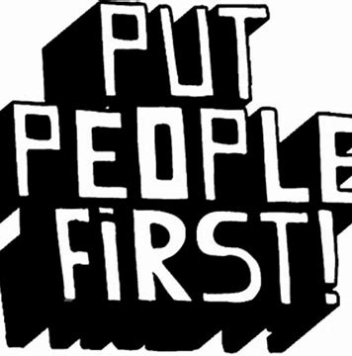
Reflection 11 :
It starts and ends with our people.
Always.

Slide 17
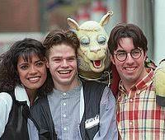
Bonus Reflection on life:
It’s never too late. Don’t have regrets.

