Slide 1

Michelle Percy- Director of Place
Newcastle City Council

Slide 2

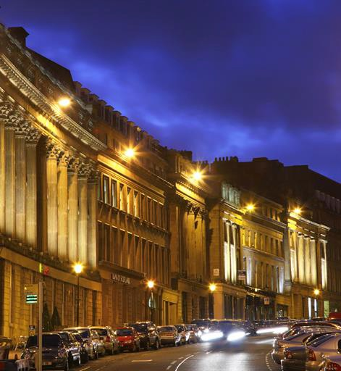
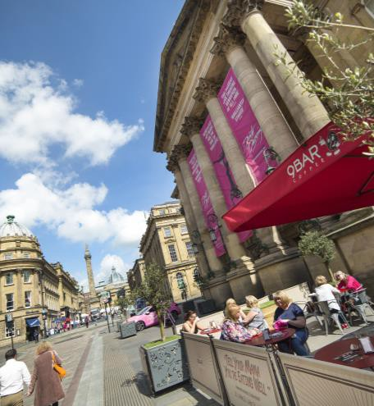

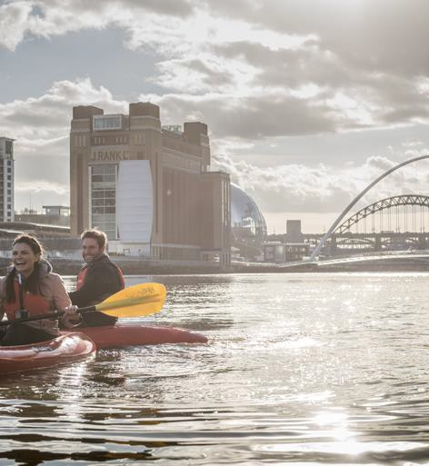
Initial Impacts of covid on our economy
An extra 36,000 people claiming unemployment benefit.
33% of our workforce furloughed.
Estimated £3bn loss to the tourism economy with 10,000 job losses.
City centre footfall -74% down from pre-covid levels and closure of high street shops.
Low base line of SMEs, diverse economy & fragile labour market.
Notes:
Although the initial impact of the pandemic hit hard, we are well on the way to recovery and renewal.
Unewmplyment rates are not as high as feared, but there is now a national shortage of skills
Hospitality and care sector workers are in demand
Newcastle has seen significant growth in key resiliant sector- tech and digital, life sciences, energy and corporate services

Slide 3
Our approach to economic recovery
Our approach is a place based one, which identifies and responds to the biggest areas of need and the biggest opportunities for change.
Skills and the future of work.
Supporting and attracting businesses to grow.
The future economy.
Community and Place.
Digital and Transport.

Slide 4
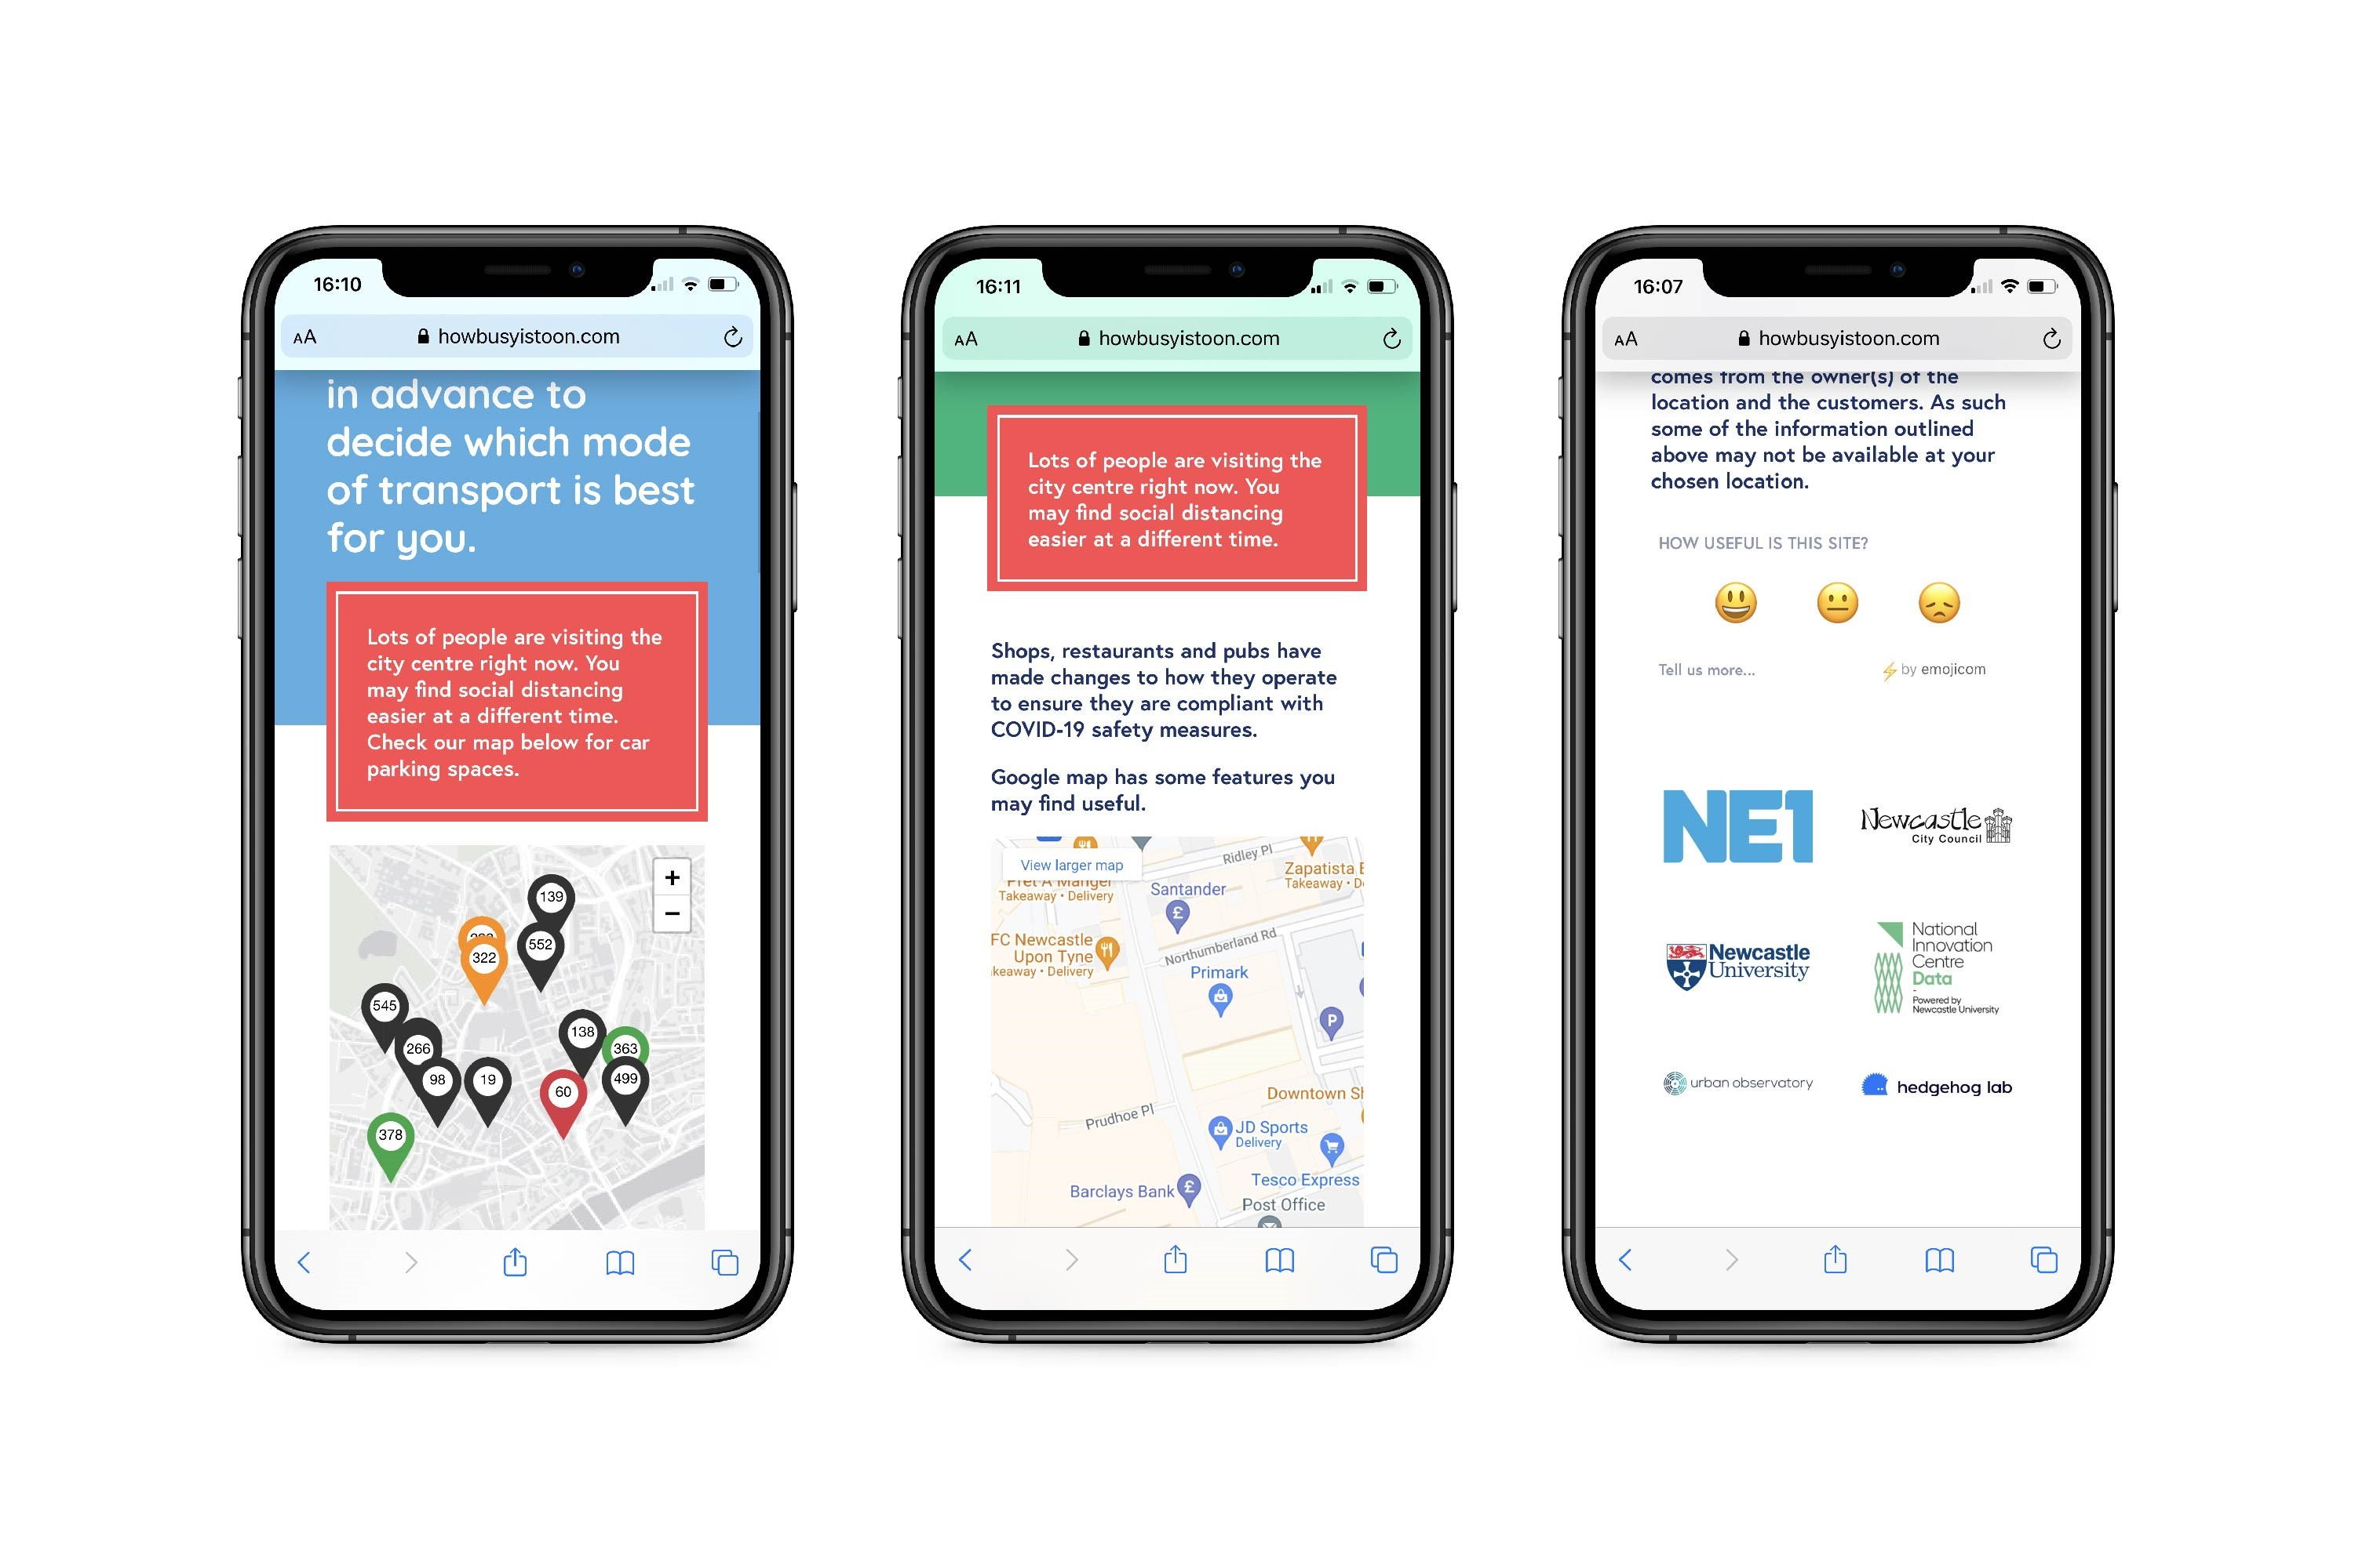

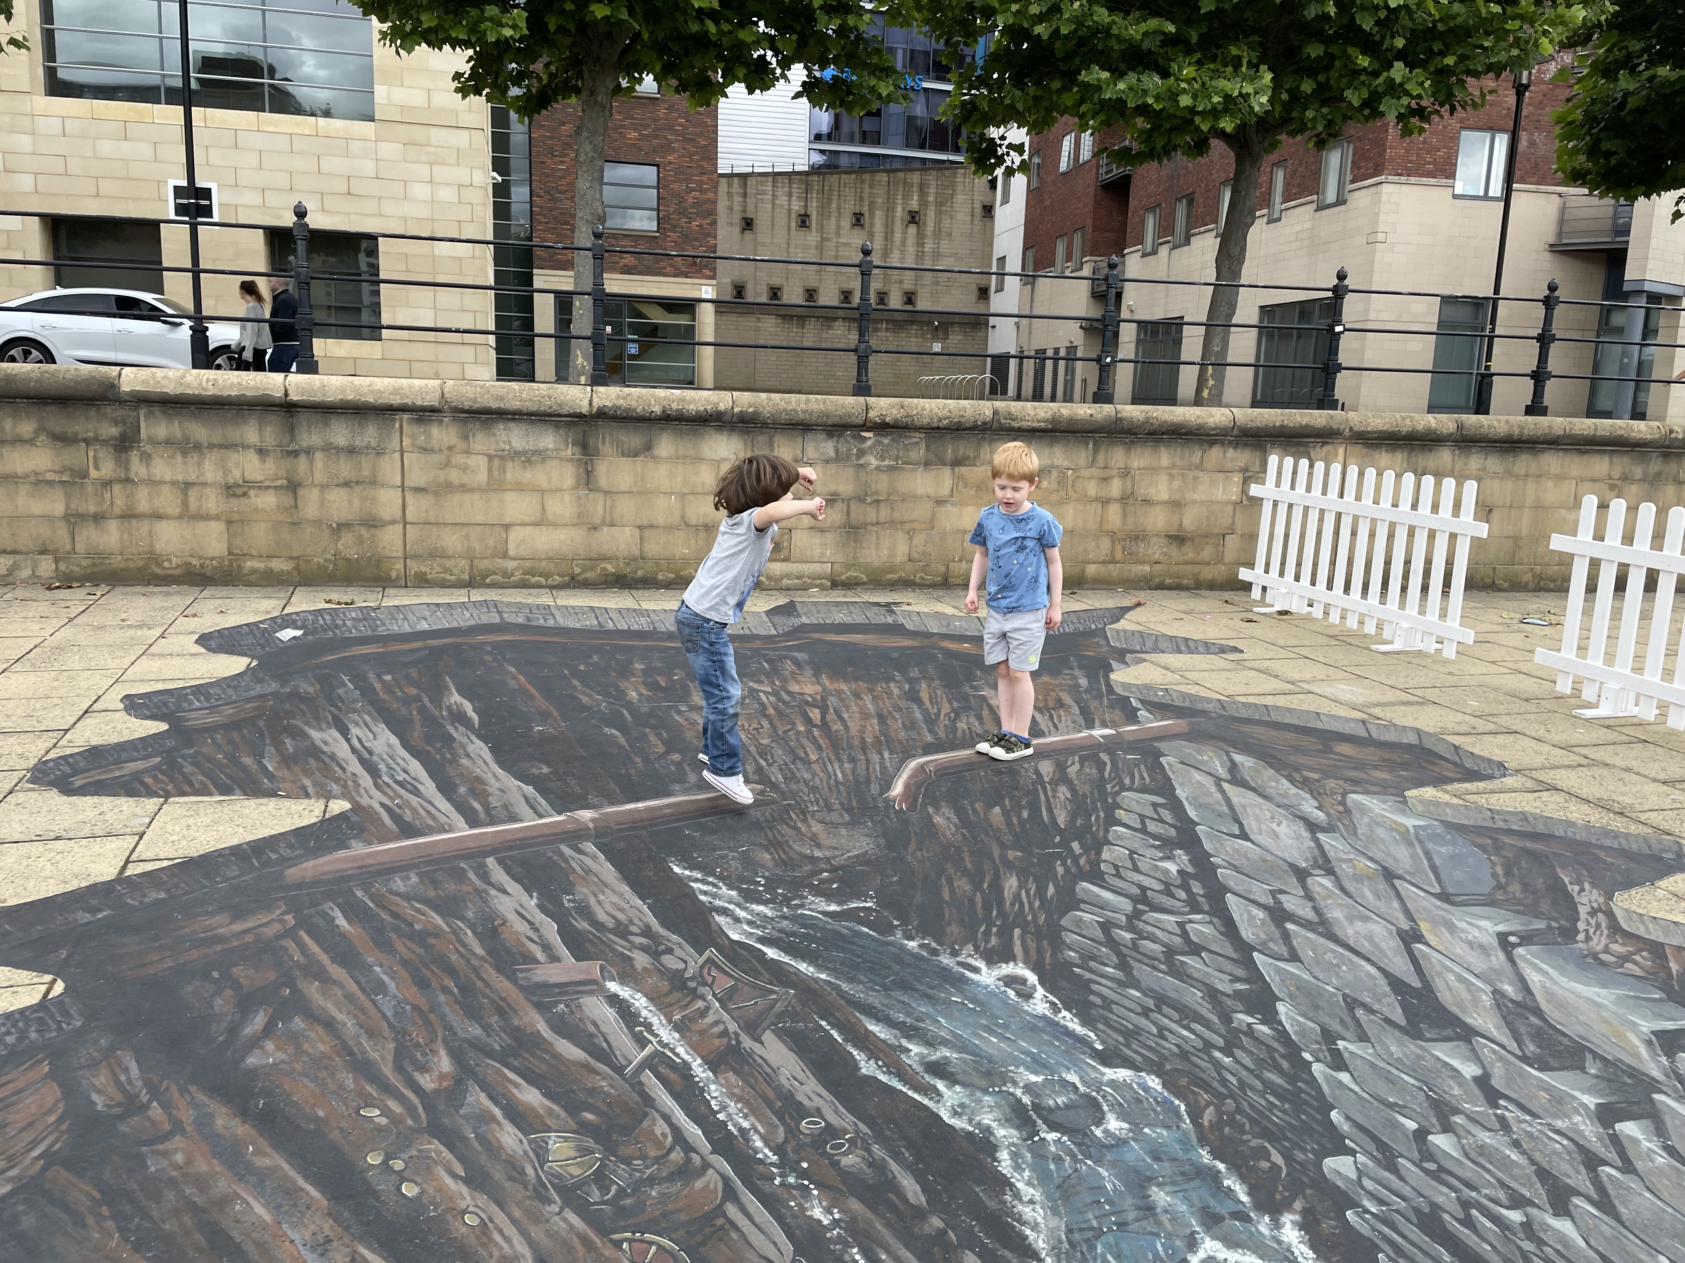
What have we done
£120m in grants to businesses.
CityLife Business Support Programme.
HowBusy is Toon.
Save Your Summer Campaign (Visit Britain Delivered by NGI).
Summer in The City by NE1.
Granted pavement café licenses.
Welcome Back Funding.
Neighbourhoods and Food and Drink Projects.
Notes:
As well as helping businesses and individuals during lockdown periods, it has been important to help drive people back into the city centre and local high streets in a safe way.
How Busy is Toon- working with NE1 and the Urban Observatory alows citizens to view footfall and transport to make a decision on when to visit
NGI delivered the Save Your Summer Campaign on behalf of Visit Britain, to increase visitors back to attractions
NE1 deleivered a vibrant programme of events, from the annimation of the quayside, to the greening of Blacket Street- creating a vibrant mixed use entertainment space for visitors of all ages

Slide 5
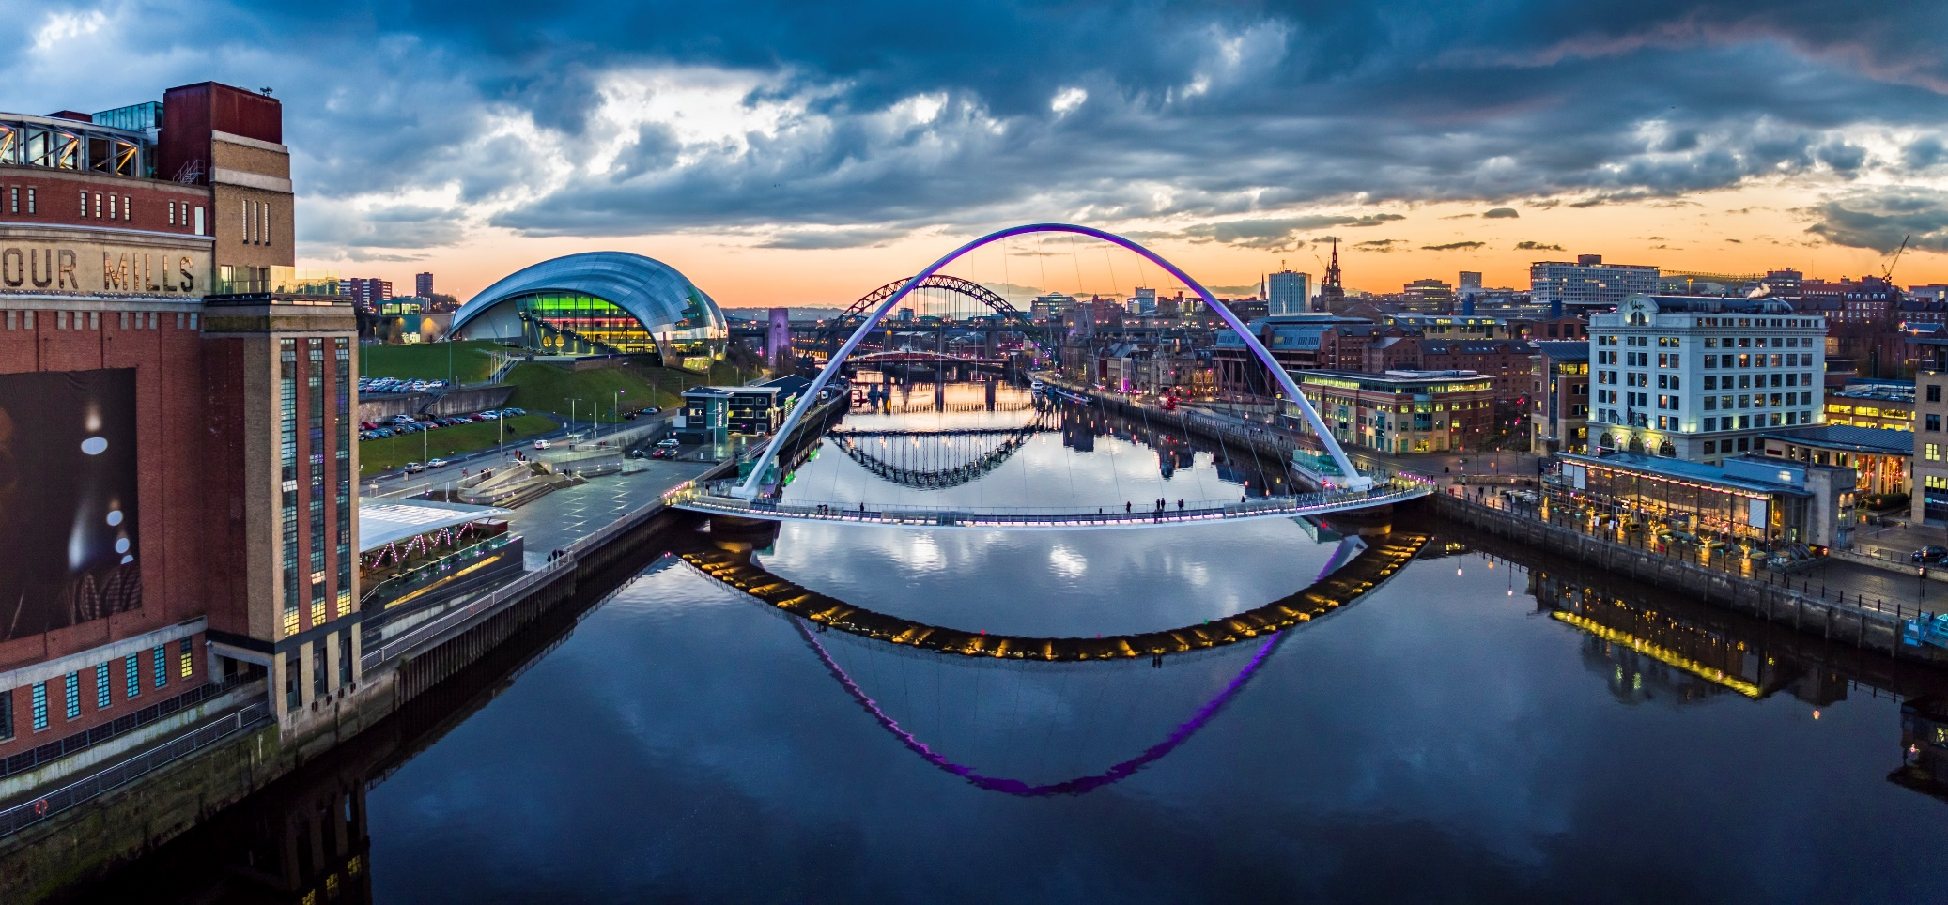
Levelling Up
There has been significant confidence in Newcastle as a place to invest:
£50m City Centre Transformation Plan
£300m NUFC takeover
Brand new 5* hotel
Pilgrim Quarter
£100m 14 storey Bank House Scheme
Government approval for two multi-million-pound levelling up bids
  New leisure centre in West Denton
  Renovation of Grainger Marker & Old Eldon Square
Notes:
An extrodinary amount of work from Council Teams and External partners went into creating 3 compelling Levlling Up Bids. We were successful in achieving 2 announced in the CSR (c£20m each).
A thrid bid for the Tyne Bridge is also currently with DfT

Slide 6
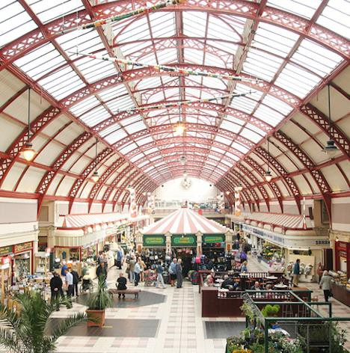
City Centre Transformation
Our city centre is the economic, cultural and leisure hub of the North East
12 months consultation with local stakeholders has identified a host of major initiatives
Initial works have begun but thanks to a major funding boost from central government the initiative will embark on a £10.5m capital investment programme
These works only represent the beginning of the changes and are part of a planned £40m investment in the city centre not including work to enhance the Grainger Market.

Slide 7
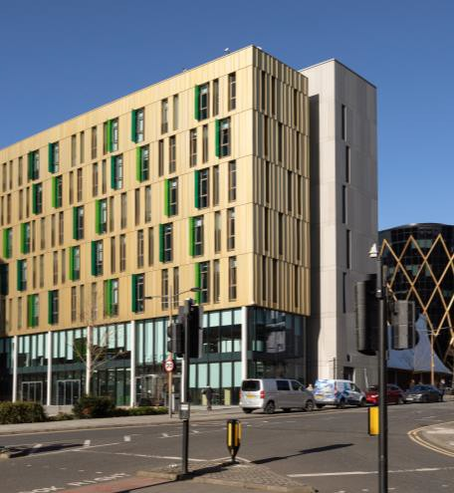
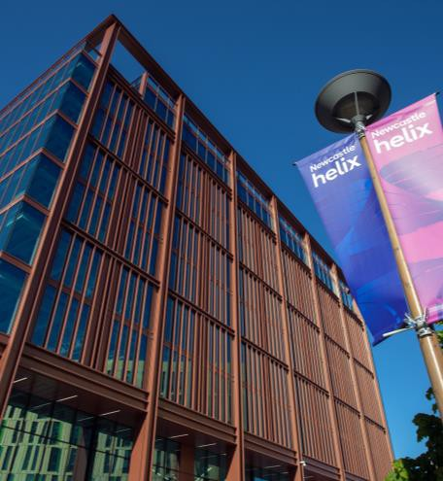
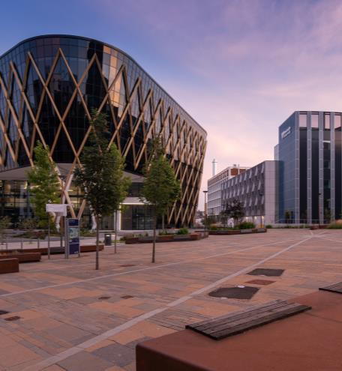
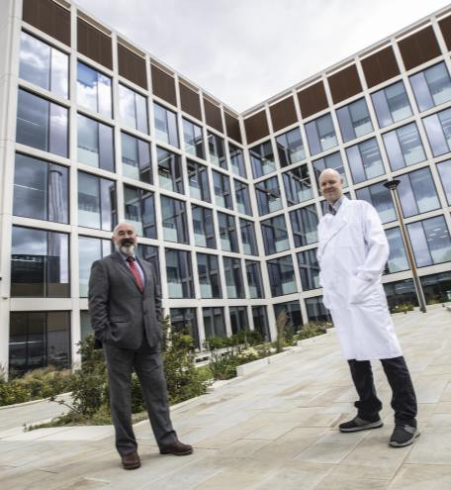
Building our future economy
As a global hub for innovation Newcastle Helix is positioning our region as a test bed for new innovations.
Helping to build our economy around world- leading academic research in fields such as healthy ageing, sustainability, data and life sciences.
It’s unique approach to collaboration will continue to enhance our international proposition to investors and will play an instrumental role in our post Covid-19 recovery.

Slide 8
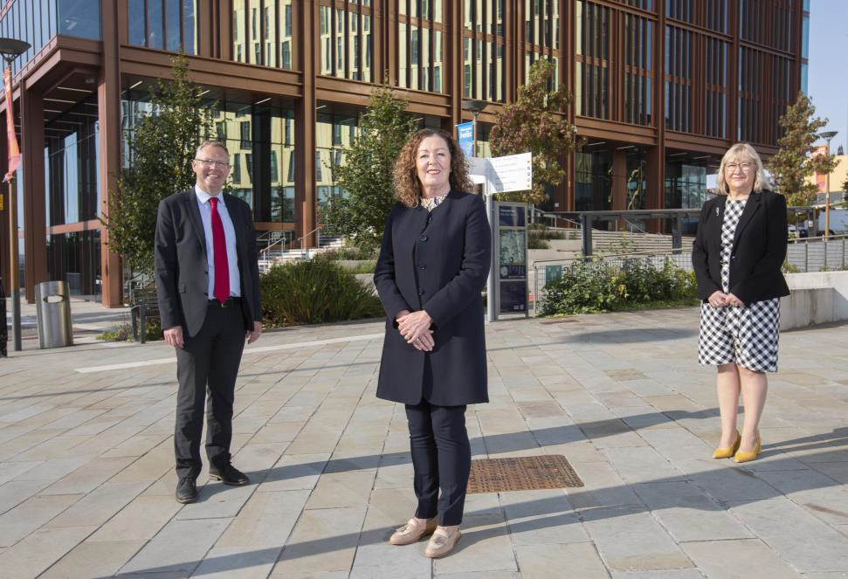
Newcastle Helix
Further plans for a £18m hotel and new office space (Spark) under construction.
Karbon Homes secured planning permission for 66 Future Homes with a £5m pledge from L&G
Tender opportunity to bring number of homes to 440
New occupiers include Homes England, Digital Technology Group, Savills, law firm WBD & Integrated NHS Covid Hub.
The Biosphere is almost full & continuing to enhance our global reputation as a hotspot for life sciences.
Significant interest in office space from inward investors who value the collaborative eco system.

Slide 9
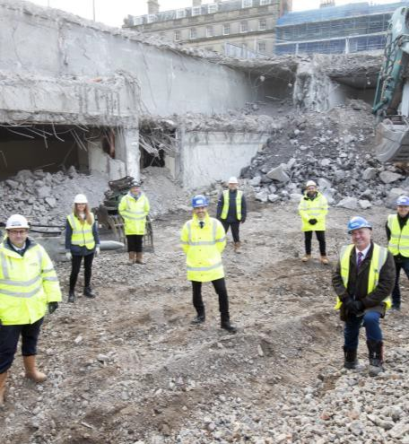
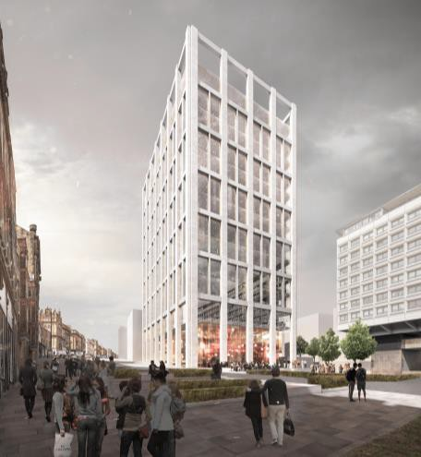
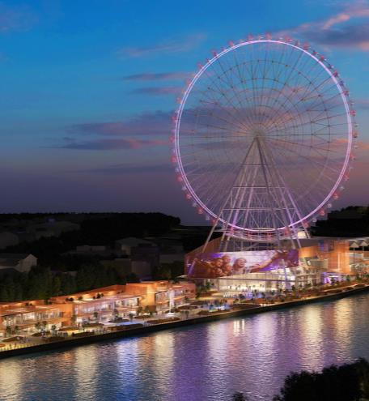
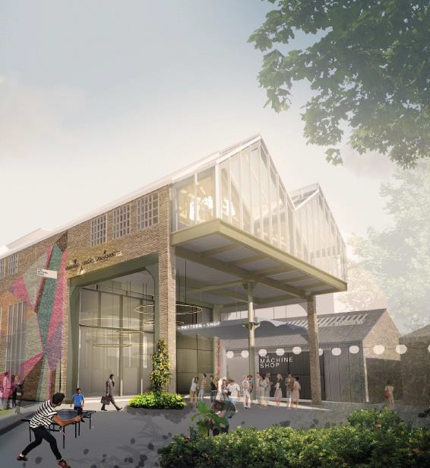
Ongoing investment
Igloo appointed to develop Stephenson Quarter –
estimated 2000 jobs.
£100m East Pilgrim street gateway has kickstarted our transformation, with private sector investment in Bank House (a 14 storey,120,000 sq. ft. office building).
World Wheel ‘Whey Aye’ a £100m world-class tourist destination that will create 800 jobs.
Levelling up - Promising to see
businesses/investors recognising us as a ‘northern city hub’ and a potential location for government
Accelerated Development Zones, part of the City deal, are helping to unlock city centre growth and create jobs.

Slide 10
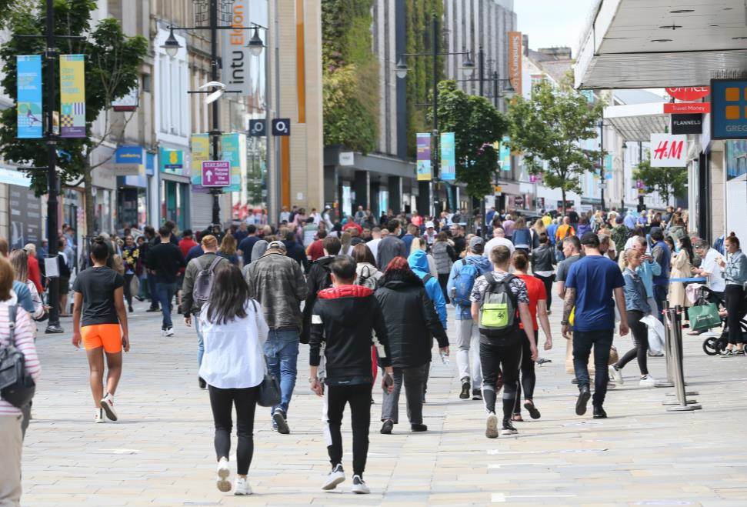
Our vision
Establish the city as a significant, unique European destination for tourism, business, & investment.
A collective of streets and spaces that each provide a different role and function
A rich and engaging experience for visitors, workers
& residents
A place residents can continue to be proud of, attracting further investment & allowing Newcastle to continue to grow for its communities.
The pandemic has accelerated changes that were underway in some sectors such as retail, which has long been the backbone of our city centre.
By 2030 that 14,000 additional jobs and an extra 3 million visitors will be attracted as a result this transformation

Slide 11

Covid 19 and placemaking
Well before the pandemic and in reaction to the changes in shopping habits we created our vision for the city centre.
Integrated experiences are fast becoming a critical part of towns and cities. This has further strengthened our belief in our vision and the importance of a healthy, green city that features outdoor spaces and activities that everyone can enjoy.
A chance to change and rebuild

Slide 12
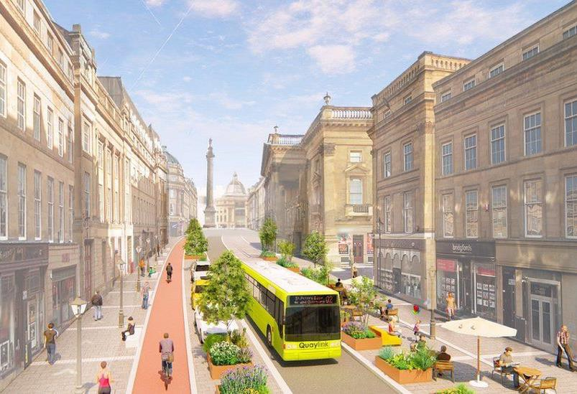
Healthy placemaking
A modern vibrant & people focused city
Experiential & Cultural
More meanwhile and green spaces
Grey street (A greener and cleaner space)
Blackett Street ( A green gateway)
Princes Square ( A peoples playground)
Ridley Place (A bohemian paradise)
Grainger Market (A new experience)
The Council will lead this transformation in partnership with our private sector partners
Creating better, cleaner and
greener spaces for everyone
£2.5 million from the government’s Active
Travel Fund

Slide 13
Thank you

