Slide 1
Excellence in Financial Management
November 2019
Carolyn Williamson – CIPFA President

Slide 2
Performance Tracker 2019
Published in partnership with the Institute for Government
Key findings:
  Day-to-day spending on local services fell by 20-40% between 2009/10 and 2017/18
  Spending on adult social care fallen 2.1% 2009 - 2019.
  Public satisfaction with services holding steady
  NHS revenue spending protected and rose after 2009/10

Slide 3
Aims of the FM Code
Catalyst for improvement and ambition
Improved financial sustainability
Support for the finance professional
Encourage greater organisational responsibility

Slide 4
Principles of the Code
Leadership
Accountability
Transparency
Standards
Assurance
Sustainability

Slide 5

Going Forward
Conference 29 November
Bespoke workshops
Webinars
Guidance

Slide 6
Financial resilience concerns
Arising in the context of substantial reductions in grant funding for local authorities from the UK Government
Discussions around resilience have included :
  leadership and governance issues
  financial planning and control
  dealing with rising demand
  effective audit

Slide 7
Financial stress warning signs
5 key symptoms of stress
  Running down of reserves
  Failure to plan and deliver savings
  Shortening financial planning
  Tendency to overspend
  Lack of detail in business decisions – risk management
A symptom is a possible indicator

Slide 8
Resilience Index
Long term sustainability of public services
Flagging up possible area of stress
One of a number of tools available to the public sector

Slide 9
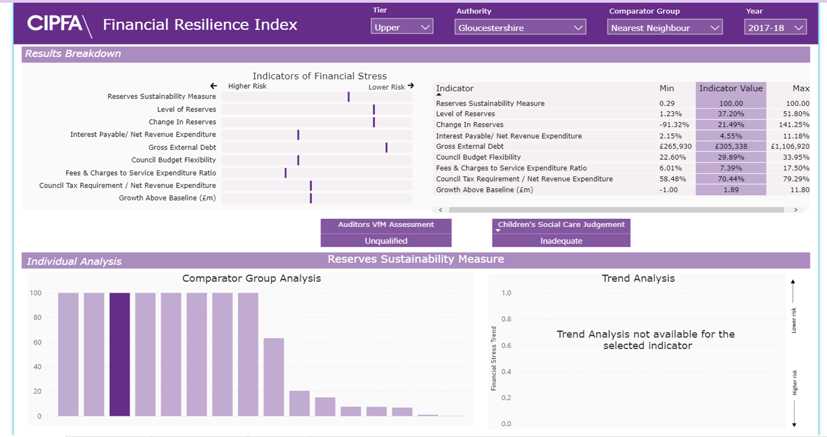
What the index will look like

Slide 10
Going Forward
Release
Important story to tell but complicated narrative
Identifying possible symptom of stress
Consultation on forward looking indicators
Awareness of other activities
  Redmond Review
  NAO consultation

Slide 11
Consultations – what we’re asking
Is the current regulatory environment is as effective and robust as it could be?
Is there a role for a separate body with expertise in local audit?
Where issues arise as a result of an audit, are local authorities establishing plans for corrective actions as soon as possible?

Slide 12
CIPFA/LASAAC - Streamlining the accounts
August 2019 – consulted on streamlining the accounts
Accounts seen to be too complex
Variable quality of narrative reporting
Summary accounts could be beneficial as long as do not create additional work

Slide 13
CIPFA/LASAAC – Differential reporting
November 2019 – Discussion papers
Primary goal should be to achieve clearer streamlined accounts for all authorities
Differential reporting criteria
Less benefit in differential reporting if the Whole of Government Accounts requirements remained standardised

Slide 14
Health and social care
October 2019 – Insights into Integration conference
Partnership work with Public Health England
  Reframing thinking around prevention
  Reposition prevention as an investment in place
  Developing a framework to evaluate preventative measures

Slide 15
Prudential borrowing
New guidance released in November - Prudential Property Investment
Commercial investments do not necessarily sit well with the primary focus of local authorities
New guidance seeks to ensure we are asking the right questions around commercial property investments
Also aims to ensure transparency and democratic accountability

Slide 16
Questions?

