Slide 1
economic review & Brexit update
EXPIRED
DRAFT
John Kelly
22 November 2019

Slide 2
agenda
Global environment
Trends in the UK
Brexit arithmetic
First a question…
EXPIRED
DRAFT

Slide 3
MARKET REVIEW – 10 YEAR RETURNS TO 31 OCTOBER 2019
Source: Bloomberg as at 31 October 2019

Slide 4
Growth…
Longest growth phase in modern times
Supported by extraordinary monetary policies
Ultra low rates, quantitative easing

Slide 5
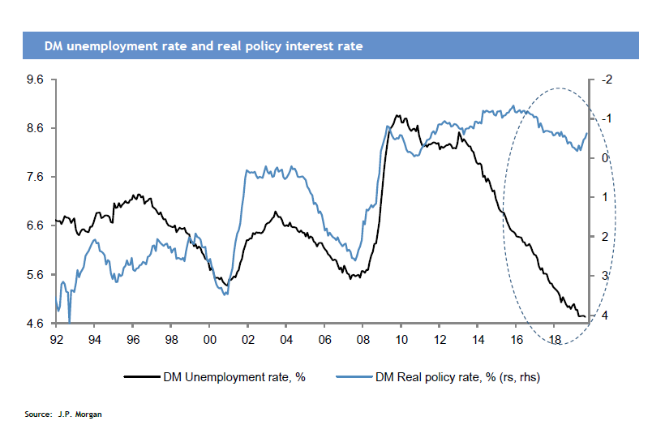
Interest rates have been kept low despite recovery
Source: J.P. Morgan

Slide 6
Central bank balance sheets have grown
Easing has been a common feature of the period
12-month change in QE (US$ trillions)
2.5
Projection (assuming constant FX rates)
2.0
1.5
1.0
0.5
0.0
-0.5
-1.0
07 08 09 10 11 12 13 14 15 16 17 18 19
Fed [Aug-18 = -176.9] ECB [Aug-18 = 505.6] BoJ [Aug-18 = 287.7]
BoE [Aug-18 = 57.5] PBoC [Jun-18 = 191.9] SNB [Jul-18 = -0.6]
Riksbank [Jun-18 = 32.8] Total [Jun-18 = 1317.7]
Source: Thomson Reuters Datastream

Slide 7
Global growth: signs of weakness ?
Annual change (%)
10
8
6
4
2
0
-2
-4
-6
-8
-10
92 94 96 98 00 02 04 06 08 10 12 14 16 18
Global leading indicator [Dec-18 = 3.1%] Global industrial production [May-18 = 3.5%]
Source: Thomson Reuters Datastream

Slide 8
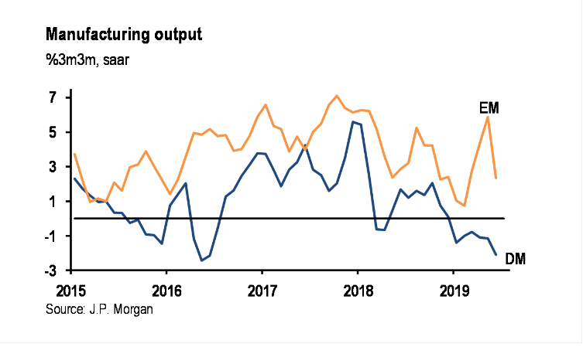
Manufacturing output
Source: JP Morgan

Slide 9
Interest rate outlook: Reverse course!
Central banks to the rescue? A new march to lower borrowing costs
Fed: three cuts made, more to come
ECB: further into negative territory, more to come ?
BoJ: autumn review
BoE ?
Finding the ELB?

Slide 10
Despite deepening problems for:
Banks
Pension Funds
Savers
And the problem associated with excess debt
Riksbank changes tack

Slide 11
The Risk list is formidable
Rise in jobless – from current lows
Geopolitics
Oil – Saudi attack
Trade – the biggest concern

Slide 12
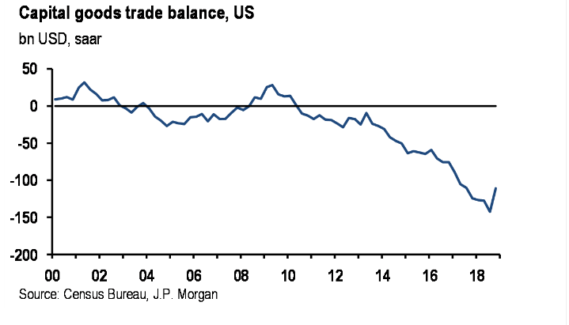
Risk list - trade

Slide 13
Risk list - trade
Trade = 25% global GDP
US at centre of global financial system
China at centre of global supply chains
Trade dispute or geopolitical struggle?
Highest casualties elsewhere than main protagonists

Slide 14
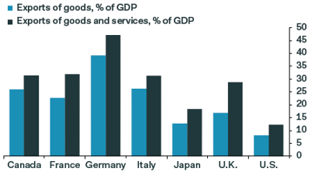
Trade as % of gdp
Source: xxxxx

Slide 15
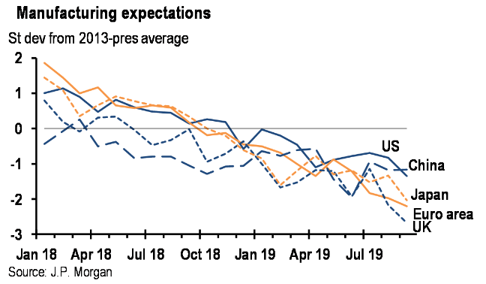
Manufacturing expectations

Slide 16
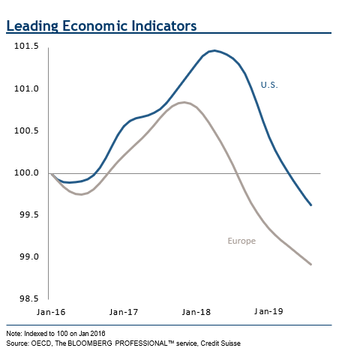
Leading economic indicators

Slide 17
Friends across the water? - Europe
EU a lagging participant in the upturn
Slow to adjust policies – lack of consensus
Unemployment down but patchy
Change of leadership at the ECB
Back on the gas !

Slide 18
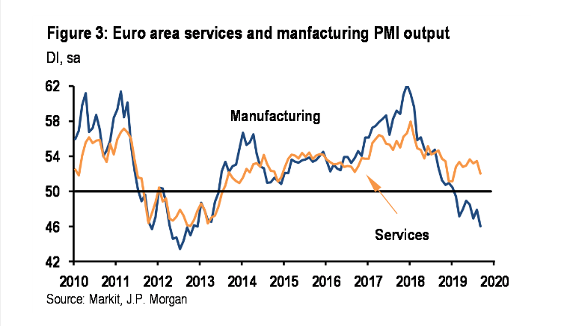
Activity in Europe has weakened

Slide 19
The question for investors:
Will rising wages and new looser monetary policies be sufficient to offset the effects of a maturing trend and geopolitical threats?
It’s important because ‘Brexit’ against a back cloth of growth, is very different from Brexit in a global recession.

Slide 20
Global environment
Growth most likely to continue but at modest, sub-trend rate
Geopolitical pressures ease
Easier monetary policies take an effect
Inflation stays low
Wage growth continues
China tax cuts
Fiscal expenditure

Slide 21
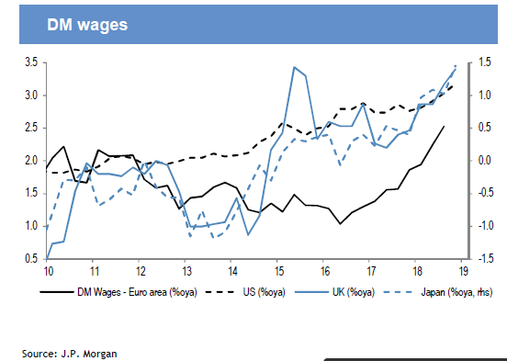
RISK OF RECESSION? WAGES ARE RISING
Source: JP Morgan

Slide 22
Domestic uncertainties
Source: Bloomberg as at 31 October 2019

Slide 23
Uk economic data, peering through the fog
Estimated economic/trend growth 1.25% - 1.50%
Current rate below but not substantially
End of austerity, spending again on the agenda (all agendas!)
But sentiment held back by Brexit uncertainty

Slide 24
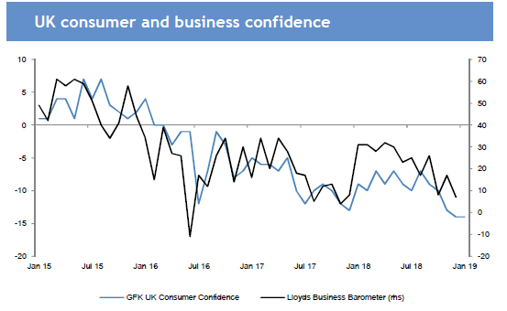
Domestic uncertainties
Fading confidence
Source: Bloomberg

Slide 25
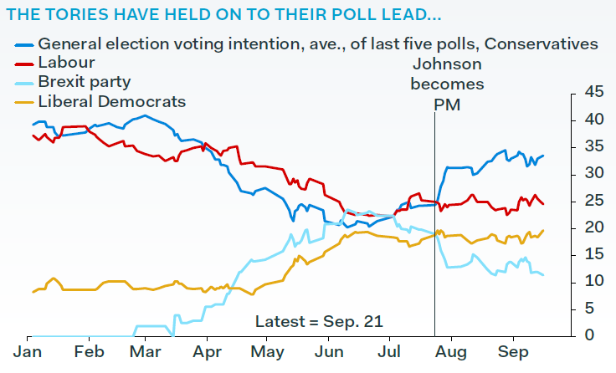
UK politics

Slide 26
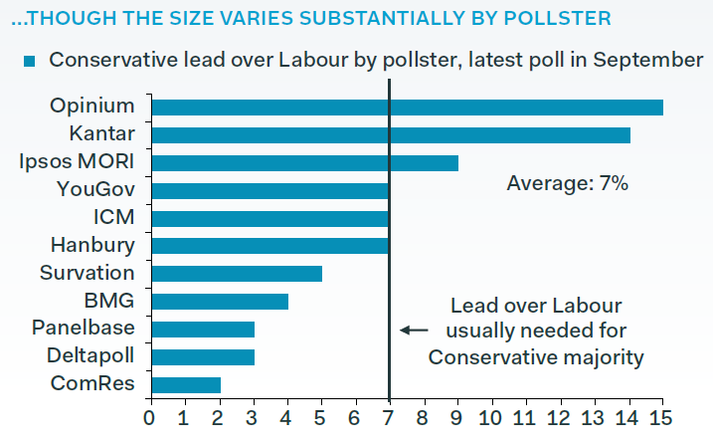
Uk politics

Slide 27
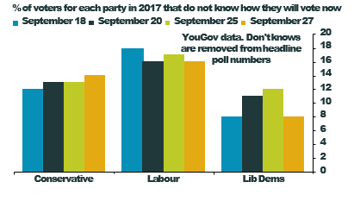
A lot of ’don’t knows’ - especially for labour

Slide 28
Brexit – possible outcomes
Same underlying economic model
But estimates are directional and ‘ball-park’
Three Scenarios
No ‘Brexit’
A Deal
No Deal
Both b) and c) reflect mid-range estimates

Slide 29
No brexit
 | 2019 | 2020 | 2021
GDP | 1.0 | 1.8 | 1.8
Inflation | 2.0 | 1.5 | 1.5
Interest Rates | 0.75 | 1.00 | 1.50
Activity rebounds, some recovery, consumer spend bounces.
In investment, a stronger currency pushes inflation lower.
The BoE starts to normalise rates

Slide 30
A deal
 | 2019 | 2020 | 2021
GDP | 1.0 | 1.6 | 1.6
Inflation | 2.0 | 2.0 | 2.0
Interest Rates | 0.75 | 0.75 | 1.25
Some recovery in investment. Consumer remains resilient
Inflation little changed, interest rates rise but slowly

Slide 31
No Deal
 | 2019 | 2020 | 2021
GDP | 0.9 | 0.2 | 1.5
Inflation | 2.0 | 2.8 | 2.5
Interest Rates | 0.75 | 0.50 | 0.75
A real risk of recession, avoided here by Government action – spending, tax cuts.
Inflation pushed higher by Sterling weakness.
Bank use monetary policy to support activity

Slide 32
Beyond the decision
Beyond exit to relationship
Leave means leave…?
Expected early move to a Free Trade Agreement
But tariffs are not the only friction – good will needed!
Until EU relationship settled other deals hard to finalise
Issues within the Union?

Slide 33
EXPIRED
DRAFT
www.ccla.co.uk
CCLA Investment Management Limited (registered in England No. 2183088) and CCLA Fund Managers Limited (registered in England No. 8735639) at Registered office, Senator House, 85 Queen Victoria Street, London EC4V 4ET, is authorised and regulated by the Financial Conduct Authority.

