Slide 1
Ethics - under pressure?
CIPFA NE Professional Update Event
13 March 2019
Margaret Pratt CPFA

Slide 2
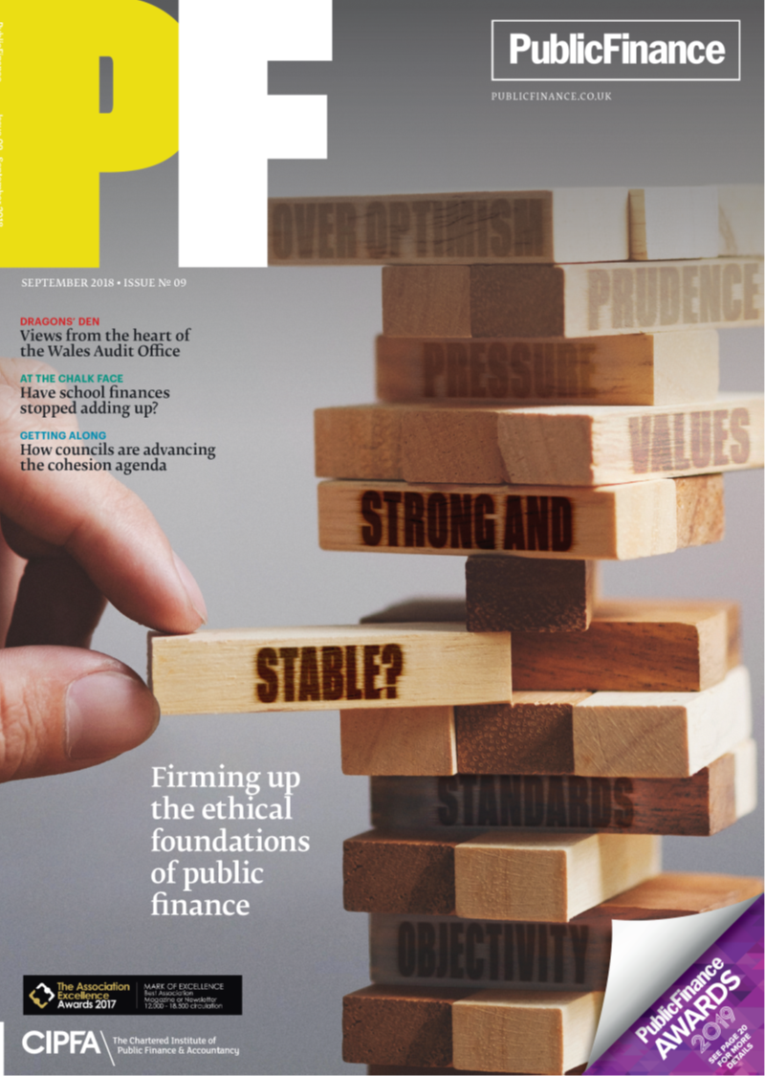
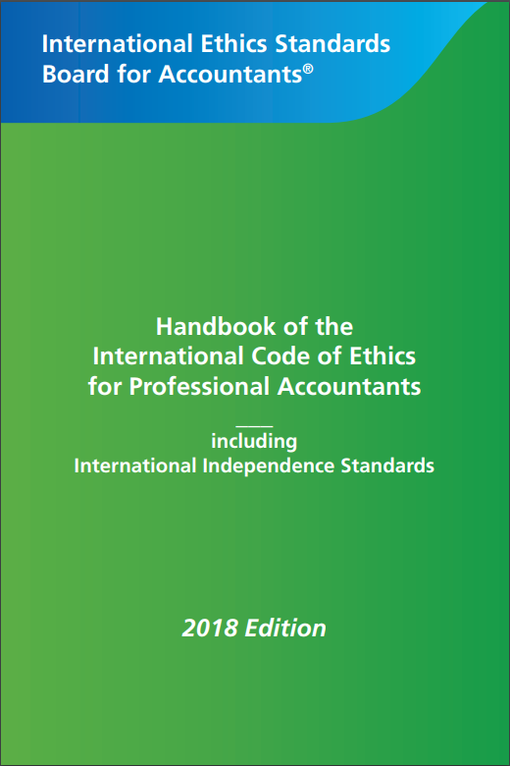
Ethics survey
2018 Code
Notes:
So, today I want to share with you the detailed findings of the recent CIPFA survey on Ethics
And then I will take you through the key headlines in the new Code of Ethics – it’s been revised and updated and CIPFA Council approved adoption wef November 2018 . CIPFA is the first CCAB body to do so!

Slide 3
What puts people under pressure?
“We must hit the numbers”
Incentives/
Pressure
Opportunity
Attitude/
Rationalisation
“Nobody really checks”
“It’s OK, everyone’s doing it”
Notes:
We’ve all rehearsed the excuses…
Austerity / funding squeeze
Greater commercialisation
Hitting targets / “Control Totals”
Incentives / rewards for organisation
Complex contracts / trading vehicles
Politics - local and central
Regulator pressure and demands
Keeping up with peers / ambition
Job insecurity / whistleblowing
Resources – staff & skills

Slide 4
Survey June- July 2018 - 487 respondents
CIPFA 77%
Qualified 86%
70% qualified 10+ years
Sectors
Local Government | 239
NHS | 52
Civil Service / Regulator | 41
Charity / NfP / Housing | 23
FE / HE / Schools | 15
Police / Fire | 14
Audit Firm | 12
Other incl Consultants, Commercial | 56
Retired / not working / break | 35
Notes:
CIPFA survey undertaken June- July 2018
18 Survey monkey questions
Objective: to get a sense of the ethical temperature: just how under pressure do members feel? And to help CIPFA design responses tat will help members in a practical way.
We had almost 500 respondents
Three quarters were CIPFA – we publicised through PF, Twitter, Linked In. It was open to all accountants and auditors.
86% qualified and a good number of PQ and students
70% qualified more than 10 years.
Great cross-section of employers…
So a fairly representative sample I hope you’ll agree.

Slide 5
Survey Questions
About you - Qualified, Qualification, Role, Sector, Years qualified
Have you ever been put or felt under pressure to act unethically?
How many times?
Who put you under pressure?
What were you asked to do?
Were you offered incentives?
Did you feel under threat?
Did you undertake the unethical task?
What consequences did you experience?
Have you read your Institute’s Code of Ethics in last 3 years?

Slide 9
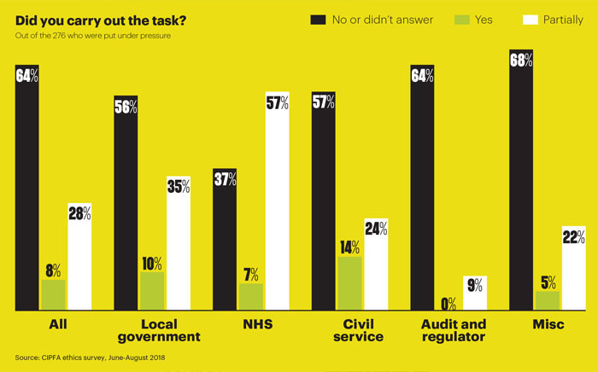

64%
45%
36%
38%
27%
9%

Slide 10
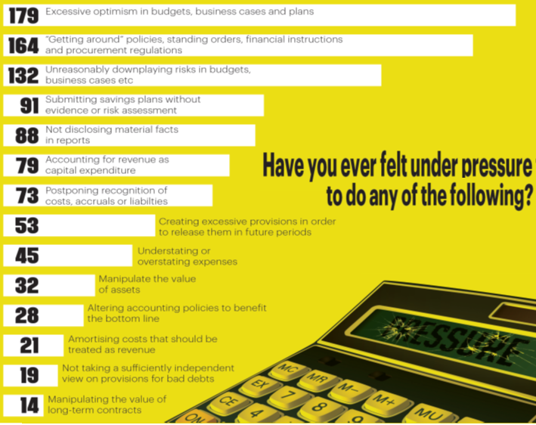

Slide 11
Who put you under pressure?
Notes:
And was it made worth while for professionals to accede to the pressure: Overwhelmingly, NO! 99% only 1% felt hey had been offered incentives

Slide 12
Did you feel under threat?

Slide 13
What consequences did you suffer?

Slide 14
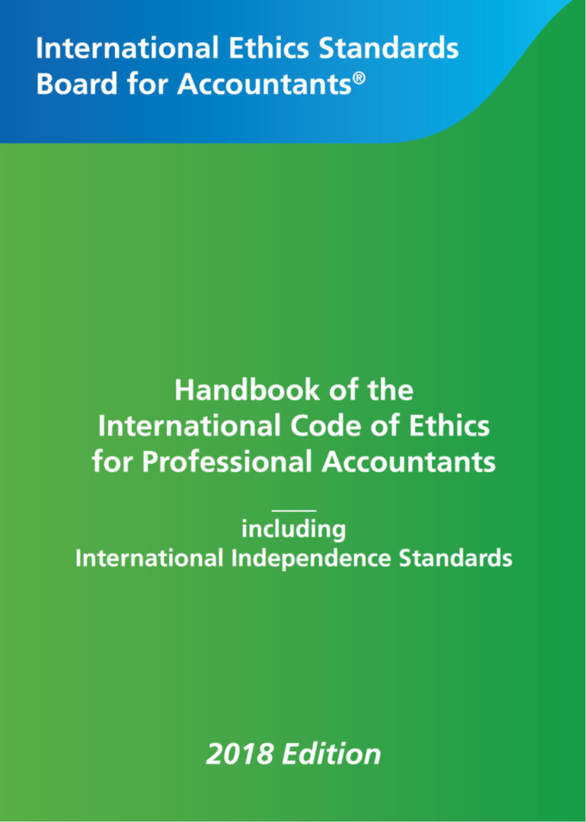
*New* Code of Ethics for Professional Accountants
Part 1 Complying with the Code, fundamental principles and conceptual framework
Part 2 Professional accountants in business
Part 3 Professional accountants in public practice
Part 4 International Independence Standards

Slide 15

Part 1 Fundamental principles and Conceptual framework
a distinguishing mark of the accountancy profession is its acceptance of the responsibility to act in the public interest
a professional accountant's responsibility is not exclusively to satisfy the needs of an individual client or employer
a professional accountant shall comply with the Code [and] with each of the fundamental principles

Slide 16
Fundamental principles
Objectivity
Integrity
Confidentiality
Conceptual
Framework
Professional Competence and Due Care
Professional Behaviour

Slide 17
Conceptual framework
Identify threats
Evaluate threats
Address threats
Exercise professional judgment
Remain alert to new info and changes in facts and circumstances
Use the “reasonable and informed third party test”

Slide 18
Compliance Threats
Self-interest
Self-review
Advocacy
Familiarity
Intimidation

Slide 19
Examples of pressure to influence:
Report misleading results
Misrepresent programmes or projects
Mis-state income, expenditure, rates of return to bias decision making
Suppress audit findings
Approve expenditure that is not legitimate
Manipulate KPIs to benefit reward/compensation
Perform a task without sufficient skills, resources or with unrealistic deadlines

Slide 20
Safeguards – who to talk to :
Your manager, Assistant Directors, Deputy
CEO, CFO, Accounting Officer, Section 151 Officer
Audit or Finance Committee Chair
Chair of Board, Leader of Council
External:
Trusted colleagues
External Auditor
Professional membership body
Networks / Associations
Regulator
National Audit Office
Union

Slide 21
What should you do?
Read and understand the Code of Ethics
Promote an ethics-based culture in your workplace
Challenge, if necessary...
Inform non-finance colleagues of your professional responsibilities
Call out inappropriate practice & behaviour
Do not pressurise your team
Seek support if you need it
Remember - The more senior you are, the greater responsibility

Slide 22
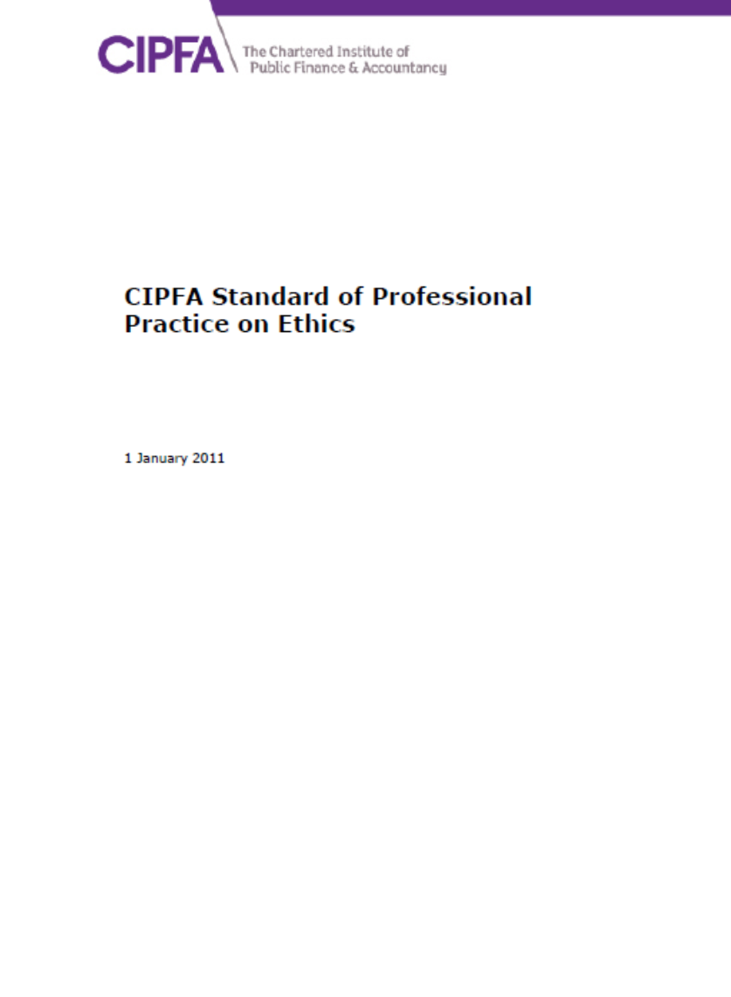
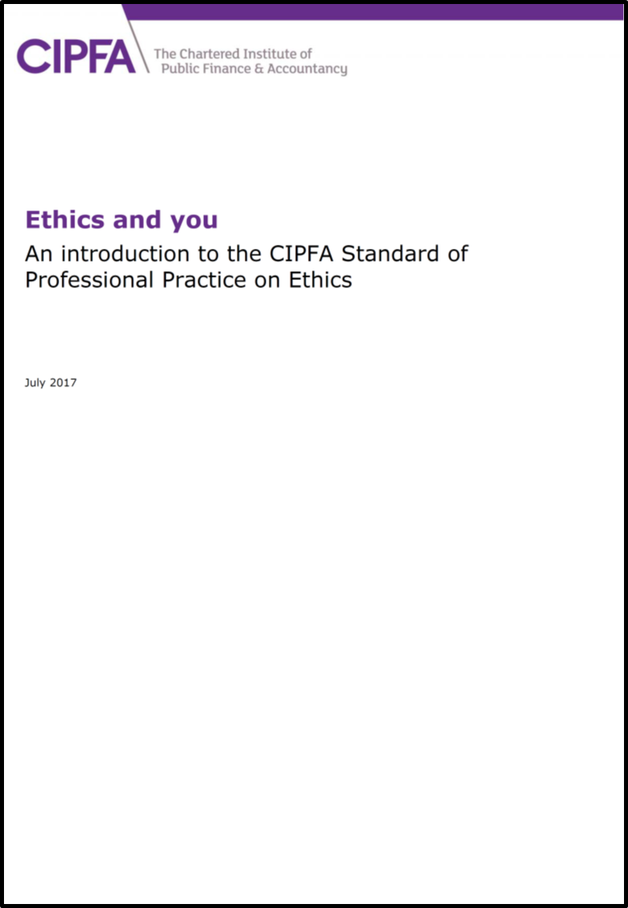
What is CIPFA Doing?
CIPFA Council adopted the new 2018 Code (27 Sept)
Implementation November 2018
Revised Standard of Professional Practice (SOPP)
Update “Ethics and You” handbook
Review Ethics in Prof Qualification
CPD: Regional presentations
Website – Ethics pages with stories
Members’ Hotline?
Resources - E-learning?
Notes:
CIPFA Council will consider adopting the 2019 Code on 27 September.
All bodies must adopt the Code by 15 June 2019. Early adoption is encouraged. CIPFA is the first of the UK accountancy bodies to adopt.
CIPFA acknowledges that the IESBA code / SOPP is a large document. So CIPFA has updated a short guidance document” Ethics and You” to continue to make it more accessible and relevant to our members. It was produced by the Ethics Working Group. Ethics and You provides additional guidance and focuses on what the IESBA Code means for the public sector workplace.

Slide 23
Download the IESBA Code
www.ethicsboard.org/iesba-code
Read CIPFA’s guidance
www.cipfa.org/ethics

