Slide 1
Integration – Tameside and Glossop Way
23rd November 2018

Slide 2
Content of presentation
Tameside and Glossop Vision
Developing our Strategic Commission
Tameside and Glossop Integrated NHS Foundation Trust – our local Provider
Integrated Finance
Local reflections
Questions

Slide 3
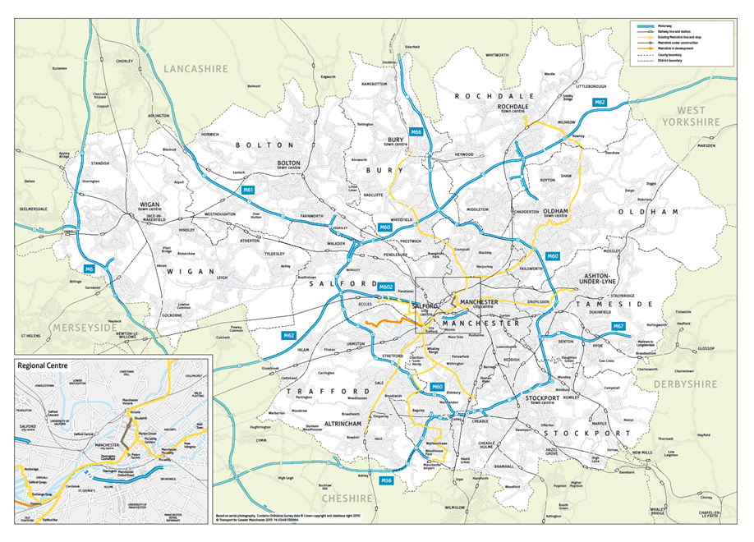
GREATER MANCHESTER

Slide 4
GM Growth and Reform Plan
Brings together two policy themes of Growth and Reform
Produced as part of the Government’s Growth Deal process
Not simply a bid for funding: the plan sought a new relationship with Government to enable GM authorities to undertake their place shaping role to:
create high quality places that will attract and retain more productive people and businesses
reform the way that public services are delivered to improve outcomes for our people
Made the case for the devolution of significant additional functional and fiscal responsibilities

Slide 5
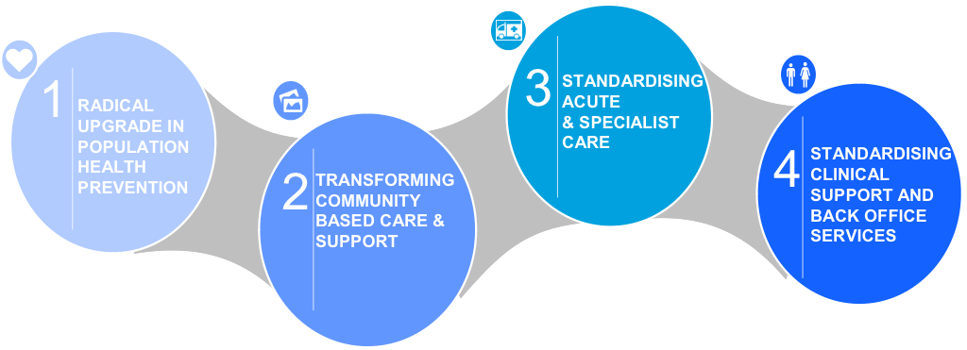
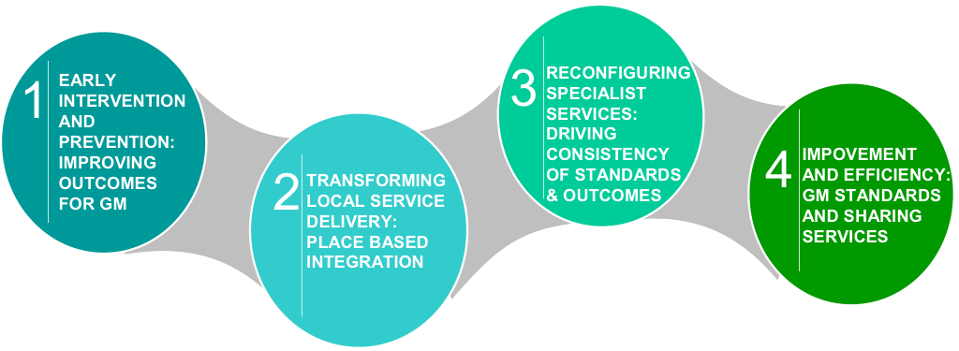
GM Strategic Plan
H&SC TRANSFORMATION
WIDER REFORM ACROSS GM

Slide 6
Vision for Tameside and Glossop
“To significantly raise healthy life expectancy in Tameside and Glossop through a place-based approach to better prosperity, health and wellbeing and to deliver a clinically and financially sustainable health and social care economy within 5 years”
Tameside and Glossop Locality Plan
October 2015

Slide 7
Key Aims
Driving up Healthy Life Expectancy (HLE)
Improving quality of provision, access and reducing variation and inequality
Improved workforce satisfaction, recruitment and retention
Build, not buy
Improved financial sustainability
Aligned to GM HSCP vision and objectives
Two main programmes;
Development of strategic, place based commissioner focused on wider public sector reform and incorporating health and well being outcomes
Creation of Integrated Care Organisation using the FT licence (ICFT)

Slide 8
T & G Strategic Commission

Slide 9
Move to Strategic Commissioning
January 2016
- Agreed vision and objectives
- Shadow Single Commissioning Board (SCB)
formulated
- Co-location of commissioning teams
- Staff engagement
April 2016
- Aligned governance structure
- Integrated commissioning fund of £447m
- Interim senior management team established
- Approved 5 year commissioning strategy
September 2016
- Council CX appointed CCG Accountable Officer
- Senior management consultation process
- Reduction in transaction costs
- Strategic Estates Plan
Autumn 2017
- Joint CFO appointed
- Substantive management structure focussed on life course
- New clinical leadership arrangements
- Building capacity & capability
- Corporate Delivery Plan
- Strategic Commissioning Board
April 2018
- Aligned Governance
- Integrated Financial Reporting
- Integrated Commissio- ning Fund increased to £942m

Slide 10
Care Together Programme Delivery Structure

Slide 11
Integrated Care Foundation Trust
Organisational form developed using FT Trust licence
Significant improvement in key metrics; Good CQC rating
Community Services embedded
GPs in clinical leadership positions and within ICFT governance structures to drive neighbourhood developments
Comprehensive IM&T strategy and interconnectivity delivery plan (subject to capital funding)
Consolidation of Intermediate Care onto main hospital site
Due Diligence process underway for Adult Social Care transaction

Slide 12
Neighbourhood developments
Establishment of 5 x neighbourhood management teams
Creation and co-location of Intermediate Tier
Multi disciplinary IUCT (Integrated Urgent Care Team) across T&G
3 x Extensivists in post
Co-location of District Nurses and Adult Social Care in each neighbourhood; now expanding for other services
Interconnectivity/remote access for community services and GP
Social prescribing and asset based approaches established
Organisational Development programme
Health and Social Care Estates lead to support MDT design and development of Integrated Neighbourhood hubs

Slide 13
Innovative approaches; Digital Health
Developed by ICFT
IT infrastructure funded and delivered by Council
Health and social care close working
Supporting all T&G Care Homes

Slide 14
How the Money Works

Slide 15
T&G Economy Financial Gap

Slide 16
Integrated Commissioning Fund
Integrated Commissioning Fund (ICF) established 1st April 2016 underpinned by robust Financial Framework
Included Council services: Adults, Children and Public Health but excluded other Council services
Included total resource allocation for the CCG including delegated primary care co-commissioned budgets
Expansion to single ICF in 2018-19 including all Council and CCG resource totalling ~ £1billion gross (£0.581m net)

Slide 17
Integrated Commissioning Fund
Budget Allocation Sections | Detail | Governance implications
Section 75 (Pot A) | This relates to legislation that allows the establishment of pooled funds between NHS bodies and local authorities at a local level | The Single Commissioning Board will make decisions on this funding which are binding upon the two statutory partner organisations.
Aligned Services (Pot B) | Funding contributions for services that cannot be delegated for formal joint provision | The Single Commissioning Board will make recommendations on the spending of this funding. These recommendations will require ratification by the relevant statutory organisation.
In Collaboration Services (Pot C) | Funding for services which cannot be included within Section 75 arrangements without a change in legislation. These specialised services are jointly commissioned with NHS England. | The Single Commissioning Board will make recommendations on the spending of this funding. These recommendations will require ratification by NHS England and the relevant statutory organisation.

Slide 18
Integrated Financial Reporting
Net or Gross
LA’s Net Budget = amount charged to tax payer
But we control the gross
Brackets are Bad
Report formats – traditional LA vs more flexible CCG
CCG/Council S75 SCB meets immediately before Council’s Executive Cabinet – all in attendance
Streamlined briefings

Slide 19
Benefits of ICF
Streamlined governance and decision making
Strengthening of budget leadership
Single Strategic Commission budget resource reporting
Single accountable body for the Section 75 element of the ICF
Rationalisation of any existing joint funding arrangements between the Council and CCG
Alignment to the Strategic Leadership structure
All health and Council service resource decisions would be intrinsically linked to the corporate strategic priorities.

Slide 20
Examples of Direct Benefits
Council Balance Sheet Strength
Trust in deficit
Loan interest
Front loading of community contract payments cuts interest costs – saved £350k in 2018/19
Control total support
Property Savings
Expensive and poor quality health estate
Council rationalising its estate
Council borrow at 2.5%
Estimated £5-6m of economy wide estate savings

Slide 21
Examples continued
Risk Share Agreement
T&G CCG £20m QIPP – one of the largest in GM
TMBC – healthy reserves position for now
TMBC – cliff edge from 2020/21
TMBC agreed risk share of up to £10m in 2017/18 & 2018/19
CCG reverse in 2019/20 and 2020/21 – through s75 sharing
£20bn of additional NHS funding???
Local Government Spending review 2020 – further cuts?

Slide 22
Some Local Reflections
System wide vision and approach is crucial
System/Place not institutional leadership
Concentrate on the things that bind you
Relationships (and trust) are everything
Never waste a crisis
Get the basics right
Share your partners’ risk
Always involve your auditors
Choppy waters inevitable but keep going!

Slide 23
Closing thought …
Mitigate risk through Integration!

Slide 24
Questions
Thank you for your attention.
Tracey Simpson Tom Wilkinson
NHS Tameside & Glossop CCG Tameside Council
Email: tracey.simpson@nhs.net tom.wilkinson@tameside.gov.uk

