Slide 1
Re-imagining Our Town Centres
Stuart Reid
South Tyneside Council
23rd November 2018

Slide 3
Changing Face of Retail…………….
15 town centre shops close every day
50,000 retail jobs lost this year
Half of existing stores will close by 2030
40% of all retail sales will be on-line by 2030 (18% currently)

Slide 4
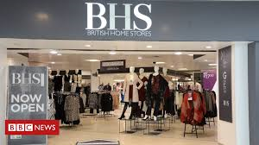
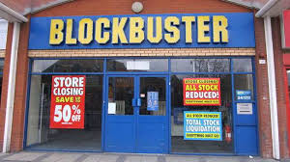
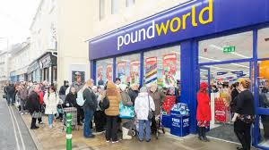
Death of the High Street?

Slide 5
Town Centre Challenges
On-line competition
Weak customer demand
Intense price competition
Business rates burden

Slide 6
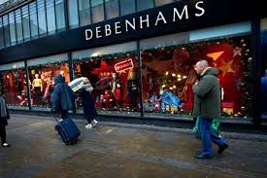
Changing Face of Retail…………….

Slide 7
Reshaping Town Centres - Grimsey Review
Establish town centre commissions
Embed libraries / community hubs and public spaces
More powers to councils – planning, levying penalties against landlords with long term vacant space
Smarter use of technology e.g. public wifi…..

Slide 8
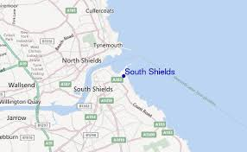
South Shields
Population of 75,000
Main conurbation in South Tyneside
Home of the Great North Run finish
Home to 2nd Oldest Lifeboat in world
Home to oldest provincial newspaper

Slide 9
Famous Sanddancers………….

Slide 10
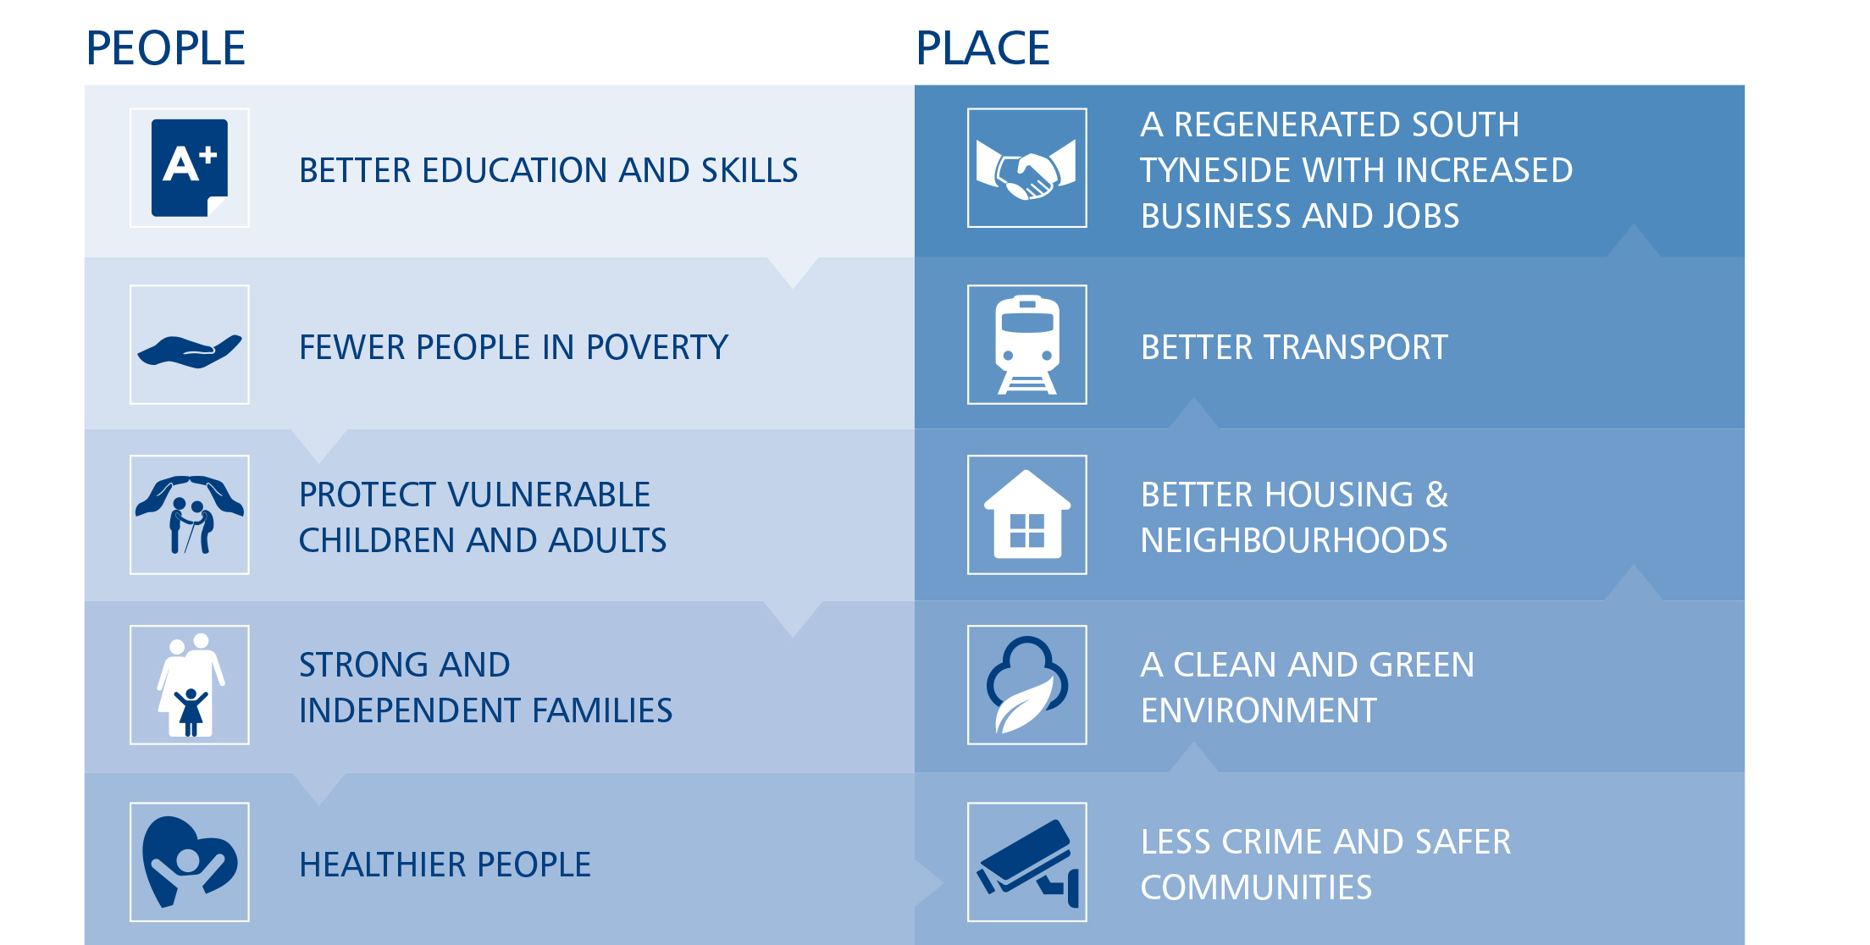
Key Council Objectives

Slide 11
South Shields Town Centre
Percentage of resident spend retained in town centre?
3.7

Slide 12
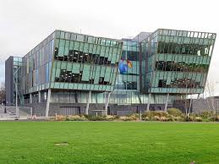
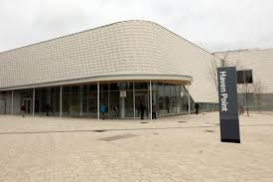
South Shields Town Centre (2)
Some redevelopment through BT building / Haven Point but…..
Unattractive transport gateway
Lack of retail circuit

Slide 13
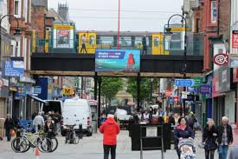
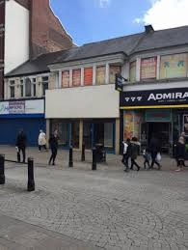
South Shields Town Centre (3)

Slide 14
Options to Regenerate Town Centre
Leave it to the market
Become dormitory town / part of commuter belt
Intervene
Bold decision from members

Slide 15
Vision
Visitor attractions
Transformed visitor gateway
Enhanced retail / leisure offer but not over reliance upon retail
Improved food shopping offer
Opportunities for new housing

Slide 16
Challenges
Site assembly
Capacity / capability
Gap Funding – Overall £100m development
Changing market forces – food retail deferred

Slide 17
Procurement
Muse appointed as private sector partner in 2012
Part of Morgan Sindall Group
Strong Market Reputation

Slide 18
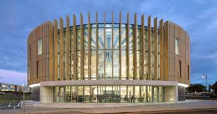
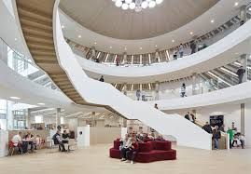
Phase 1
The Word – National Centre for the Written Word
Multi media & conference facility
Over 800,000 visitors since opening in October 2016
Creates confidence in the market

Slide 19
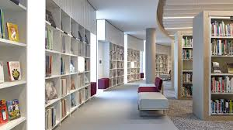
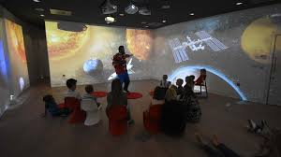
Attracting Repeat Visits

Slide 20
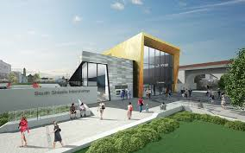
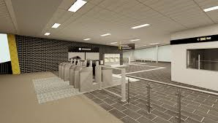
Phase 2 – Transport Interchange
Collaboration with Nexus
Supported by NELEP & Nexus funding
Due for completion Summer 2019

Slide 21
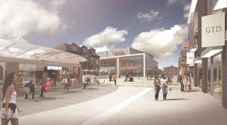
Phase 3 – Retail / Entertainment
Cinema
Retail
Café / Restaurant Space

Slide 22
Risk Management
Regular engagement with members / partners
Acceptance of trade-offs within capital programme
Capable external legal / project management advisers
Regular scrutiny / challenge of delivery and costs

Slide 23
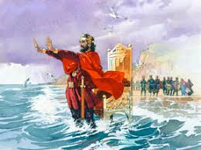
Holding Back The Tide…………?

Slide 24
Conclusion
Change starts with a vision
Play the long game
Councils as place-shapers and community builders
Partnership working
Manage risks but be bold

Slide 25
Final Thought………..
Average shop time before boredom sets in?
Women – 120 minutes
Men – 26 minutes

