Slide 1



CIPFA North East Regional Conference
To vote on the questions please can you download:-
app
App store for iPhone
Google Play store for Android

Slide 2
Agenda
Who we are & what we can do
Introduction to the team
Panel
Group Discussions
Q&A

Slide 3
Who we are & What we can do
Partnership begun in July 2015
Team development
Interim portfolio has grown from 40 to 70+
Executive Search and Sourcing recruitment
Notes:
- Penna is a HR Consultancy with an offering, which covers the full life cycle of recruitment from advertising, sourcing, assessing through to appointment. In 2015 Penna and CIPFA decided to enter into a partnership agreement.
Since then the team has increased from 2 – 5 in the interim team alone, due to an expanding market.
The volume of interims working at any given time has almost doubled in that time.
As well as interim, we have Executive Search capability which recruit to senior level posts and a Sourcing business which focuses on more junior level roles.

Slide 4


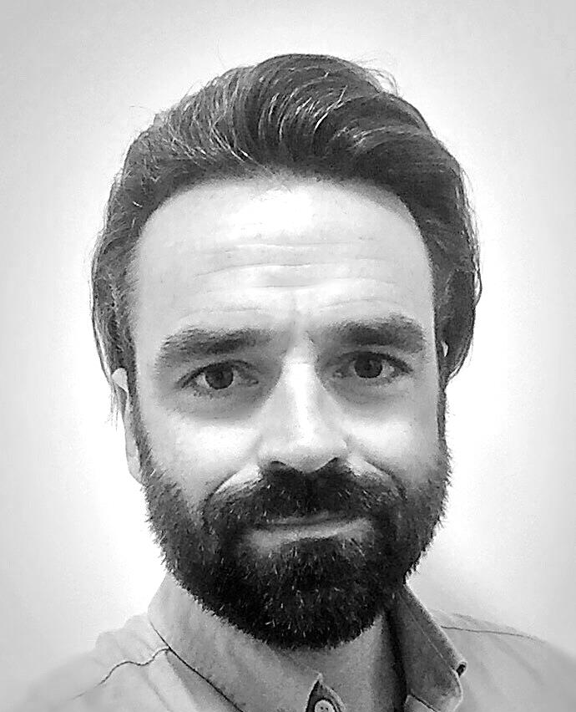
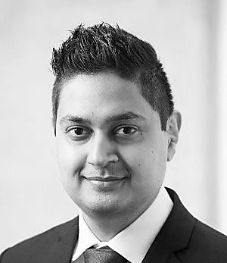
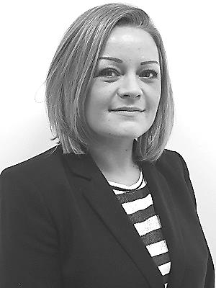
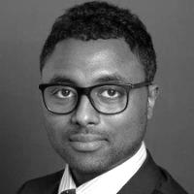
Introduction to the team
Philippa Watkins - Associate Director
Jonathon Sheppard – Senior Consultant
Az Ahmed – Consultant
Catherine Bush – Associate Consultant
Haben Solomon – Consultant
Notes:
Az Ahmed, I’ve had a varied career in recruitment, starting by overseeing operations, then moving onto finance, as a financial analyst before joining the interim team in May 2015. I focus on public finance in the local government arena - placing qualified finance professionals in a diverse range of roles, from Management Accountants, to Finance Business Partners through to Assistant directors of finance.

Slide 5
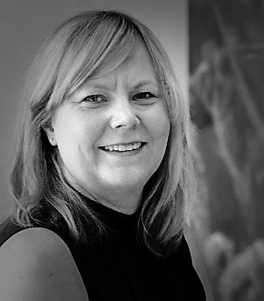
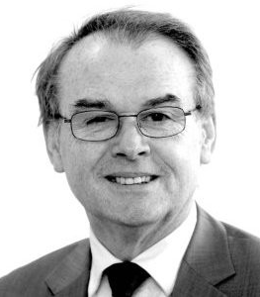
Panel
Lisa Kitto
Finance Director
Background
-Parliamentary and Health Service Ombudsman
-Office of the Police and Crime Commissioner Lancashire
-Lancashire County Council
Paul Woods
Finance Director
Background
-North East Combined Authority
-Nexus
-Newcastle City Council

Slide 6

The Role of the Modern Finance Director
https://create.kahoot.it/login

