Slide 1
What happens when Digital Transformation meets the NHS? Anna Caine & Tori Hutchinson

Slide 2
Agenda
1. Who are the NHS Business Services Authority (NHSBSA)?
2. How did the NHSBSA approach digital transformation?
3. Case Studies:
NHS Jobs
Loss Recovery Services

Slide 3
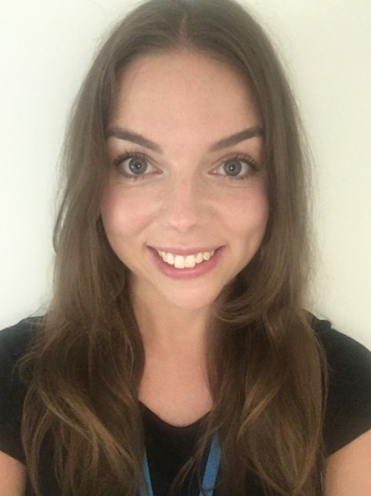
Who are we?
Anna Caine
Lead Digital Delivery Manager
Tori Hutchinson
Lead Digital Delivery Manager

Slide 4
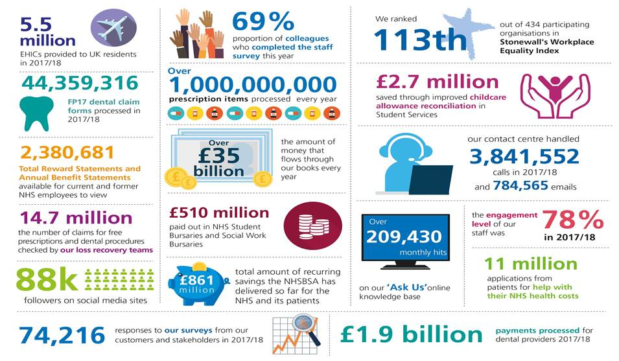
Who are the NHSBSA?

Slide 5
How did the NHSBSA approach digital transformation?

Slide 7
gov.uk/service-manual

Slide 8
gov.uk/service-manual

Slide 12
2015
5 people
1 project
2017
100 people
13 projects
2018
120 people
7 product teams

Slide 13
Focus On: NHS Jobs

Slide 14
The NHS is the 5th largest employer in Europe.

Slide 15
In June 2018 there were 1.2m NHS workers in England alone.
This increases to over 5m if extended to those working in health or social care.
That’s 13.5% of the UK’s employed population.

Slide 16
In 2016/17 the NHS spent roughly £2.9 billion a year on temporary staffing solutions
and
£2.5 billion on Bank staff.

Slide 17
About the NHS Jobs Service
11,000,000
710,000
Candidate accounts registered at NHS Jobs
New candidate accounts per year
6,800
380,000
Healthcare related organisations centrally provided by NHS Jobs
Vacancies are posted each year
11
4,000,000
Average number of applications per vacancy
Applications received from candidates each year

Slide 18
The contract for the current NHS Jobs service expires in January 2020.

Slide 19
The Big Problems
#1
Recruitment across the NHS is slow and inefficient.
This leads to increased cost of recruitment, failure to attract the best candidates and excessive spend on Bank and agency staff who provide temporary cover.

Slide 20
#2
NHS organisations are increasingly turning to 3rd party suppliers to provide systems and services that NHS Jobs was intended to deliver.

Slide 21
Our Vision
To be the recruitment solution of choice for the NHS.
To make it easier to get the right people into the right roles, reducing the time to hire and creating savings across the NHS.
NHS organisations will not need to procure additional 3rd party tools to supplement recruitment technology.

Slide 22
Who are our users?
Recruiting Organisations
Applicants
National
E.g. NHS England, NHS Improvement, HEE.
Medical
Including nurses, carers, consultants, surgeons, and lead pharmacists or GPs
Corporate level
Lead clinicians, heads of department
Big users
Those recruiting for their own team in large organisations e.g. Trusts or hospitals
Small users
GP practices, Care homes etc.
Non-medical
Including clerical, administration, maintenance, project or programme managers and IT roles
Shared Services partnerships/ HR Shared Services
Those who run recruitment on behalf of others (i.e. clients), at a cost. Clients can include Trusts or national organisations

Slide 23
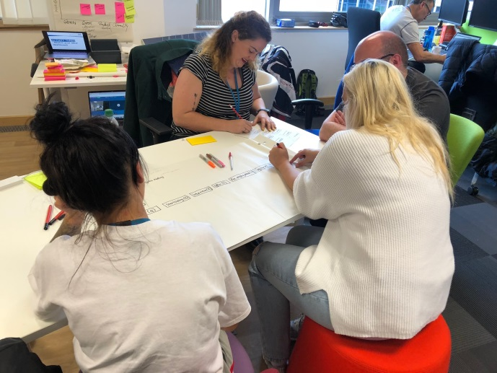
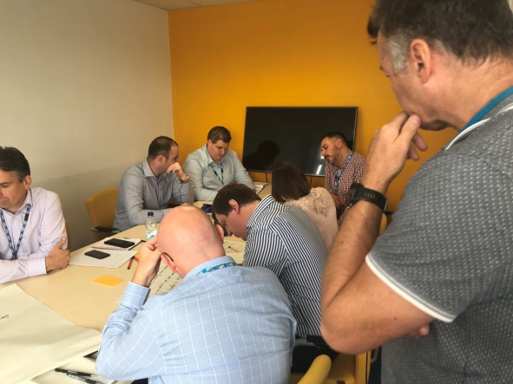
Hearing from our Users
150 users spoken to so far…

Slide 24
What Users said
Good/great system that’s easy to use
Never had problems with using NHS Jobs
Having an end to end online service makes it very manageable
Some great parts of the system but reporting is key to what we do now and it needs to be better
Works quite well. It's a bit cumbersome in regard to submitting vacancies / recruitment requests
Interviewing isn't as intuitive as it could be
I would like to be able to send offer/decline letters and build a template to do this
Shortlisting process is difficult
Need better on-boarding
Application tracking system (ATS) is ineffective
I want to know where I am in the process
Need better MI to improve our recruitment service

Slide 25
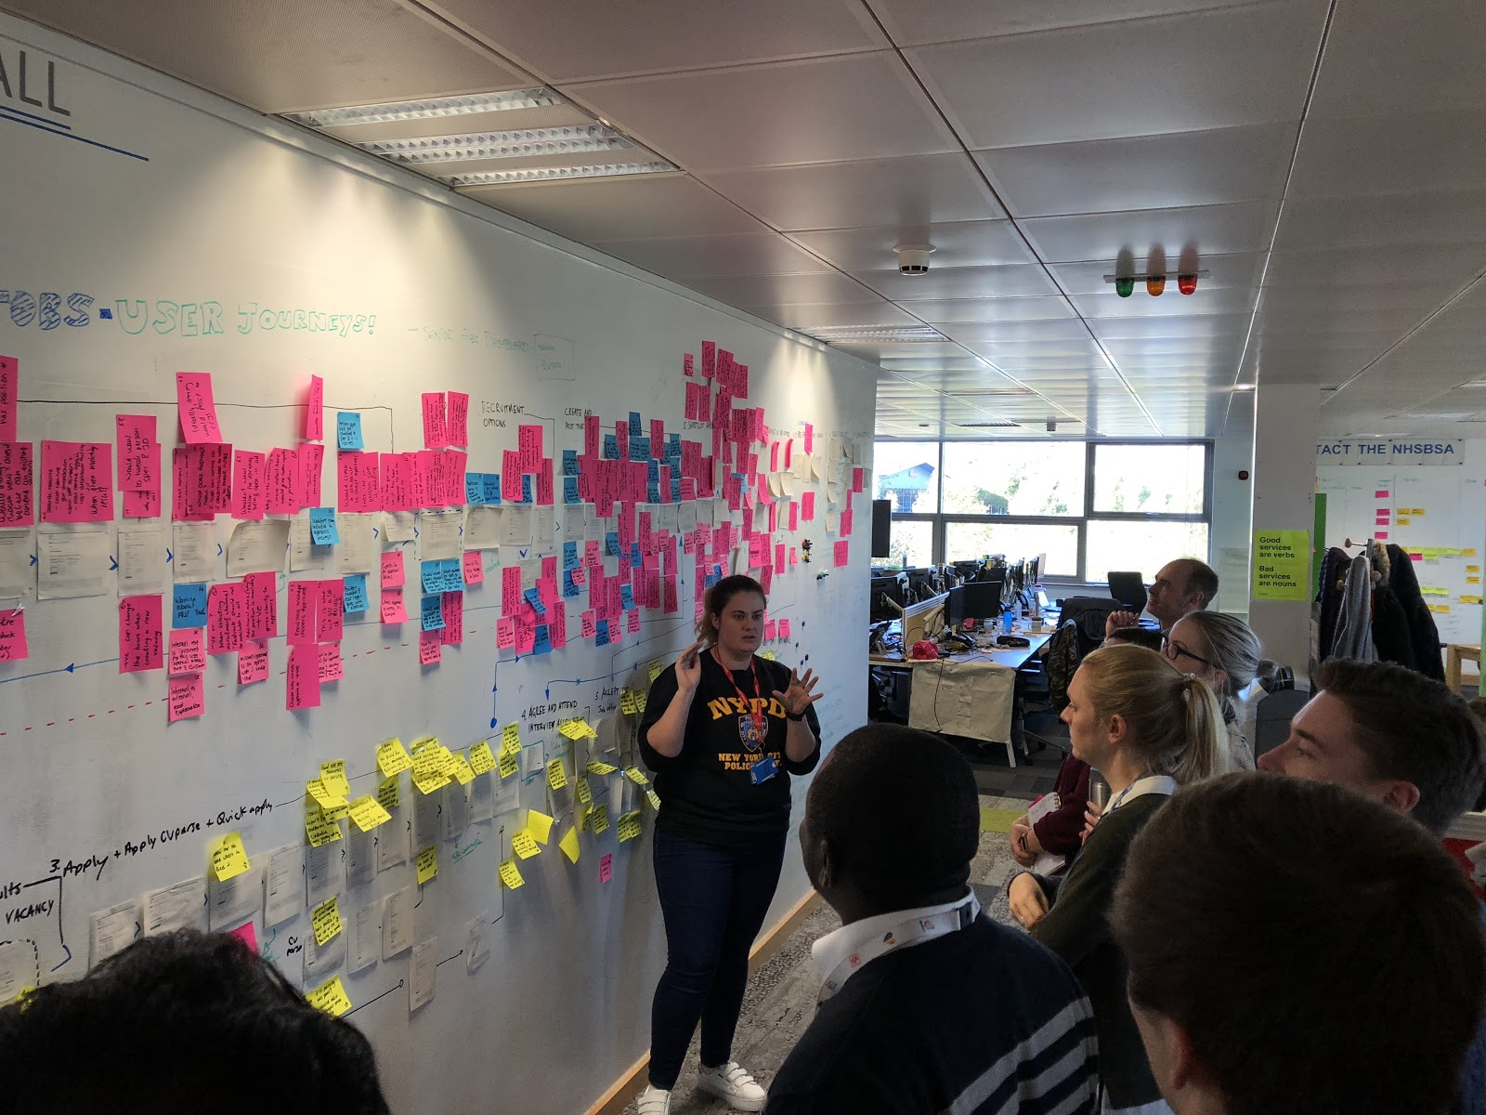
Learning from our Users

Slide 26
Technology Opportunities
We will not buy an off-the-shelf Application Tracking System (ATS).
We will ‘build’ and ‘configure’ our own using open-source code.

Slide 27
CV parsing
User Guides
AI to assist with shortlisting
Job Description and Job Advert enhancer
Dashboards and reporting
Social Media
In system validation - Nursing & Midwifery Council and General Medical Council
Electronic Staff Record integration
Online DBS checks

Slide 28
Scope of Opportunity
Implement a best in class system – with commercial potential
Reduction of spend across the NHS through:
- reduction of use of 3rd party systems
- reduction in Bank/temporary staff costs and use of agencies
Improved Data and Management Information (MI) enabling better data driven decisions
Future proofed technology, sustainable service blueprint and operating model - Delivering the best value for the cost.

Slide 29
Focus On: Transforming Loss Recovery Services

Slide 30
What is Loss Recovery Services?
Patient declarations are checked against our records of exemption certificates and DWP’s benefits records
Where no match can be found, a Penalty Charge Notice (PCN) is sent to the patient asking them to either:
Contact us to confirm their entitlement
Pay the original charge, plus a penalty charge of up to £100

Slide 31
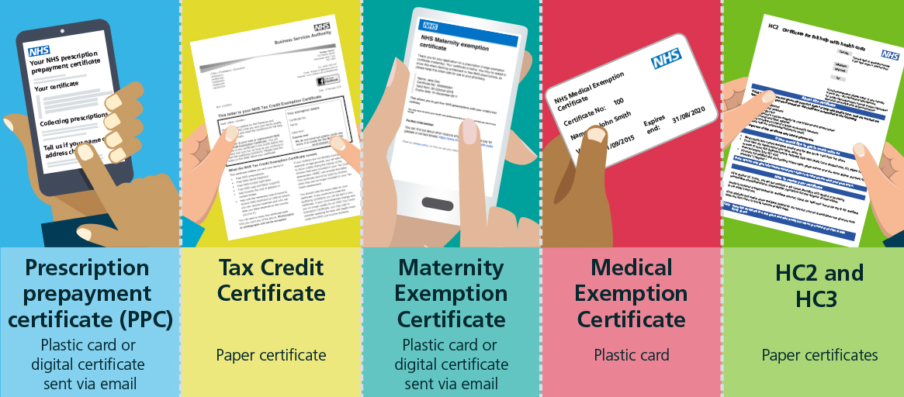
Focus On: NHS BSA Exemptions

Slide 32
How did we transform Loss Recovery Services?
2014 - 2016
656k
PCN’s =
£11.5m
£250m worth of fraud identified
Loss Recovery Services piloted for Prescriptions (2014)
656,000 Penalty Charges issued
£11.5 m recovered

Slide 33
How did we transform Loss Recovery Services?
2016-17
1.2m
PCN’s =
£22.8m
Recoveries back into front-line NHS, but ‘exemption confirmed’ cases are causing frustration. Improved algorithms implemented to reduce this.
Introduced Dental checking and system is scaled up.
Discovery is kicked off on improving access to Help with Health Costs.
1.2m Penalty Charges issued
£22.8m recovered

Slide 34
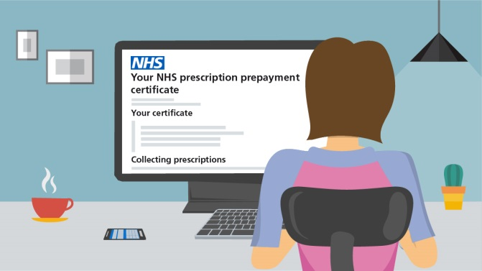
How did we transform Loss Recovery Services?
2017-18
1.3m
PCN’s
£27m
Help with Health Costs ramps up transformation, and starts to issue digital certificates.
Loss Recovery Services Discovery led to overhaul of PCN letters
1,273,000 Penalty Charges issued
£27m recovered

Slide 35
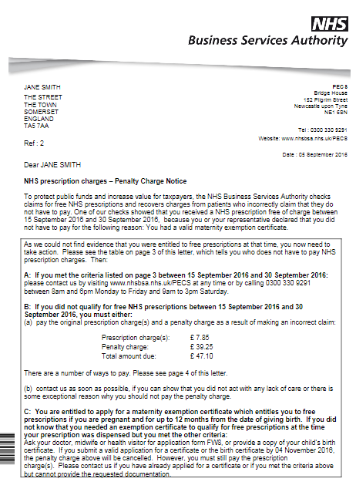
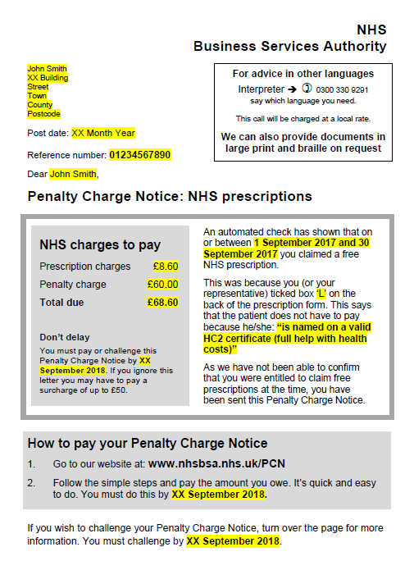
Focus On: Penalty Charge Notice Letters
Letters side by side

Slide 36
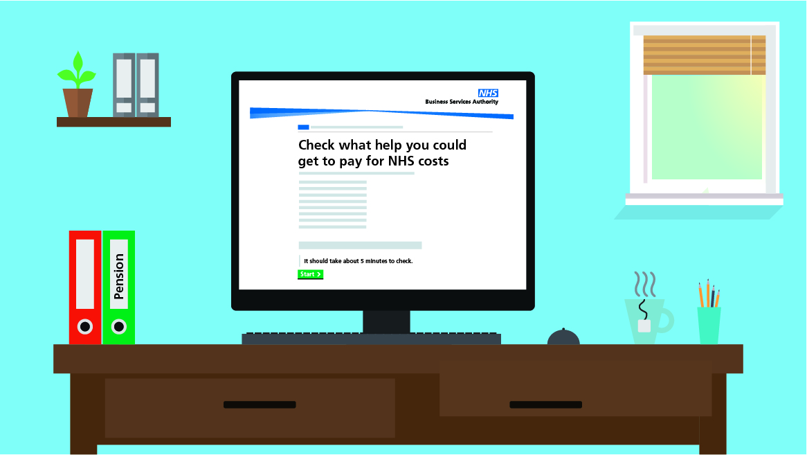
How did we transform Loss Recovery Services?
2018-19
How can I deal with my PCN online easily?
1.6m
PCN’s
£31m
How do I know what I am entitled to?
Released 3 web applications:
Pay or Challenge a Penalty Charge Notice
Check if you’re eligible for help
Am I Exempt?
National Communications Campaign
How can I prove what I am entitled to?
Target:
1,600,000 Penalty Charges issued
£31m recovered

Slide 37
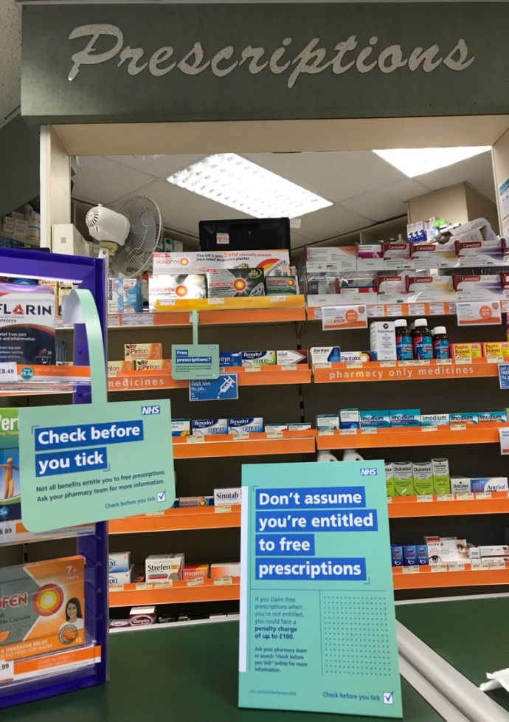
Focus On: National Communications Campaign
Average users/day of Eligibility Checker:
Pre campaign – 905
Post campaign – 3205

Slide 38
What is next for Loss Recovery Services?
Collaboration with DWP to get real-time access to benefits data
Real Time Exemption Checking
Continued improvements on Help with Health Costs
Patients can access medical treatment at the lowest cost they are entitled to.
Loss Recovery can purely target fraud.

Slide 39
Questions?

