Slide 1
The Future of Business Rates and Council Tax
Tony Travers
London School of Economics

Slide 2
Local government funding and the future
Local government current expenditure still broadly planned to follow the path set by last autumn’s spending review
    Extra council tax (ASC precept) and draw-down of reserves to boost spending slightly
Government not now planning to move to 100% NDR retention by 2019-20
    RSG to continue
    London, Manchester, Liverpool, Cornwall, the West Midlands and potentially others to be ‘pilots’ for 100% retention
However, there will be a ‘fair funding’ re-set of the underlying ‘needs’ assessments which are likely to shift resources around from 2020-21
‘Tariffs’ and ‘top-ups’ will be re-set to achieve a redistribution of resources
Consultation document expected before Christmas
Local government settlement for 2018-19 announcement likely on 13th or 20th (!) December

Slide 3
Decisions that will need to be taken
How to determine allocation of larger/100% pilot NDR yield?
    Within city regions; nationally; other?
    Implications for transfer of responsibilities
How far to ‘re-set’ the system in 2020
    Adjustments to reflect needs and resources changes
When to ‘re-set’ it thereafter
    Ten-yearly or more frequently?
Allow councils to keep growth in different percentages of NDR base?
How to treat NDR appeals?
How far to allow full gains to be held locally?
How far to protect losers? ‘No detriment’?

Slide 4
Issues to be managed
The run-in to 2020-21 will see a reduction in local government ‘spending power’: already in Treasury plans
Need for functional or grant transfers so that overall CT+NDR does not exceed ‘spending power’ in 2020
Revaluation in 2017 has shifted the base around, thus altering ‘tariffs’ and ‘top ups’ in 2020 as compared to where they would be without a revaluation
    Appeals undermine the tax base and affect some councils substantively
    System operates as it does because previously a national revenue
    Move to 3-yearly revaluations after the next one
Growth in tax base because of increase in productivity (by improvement if use of buildings) is not retained by a council, where ‘new build’ is
    Revaluations remove all ‘improvement’ growth
NDR ‘multiplier’ now to be uprated in line with CPI not RPI [not 2020]
Removal of part of NDR base (by HMT) provides incentives for councils to favour larger developments

Slide 5
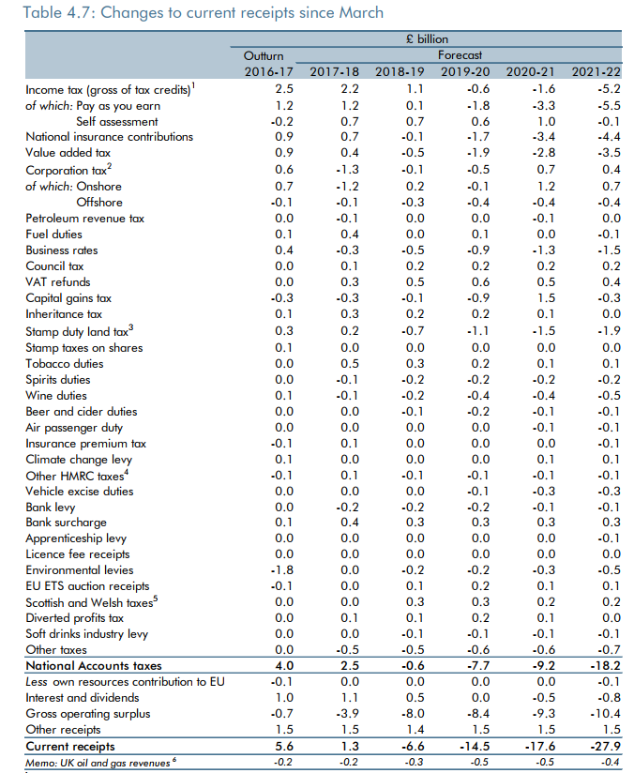
Tax revenue changes
in the recent Budget
compared to the
Spring Budget
NDR yield to be lower
because of move to
CPI up-rating

Slide 6
NDR retention - consequences
Likely (intended) impacts:
Pressure to build homes and develop business premises
Pressure on the Green Belt and green land?
Power for the finance department in relation to planning department within councils?
Big potential for areas with high land values, plus willingness to build and plenty of available land
    Interaction with CIL and S106…
Challenge for places with less willingness to build and/or less land and/or lower land values
NHB suggests big differentials….

Slide 7
New Homes Bonus yield 2016-17
 | NHB (£m)
Tower Hamlets | 28.6
Birmingham | 20.2
Cornwall | 19.6
Hackney | 18.0
Wiltshire | 17.9
Leeds | 17.1
Southwark | 16.3
Islington | 15.3
Lambeth | 13.9
Bristol | 13.5
Greenwich | 13.3
Manchester | 13.1
Wandsworth | 13.0
Newham | 12.7
Milton Keynes | 12.3

Slide 8
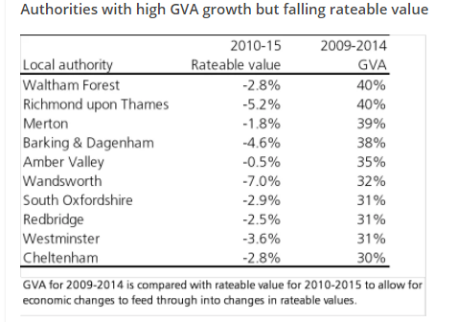
However, the link between GVA growth and NDR growth is paradoxical

Slide 9
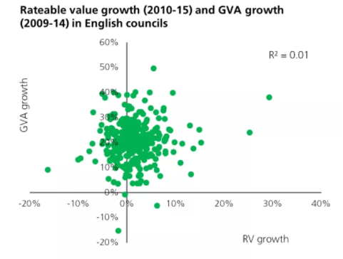
Rateable value growth and GVA growth
Source: HoC Library

Slide 10
Conclusions on NDR reform
The government’s proposed reform to local authority funding was/is potentially radical
    Moves from a system equalising for needs and resources differences to one where economic (tax base) growth will be key driver of changing spending power
    Chancellor’s purpose is to incentivise economic growth and to weaken resistance from the planning system (and public opinion)
Full impacts would take a number of years to be seen, but they will impact the scale and patter of development/economic growth
Having said this, is the balance of tax-raising between NDR and council tax in any sense fair?
  A few slides to examine this issue….

Slide 11
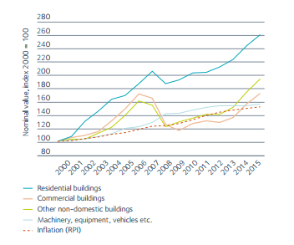
Change in value of housing and commercial property
- UK, 2000 to 2015

Slide 12
Change in values compared to change in tax
- commercial and domestic property, 2000 to 2015
 | Change in property value (%) | Change in property tax (%)
Commercial | +80 | +68
Domestic | +160 | +109
Sources: Values - BPF; Property tax - HM Treasury, Budget reports

Slide 13
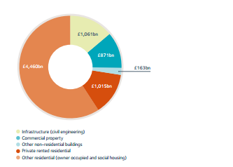
Value of commercial vs residential property
- UK, 2015
Residential: £5475bn
Commercial: £1034bn
Infrastructure: £1061bn

Slide 14
Property taxes paid, commercial vs residential
- UK, 2015-16
Commercial (NDR) £28.8bn
Domestic (Council tax) £29.0bn
Source: HM Treasury, Autumn Statement 2016

Slide 15
Property values compared to property taxes
- UK, 2015-16
 | Property value (£bn) | Property tax (£bn)
Commercial | 1034 | 28.8
Domestic | 5475 | 29.0
Sources: Values - BPF; Property tax - HM Treasury, Budget reports

Slide 16
Council tax - 1
Council tax remains the most politically-salient revenue in Britain, yet…..
….local government remains outside the political Establishment’s concerns
Almost all national politicians are ‘localists’ yet none really trusts local government
The public is not fired up for reform
Raynsford and Lyons reviews were not able to convince ministers
In England, no revaluation since 1993 (1991 values)

Slide 17
Council tax - 2
Council tax requires modernisation
  Revaluation
    Then regular (annual) revlauations?
  Wider range of bands (or actual capital values)
  Broader understanding of the benefits of effective domestic property taxation
    If properly operated, it would ‘discipline’ house prices and deliver more efficient use
  But….British attitudes to property and inheritance!
Stamp Duty Land Tax
  Now used to collect £8bn – in lieu of a properly-functioning annual council tax
A better system would abolish SDLT and raise more from CT
  But, politically impossible and more difficult every day that passes without reform

Slide 18
Other countries: tax revenue attributable to sub-national and central/federal government as % of GDP
OECD Revenue Statistics
UK at 1.6%

Slide 19
Reform? Evidence about devolution
Scotland, Wales and Northern Ireland all govern themselves within a UK context
Regions in other countries have far more fiscal power
Academic evidence doesn’t suggest any threat to economic growth from devolution
Evidence suggests fiscal devolution has efficiency gains and a broader tax base allows for more stable and fairer local
The public supports devolution to sub-national government
    At least in some polls….

Slide 20
Devolution in England
- different from Scotland and Wales
London
  Has existed as a ‘city region’ since 2000/1965
Greater Manchester since 2004/1974
Tees Valley; Liverpool City Region; Birmingham/West Midlands; West of England/Bristol; Peterborough/Cambridge
    Mayoral elections in these new city-regions in May 2017
North of Tyne to follow?

Slide 21
Why devolve powers to sub-national government?
Better use of public money – fiscally neutral from day 1
Incentives for growth
More balanced power within the UK system of government
Part of a solution to the ‘England question’

Slide 22
Chances of success?
Scotland and Wales are precedents – economic incentives and accountability accepted rationale
More accessible government = better government
Brexit: not more power to Whitehall, surely?
Need to ‘fix’ UK government and politics: devolved sub-national government with greater tax powers is a key part of the solution

Slide 23
The Future of Business Rates and Council Tax
Tony Travers
London School of Economics

